Slide 1
Data tables 1 & 2
Jill I. Vampola Training Grant Analyst Research Service Core
October 12, 2023

Slide 2
Data Tables
Recap from last office hours
Census of Participating Departments and Interdepartmental Programs
1
Participating Faculty Members
2
Federal Institutional Research Training Grant and Related Support Available to Participating Faculty Members
3
Research Support of Participating Faculty Members
4

Slide 3
5 A & B
Publications of Those in Training
6 A & B
Applicants, Entrants, and their Characteristics for the Past Five Years
Appointments to the Training Grant for Each Year of the Current Project Period (Renewals only)
7
Program Outcomes
8

Slide 4
Data Table 2

Slide 5
Table 2: Participating Faculty Members
Assess the distribution of participating faculty by:
Rank (Junior vs. Senior)
URM
Research interests
Department or interdepartmental program
Summarize and analyze this data in the Background section and the program faculty section of the program plan

Slide 6
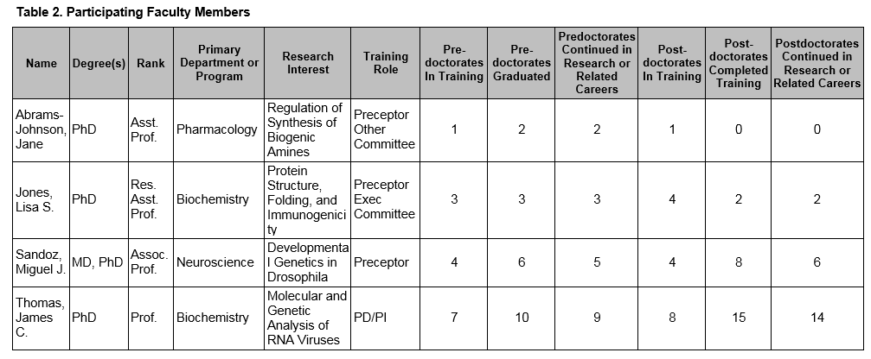
Table 2 Instructions
One PRIMARY department only
Training Roles:
PI/PD
Preceptor (Mentor)
Executive Committee
Other committee member
Provide the terminal (highest) degree
First, last middle initial
Research interest that is relevant to the training program

Slide 7
Mentor Records
Predoc trainee is defined as a Ph.D candidate, master’s students and undergrads excluded
Mentoring Records = last 10 years
Predocs/Postdocs that have continued in research or related careers
Should include ALL current predocs and postdocs (even if they are NOT eligible) in mentor labs
Include ALL Predocs/Postdocs that have graduated or completed training in the last 10 years
Exclude trainees doing research rotations, and clinical interns and residents unless they have been or are currently engaged in full-time, mentored research training in the faculty member’s research group.

Slide 8
Define “Research or Related Careers?”
Teaching
Design experiments
Develops protocols
Collects and interprets data
Administering research or higher education programs
Tech transfer
Science policy
Occur at places such as: NIH, FDA, commercial setting or biotech

Slide 9
Tips on Gathering info for Table 2
ALWAYS Confirm with the PI for any changes/additions to participating faculty
For renewals, start by checking what was submitted last time and ask PI about edits to the list
Leverage data from previous submissions on campus

Slide 10
Tips to Gathering & Verifying Data for Table 2
Mentor Records Need to come from each individual participating faculty member
Verify faculty members home department, program, division, or rank in

Slide 11
Table 2 FAQ’s
Q. Should Undergraduates or Master’s students be included in mentor records?
No
Q. Can I list more than one department?
No, if the faculty has a dual appointment, work with your PI to determine the more relevant appointment applicable to this application

Slide 12
Table 2 FAQ’s
Q. Should I include past faculty on the table?
No, they want to assess current training faculty
Q. Should mentees (i.e. visiting scholars) from foreign institutions be included in the count for Table 2?
A. No

Slide 13
xTRACT

Slide 14
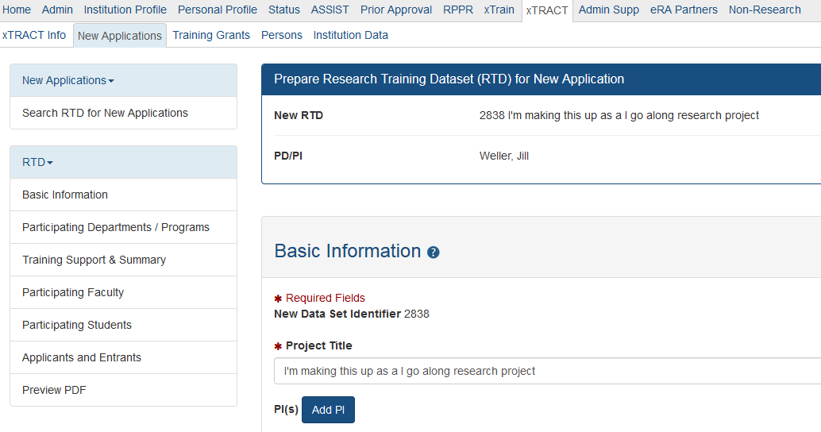
Main Navigation Page
Data Table 2

Slide 15
Add Participating Faculty

Slide 16
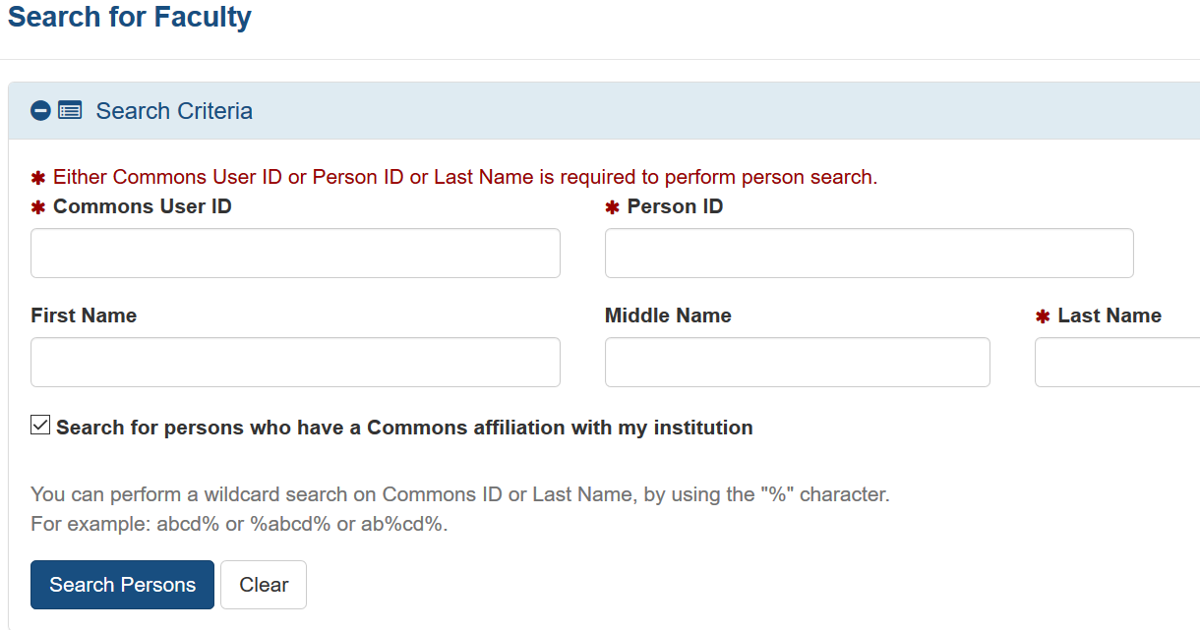
Search and Add Faculty

Slide 17
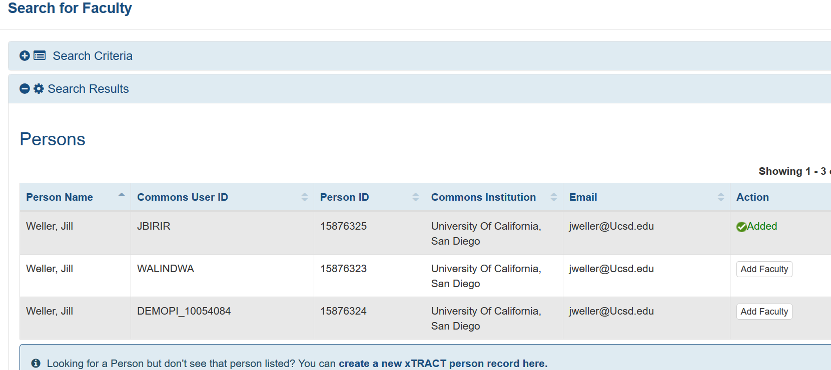
Search and Add Faculty

Slide 18
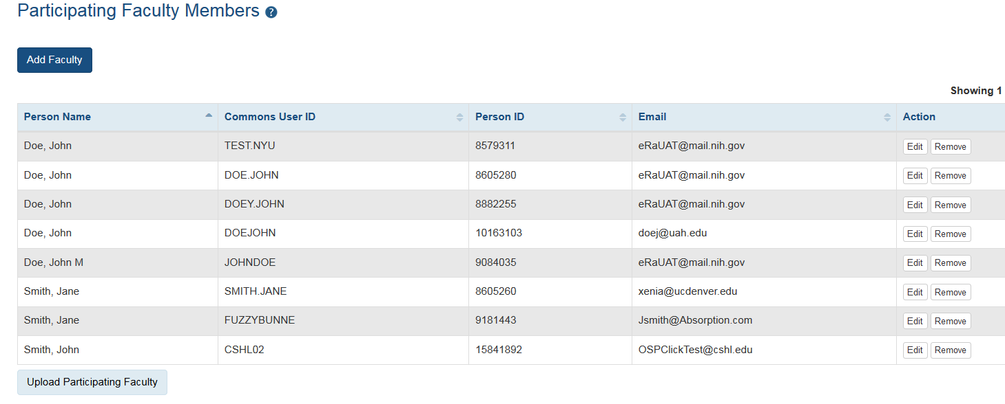
Table 2 in xTRACT
All Table 2 information should be added in Participating Faculty

Slide 19
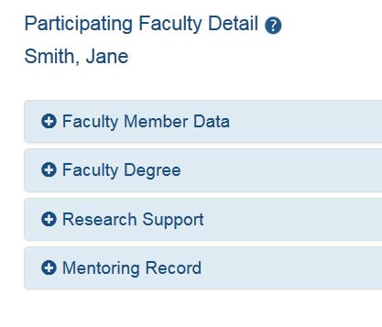
Participating Faculty Detail

Slide 20
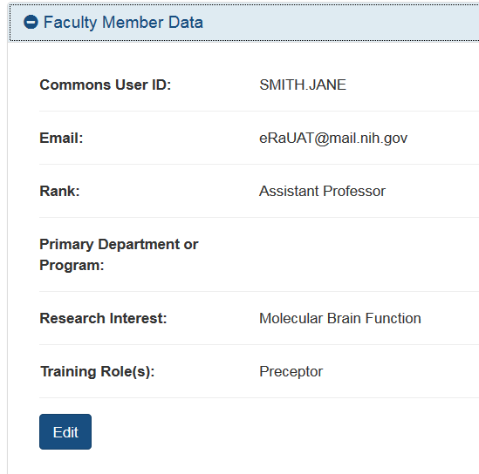
Rank, Department, Research Interest & Role
Some info pulled from eRA commons profile like email or eRA commons ID

Slide 21
Best Practices for Table 2
The participating faculty list is your starting point to sending out emails
When in doubt ask your PI
Make sure your numbers are consistent within the table!
Notes:
Possibly bypass this demo for the sake of time

Slide 22
Data Table 1

Slide 23
Data Table 1 Objectives
Census of Participating Departments and Interdepartmental Programs
Provides insight into the environment in which the proposed training will take place
Does the program have the "critical mass" of trainees and faculty and to be effective
Detailed data on program applicants, entrants, and appointees for participating departments and interdepartmental programs are collected in a parallel fashion on Table 6.
Summarize this data in the Background Section of the Research Training Program Plan

Slide 24
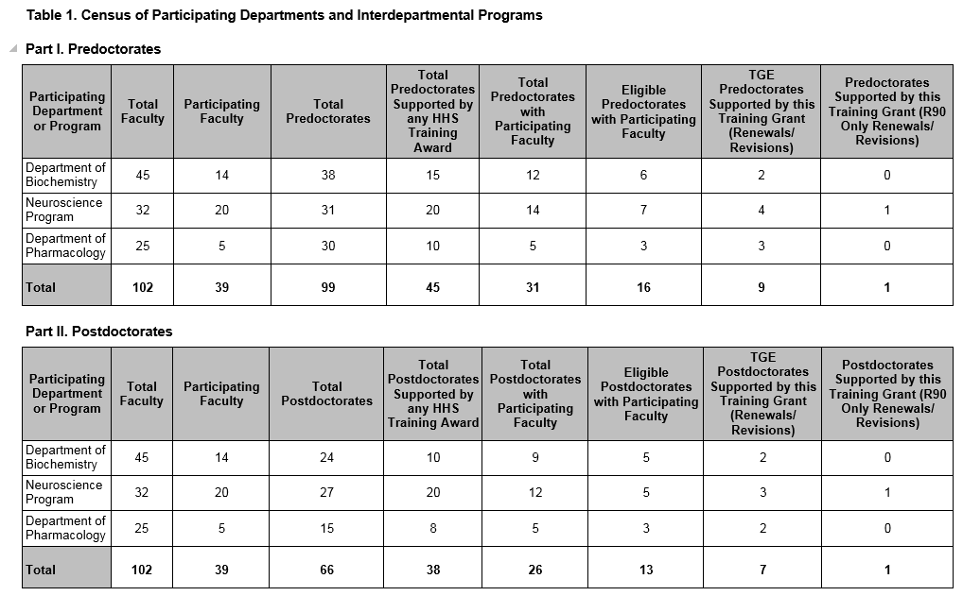
Table 1 - Instructions
Part I. Predocs
Part II. Postdocs
1. List program, dept. or division involved with the application
Biomedical Sciences (Grad program)
Biological Sciences (Division)
Physics (Dept.)

Slide 25
Special note between predocs and postdocs
Applicants proposing research training in settings where there are no students in predoc research training, such as some clinical departments or divisions, should omit Part I for predocs
All other applicants are expected to complete Parts I and II, regardless of whether this is a predoctoral or postdoctoral program application

Slide 26
Table 1 – Dept. Counts
ENTIRE count of predocs or postdocs in that dept.
Total amount of predocs or postdocs in training with participating faculty
Total amount of current faculty in each dept., program or division
(12 predocs across 14 participating faculty)
TOTAL amount of predocs or postdocs supported on HHS TRAINING funds (T32’s, F32, etc.)
Total of participating in that dept. or program faculty on this grant

Slide 27
Table 1 – Dept. Counts
Only applicable to R90 grants, leave blank
Total amount of students eligible for support Exclude non-citizens
Training Grant Eligible (TGE) postdocs or predocs on this grant
Eligibility Policy for NRSA Grants - http://grants.nih.gov/grants/policy/nihgps_2012/nihgps_ch11.htm

Slide 28
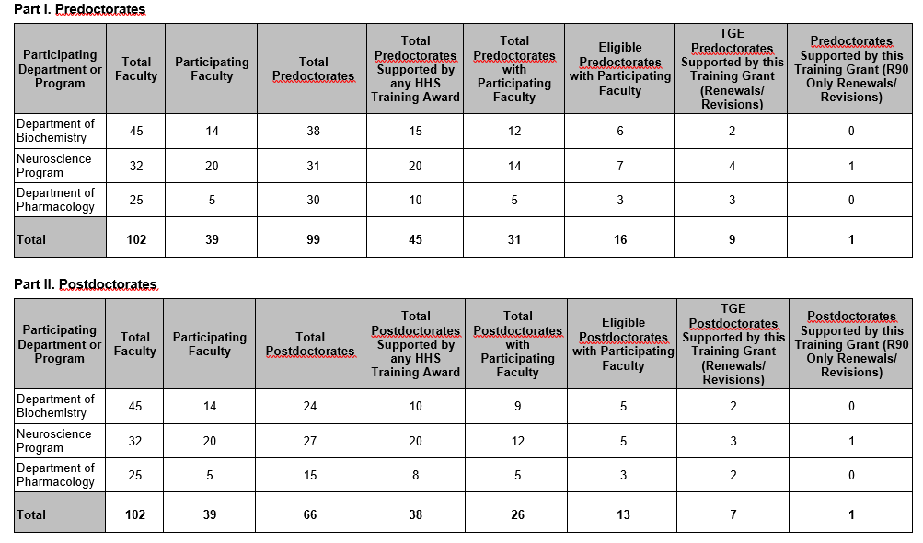
Table 1 – Dept. Totals

Slide 29
Tips to Gathering info for Table 1
Total Predoc/Postdoc population, eligibility and HHS funding information will NEED to come from the departments. i.e. HR, ARC or grad program
Participating faculty members need to supply individual mentoring records, then you will need to calculate totals

Slide 31
Table 1 - FAQ’s
Q. What does the acronym TGE mean?
A. “Training Grant Eligible.” Only U.S citizens and permanent residents are eligible for NRSA support
Q. How do I do I know how many trainees are on HHS funds?
Check NIH RePORTer for F31/F32 Fellowships, check the TG website for slots on TG on the campus by department (approximate)
Notes:
Delete the word attributer and replace!

Slide 32
Table 1 - FAQ’s
If a graduate program T32 is cross-departmental, does one list just the program in column 1 or each department that is involved in the graduate program along with the graduate program?
A. List each department participating in the T32 program. If the graduate program is comprised of six departments but only four participate in the T32, then just list those four.
Notes:
Delete the word attributer and replace!

Slide 33
xTRACT

Slide 34
Data Table 1 in xTRACT
Data Table 1

Slide 35
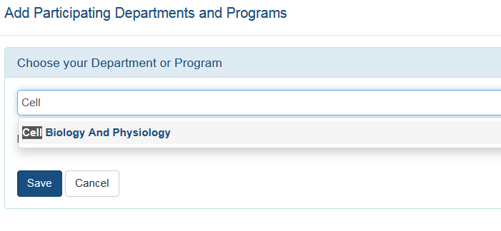
Adding a Department or Program

Slide 36
Editing Programs and Entering Census Data

Slide 37
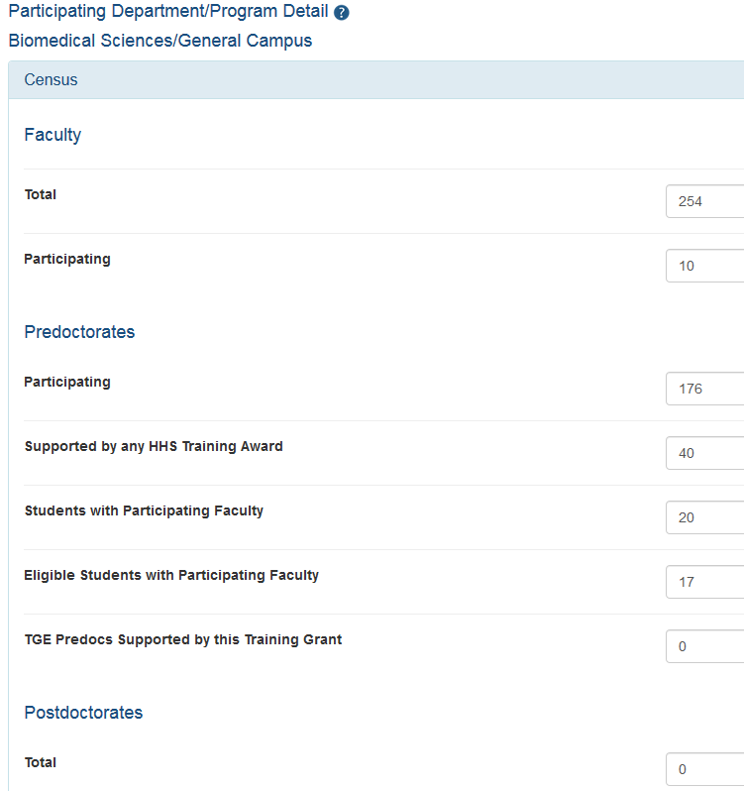

Slide 38
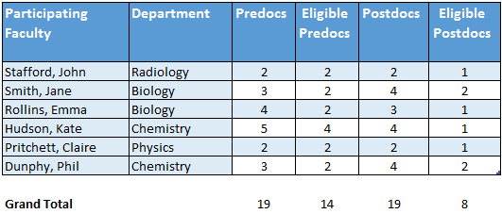
Best Practices and Reminders for Table 1
Counts for total populations need to come from each individual department
“Table 1 mentor” tab
Use the “organizing spreadsheet” so you can easily calculate the amount of predocs & postdocs based on your participating faculty responses
Notes:
Possibly bypass this demo for the sake of time

Slide 39
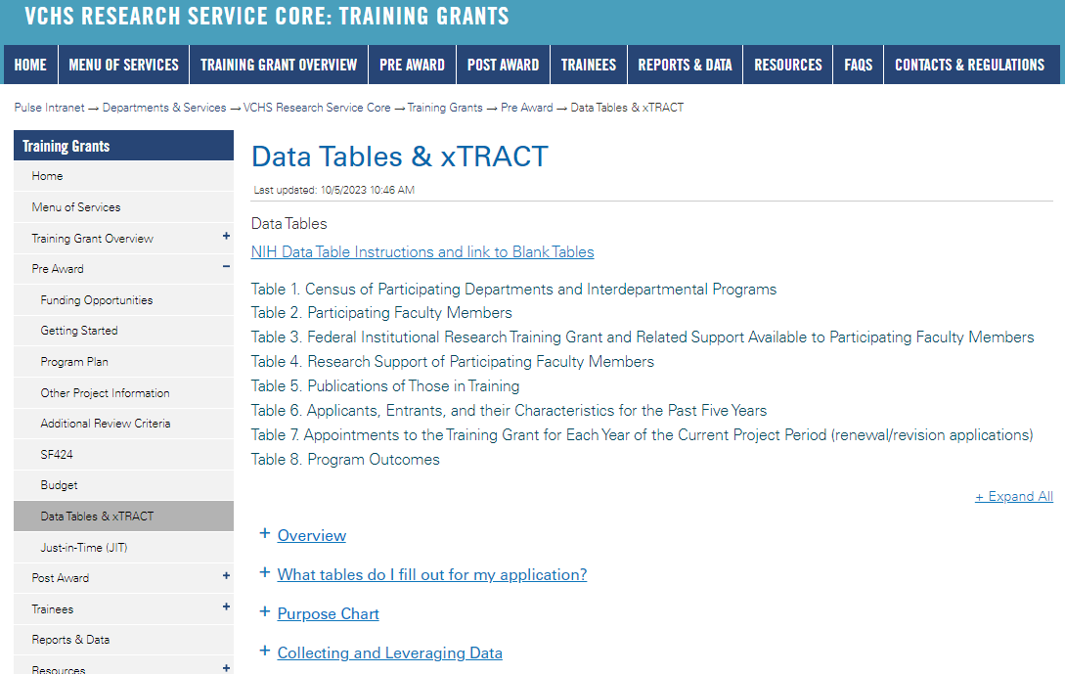
https://pulse.ucsd.edu/traininggrants - AD credentials required
Data Table Resources

Slide 40
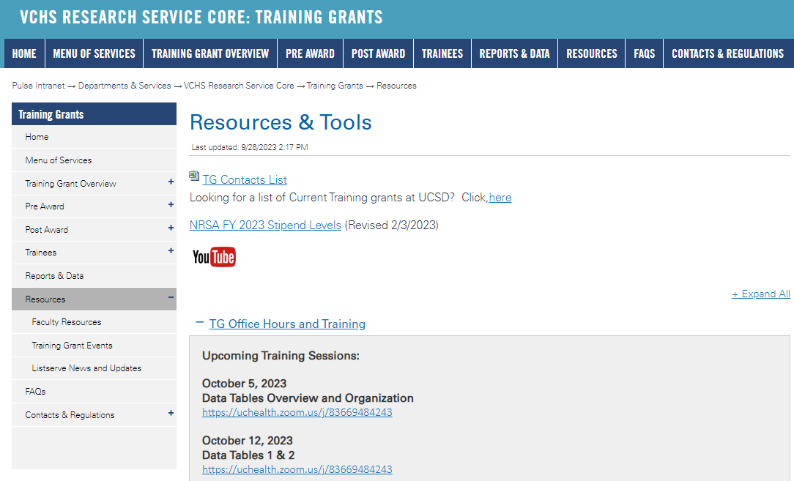
https://pulse.ucsd.edu/traininggrants - AD credentials required
Resources
Notes:
If you need to remember one thing.. Its the TG website.

Slide 41
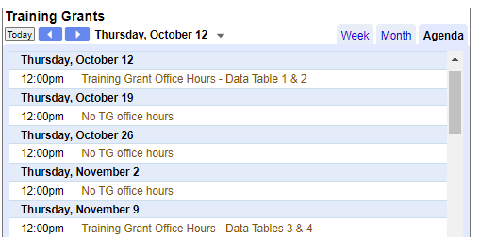
Coming up TG Office Hours
No office hours October 12, 19 and November 2
November 9 – Data Tables 3 & 4
Notes:
Add this to your Google Calendar https://calendar.google.com/calendar/u/0?cid=amVjZHVqZTA0ZTM1aGQzcW1wbnB0djloNGdAZ3JvdXAuY2FsZW5kYXIuZ29vZ2xlLmNvbQ

Slide 42
Questions

