Slide 1
Data tables 3 & 4
Jill I. Vampola Training Grant Analyst Research Service Core
November 9, 2023

Slide 2
Recap from last office hours
Data Tables 1 & 2

Slide 3
Data Table 3

Slide 4
Table 3 Objectives
Federal Institutional Research Training Grants and Related Support Available to Participating Faculty Members
Current level of support for related research training
Overlap in participating faculty
Used to assess the institutional environment and determine the number of training positions to be awarded
Analyze and summarize this data in the Background Section of the Program Plan

Slide 5
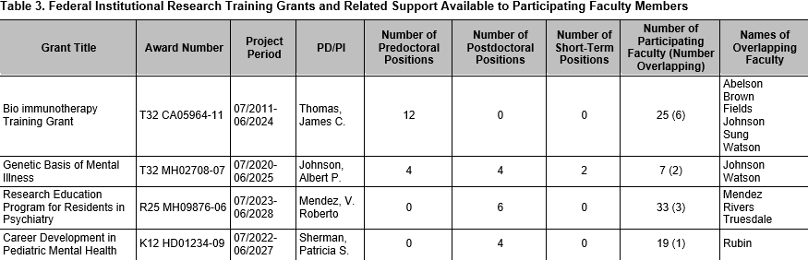
Table 3 Instructions
Inception to date - entire Project Period (MM/YYYY)
Full Grant Title
Include mechanism (i.e. T32) and current year
PD/PI of TG

Slide 6
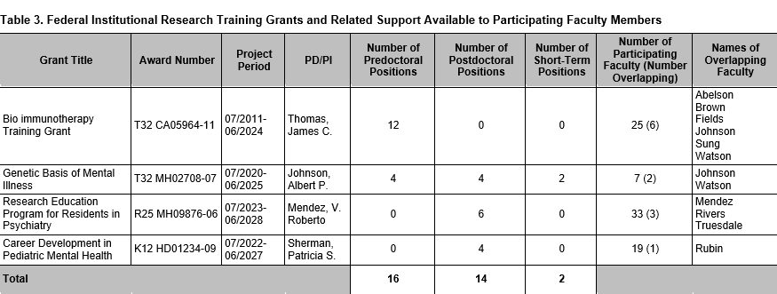
Table 3 – Slot and overlapping faculty info
Total Participating
Faculty on TG
List Overlapping Faculty
Number of overlapping faculty between this grant and the one you are working on (in parenthesis)
Total Predoc, Postdoc, and Short-term Slots

Slide 7
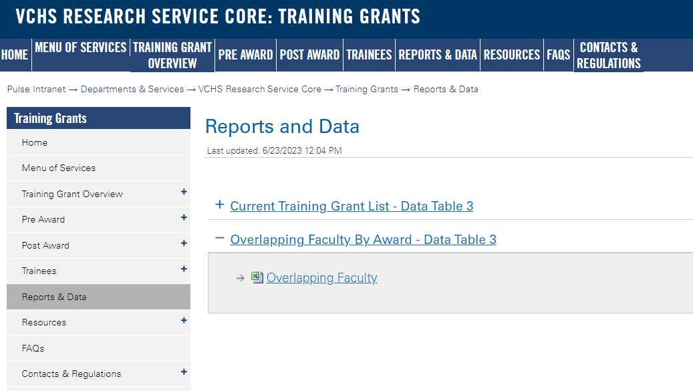
Tips to Gathering Data for Table 3
Go to “Reports and Data” on TG website – “Current Training Grant List - Data Table 3” and “Overlapping Faculty” list(s)
https://pulse.ucsd.edu/departments/research-service-core/training-grants/reports-data/Pages/default.aspx

Slide 8
Data Table 3 Demo
Compare your grant to overlapping grants on campus
https://pulse.ucsd.edu/traininggrants
Notes:
Possibly bypass this demo for the sake of time

Slide 9
Data Table 3 In xTRACT

Slide 10
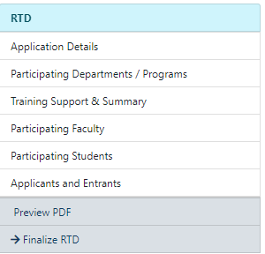
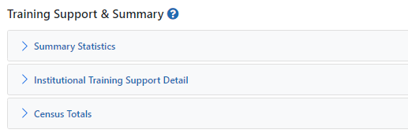
Table 3 in xTRACT
Data Table 3
Auto populated

Slide 11
Institutional Training Support Detail

Slide 12
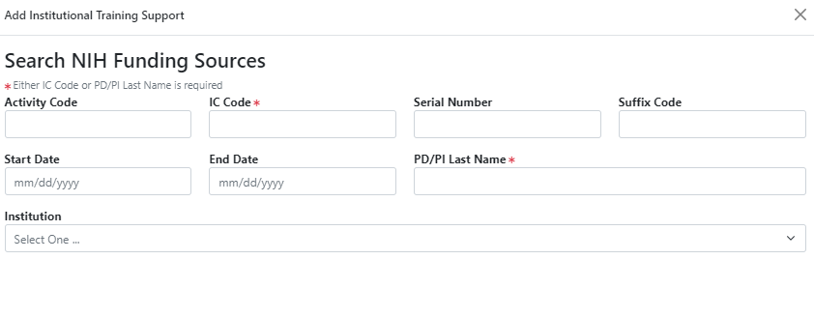
Search for TG’s

Slide 13
Search for TG

Slide 14
Institutional Training Support Detail

Slide 15
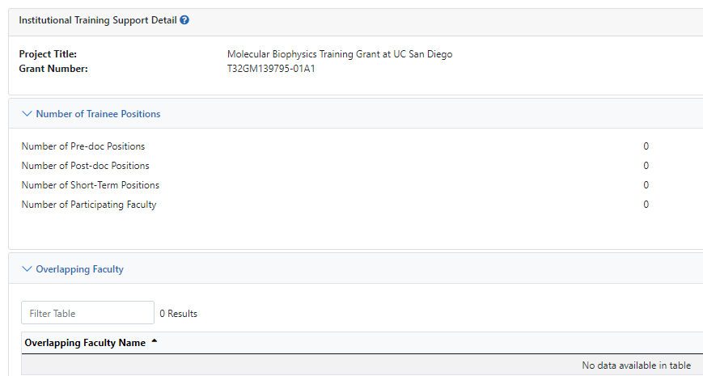
Add Overlapping Faculty
Notes:
Update side with numbers screenshot

Slide 16
Add Overlapping Faculty

Slide 17
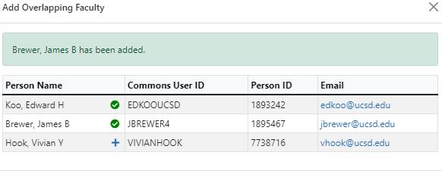
Add Overlapping Faculty
Search list is based on Participating Faculty in your RTD

Slide 18
Table 3 - FAQ’s
Q. Are only T32’s listed?
A. No, all of federal institutional training (e.g., NIH T32, T35, T34, T15), career development, and research education (e.g., NIH R25, K12/KL2, TL1) support available to the participating faculty members
Notes:
Delete the word attributer and replace!

Slide 19
Best Practices for Table 3
Only include grants that have overlap with the grant you are working on
Compare the grant you are working on with each one on the list
Use the TG website as a resource!
Notes:
Possibly bypass this demo for the sake of time

Slide 20
Data Table 4

Slide 21
Table 4 Objective
Research Support of Participating Faculty Members
Provides evidence of the strength of the research environment
The availability of funds to support research conducted by the trainees
Appropriateness of the participating faculty in terms of their active research support
Analyze and summarize this data in the Program Plan

Slide 22
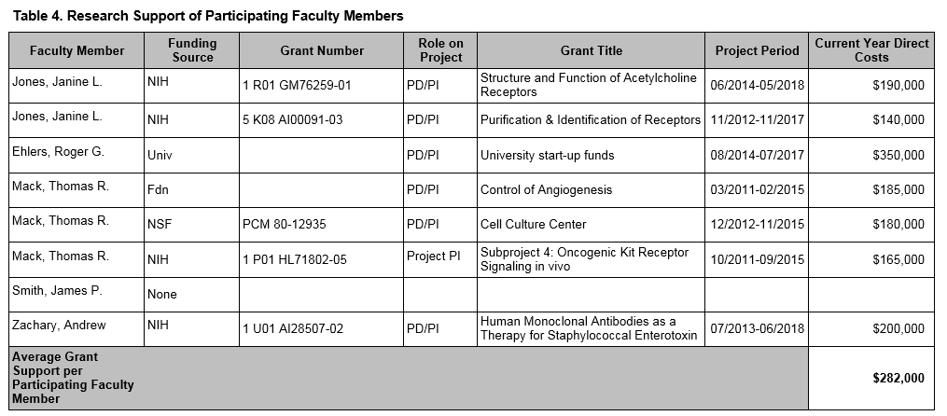
Data Table 4: Research Support Instructions
Participating Faculty
Agency/Fund Source of Funding
Full Grant Number
Role – should be PI only (NO CO-I unless a multi PI Project)

Slide 23
Data Table 4: Research Support Instructions
Full Grant Title
Current Year direct costs only - NOT total project costs
MM/YYYY format
Sum of current year direct costs divided by the total number of faculty

Slide 24
Tips to Gathering & Verifying Data for Table 4
xTRACT pulls NIH grants in directly from NIH RePORTER when you add the participating faculty
However, the dollar amounts aren’t editable in xTRACT and may not be correct – especially for large project grants
Use NIH RePORTER to verify direct costs
https://projectreporter.nih.gov/reporter.cfm

Slide 25
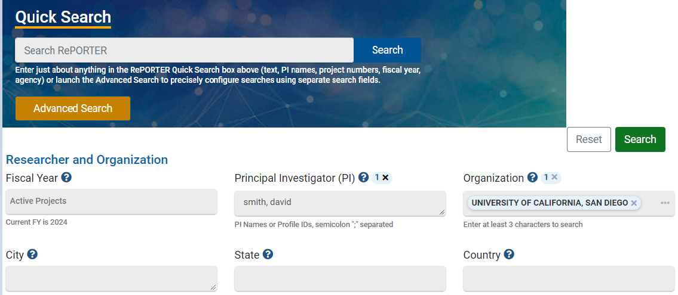
NIH RePORTER
Notes:
Redo this search slide

Slide 26
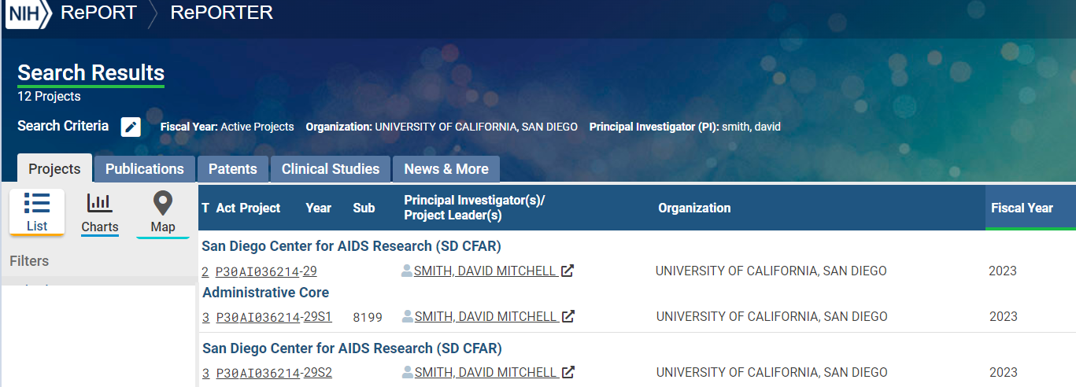
NIH RePORTER
Notes:
Redo this search slide

Slide 27
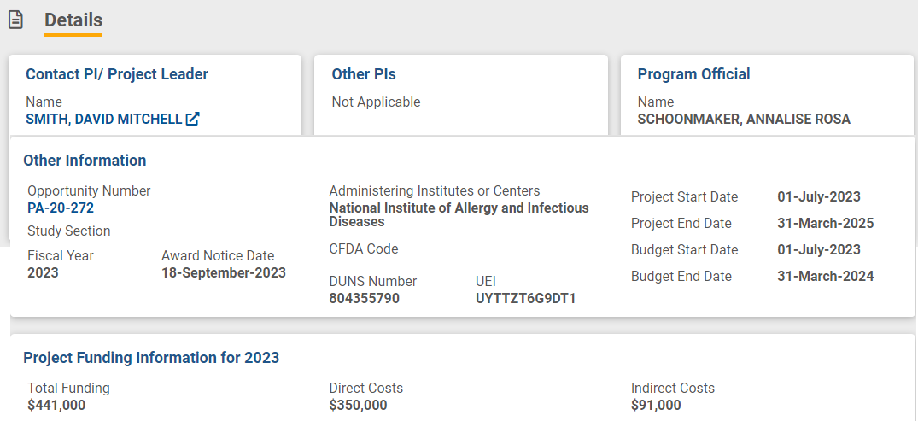
NIH RePORTER
Notes:
Redo slide to have a sample with Project start/end date

Slide 28
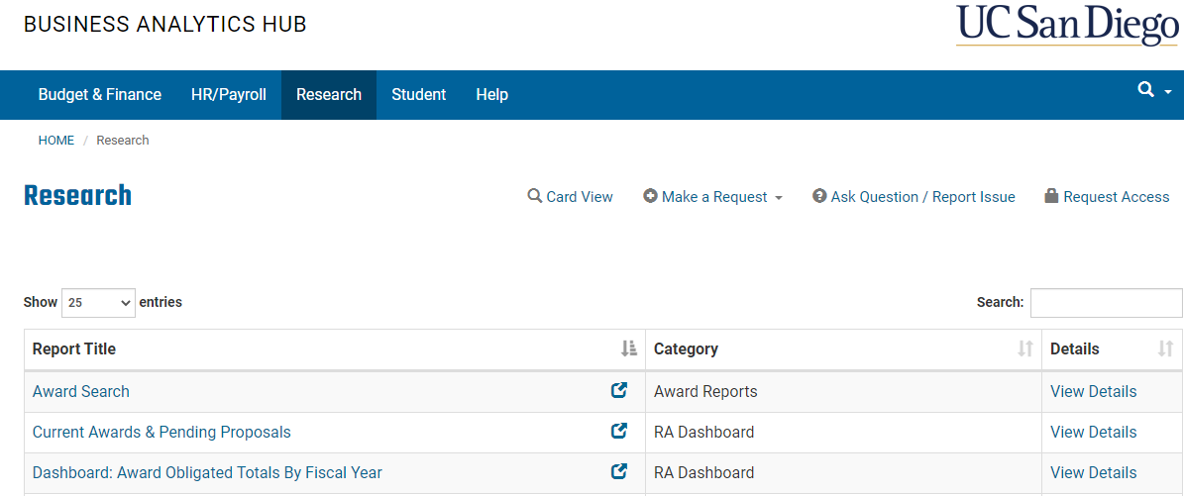
BAH Reports

Slide 29
BAH Reports
Divide direct costs by # of years

Slide 30
Table 4 FAQ’s
Q. Does Table 4 only include pending support?
A. No
Q. Should Co-PI funding be included for participating faculty?
A. If a faculty member is a co-PI of a multi-PI award (i.e. U19 or P50), he or she can be listed but otherwise the answer is no!
Q. Can you list grants in no-cost extension?
A. No

Slide 31
Table 4 FAQ’s
Q. Should start-up funds and other discretionary research funds be included, or only sponsored grants and contracts?
A. All funds available to the faculty member should be listed on the table, including university funds (like start-up funds), and foundation, and other discretionary funds
Can a sub-award be listed in Table 4?
A. Yes

Slide 32
Data Table 4 in XTRACT

Slide 33
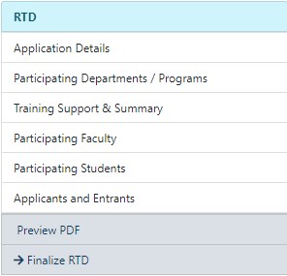
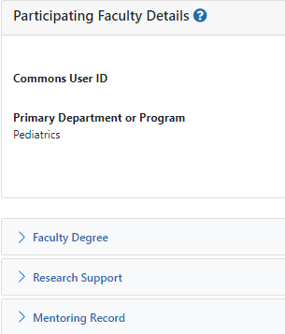
Participating Faculty
Data Table 4 (and 2)

Slide 34
Research Support

Slide 35
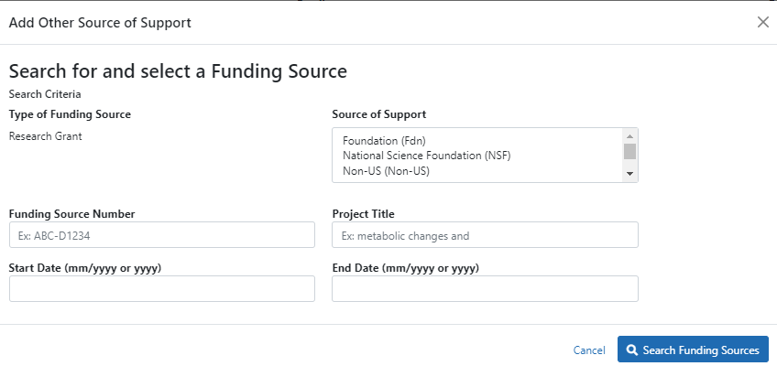
Search for Funding Source

Slide 36
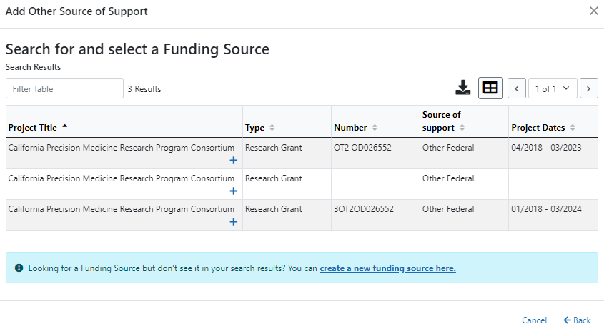
List of Other Fund Sources

Slide 37
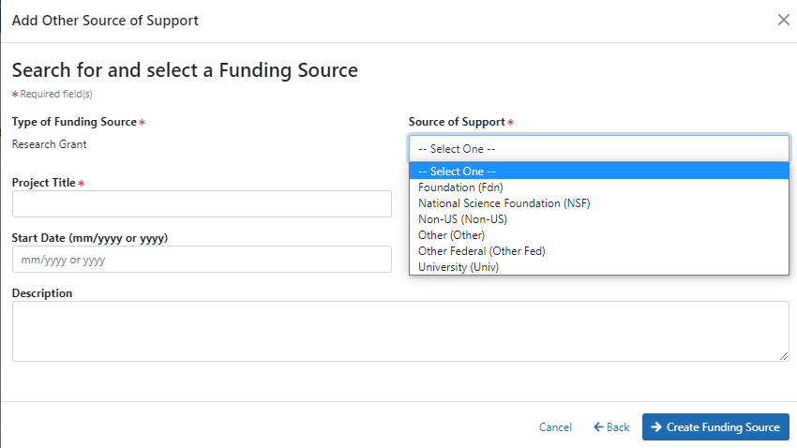
Adding a New Funding Source
Notes:
Update screenshot

Slide 38
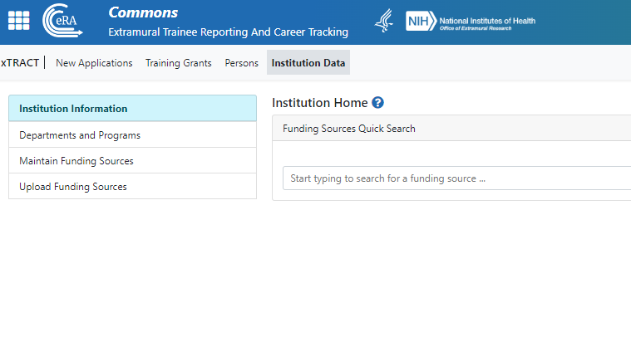
Maintaining Funding Sources

Slide 39
Table 4 Quiz

Slide 40
True or False
1. It’s OK to list pending awards in Table 4
False, no pending should be listed
2. In the last column, list the total project costs
False, only annual direct costs
3. I can run a query in NIH RePORTER to find the direct costs for an NIH grant
True

Slide 41
Table 4 - True or False
4. I should list the entire project period of the grant
True
5. Table 4 provides information on the strength of the research environment
True
6. Other support is the exact same as Table 4
False, no effort amounts or pending awards are listed in Table 4

Slide 42
Best Practices for Table 4
Remember, Table 4 is not the same as a Other Support
However, you can glean most the information you need off these documents
No Co-I’s unless a program project or multi-PI award
xTRACT pulls NIH grants in directly when you add the participating faculty

Slide 43
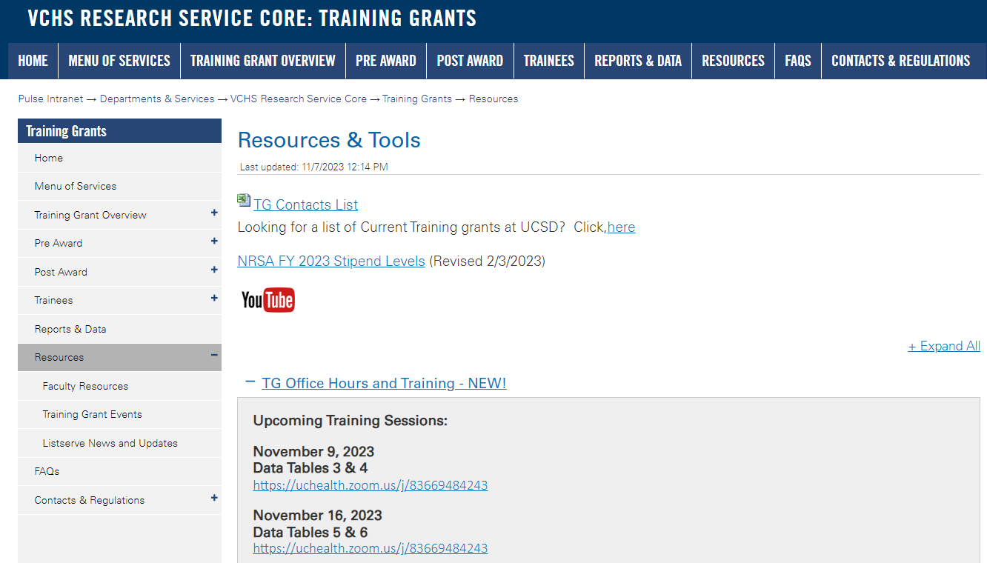
https://pulse.ucsd.edu/traininggrants - AD credentials required
Resources
Notes:
If you need to remember one thing.. Its the TG website.

Slide 44
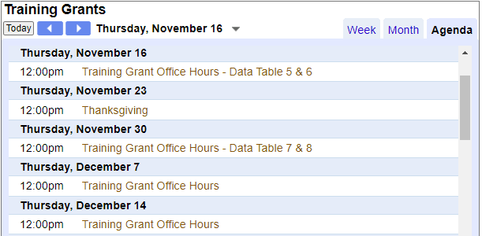
Coming up TG Office Hours
Notes:
Add this to your Google Calendar https://calendar.google.com/calendar/u/0?cid=amVjZHVqZTA0ZTM1aGQzcW1wbnB0djloNGdAZ3JvdXAuY2FsZW5kYXIuZ29vZ2xlLmNvbQ

Slide 45
Questions

