Slide 1
Data tables 7 & 8
Jill I. Vampola Training Grant Analyst Research Service Core
December 14, 2023

Slide 2
Recap from last office hours
Data Tables
5
Publications of Those in Training
6
Applicants, Entrants, and their Characteristics for the Past Five Years

Slide 3
Data Table 7

Slide 4
Table 7 Objectives
Appointments to the Training Grant for Each Year of the Current Project Period
Awarded training positions for the last 5 years
(Renewal/Revision Applications Only)
Summarize this data in the Progress Report Section. Also useful to refer to this data within the “Recruitment and Retention Plan” to Enhance Diversity Section

Slide 5
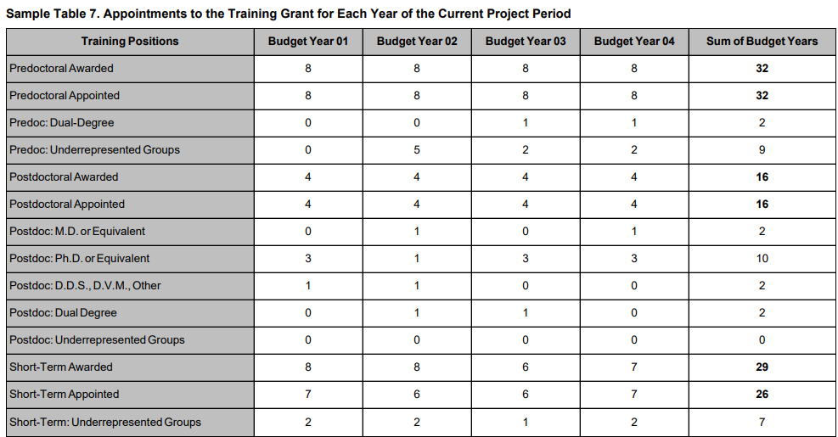
Table 7 Instructions
Since the last competing grant application provide the following counts awarded and appointed for each complete budget year
Sum of Budget Years

Slide 6
Tips on gathering Data Table 7 Info
Look at previous RPPR’s, notice of awards and/or tracking records for awarded slot information
Check your “trainee diversity report” from the past RPPR’s
If you have access to xTRAIN then you can view the grant detail for current and previous years

Slide 7
xTRACT

Slide 8
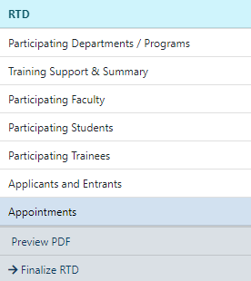
Data Table 7 – Appointments (Renewals only)
Data Table 7

Slide 9
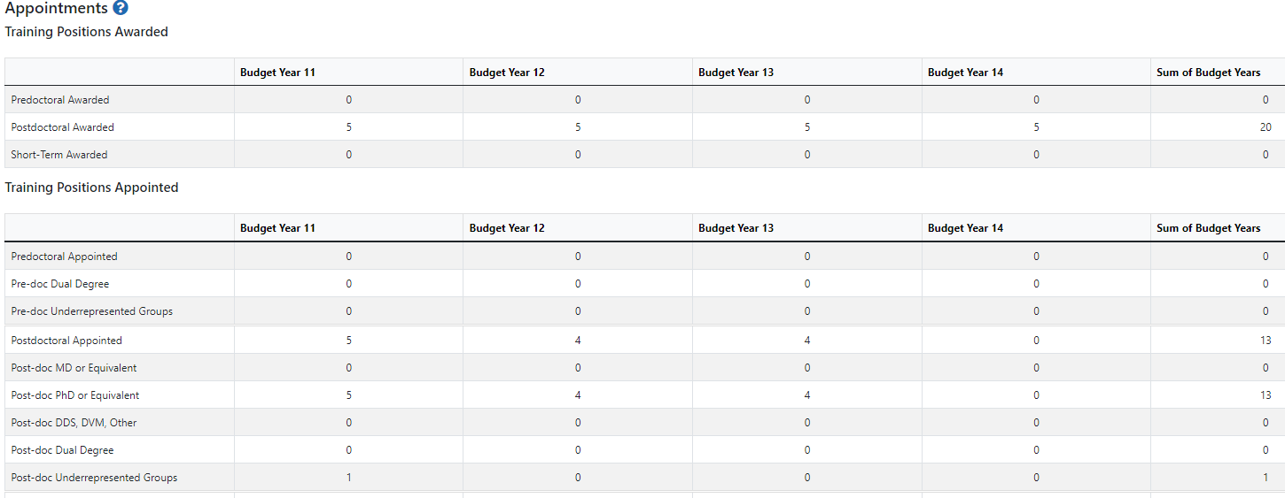
Data Table 7 - Appointments (Renewals only)

Slide 10
Best Practices for Table 7
Your numbers should match between awarded and appointed!
NIH will not look favorably if you didn’t fill all your slots!

Slide 11
Table 8 Objectives
Program Outcomes
Effectiveness of the proposed training program
Track trainee outcomes for 15 years
Summarize the data in the Program Plan Section or the Progress Report Section, as appropriate

Slide 12
Table 8 has Four Parts
Part I.
Part II.
Part III.
Part IV.
Those Appointed to the Training Grant
Those Clearly Associated with the Training Grant
Recent Graduates (New applications)
Program Statistics – Predocs only
Notes:
FIX ANIMATIONS?

Slide 13
Instructions differ between application types
New
Renewal
RPPR
Part I. Those Appointed to the Training Grant
Part I. Those Appointed to the Training Grant
Part III. Only Recent Graduates for the last 5 years
Part II. Those Clearly Associated with the Training Grant
Part II. Those Clearly Associated with the Training Grant
Part III. Recent Graduates (only for expanding programs)
Part IV. Program Statistics – predocs only
Part IV. Program Statistics – predocs only

Slide 14
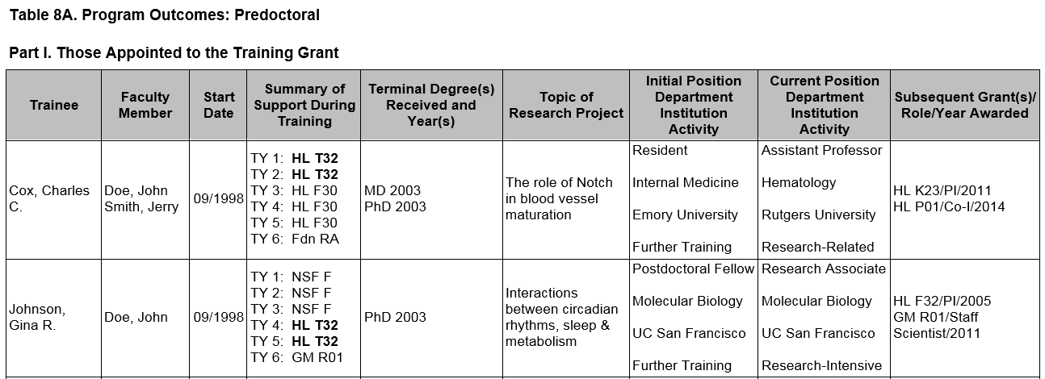
Data Table 8 Instructions
Up to two faculty members
The start date (MM/YYYY format - no day) is the first year that the trainee began graduate studies at the applicant institution, even if they did not become associated with the training program until later
Predoc trainee is defined as a Ph.D candidate, master’s students and undergrads excluded

Slide 15
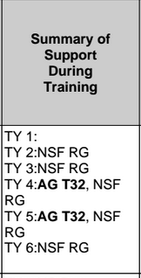
Sources of Support
Provide the primary source and type of support during each 12-month period of training, using TY1 for Training Year 1, etc.
If the trainee was listed on a prior RPPR for any NIH grant, it should appear in xTRACT automatically. Other non-NIH fund sources will need to be manually entered.
Sources of Support
• NSF
• Other Federal (Other Fed)
• University (Univ)
• Foundation (Fdn)
• Non-US (Non-US)
• Other (Other)
Types of Support
• Research assistantship (RA)
• Teaching assistantship (TA)
• Fellowship (F)
• Training Grant (TG)
• Scholarship (S)
• Other

Slide 16
Degrees for Predocs
For past predocs, list the terminal degree received and year awarded
Trainees currently in the program should be designated “in training”
Those who have left the graduate program without a degree, report “none.”

Slide 17
Topic of Research – Predocs & Postdocs
Research Topic is limited to 200 characters

Slide 18
Degrees Dates for Postdocs
List degree resulting from postdoc training, usually “none.”

Slide 19
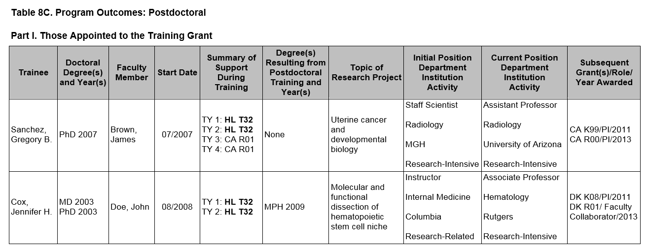
Post-Training Positions
For trainees who completed or left the program, provide their initial and current positions, departments, and institutions
Classify each position as predominantly:
Research-intensive
Research-related:
Teaching
Administering research
Science policy
Technology transfer
3. Further Training
4. Other
If information is not available, report “unknown.”

Slide 20
Subsequent Grants
The support can be from any source whether as PD/PI or in another senior role:
Co-I
Faculty collaborator
Staff scientist
Other
If applicable, list the type of
support after completed training:
Subsequent fellowship (F)
Career development (K)
Research grant (R)
Up to five grants may be listed

Slide 21
Part II. Clearly Associated Students

Slide 22
Clearly associated is defined as:
A current trainee who is having a training experience identical to those appointed to this grant and they must have been or currently are funded by another HHS or NIH mechanism (fellowship, R01, even for a short time)
Eligibility to be on a TG is NOT a factor here
e.g. non-citizen’s can be listed if they are on HHS or NIH fund sources

Slide 23
Table 8 Part II. Clearly Associated
Same instructions as Part I.
For RPPR’s -
In each subsequent year, they should continue to add new entrants and provide updated information about current and past clearly associated students until 15 years of data have been completed
Notes:
Split slide, small font?

Slide 24
Table 8 Part III. Recent Graduates

Slide 25
Table 8 Part III. Recent Graduates
Similar instructions to Part I & II
For NEW applications & predoc renewal/revision applications requesting an expansion to postdoc support OR vice versa
List sequentially all pre or postdocs whom have completed the proposed program in the last five years who would have been eligible for appointment, if an NIH training or related award were available
Summarize the data from Parts I-III (as applicable) in the Research Training Program Plan, either in the Program Plan Section or the Progress Report Section, as appropriate
Notes:
Split slide, small font?

Slide 26
Table 8 Part III. Recent Graduates
For each predoc or postdoc, no summary of Support During Training
Notes:
Split slide, small font?

Slide 27
Table 8 Part IV. Program Statistics

Slide 28
Table 8 Part IV. Program Statistics - PREDOCS
The percentage of trainees entering 10 years ago that received support from this training grant who received PhDs or equivalent degrees
Average amount of years to Ph.D.
Calculated to one decimal place (e.g., 5.5 years)
Notes:
Split slide, small font

Slide 29
Table 8 Part IV. Program Statistics - PREDOCS
New programs that have not yet had any trainees complete the PhD should not include this table at all
Programs that have not received support for at least 10 years should not include the percentage of trainees completing their degrees within 10 years
For RPPRs - summarize this data in the Accomplishments Section
What opportunities for training and professional development has the project provided?”
Notes:
Split slide, small font

Slide 30
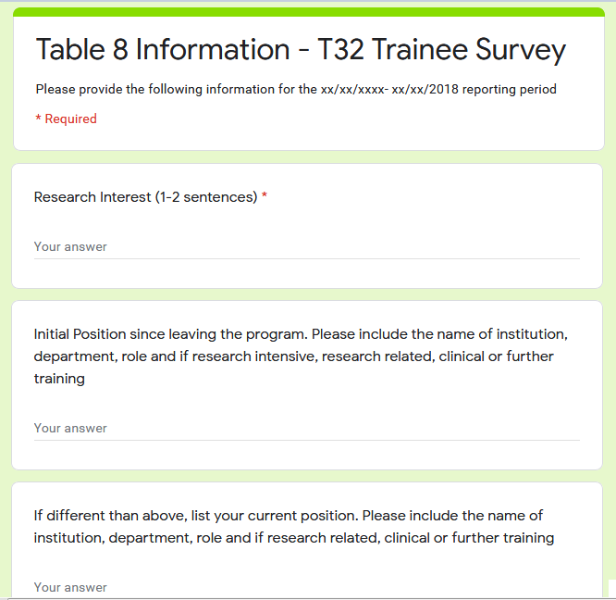
Tips on Gathering Info for Table 8
Create a group page for your program. At the time of appointment be sure to have the trainee add themselves to the account and that they understand the expectation of staying in contact for the next 15 years
Send out a Table 8 Annual survey
Email trainees to update their “Personal Profile” in

Slide 31
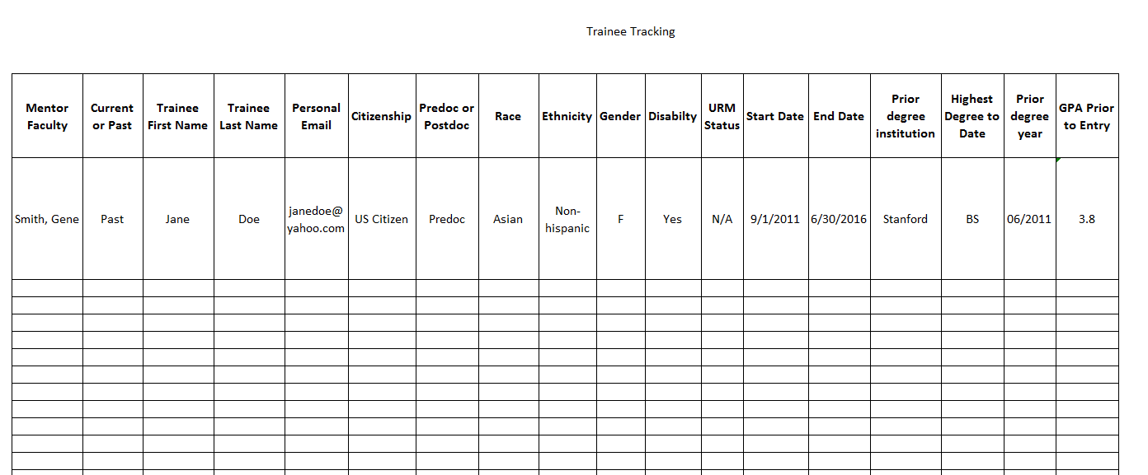
Trainee Tracking – Keep adequate records

Slide 32
Table 8 FAQ’s
Q. If you are submitting a new predoc application, which part do I fill out?
A. Part III – Recent Graduates only. List students who graduated in the last 5 years but who would have been eligible for this T32, if it existed. (There is no data for part I, II, IV.)
Q. Should I include ALL the students in my participating Ph.D. program?
A. Include only TGE students and students in participating mentors' laboratories in the proposed training program
Notes:
Split slide, small font

Slide 33
Table 8 FAQ’s
Q. If you are submitting an RPPR, which parts do I fill out?
A. Parts I, II & IV (program statistics are for predocs only). Provide updated trainee or current clearly associated student information, reflecting new appointments/entrants and other changes over the last reporting period
Part II. for clearly associated, continue to add new entrants until 15 years of data have been completed
Notes:
Split slide, small font?

Slide 34
Table 8 FAQ’s
Q. For predocs, where should subsequent fellowship awards be reported?
A. In Table 8A, if a predoc receives a fellowship during grad school, it should be reported in the “Summary of Support During Training.” If a predoc goes on to receive a fellowship after completing graduate school, it should be reported under “Subsequent Grant(s)/Role/Year Awarded.”
Notes:
Split slide, small font

Slide 35
Table 8 FAQ’s
Q. Are students that are supported by a private fellowship or a NSF fellowship considered “clearly associated”?
No, since these are not NIH or HHS awards
Q. What should we do if we don’t have all the historical data?
A. Provide as much as reasonably possible, and begin collecting the relevant information, so that it will be available in the future. The PI should address it in the narrative.

Slide 36
xTRACT

Slide 37
Edit Trainee
Data Table 8
Table 8 is populated from Participating Trainees or Students (new applications)
Notes:
Add in better screen shot and also accordion menu

Slide 38
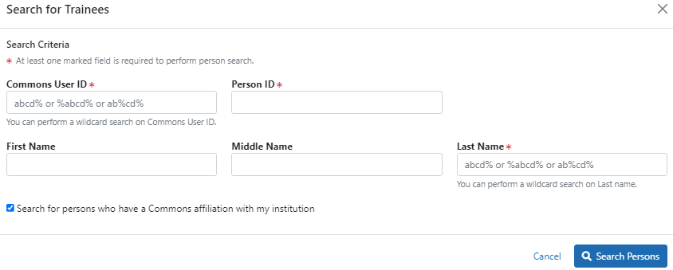
Search for a Trainee

Slide 39
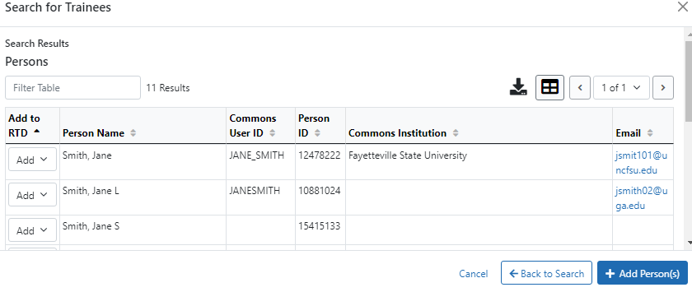
Add Trainee as a Pre or Postdoc

Slide 40
Trainee Details

Slide 41
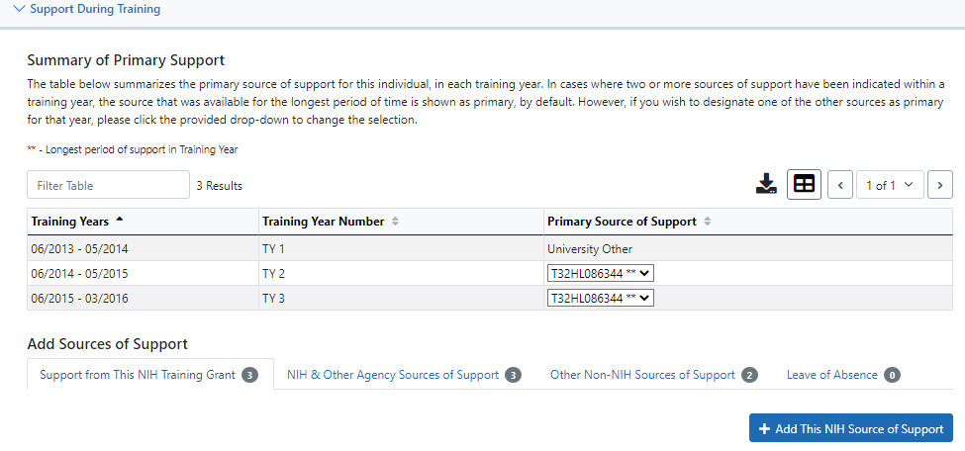
NIH TG Support or Other NIH Sources

Slide 42
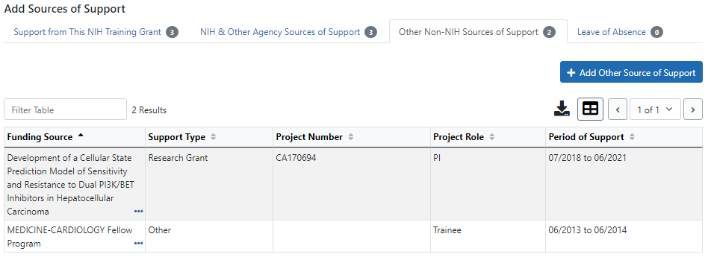
Adding Sources of Support – non NIH

Slide 43
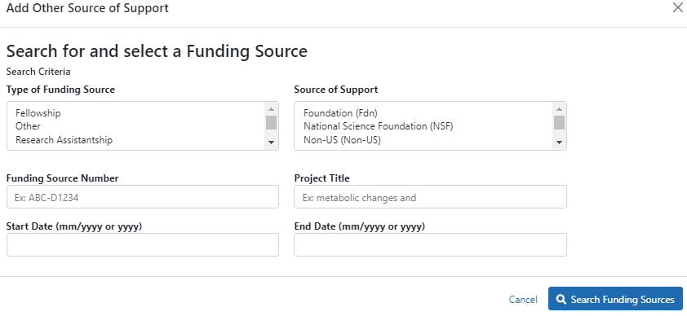
Adding Sources of Support – non NIH

Slide 44
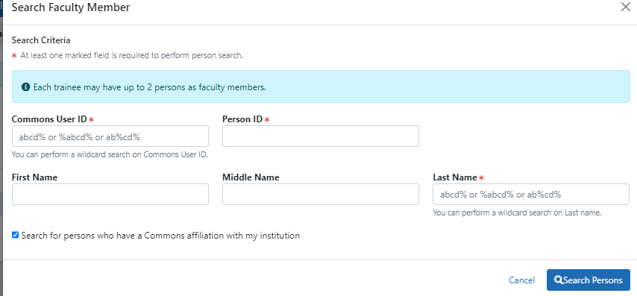
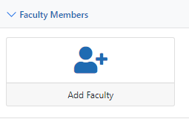
Add Faculty Mentor

Slide 45
Degree Info
If the predoc is currently in training, list the terminal degree-to-date
A postdoc that is NOT a current trainee, the doctoral terminal degree needs to be indicated
Be sure to received in training for predocs that have graduated!

Slide 46
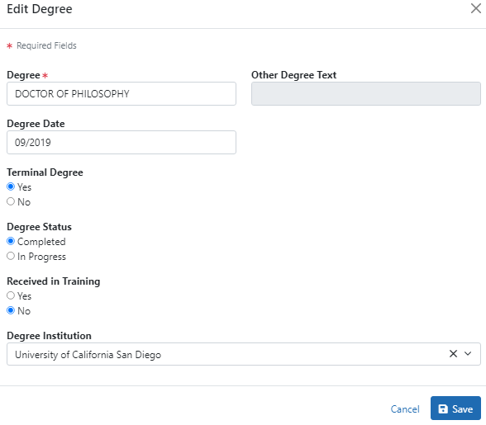
Editing Degrees
Be sure to click terminal degree if you want the trainee that has completed training on this RTD!

Slide 47
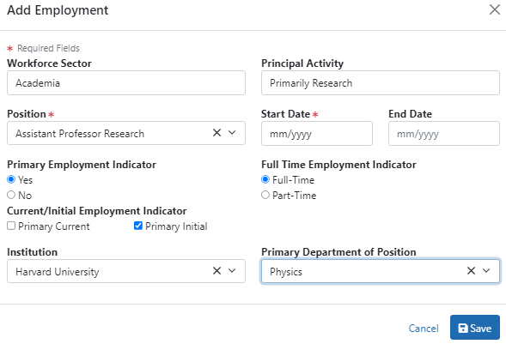
Adding Employment

Slide 48
Post-Training Positions
Be sure to differentiate between initial and current positions
Notes:
Need a screenshot of adding in employers

Slide 49
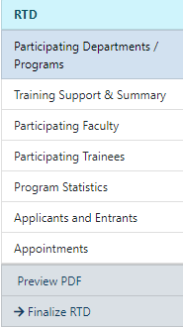
Table 8 - Program Statistics – Predocs only
NOT Auto populated
Data Table 8A, Part IV

Slide 50
Best Practices for Table 8
Provide as much data as reasonably possible. Exercise due diligence in collecting and verifying data
Start early with your tables there is a LOT of data entry, especially in xTRACT
Consider yourself a professional stalker!

Slide 51
Final Thoughts on Table 8
Be proactive and begin collecting the relevant information at the beginning of the grant, so that it will be available in the future
Tracking former participants after program completion can be challenging. Establish expectations at the time of appointment
These records are essential for creation of annual progress reports (RPPR’s) and a future renewal application

Slide 52
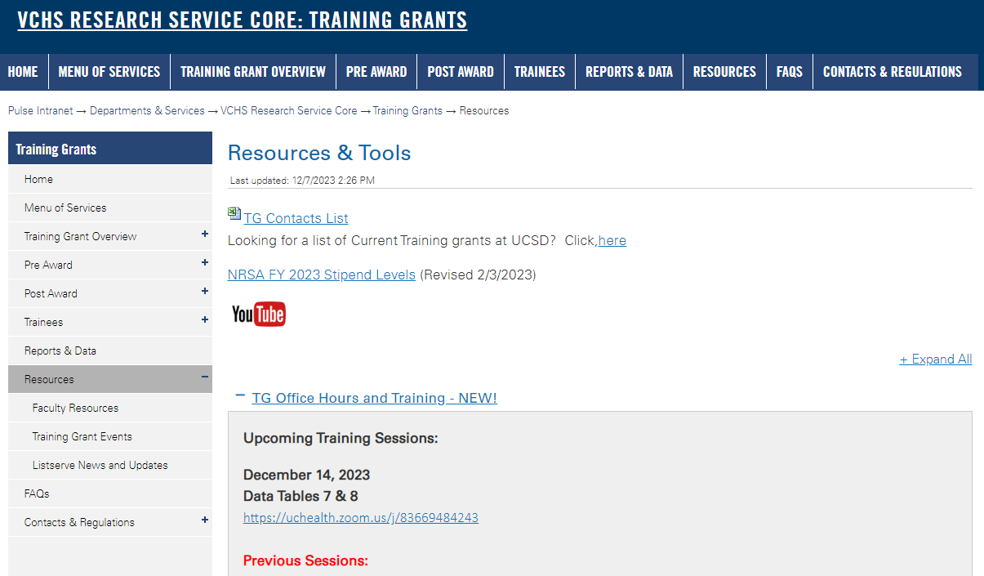
https://pulse.ucsd.edu/traininggrants - AD credentials required
Resources
Notes:
If you need to remember one thing.. Its the TG website.

Slide 53
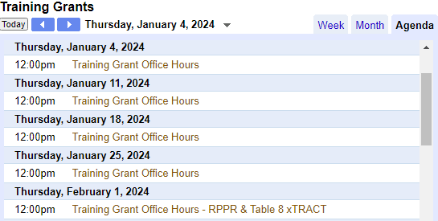
Coming up TG Office Hours
No office hours Dec 21 & 28
Notes:
Add this to your Google Calendar https://calendar.google.com/calendar/u/0?cid=amVjZHVqZTA0ZTM1aGQzcW1wbnB0djloNGdAZ3JvdXAuY2FsZW5kYXIuZ29vZ2xlLmNvbQ

Slide 54
Questions

