Slide 1
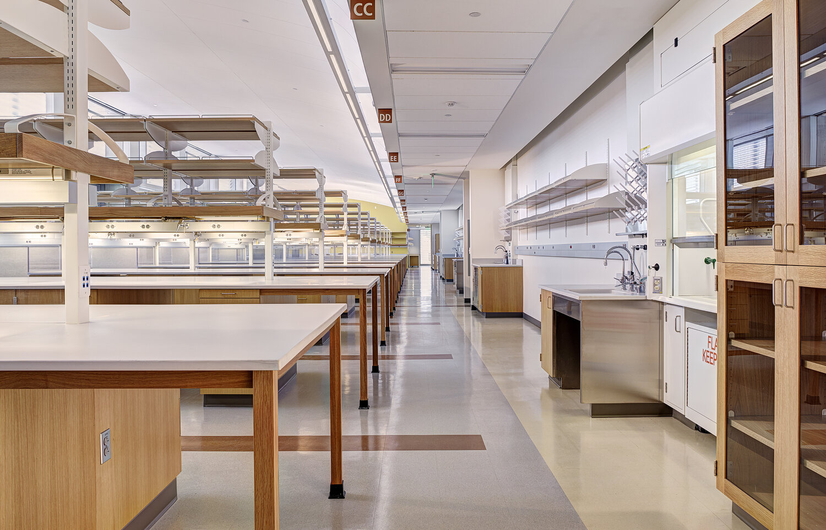
Getting Started NIH Data Tables
Jill I. Vampola
Training Grant Analyst
Research Service Core
October 4, 2023

Slide 2
Recap from last week
Four Key areas of Trainee tracking:
  Applicants (for Data Table 6b)
  Participating Faculty (Data Table 2)
  Current and Past Trainees (for Data Table 5 & 8)
  Program Activities (RPPR’s & Renewals)

Slide 3
Today’s Objectives
Data table overview
Getting organized for a submission

Slide 4
What are NIH data tables?
Required for all NRSA applications, one set of tables for all NIH institutes
Present detailed and consolidated documentation of your Training Program

Slide 5
What are data tables?
Summarize the data in the body of your grant application
Use the data to support the presentation of your training program

Slide 6
Data Tables
Census of Participating Departments and Interdepartmental Programs
1
Participating Faculty Members
2
Federal Institutional Research Training Grant and Related Support Available to Participating Faculty Members
3
Research Support of Participating Faculty Members
4

Slide 7
Data Tables
5
A & B
Publications of Those in Training
6
A & B
Applicants, Entrants, and their Characteristics for the Past Five Years
Appointments to the Training Grant for Each Year of the Current Project Period (Renewals only)
7
Program Outcomes
8

Slide 8
A vs. B Data Tables
  A tables are for predoc trainees
  Most B tables are for postdoc trainees
  C/D Tables added for Undergraduate
  Instructions may differ between new or renewal applications

Slide 9
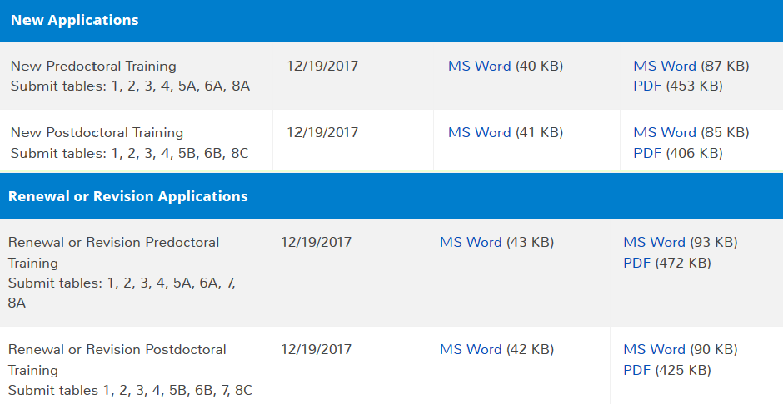
What tables do I fill out for my application?
RPPR’s = Table 8 Only – 15 years of data

Slide 10
Background

Slide 11



Understanding the Background about Data Tables
  NIH evaluates the both past and present qualifications and accomplishments of:
Institution (Departments and Programs)
Faculty
Trainees (Program Outcomes)

Slide 12
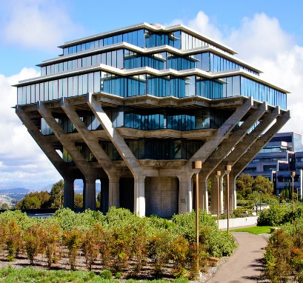


Data tables are insight into the proposed program:
Environment of the proposed training
(Tables 1 & 6)
Distribution of participating faculty by research interest
(Tables 2, 3 & 4)
Existing support for training, and availability of funds to support trainees’ research (Table 4)

Slide 13




What are reviewers looking for?
Recruitment of new trainees and progress of existing trainees, as assessed by outcomes such as:
Degree completion (Table 8)
Publications (Table 5)
Career progress (Table 8)
Subsequent involvement in research-related activities (Table 8)

Slide 14

Where do I start?

Slide 15
5 steps in the “Data Table” process
Understanding
Planning & Organizing
Hunting & Gathering
Verifying
Submitting
Notes:
Data Tables are preaward and postaward

Slide 16
Detailed Data Tables Process
Understand purpose and instructions
Create timeline to submission, stakeholders meeting
Planning and organization
Identify tables that you need to complete
Decide to use xTRACT or MS Word
Input information
Verify Information
Use checklist to record responses
Draft & send PI emails
Obtain participating faculty list from your PI
Research hard to find info
Put it all together – formatting, etc.
Review, edits/revisions
Submit
Notes:
FINSH THIS SLIDE

Slide 17
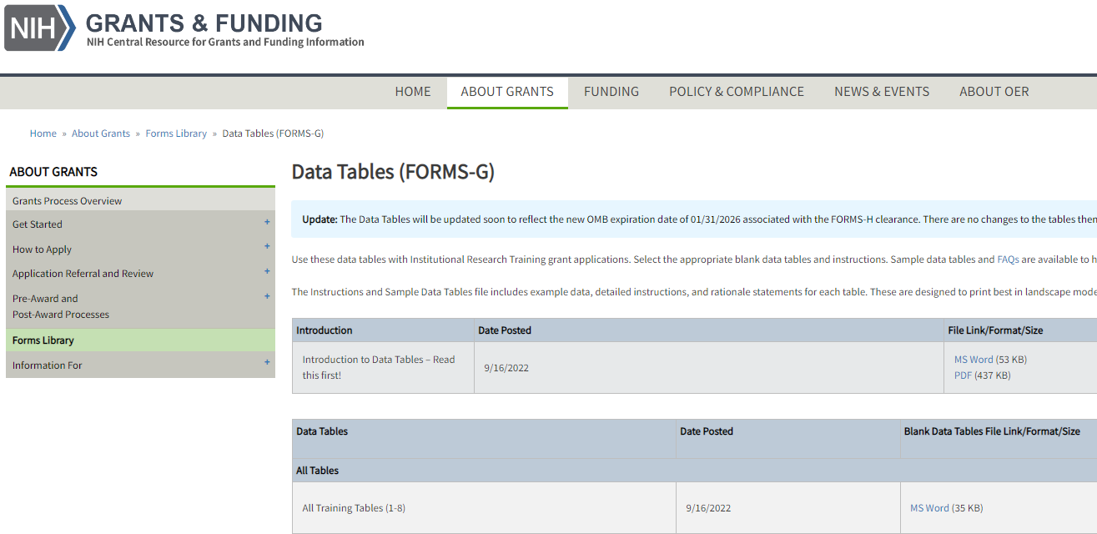
MS Word or xTRACT?
1. Download the NIH Word forms:
or
Use xTRACT and initiate a new application, renewal, RPPR, etc.

Slide 18
What is xTRACT ?
Extramural
Trainee
Reporting
And
Career
Tracking
A tool within eRA Commons used to create data training tables for RPPR’s & training grant applications
T32, TL1, and T15 RPPR’s are required to use xTRACT
Still optional for new and renewal applications

Slide 19
Upside of
xTRACT
Able to pre-populate some training data
xTrain
NIH RePORTER
Manual entry data is stored in xTRACT and can be re-used when preparing subsequent training table submissions
Makes RPPR’s and Table 8 easier in the long run

Slide 20
Down
  Requires a LOT of data entry in the beginning
Side
  Bugs in the system that still need to be fixed by NIH
Notes:
And as you enter more and more data into xTRACT, that information will also become available for re-use when preparing later applications and RPPR’s.”
Will require more data entry at the beginning, but subsequent submissions will be easier!

Slide 21
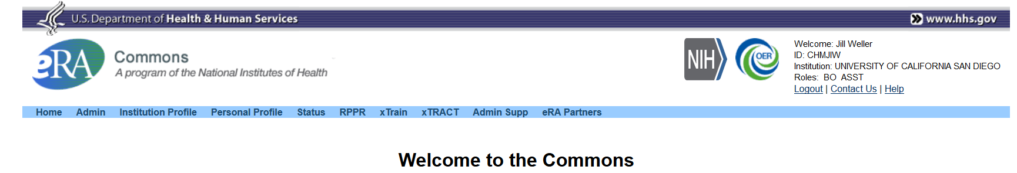
Access to xTRACT
If you have the appropriate delegation you will see xTRACT on the eRA Commons toolbar, if not, you do not have the proper access

Slide 22
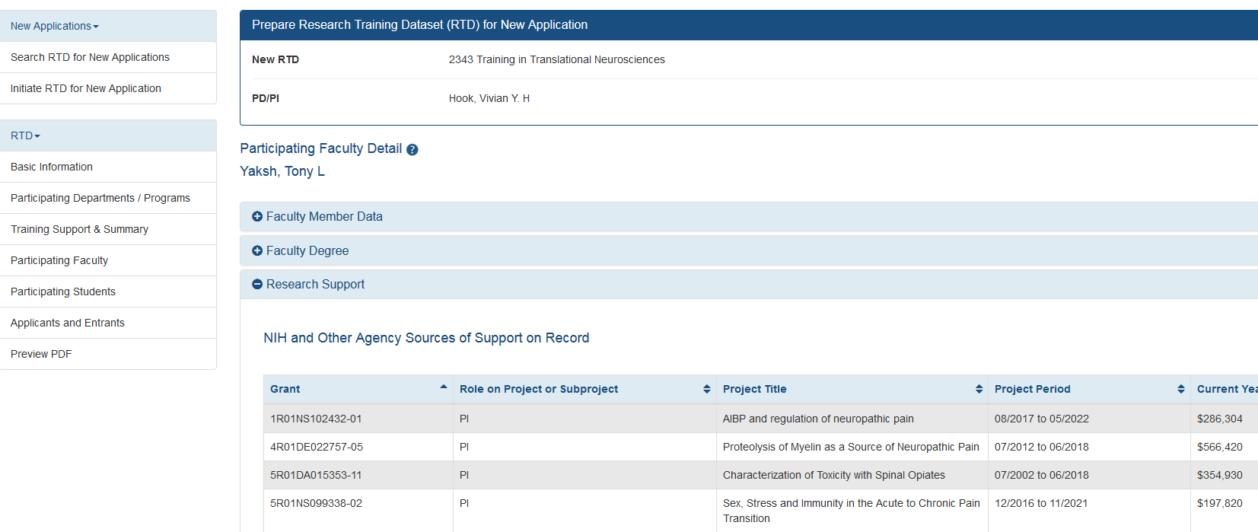

Screenshot of xTRACT

Slide 23
Planning
&
Organization

Slide 24
Admin Strategy to Successful Proposals
If possible, plan a kickoff meeting with PI, leadership, fund manager, admin, etc.
Make sure everyone understands the expectations and deadlines
Establish frequency of future meetings to assess progress
Complete the data tables before PI has to finalize the narrative

Slide 25
PI’s Strategy to Successful Proposals
Design your program and make sure it is unique
How is this different than other programs on campus?
Identify your institute/center
  Identify your participating faculty/mentors
Check overlapping faculty list to see if your faculty are on other UCSD training
Based on your participating faculty, what departments will be involved?
Review strengths and grants weaknesses on what reviewers look for
Notes:
Stay or go?

Slide 26
PI’s Strategy to Successful Proposals
Contact your Program official and get their advice and opinion on submission
Read and respond to review criteria if applicable (resubmission)
Secure institutional commitments
Familiarize yourself with the data tables
  Your program plan needs to support the data in your data tables

Slide 27
Get organized!
Start early
Ask PI for final participating faculty (mentors) list
      This will generally dictate which departments will be involved
Use the TG contacts list from website for help in identifying contact persons
Send one email per mentor
Leverage data (tables) from other depts.
Check last renewal (if applicable) for previous data tables

Slide 28
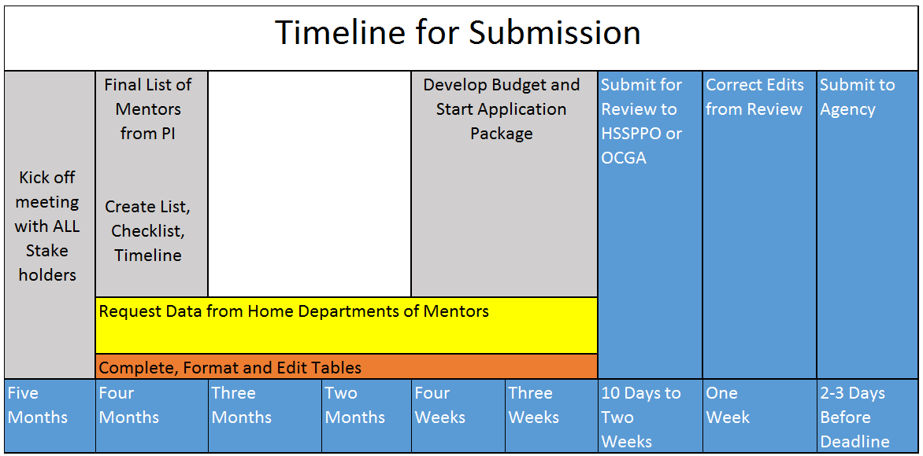

Slide 29
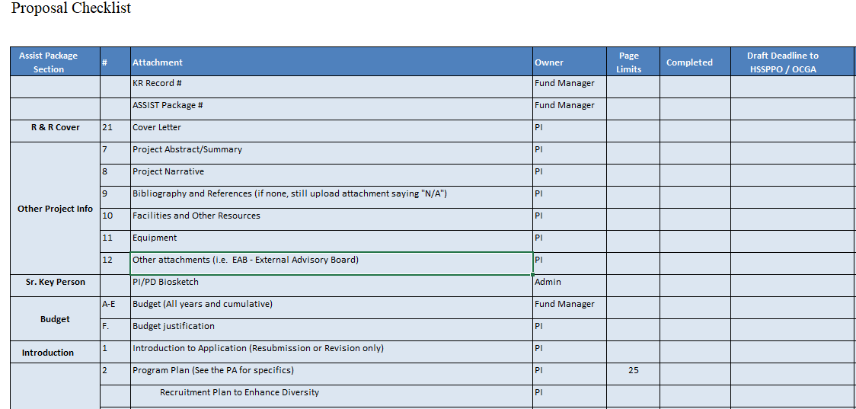
Training Grant Proposal Checklist

Slide 30
Sample email to PI and/or admins
Research interest
NIH biosketch
  Personal statement should include mentor record
Mentoring records for pre and postdocs
  Program outcomes for Table 5 & 8 if applicable
Research support

Slide 31
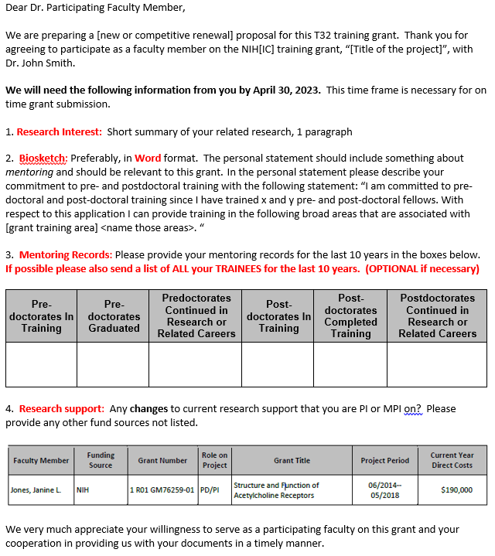
Sample email
  1. Research Interest
  2. Biosketch – with mentoring statement, EDI support of program, etc.
  3. Mentoring Records for last 10 years
  *Past trainee outcomes are optional
  4. Research Support

Slide 32
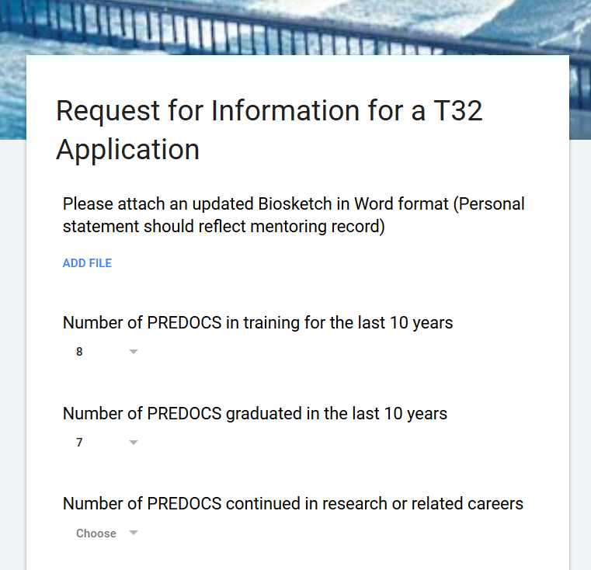
Available Alternative
Google Form

Slide 33
Do NOT ask a PI for:
Table 1
  Census numbers of department and programs
Table 3
  Other Institutional training grants
Table 6A
  Predoc applicant and Entrants
Table 6B
  Postdoc applicant and Entrants
Table 7
  Appointments to the Training Grant (Renewals only)

Slide 34
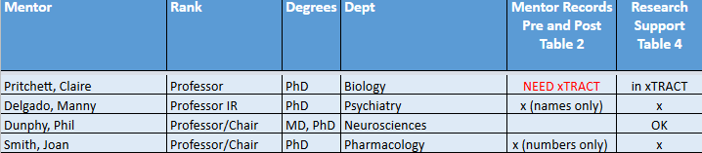
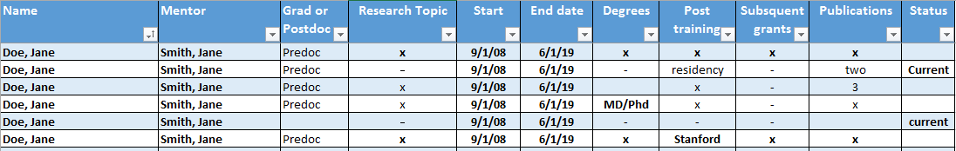
Organizing Checklist(s)
Participating Faculty
Participating Trainees

Slide 35
Best Practices for Getting Started
Be organized!
Ask the right person the right question!
Keep a copy of the data table instructions handy – you may need to refer to them often!
Notes:
Chuck this slide?

Slide 36
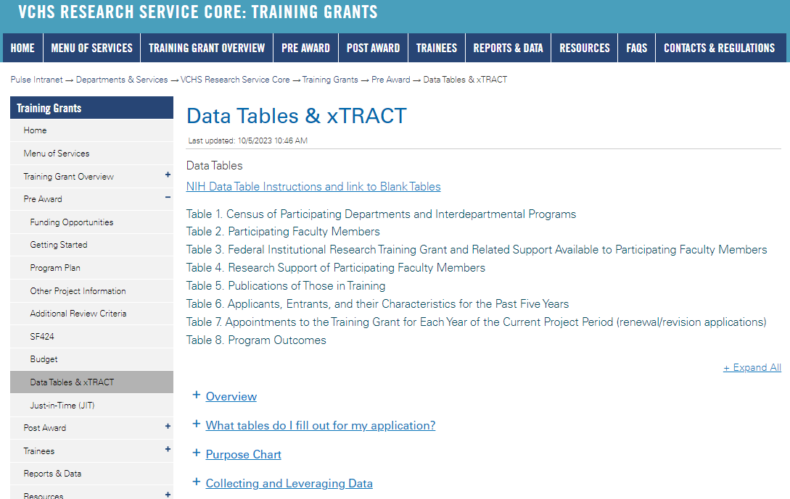
https://pulse.ucsd.edu/traininggrants - AD credentials required
Data Table Resources

Slide 37
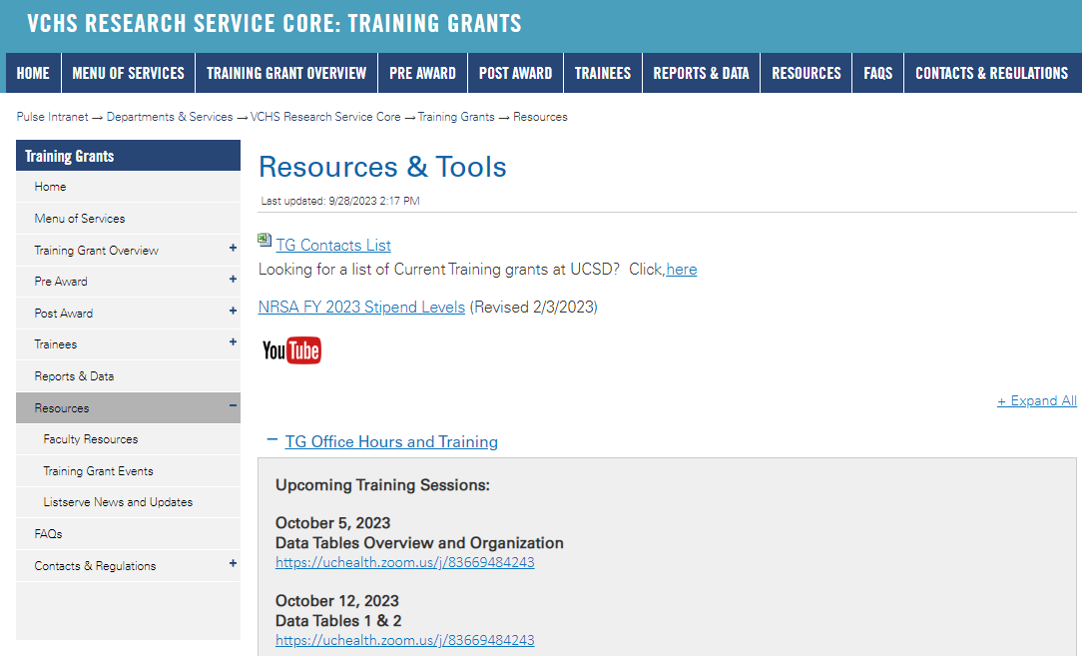
https://pulse.ucsd.edu/traininggrants - AD credentials required
Resources
Notes:
If you need to remember one thing.. Its the TG website.

Slide 38
Coming up TG Office Hours
10/12 - Data Table 2 & 1
No office hours
  10/19
  10/26
  11/2
11/9 – Data tables 3 & 4
11/16 – Data Tables 5 & 6
11/23 – Thanksgiving
11/30 – Data tables 7 & 8
Notes:
Add this to your Google Calendar https://calendar.google.com/calendar/u/0?cid=amVjZHVqZTA0ZTM1aGQzcW1wbnB0djloNGdAZ3JvdXAuY2FsZW5kYXIuZ29vZ2xlLmNvbQ

Slide 39

Questions

