Slide 1
NIH xTRAIN Appointments
Jill I. Vampola Training Grant Analyst Research Service Core
July 27, 2023

Slide 2
Today’s Objective
Recap last training
NIH xTRAIN Overview
Looking up eRA Commons accounts
Delegation of authority
Appointments

Slide 3
Training Grant Trainee Policies
Degree Requirements
Citizenship/Eligibility
Years
Trainee Policy
Stipends
Tuition and Fees
Training Related Expenses
Travel
Payback Agreements for Postdocs

Slide 4
What is xTrain?
NIH xTRAIN is part of eRA Commons, an online application that allows PD/PI’s, admin, and trainees to access & share grant info
Allows institution users to enter data, route and submit forms such as:
Appointments PHS 2271
Re-Appointments
Amendments
Termination Notices
PHS 416-7
Agency staff use xTrain to review and process the appointments & terminations that are submitted

Slide 5
xTrain Codes
For Appointments:
T32, T34, T35, TL1, T15
KL2, K12 (Career Development)
R25 (Research Education)
For Termination Notices:
T32, T35, TL1
F30, F31, F32, F33 (Individual Fellowships)
xTRAIN does not support Payback Agreements. It must be downloaded, printed, signed and send via USPS
Please note: Not all activity codes except both in xTRAIN, will have to send USPS, not all appointments require a termination notice

Slide 6
X-TRAIN Roles
X-train requires the user to have an eRACommons account and a designated role
Principal Investigator (PD/PI)
Business Official
Delegate (ASST)

Slide 7
PD/PI Role
Responsible for overall direction of the training program
Selects and Appoints Trainees, Amends Appointments (when necessary), and initiates Terminations
Also refers to individuals that have applied for or received individual fellowship (F30, etc) awards

Slide 8
Business Official (BO) Role
Research administrator who has signature or other authority related to administering training grants
BOs are the only users with the authority to submit Termination Notices on behalf of the institution for TG’s

Slide 9
PD/PI Delegate (ASST role)
Person, delegated by the PD/PI, with the authority to perform xTrain-related functions on his/her behalf
Same actions and notifications as PD/PI except for the ability to submit Appointments to Agency
Admin needs NIH eRA commons account
Assigned ASST role
PI Needs to delegate xTRAIN authority to admin

Slide 10
Before you begin the appointment…
Look up to see if they have an eRA commons account
Check to see if they have prior NRSA Support
Admin will need delegation from your PD/PI
Field of Training
Period of Appointment
Stipend Level
(amount will be auto populate)
Notes:
ENTER look up here from Biosketch PPT

Slide 11
eRA commons Account lookup

Slide 12
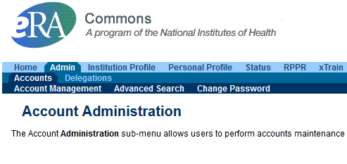
Anyone who has eRA Commons role of AO or SO can verify user ID’s in Commons – can search within or outside our organization

Slide 13
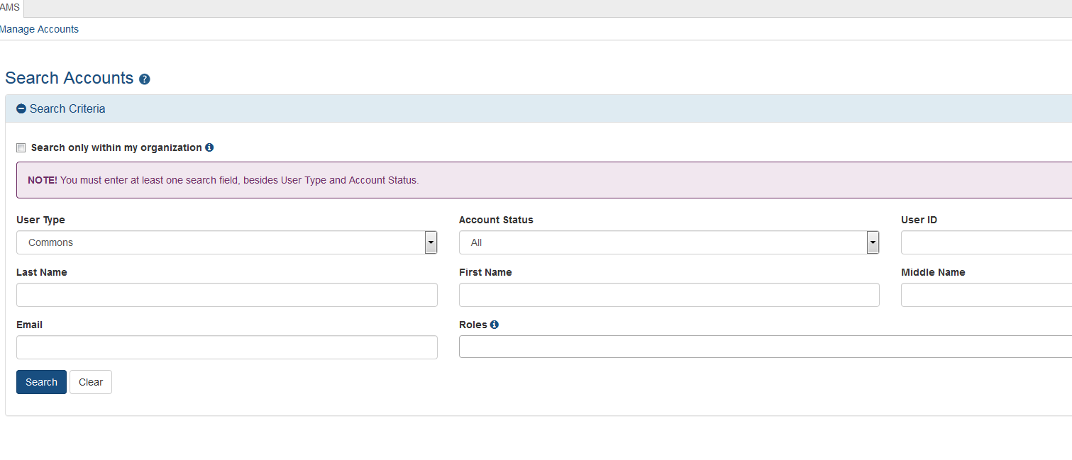
Check to see if trainee has an account

Slide 14
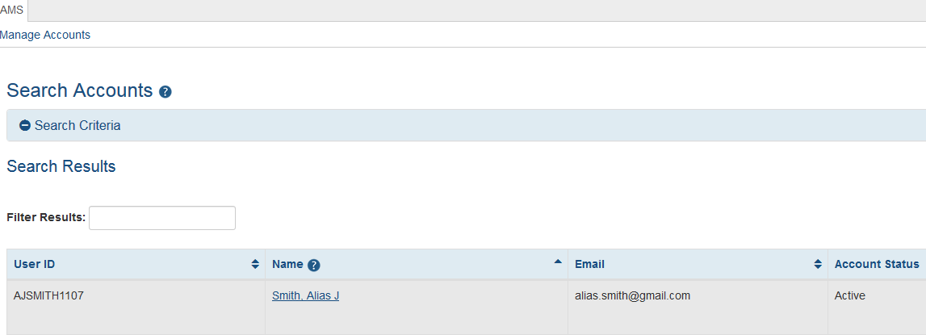
Check to see if trainee has an account

Slide 15
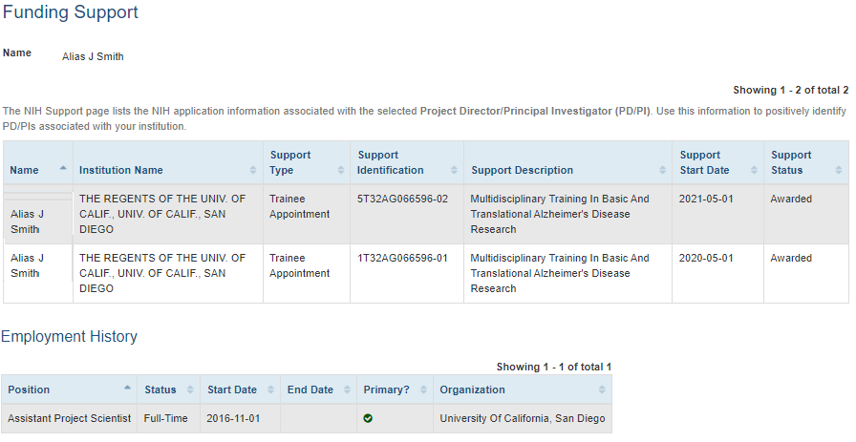
Check prior NRSA support
Predoc – 5 year Max, Postdoc 3 year Max

Slide 16
Need eRA Commons Account for yourself or a trainee?
Health Sciences: Elizabeth Tang at e8tang@ucsd.edu General Campus: era-commons@ucsd.edu
Information needed:
Full Name
Choose a username
Email address (for trainees use a personal account)
Role (ASST)
Preferred User name (6-20 characters)
https://blink.ucsd.edu/research/preparing-proposals/sponsors/federal/nih/index.html#Registration-in-eRA-Commons

Slide 17
Delegation of Authority

Slide 18
Delegation of Authority
Anyone who has eRA Commons role of ASST – only within our organization

Slide 19
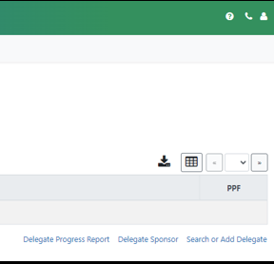
Delegation of Authority

Slide 20
Delegation of Authority

Slide 21
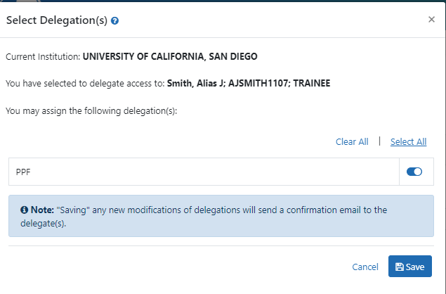
Delegation of Authority

Slide 22
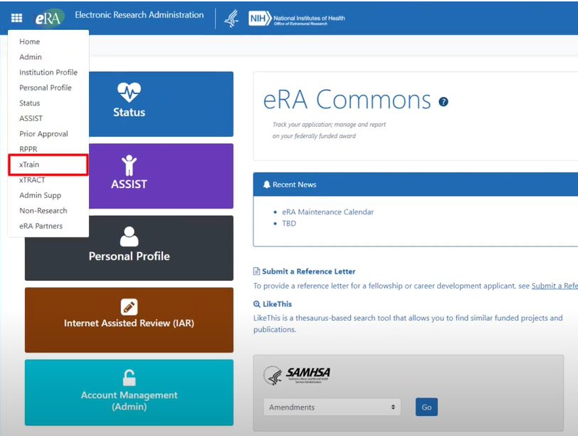
How to Login into xTRAIN

Slide 23
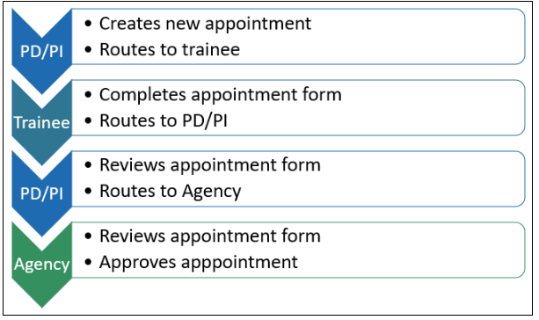
Process / Workflow

Slide 24
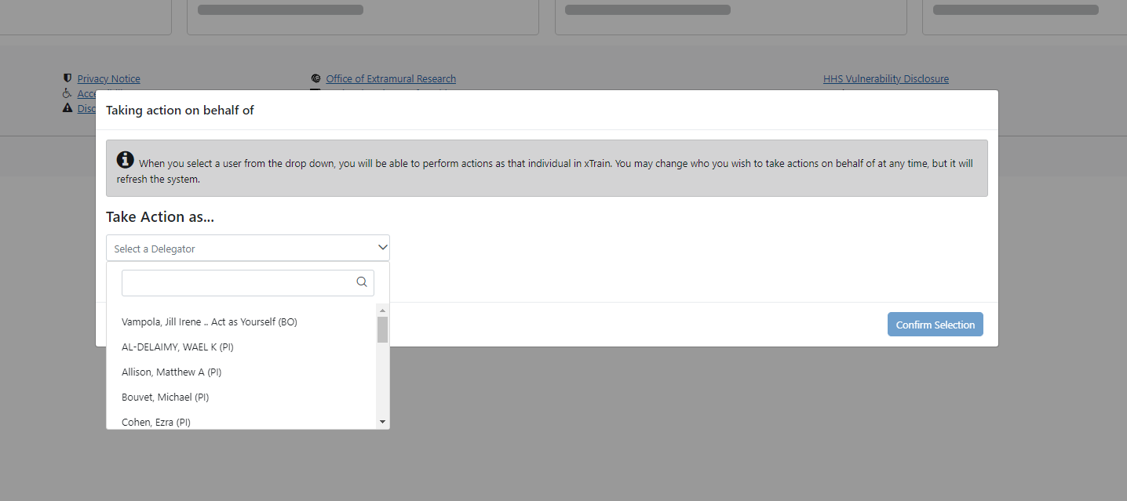

Slide 25
Type in PI last name or grant number

Slide 26
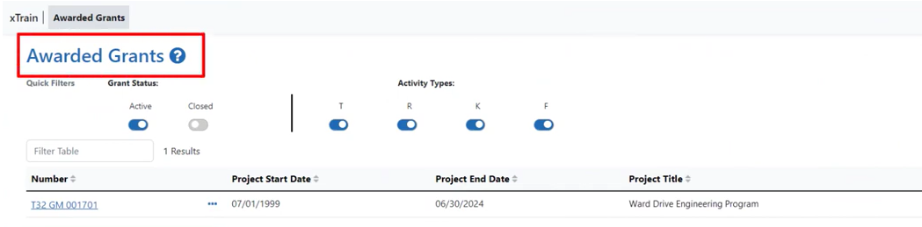
Click the hyperlinked grant number to display the Trainee Roster screen

Slide 27
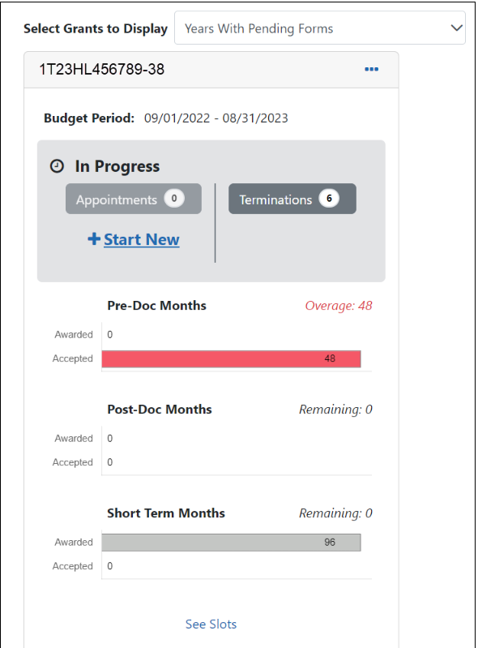
Click the Start New link under Appointments

Slide 28
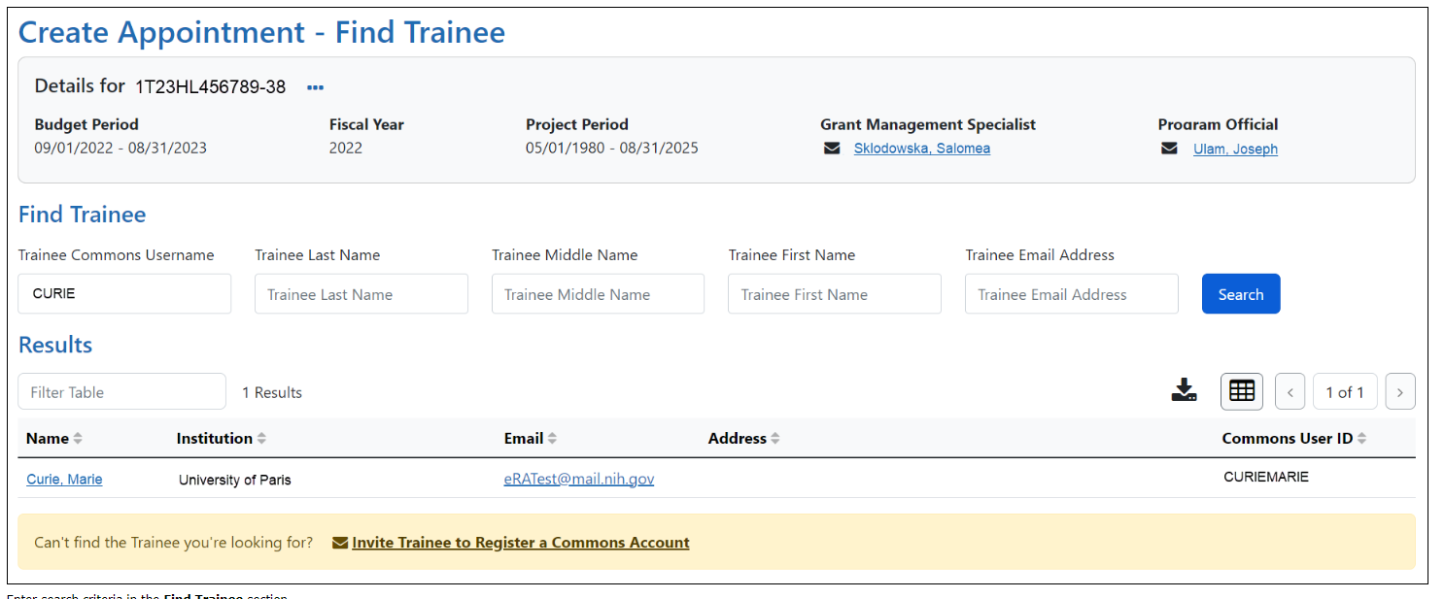
If the trainee is not listed, click the Invite Trainee to Register a Commons Account link, complete the form, and click the Send Invite button
If the trainee is listed, click the trainee's hyperlinked to continue

Slide 29
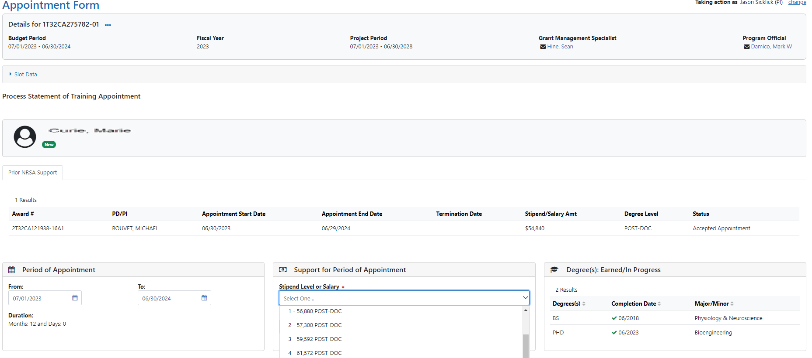
Some fields are prepopulated from the trainee’s eRA Common’s profile

Slide 30
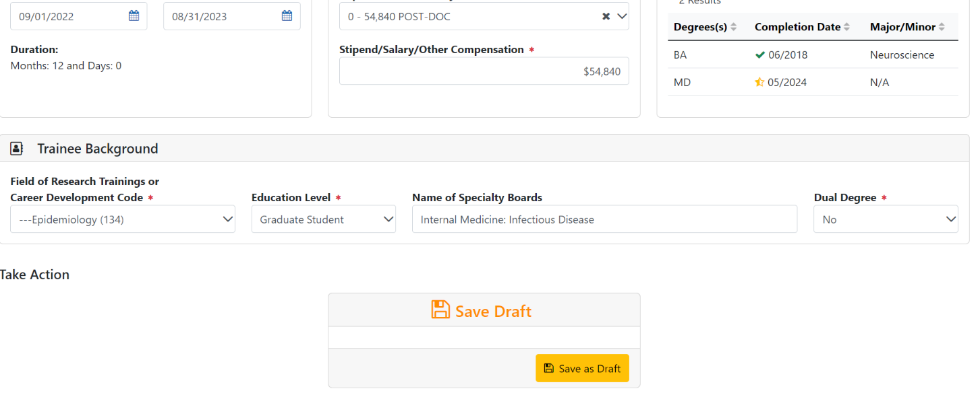

Slide 31
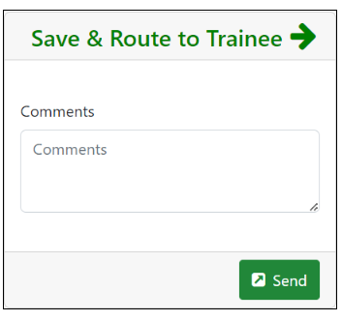

Slide 32
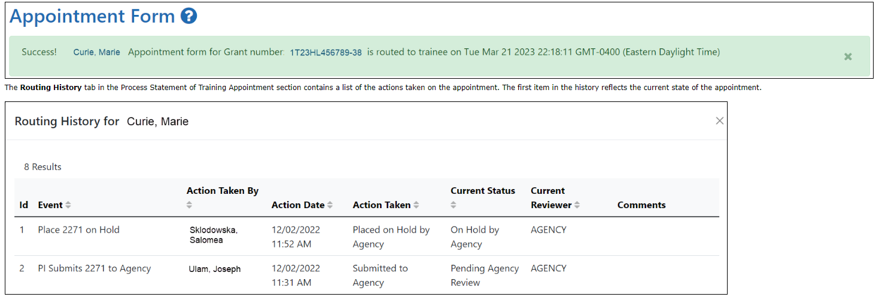
Appointments are synchronized into XTRACT. If appointments are made via xTrain, those appointments will be reflected on the RTD in XTRACT.

Slide 33
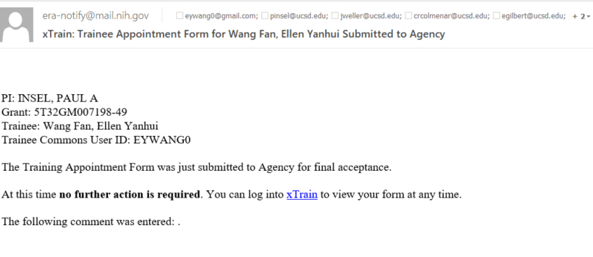
Trainee processes form
After receiving an email about the appointment and logging into xTrain, the trainee reviews and completes the info
The trainee then routes the Appointment Form back to the PD/PI

Slide 34
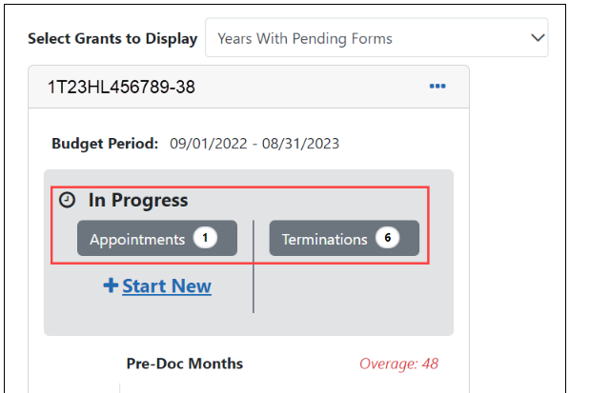
You will receive an email when the trainee has reviewed and completed the form and routed it back to you

Slide 35
To complete the Appointment, review the form one last time, add comments if desired, then click the Submit button in the Route to Agency

Slide 36
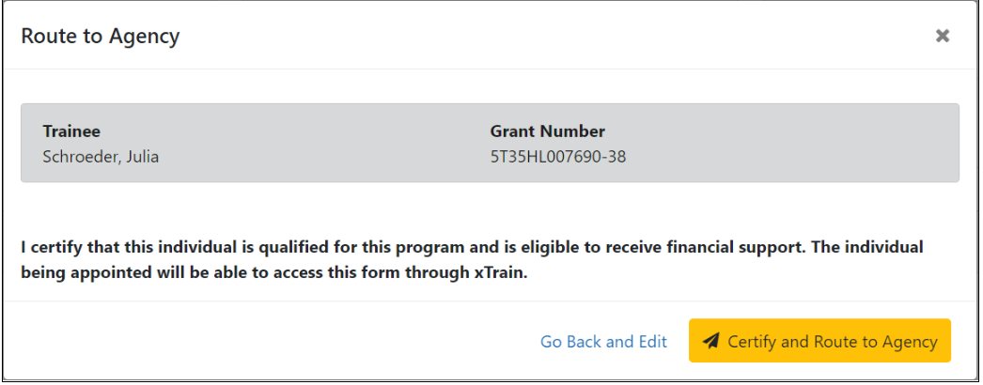
Status of the appointment is changed to Pending Agency Review

Slide 37
For Postdocs entering their initial year of NRSA support, don’t forget to mail the original signed Payback Agreement to NIH
Pre-doc Appointments – No further action is needed, unless confirmation of permanent residency status is required

Slide 38
Status types for appointments
Pending Agency Review
On hold by agency
On hold by agency – Awaiting Paper Signature - Other reason such as waiting on permanent residency card or payback
In Progress PI
In Progress Trainee
Accepted
Terminated

Slide 39
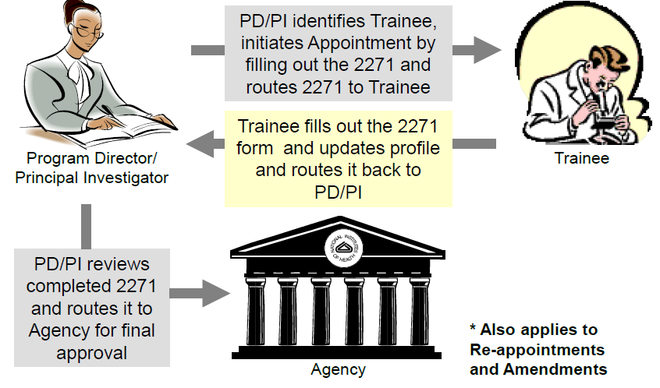
Appointments Reappointments
In Progress Trainee
In Progress PI
Pending Agency Review
Accepted

Slide 40
FAQ’s
Q. At what point can I use xTrain to make appointments for a new budget year?
The link for making a new appointment will be available as soon as the Notice of Award for the new budget period has been issued
Q. If a PD/PI delegates authority to an assistant (ASST), can that assistant perform all the same functions and receive the same notifications as the PD/PI?
A. The assistant can perform all the same functions and receive the same notifications as the PD/PI, except for submitting appointment forms or termination notices to the agency

Slide 41
FAQ’s
Q. I am appointing a trainee for a new fiscal year, but the stipend dropdown menu is only providing me the old stipend amount
A. The stipend level dropdown menu is based on the budget year of the grant period and not the appointment period of the trainee
Example: If a trainee appointment start date is 02/01/2023 but the budget start date of the Grant is 06/01/2022, the stipend to be paid would reflect FY22's stipend level.

Slide 42
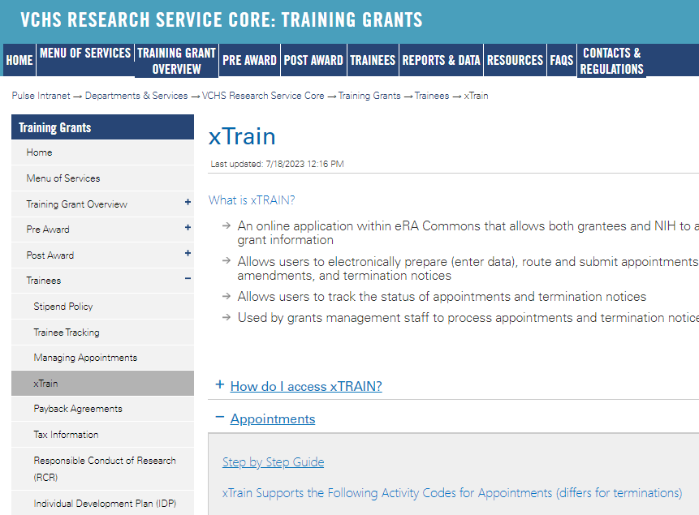
https://pulse.ucsd.edu/traininggrants AD credentials required
Resources
Notes:
If you need to remember one thing.. Its the TG website.

Slide 43
Coming up Next Week
8/3/23
*xTRAIN Terminations, Amendments and Reappointments*

Slide 44
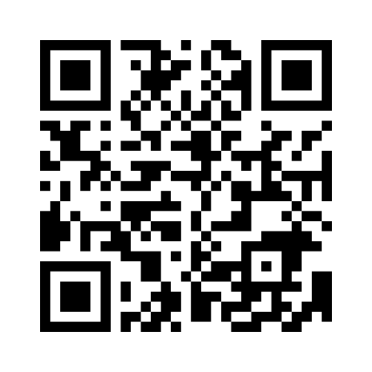
Feedback

