Slide 1
Training Grants Post Award September 10, 2020
Jill I. Weller Training Grant Analyst Research Service Core

Slide 2
Purpose of Post-Award training
Understand NIH TG policy
Importance of Trainee Tracking
NIH xTRAIN
Financial Management
RPPR Progress Report Requirements
Know tools and resources

Slide 3
Presentation Outline
Finish Preaward presentation
Stipend policies
Trainee Tracking
Managing appointments
Tax info
Financial management Q&A with opafs
Annual Progress Report - RPPR

Slide 4
Other Application Components

Slide 5
Samples of Other Components
Facilities & Resources
Abstract
Program Plan
Narrative
- Responsible Conduct of Research
- Recruitment Plan to Enhance Diversity
Animals
Progress Report (Renewals)
Human Subjects
Faculty Bio- sketches
Institutional Commitment Letter

Slide 6
Biosketches

Slide 7
Mentoring Biosketch is different from Research Biosketch
Personal statement should describe commitment to mentoring
Address diversity/inclusion efforts
Address Responsible conduct of Research (RCR)
Format and layout matter
Is the Biosketch consistent with other parts of the application?

Slide 8
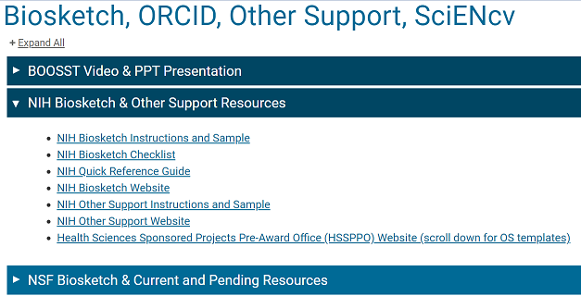
Biosketches
Required for all Key Personnel and Participating Faculty
Should be collated into one PDF and uploaded into ASSIST package
Resources and Samples on Blink:

Slide 9
Institutional Commitment Letter

Slide 10
Institutional Commitment Letter
Per new NIH requirements: NOT-GM-19-017 PAR-19-102
One 10 page letter maximum
Signed by institutional leader (EVC)
Must include information such as:
Harassment and discrimination
How UCSD supports training programs
Diversity and inclusion
https://grants.nih.gov/grants/guide/notice-files/NOT-GM-19-017.html
https://grants.nih.gov/grants/guide/pa-files/PAR-19-102.html

Slide 11
Institutional Commitment Letter
Safety of Trainees
Adequate facilities & resources
Sufficient funds for PI’s that lose funding
Disabilities
Grad Division Commitments
See FOA/NOT for more details
Contact Training Grant Analyst to start the Institutional Letter Process at least 6 weeks before deadline
https://grants.nih.gov/grants/guide/notice-files/NOT-GM-19-017.html
https://grants.nih.gov/grants/guide/pa-files/PAR-19-102.html

Slide 12
Post Award

Slide 13
Stipend Policy

Slide 14
NRSA Support Years
No fellow may receive more than:
Predoc
Postdoc
6 years for dual-degree training, e.g., MD/PhD
5 years of aggregate NRSA support
3 years of aggregate NRSA support
Includes any combination of NRSA support from institutional research TG’s & individual fellowships
- Any exception requires a written waiver from the NIH
https://grants.nih.gov/grants/policy/nihgps/html5/section_11/11.2.6_period_of_support.htm

Slide 15
Basic Stipend Policy
A stipend is provided as a subsistence allowance for NRSA fellows to help defray living expenses
Trainees are not employees of the university and do not receive salary, they receive stipends
Stipends must be paid in accordance with NIH stipend levels, which are based on a 12-month full-time training appointment
https://grants.nih.gov/grants/policy/nihgps/html5/section_11/11.3.6_period_of_support.htm

Slide 16
Budget Period VS Appointment Period
Trainees can be appointed anytime during the budget period
Portions of stipends & tuition that extend beyond the budget period are carried over as unliquidated obligations (subsequent expense)
https://grants.nih.gov/grants/policy/nihgps/html5/section_11/11.3.13_reporting_requirements.htm#Federal

Slide 17
Stipend Policy – Appointments
No trainee may be appointed to a NRSA TG for less than 9 months without prior NIH approval
Early Termination = Revised NOA will be issued

Slide 18
Trainee Application Process

Slide 19
Applying to a Training Grant Program
Every training grant application process is different
Option to use Google form from RSC
Captures necessary tracking information

Slide 20
Communicate program expectations for your mentors/participating faculty and trainees
For example:
Mentors will develop IDP plan with trainee meeting several times per year
Trainees must cite publications properly if the research was funded by the TG i.e. - T32 AG765432
Procure an index from mentor for any shortfalls for tuition/fees or health benefits at the BEGINNING of the appointment

Slide 21
Trainee Tracking

Slide 22
Postaward Training Grant Tracking
Training program info must be recorded, maintained and updated regularly – track everything!
These records are essential for creation of annual progress reports (RPPR’s) & a future renewal proposal
Use Training Tracking Spreadsheet on TG website
Avoid the last-minute struggle to gather info when requested!

Slide 23
Postaward Training Grant Tracking
Four Key areas of trainee tracking:
Applicants (Data Table 6)
Participating Faculty
(Data Table 2)
Current and Past Trainees (Data Table 8)
Track Program Activities (RPPR’s and Renewals)

Slide 24
1. Applicant Tracking – Table 6
Applicant Date
Citizenship
Data Table 6
Anyone that applies to your TG (even if not accepted)
Keep the CV or application, you will need this information for the renewal
Prior Institution
Degree (s)
URM
Disability
GPA
Prior Research
Publications

Slide 25
2. Tracking Participating Faculty (Data Table 2)
Remember this information directly affects other TG’s on campus: i.e., Table 3 Overlapping faculty.
Be sure to update changes in the progress reports (RPPR’s)
Please send jweller@ucsd.edu an updated list as it changes
Department
Admin Contact
Rank

Slide 26
3. Tracking Current & Past Participating Trainees
Entry Date
Citizenship
Data Table 6 & 8
Publications
Prior Institution
Degree (s)
Ethnicity & Race
URM
Disability
GPA
Other Fund Sources at UCSD
Initial Position after UCSD
Current Position
Subsequent Grant Funding

Slide 27
3. Tracking Current & Past Participating Trainees
Data Table 6 & 8
Current Research Category
Mentor while at UCSD
Months of Prior Research
Training Completion
Matriculation
Graduation Dates
Related Coursework
IDP
RCR

Slide 28
4. Tracking Program Activities
Courses Offered & Enrollment
Symposia & Seminars
Poster Presentations
Conference Attendance
Professional Meetings
Career Development Activities
Specialized Training
Regular Program Meetings
Annual Retreats

Slide 29
Website Tool: Tracking Spreadsheet
Applicants
Participating Faculty
Participating Trainees
https://pulse.ucsd.edu/departments/research-service-core/training-grants/trainees/Pages/trainee-tracking.aspx

Slide 30
Important Points to Remember
Set the expectations with mentors before the appointment
Must be appointed at minimum of 9 months
Must be a US citizen of Permanent resident
Trainee tracking is important!
Can start anytime in the project period (even on the last day!)

Slide 31
Appointment Process

Slide 32
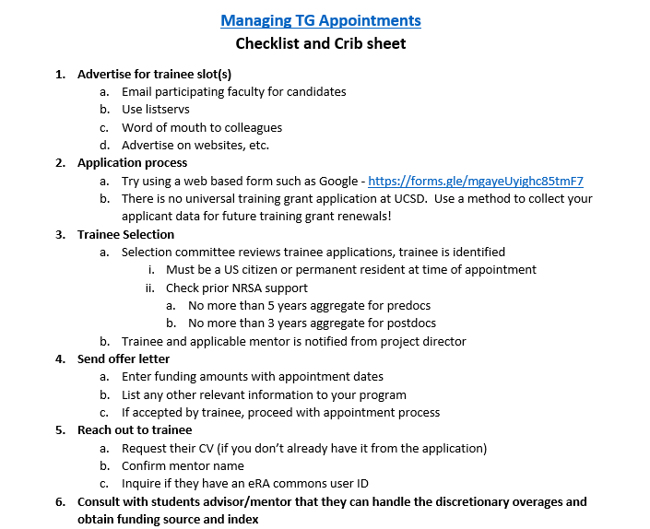
Appointment checklist

Slide 33
Appointment Expectation Letter
Send expectation letter (or conduct an orientation) with relevant information to your program that includes stipend amounts, duration of appointment, tax info, publication info, IDP, RCR, training related expenses, travel, etc.

Slide 34
NIH xTRAIN
Trainee Appointments

Slide 35
What is xTrain?
NIH xTRAIN is part of eRA Commons, an online application that allows both grantees and federal staff to access & share administrative grant information
xTRAIN allows institution users to electronically prepare (enter data), route and submit forms:
Appointments
Re-Appointments
Amendments
Termination Notices

Slide 36
NIH Electronic and Paper Forms
Appointments PHS 2271
Payback Agreement PHS 6031 Paper Format Postdocs Only
Termination Notices PHS 416-7
Completed 30 days after appt. end date

Slide 37
xTrain Codes
For Appointments:
T32, T34, T35, TL1, T15
KL2, K12
R25
For Termination Notices:
T32, T35, TL1
F30, F31, F32, F33
Not all activity codes except both in xTRAIN, will have to send USPS, not all appointments require a termination notice

Slide 38
Initiating an appointment or reappointment
eRA commons account required for trainee
Look up to see if they already have an log-in
Check to see if they have prior NRSA Support
ORCID Account is required
Notes:
ENTER look up here from Biosketch PPT

Slide 39
How do I access xTrain ?
Need NIH eRA commons account
Need ASST role
PI Needs to delegate xTRAIN authority to you

Slide 40
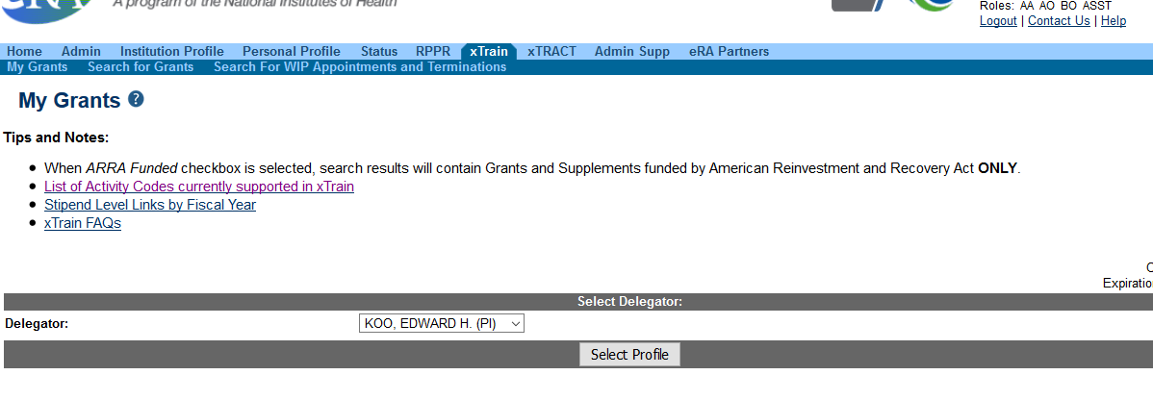
How to Login into xTRAIN
Login to eRA Commons – Live Demo

Slide 41
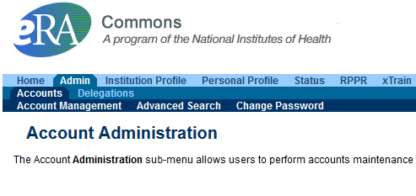
Anyone who has eRA Commons role of AO or SO can verify user ID’s in Commons – can search within or outside our organization

Slide 42
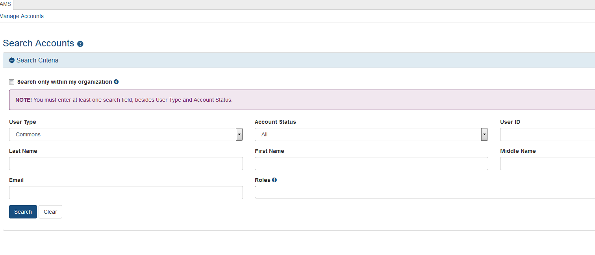
eRA Commons

Slide 43
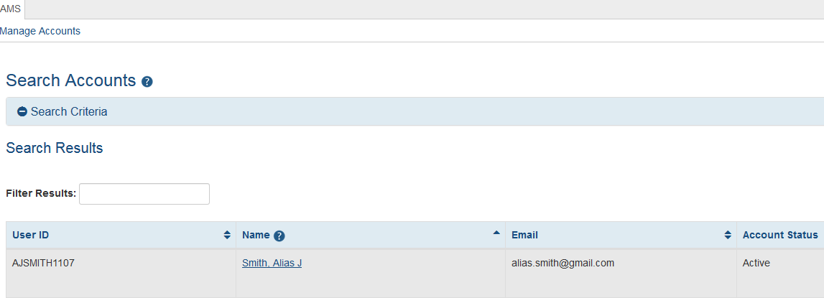
eRA Commons

Slide 44
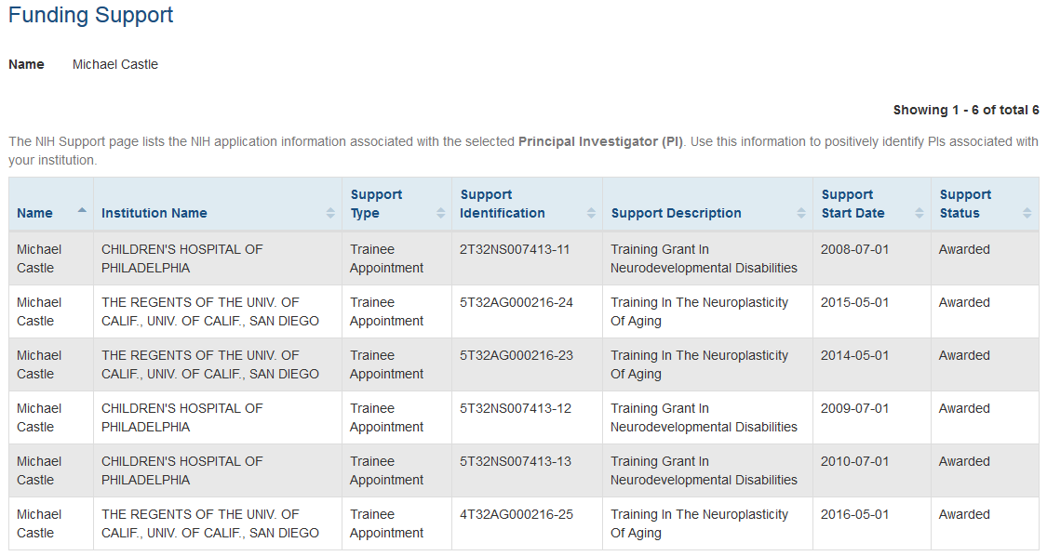
Check prior NRSA support

Slide 45
eRA Commons
Anyone who has eRA Commons role of ASST – only within our organization

Slide 46
eRA Commons

Slide 47
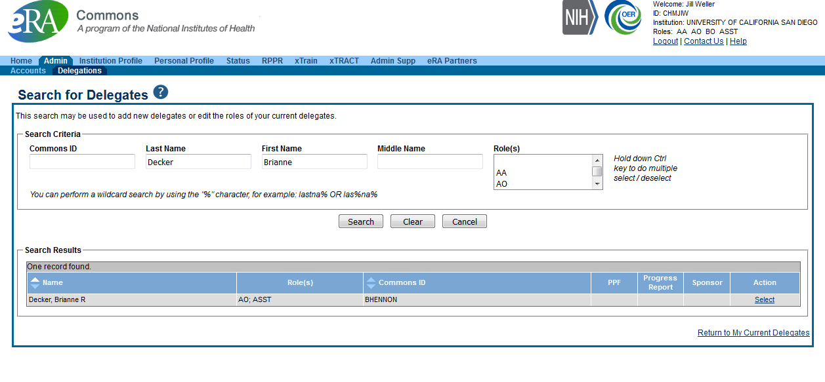
eRA Commons

Slide 48
Need eRA Commons Account?
Health Sciences: Nicole Foshey at nfoshey@ucsd.edu General Campus: era-commons@ucsd.edu
Information needed:
Name
Choose a username
Role
https://blink.ucsd.edu/research/preparing-proposals/sponsors/federal/nih/index.html#Registration-in-eRA-Commons

Slide 50
ORCID
As of October 1, 2019 (FY2020), NIH announced these individuals will be required to have ORCID IDs
Training Grants (T’s)
Fellowships (F’s)
Career Development Awards (K’s)
https://grants.nih.gov/grants/guide/notice-files/NOT-OD-19-109.html
Notes:
Jill

Slide 51
Open Researcher and Contributor iDentifiers (ORCID)
ORCID.org is an independent non-profit organization
A unique and persistent number identifying a researcher
An ORCiD profile is completely customizable by the researcher including what information is publically viewable vs. private
Connects researchers
Notes:
Karen

Slide 52
ORCID
Sign up for an ID
Connect to eRA Commons

Slide 53
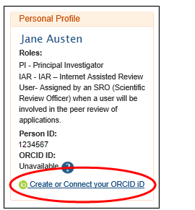
Sign me up!
Start with eRA Commons – look for the link (Create or Connect your ORCID iD
Or, go to orcid.org to create your account
Notes:
Karen

Slide 54
Create or connect your orcid id
Notes:
Karen
For trainees, email may be an issue as you expect them to move on to another position. Our best advice is to use a personal email like gmail so that when they forget their password they will have a way to recover it if they have left UCSD.

Slide 55
If you already have an ORCID iD, click on the Create or Connect your ORCID iD link in your eRA Commons Personal Profile and log into ORCID
Notes:
Karen

Slide 56
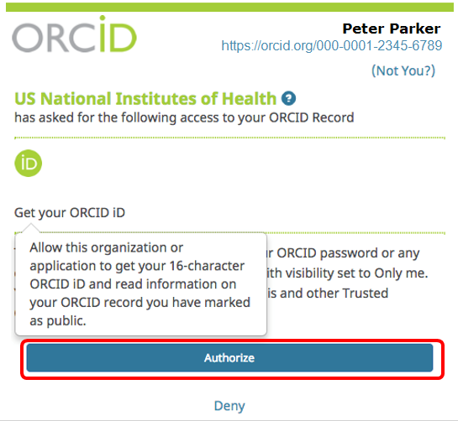
Authorize NIH access to your ORCID profile
Authorize NIH as a trusted organization
Notes:
Karen

Slide 57
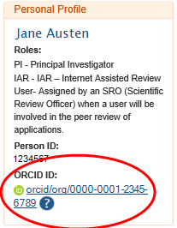
Successfully linked!
Notes:
Karen

Slide 58
Back to xTRAIN appointment..

Slide 59
Initiating an appointment or reappointment
Need this information
Field of training
Period of appointment
Stipend level (amount will be auto populate)
Notes:
ENTER look up here from Biosketch PPT

Slide 60
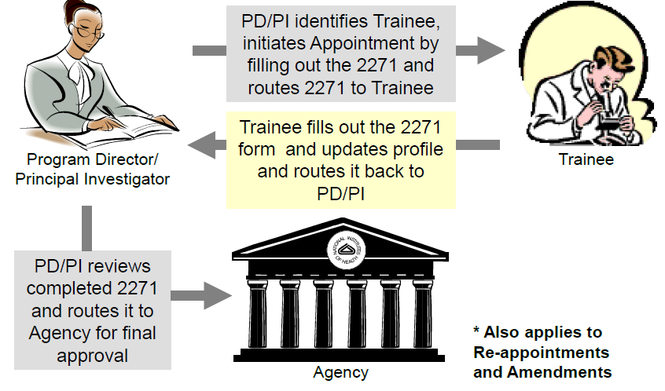
Appointments Reappointments
In Progress Trainee
In Progress PI
Pending Agency Review
Accepted

Slide 61
Reappointments
Trainees whose appointments are coming to an end can be reappointed to grants that have future award years
Use if there is no break in the two appointments
Follow same steps for appointments

Slide 62
Status types for appointments or reappointments
Pending Agency Review
On hold by agency
On hold by agency – Awaiting Paper Signature - Other reason such as waiting on permanent residency card or payback
In Progress PI
In Progress Trainee
Accepted
Terminated

Slide 63
Termination Notices

Slide 64
Initiating a Termination Notice
Should be initiated within 30 days of the end of the appointment
Trainee will need to add progress (scientific) report text
Business Official (BO) will need to verify stipend amounts and dates. Should cross check against UCSD payroll system

Slide 65
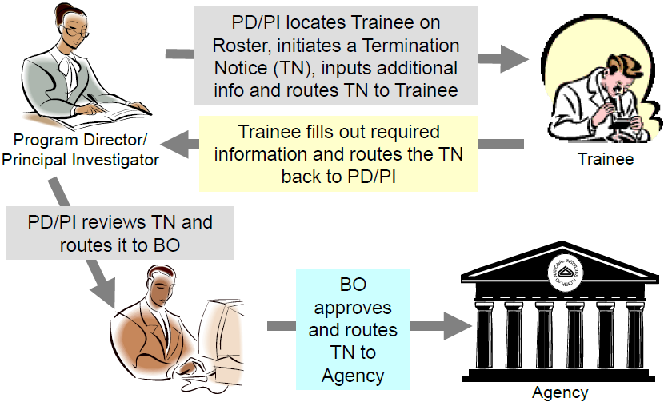
Terminations
In Progress PI
In Progress Trainee
In Progress by BO
Pending Agency Review
Accepted

Slide 66
Status Types for Terminations
In Progress BO
In Progress PI
In Progress Trainee
Pending Agency Review
On hold by agency – Awaiting paper signature (payback)
On hold by agency – Awaiting Award Revision
Accepted

Slide 67
Trainee Appointments @UCSD

Slide 68
Two appointments
Stipend appointment
Salary additional compensation appointment
Paying tuition/fees if applicable

Slide 69
Payback Agreements

Slide 70
Payback Agreement
A payback obligation is incurred for the first 12 months of support for NRSA postdoc trainees
If appointed beyond 12 months, subsequent months of postdoc NRSA supported research training serves to pay back this obligation month by month
https://grants.nih.gov/grants/policy/nihgps/HTML5/section_11/11.4_payback_requirements.htm

Slide 71
Payback Agreement
Postdocs who complete 2 years of training will have fulfilled their payback
Payback means that you will perform qualified activities for a length of time equal to the amount of time you received postdoc training under the NRSA, up to a maximum of one year of payback
https://grants.nih.gov/grants/policy/nihgps/HTML5/section_11/11.4_payback_requirements.htm

Slide 72
Payback Agreement
What qualifies as a Payback?
Research Related Activities
Teaching
Health Related Activities
Payback agreements must be submitted in paper format because it requires original signature (USPS)
Predoc trainees do not incur a payback obligation

Slide 73
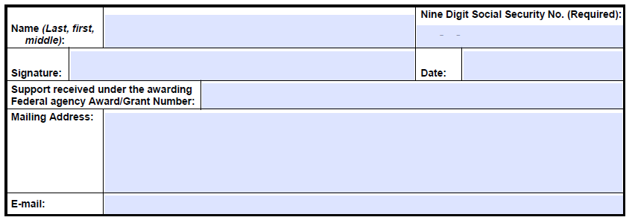
Payback Agreement - PHS-6031

Slide 74
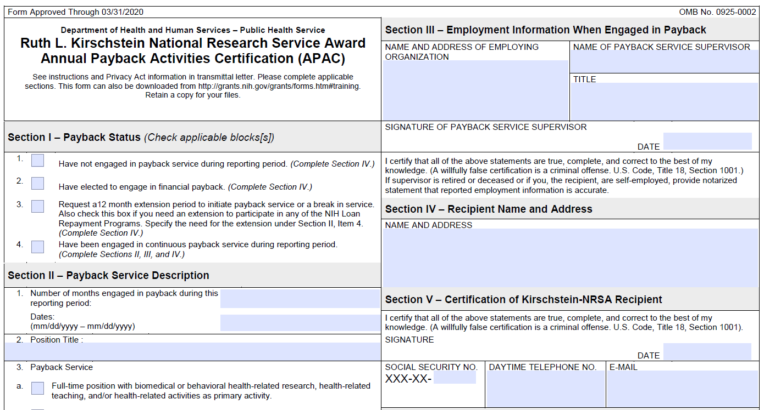
Payback Agreement 6031-1(APAC)
Notes:
Trainee may come to you with this

Slide 75
Trainee Taxes

Slide 76
Stipend and Taxes
No federal and state taxes are withheld from monthly stipend check
Trainee receives gross pay gross pay with no taxes taken (social security, federal, state, Medicare, SDI, etc.)
Trainees are not subject to employer/employee FICA withholding

Slide 77
Stipend and Taxes
Trainee will not receive a W2 for stipend payments
Trainees are not employees of the university
Trainee is required to report stipend payments as “additional income” to the IRS
UCSD does not issue 1099’s at the end of the year

Slide 78
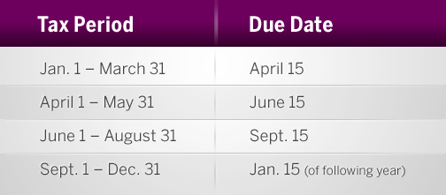
Tax Liability Options
Option to submit federal and state quarterly estimated tax payments by using the Federal Form 1040-ES and California State Form 540-ES
https://pulse.ucsd.edu/departments/research-service-core/training-grants/trainees/Pages/trainee-pay-taxes.aspx

Slide 79
Another Option
Trainees receive a stipend and additional compensation (salary) payments each month and have the option to increase the amount withheld from the salary paycheck to cover any tax liability for the total combined income

Slide 80
Stipend and Additional Compensation | Predocs | Postdoc Researcher | Clinical Resident
NIH Stipend Payment | ProSAM - Student Aid Management System | UC PATH | UC PATH
Additional Compensation | UC PATH | UC PATH | UC PATH
Additional Tax Withholdings from payroll check to cover stipend

Slide 81
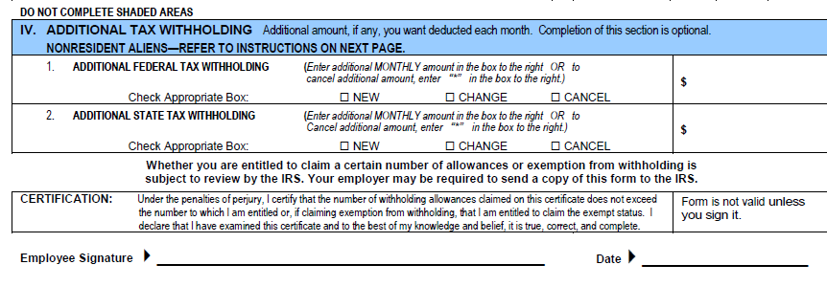
Additional Withholdings
In Section IV of the UC W-4, you may authorize additional federal and state tax withholding

Slide 82
Additional Withholdings
Remember to cancel the additional withholdings when they are no longer receiving stipend payments and receive only GSR or Resident Physician salary

Slide 83
Common Questions about Taxes
Why didn't I receive my W-2?
Stipend payments have not yet been reported to the IRS, it is self-reported on your W-4 as "additional income.“
How do I know how the amount of stipends I received for the last tax year?
Refer to the initial trainee appointment letter for the stipend amount
I received my W-2, but it doesn't list my entire income for last year
Only additional compensation will be on the W-2, the stipend portion is self-reported and not reflected

Slide 84
Travel
Scientific meetings are OK
Foreign travel is OK
Travel not booked in budget period is usually not allowed. IC approval would be required
Training experience away from institution is OK but requires prior IC approval
Can not be carry forwarded as subsequent or unliquidated expenses

Slide 85
Rebudgeting

Slide 86
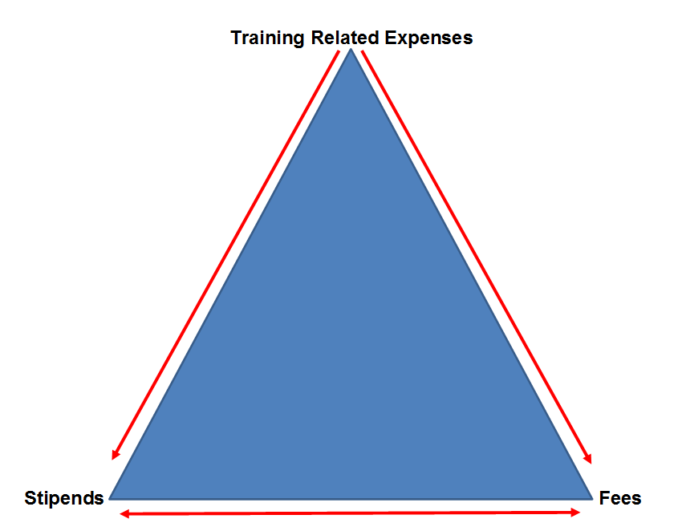
Re-budgeting Guidelines
Allowed to move down
Allowed to move across
Not allowed to move up

Slide 87
Re-budgeting
Can tuition & fees be re-budgeted to training related expenses?
No
Can stipends be re-budgeted to training related expenses?
No
Can stipends be re-budgeted to fees?
Yes
Can fees be re-budgeted to stipends?
Yes
Can training related expenses be re-budgeted to stipends and/or fees?
Yes

Slide 88
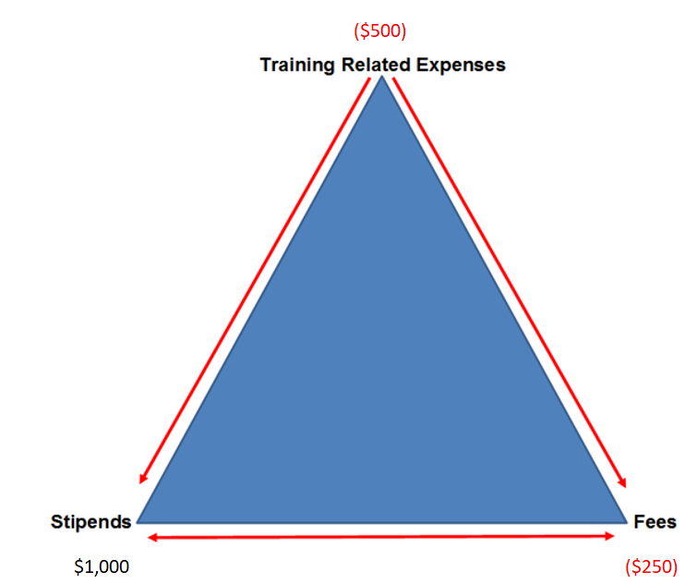
Re-budgeting
What is the FER balance?
TRE= -$500
Fees = -$250
Stipends = $1000
Re-budget $250 from stipends to cover deficit in fees. $1000 - $250 = $750
-$500 is moved off to unrestricted funds
True FER balance in this example = $750

Slide 89
Rebudgeting
A balance in stipends and/or fees mean:
It will need to be reported to the agency – even if the overall fund is in deficit
A balance in stipends and/or fees cannot be used to cover the deficit in training related expenses
Only if you receive written approval from NIH

Slide 90
Unliquidated Expenses

Slide 91
Budget Periods VS Appointment Periods
Trainee stipends and tuition are obligated for the full 12-month appt from the budget period in which the appt. is initiated
Trainees can be appointed anytime during the budget period. Portions of stipends and tuition that extend beyond the budget period are carried over as unliquidated obligations (subsequent expense)
Know your budget start and end dates to effectively manage trainee appts
Use Excel to track appointments year to year

Slide 92
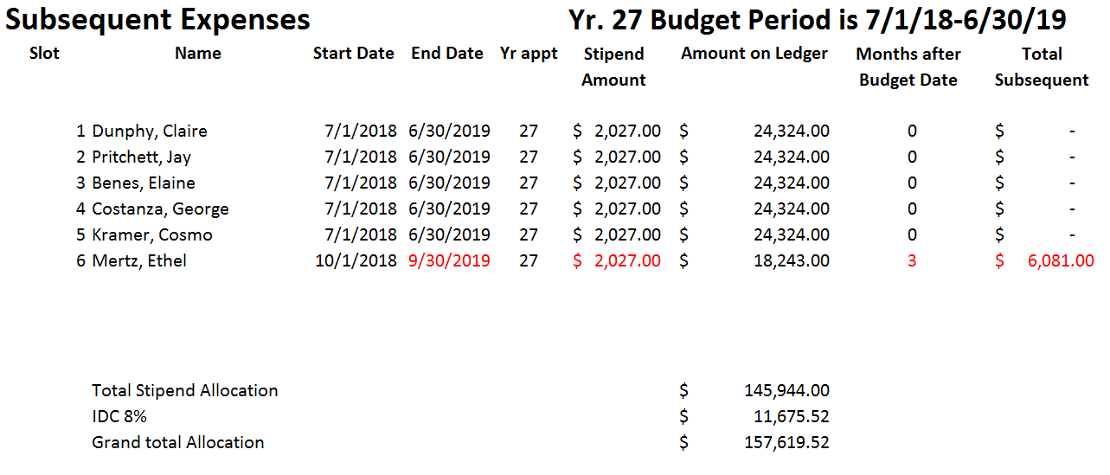
Subsequent (Unliquidated) Expenses
Use the same method for fees and/or health benefits

Slide 93
Financial Management
Wella Garcia – Office of PostAward and Financial Services (OPAFS)

Slide 94
Updates on Known Issues and Changes
PPM and Tasks – default to one project, 3 tasks
Allocations – will follow based on the 3 tasks
Restricted balances would be converted to TRE task. Old 680000. In oracle now called financial resources
What does a TG chartstring look like? 20000 (Oracle) – 20001 UC Path. Paid from ISIS still the same. 780 stipend/fees. 400 - instruction 440 research
Composite Benefits Rates (CBR’s) mask postdoc unallowable benefits

Slide 95
Updates on Known Issues and Changes
Composite Benefits Rates (CBR’s) mask postdoc unallowable benefits
Calculate to move off unallowables
Redirect will hopefully possible
Still waiting on final answer

Slide 96
Updates on Known Issues and Changes
Burden/IDC – no changes 8%. Can charge IDC at the task level.
Redirect of NGN/HSIT charges
Can still redirect
Have expenditure types – wella #1 – to provide later
Stipend Payments not set up for full 12 months, only till end of the project period (unliquidated expenses) – UC Path
Clinical Researcher stipends now processed in UC Path

Slide 97
Progress Reports (RPPR’S)

Slide 98
Annual Reporting (RPPR)
RPPR’s are due approximately 60 days before project end date
Except at the end of the project period, then the progress report is submitted with the renewal application
Always check eRAcommons for the correct date
Some T32's RPPR's are off schedule. e.g., NIGMS are due 11/15

Slide 99
RPPR
B.4 - What opportunities for training and professional development?
Insert trainee summaries – should be a few paragraphs
Individual Development Plans
Describe how they were used in this reporting period to help manage the training and career development of the trainees/scholars (do not include actual IDPs)
Trainee diversity form
http://grants.nih.gov/grants/funding/2590/2590.htm

Slide 100
RPPR
Table 8a/b/c – MUST BE COMPLETED IN XTRACT
Part I (Those appointed to the grant)
Part II (Those clearly associated with the grant)
Provide updated trainee or current clearly associated student information, reflecting new appointments/entrants and other changes over the last reporting period
Part IV – Program statistics
Summarize this data in the Accomplishments Section B.4, in responding to the question, “What opportunities for training and professional development has the project provided?”

Slide 101
RPPR
C.1 - Publications during the reporting period
Report publications that were accepted during the reporting period and resulted from work conducted while a trainee was supported by the award
Publications must be entered into the PI’s MyNCBI and must be associated with the training grant
D.1 - What individuals have worked on the project?
Only address key personnel here (PD/PI). Do not report personnel for whom a PHS 2271 appt. form has been submitted through xTRAIN, do that in B.4.

Slide 102
Annual Reporting (RPPR)
D.2b - New senior/Key personnel
Add Biosketch and other support for new participating faculty
G.2 - Responsible Conduct of Research
Should be updated annually by PI
Include a description of any enhancements from the plan described in the competing application
H - Budget for next budget period
(KR record is required)
Select PHS398 from drop down menu

Slide 103
Important Points to Remember
RPPR requires Table 8 and trainee summaries
Use a trainee form or Google form to collect information from your trainees
Publications can be tricky in MyNCBI because the PI isn’t necessarily on the publication

Slide 104
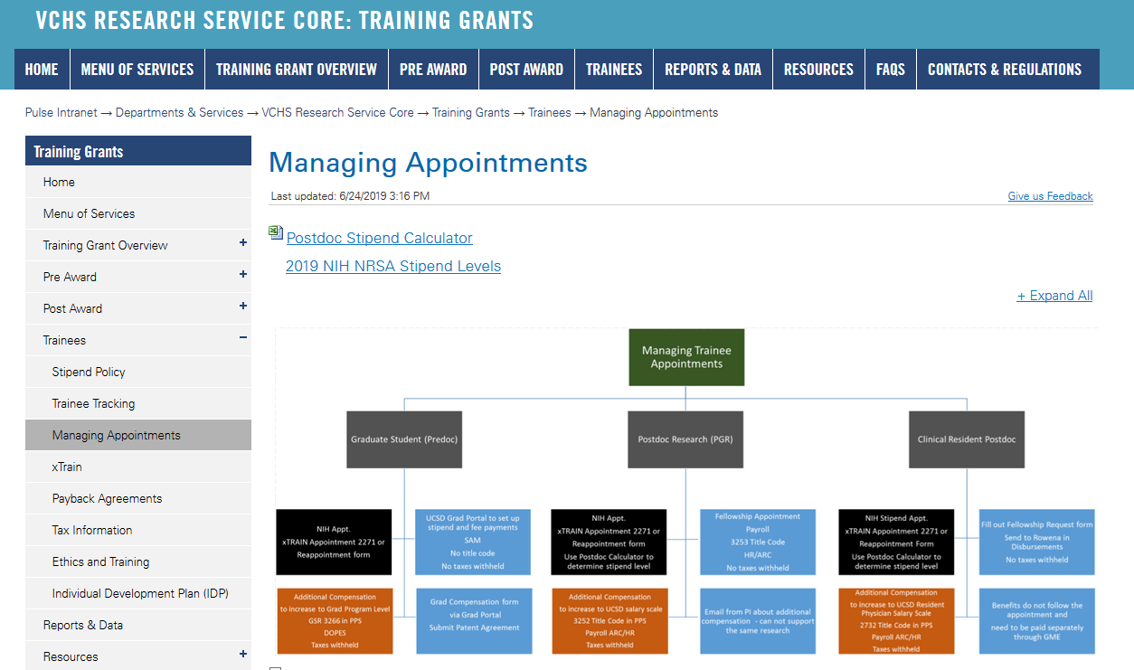
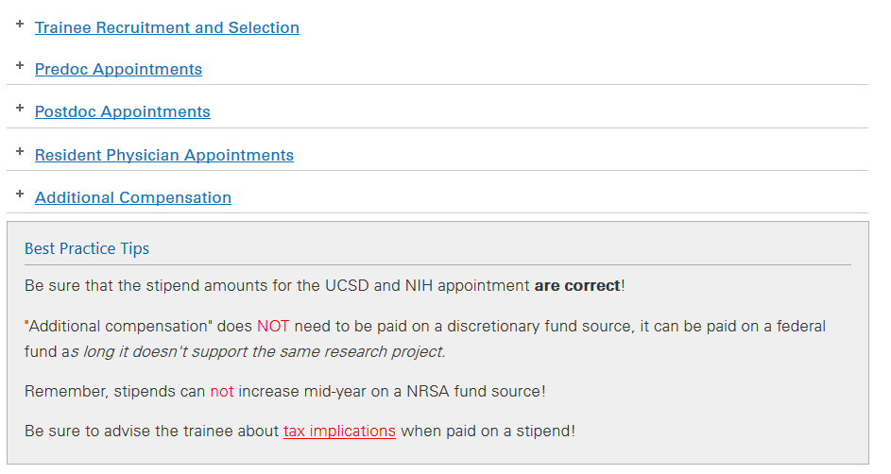
Website resources

Slide 105
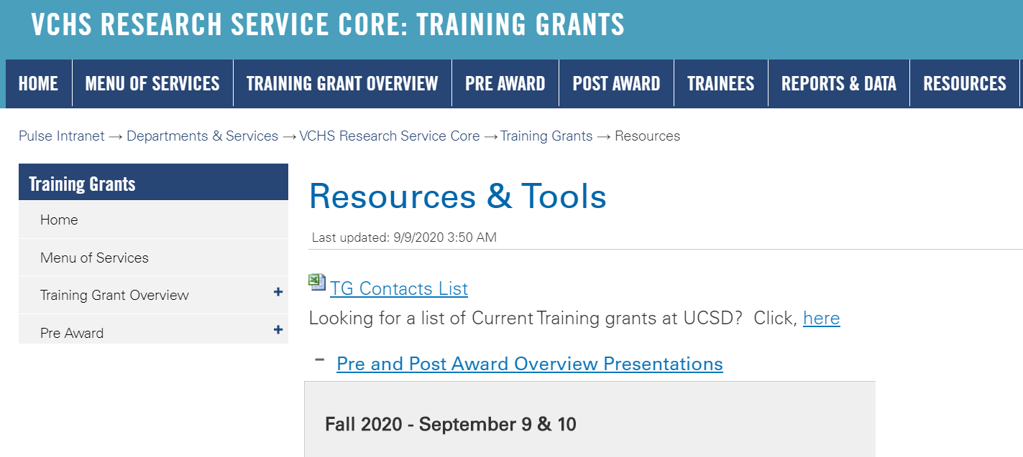
Training Grant Presentations
Notes:
Update this slide

Slide 106
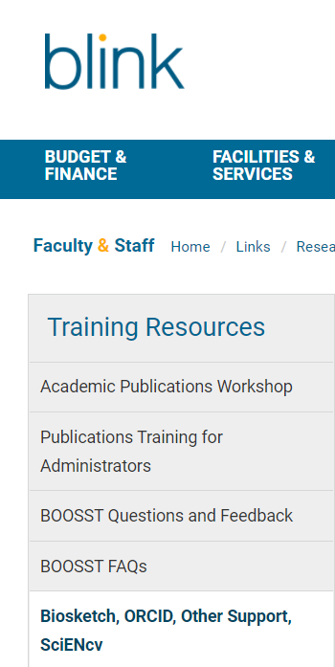
Website Resources – Search “RSC” in Blink
http://blink.ucsd.edu/sponsor/rsc/training-resources/index.html

Slide 107
Please fill out the eSURVEY
and let me know how I can improve on this course!
Jill I. Weller
Training Grant Analyst
X43933
jweller@ucsd.edu
Questions?

