Slide 1
Admins Guide to Training Grant RPPR’s
February 14, 2018
Jill I. Weller
Training Grant Analyst
Research Service Core
X43933
jweller@ucsd.edu
Karen Heskett
Librarian
X41199
kheskett@ucsd.edu

Slide 2
Purpose & Objectives
How to complete an NIH Training Grant RPPR – (Research Performance Progress Report) from an administrator perspective
Understand the differences between a Research RPPR and a Training RPPR

Slide 3
Presentation Outline
RPPR Sections
Section A. Cover Page
Section B. Accomplishments
Trainee Summaries
Data Table 8
Trainee Diversity Form
Section C. Products (Publications)
Section D. Participants
Biosketch and/or other support

Slide 4
Presentation Outline
RPPR Sections (Cont.)
Section E. Impact
Section F. Changes
Section G. Special Reporting Requirements
Responsible Conduct of Research
Section H. Budget (Exercise)
Tools & Resources
Questions

Slide 5
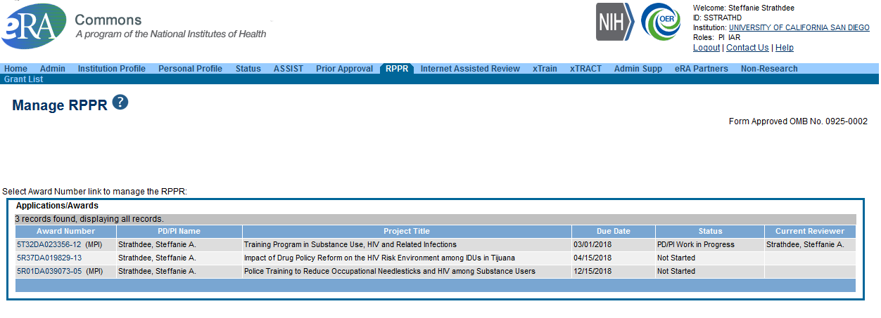
Getting Started
Log in to eRA commons as PI to initiate from the RPPR or status page

Slide 6
Getting Started

Slide 7
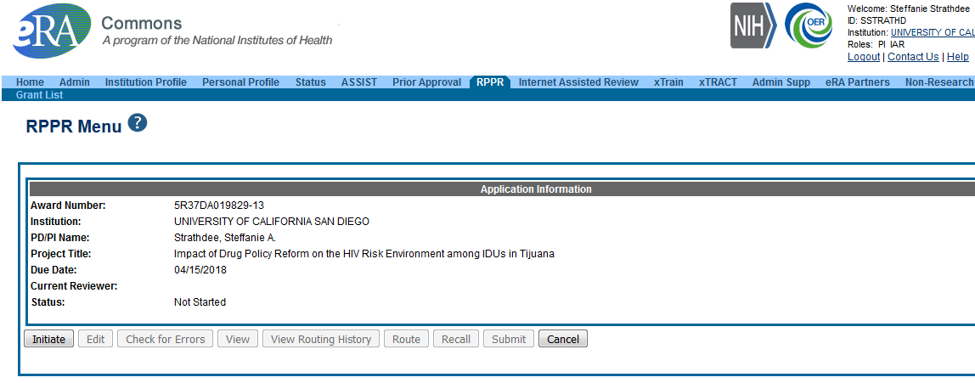
Getting Started

Slide 8
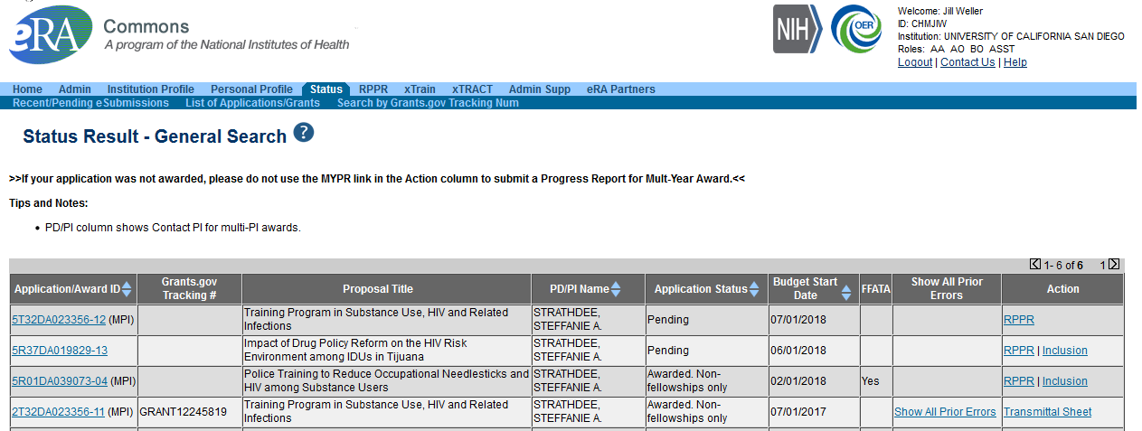
Getting Started – Admin view

Slide 9
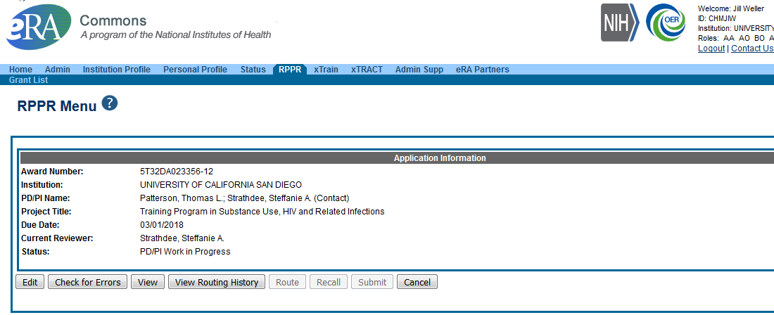
Getting Started – Admin view

Slide 10
Section A. Cover Page
Cover Page

Slide 11
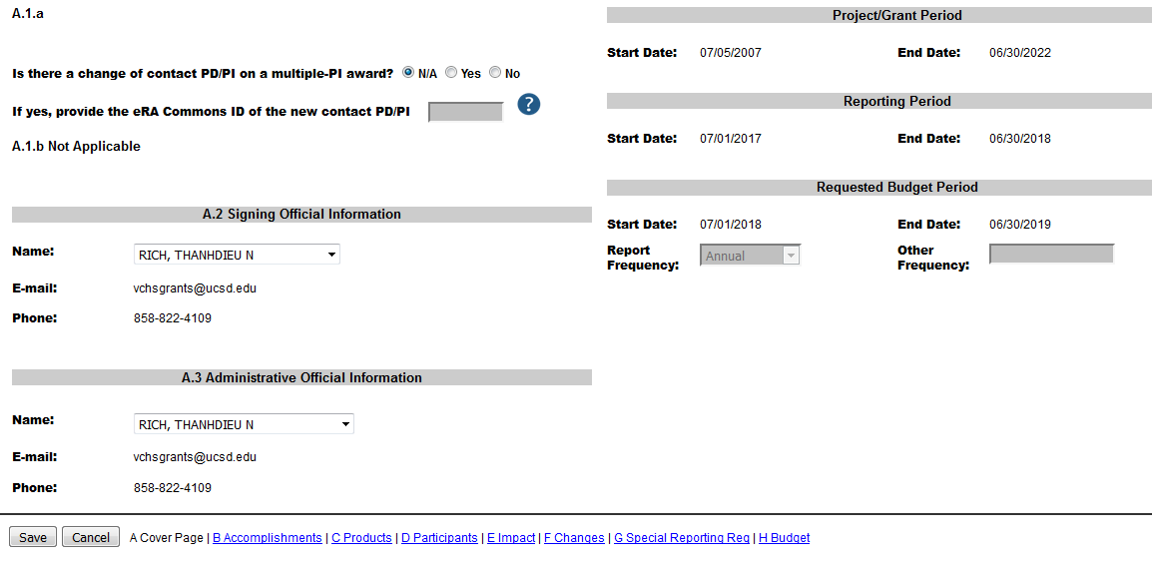
Section A. Cover Page
Mostly prefilled data from eRA Commons
Confirm Signing & Administrative Officials
Confirm Project Dates & Reporting Period

Slide 12
Keep in mind
Save often and before navigating to the next screen!

Slide 13
Section B.
Accomplishments

Slide 14
Section B. Accomplishments
B.1 - What are the major goals of the project?
Text should match project goals as stated in the approved application
B.1.a - Have the major goals changed since the initial competing award or previous report? Yes or No
B.2 - What was accomplished under these goals?
PDF upload
B.3- Competitive Revisions/Administrative Supplements

Slide 15
Section B. Accomplishments
B.4 - What opportunities for training and professional development has the project provided?
Trainee progress report summaries include:
Mentor
Any applicable coursework
Degrees
Description of research project and progress

Slide 16
Section B.4 – Trainee Summaries (Cont.)
Attended conferences
Presentation
Fellowships
Workshops
Career development activities

Slide 17
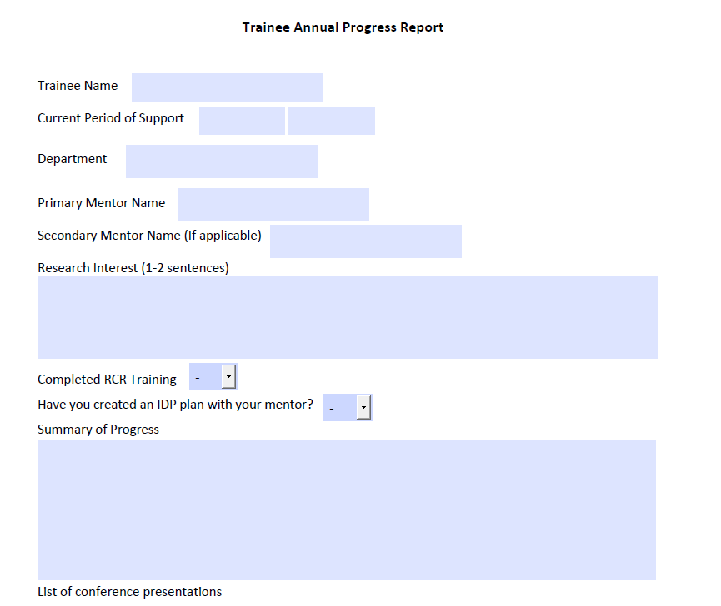

Slide 18
Section B.4 – Example

Slide 19
Section B.4 - (Continued)
B.4 - What opportunities for training and professional development has the project provided?
Individual Development Plan (IDP)
Do not include, but PI needs to write summary
Table 8 (Parts I, II & III)

Slide 20
Section B.4 What is Table 8?
Program Outcomes
Effectiveness of the training program
Extended the tracking of trainee outcomes from 10 to 15 years

Slide 21
Section B.4 Table 8 Instructions
Part I. Those Appointed to the Training Grant
Provide updated trainee student information, reflecting new appointments/entrants and other changes over the last reporting period
Cumulative up to 15 years
Use xTRAIN for trainee names
Notes:
FIX ANIMATIONS?

Slide 22
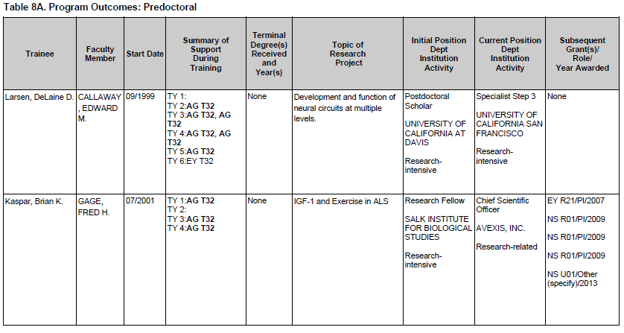
Section B.4 Table 8 Instructions
1. Add the middle initial to first and last name
2. Faculty Mentor
3. Calendar month and year of entry (MM/YYYY format) into the current program

Slide 23
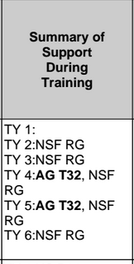
Section B.4 Table 8 Instructions
4. Provide the primary source and type of support during each 12-month period of training, using TY1 for Training Year 1, etc.
For NIH and other HHS support, list the awarding component and the activity (e.g., CA R01).
Bold the grant being reported in this application
Sources of Support
• NSF
• Other Federal (Other Fed)
• University (Univ)
• Foundation (Fdn)
• Non-US (Non-US)
• Other (Other)
Types of Support
• Research assistantship (RA)
• Teaching assistantship (TA)
• Fellowship (F)
• Training Grant (TG)
• Scholarship (S)
• Other

Slide 24
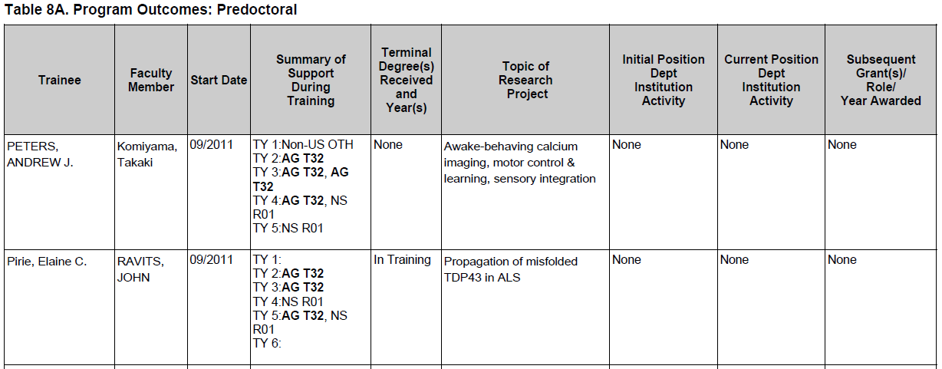
Section B.4 Table 8 Instructions
5. For predocs, list the terminal degree received and year awarded.
Trainees currently in the program should be designated “in training” Those who have left the graduate program without a degree, report “none.”
2. For postdocs, list the doctoral degree and year. (MM/YYYY format)
6. For postdocs, list degree resulting from postdoc training, usually “none.”
6/7 Topic of Research Project is now up to 200 characters (was 80)

Slide 25
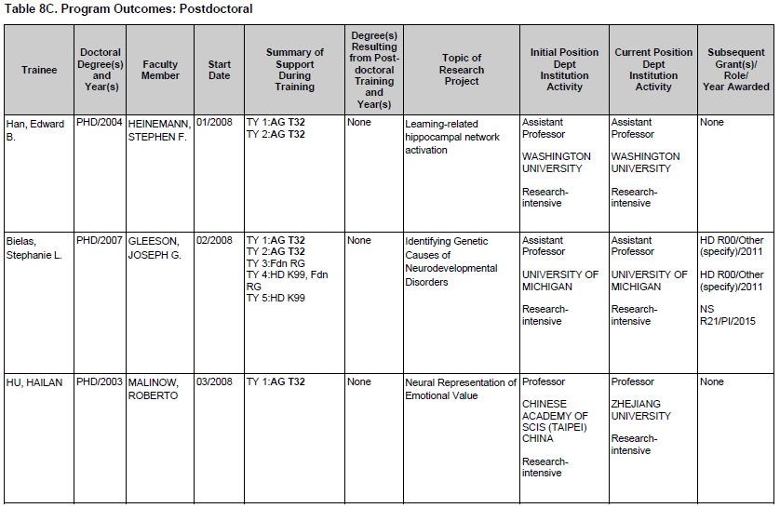
Section B.4 Table 8 Instructions
8. For trainees who completed or left the program, provide their initial and current positions, departments, and institutions
Classify each position as predominantly:
Research-intensive
Research-related:
Teaching
Administering research
Science policy
Technology transfer
Further Training
Other
If information is not available, report “unknown.”

Slide 26
Section B.4 Table 8 Instructions
9. If applicable, list the type of
support after complete training:
Subsequent fellowship
Career development
Research grant
The support can be obtained
from any source whether as
PD/PI or in another senior role:
Co-I
Faculty collaborator
Staff scientist
For NIH and other HHS
support, list the award in this
format: GM R01/PI/2011
Up to five grants may be
listed

Slide 27
Table 8 Part II. Those Clearly Associated with the Training Grant

Slide 28
Section B.4 Table 8 - Part II. Those Clearly Associated with the Training Grant
Current pre or postdocs who have a training experience identical to those appointed to this grant and they must have been or currently are funded by another HHS or NIH mechanism (fellowship, R01, etc.—even for a short time). Can be either TGE or non-TGE (non-citizen). Eligibility is NOT a factor here.
Users should initially report only current “clearly associated” students. Then in each subsequent year, they should continue to add new entrants & provide updated information about current & past clearly associated students until 15 years of data have been completed

Slide 29
Section B.4 Table 8 - Parts III & IV
Part III. Recent Graduates
not applicable
PI needs to summarize this data
Notes:
Split slide, small font

Slide 30
Section B.4 Tips for gathering data
Use Linkfamily to look up fund sources
PPS
Querylink
Employee History
Email
Keep good continuous records

Slide 31
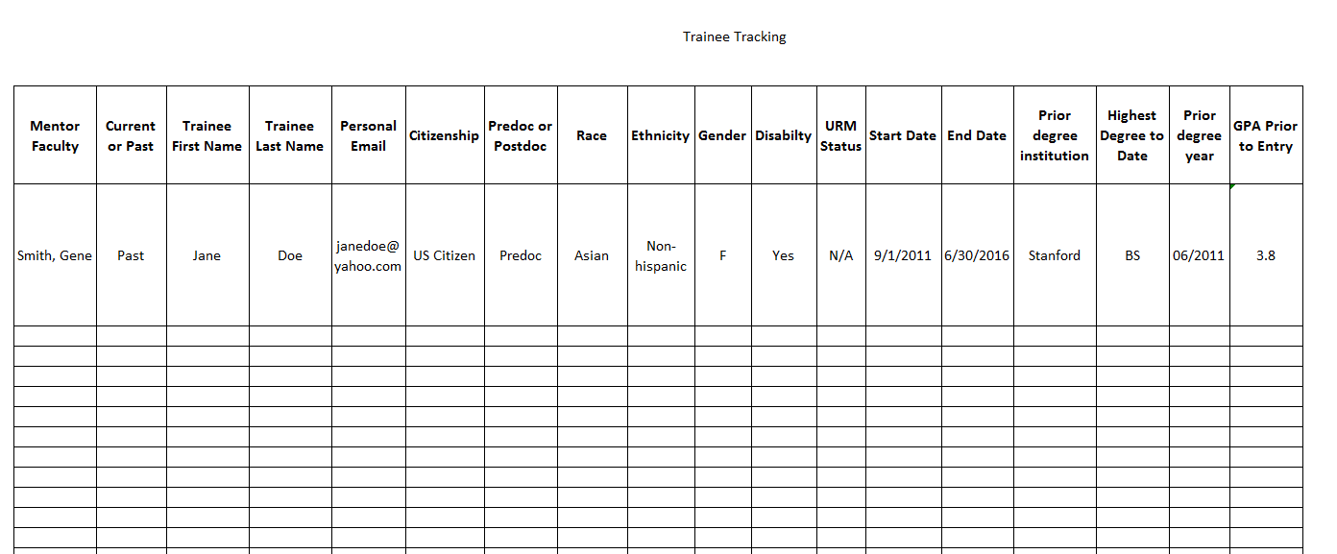
Section B.4 Trainee Tracking

Slide 32
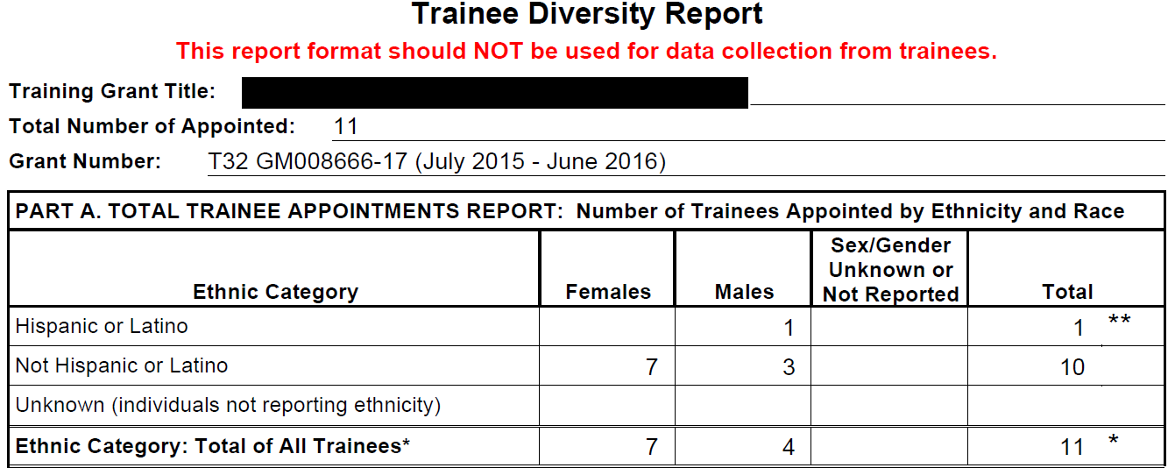
Section B.4 - (Continued)
Trainee Diversity Form
http://grants.nih.gov/grants/funding/2590/2590.htm

Slide 33
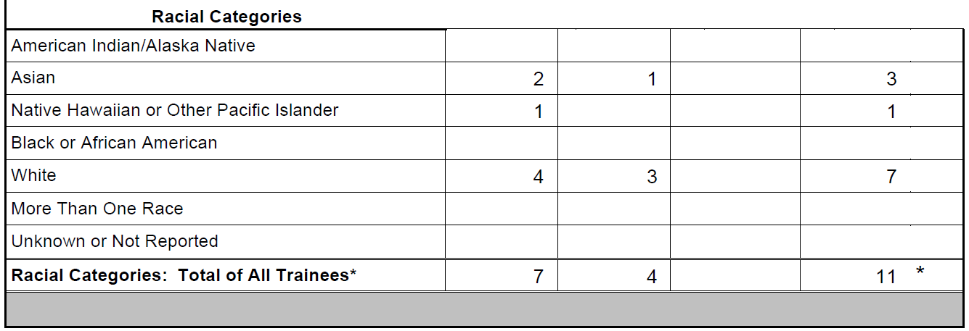
Section B.4 Trainee Diversity Form

Slide 34
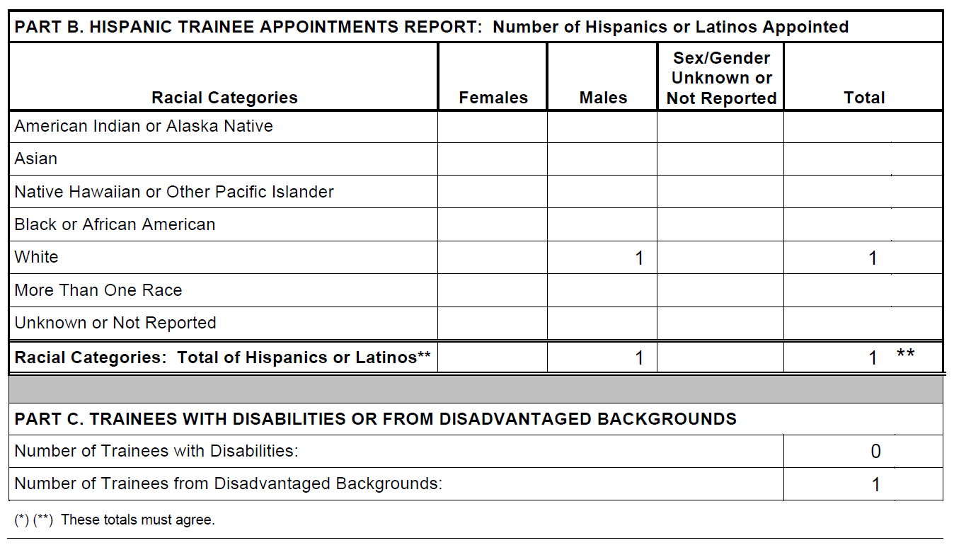
Section B.4 Trainee Diversity Form

Slide 35
Section B.4 PDF Upload
B.4 – When all components are complete, collate into one PDF and upload
Trainee Summaries
Individual Development Plan (IDP) Summary from PI
Table 8 Part I, II & III
Table 8 Part III Summary from PI
Trainee Diversity Form

Slide 36
Section B. Accomplishments
B.5 - How have results been disseminated to communities of interest?
Nothing to report or enter text. Usually, not applicable
B.6 - What do you plan to do for the next reporting period to accomplish the goals?
PI enters response in text box

Slide 37
Section C.
Products

Slide 38
Section C. Products
C.1 - Publications
C.2 – Website
Not applicable
C.3 – Technologies or Techniques
Not applicable
Notes:
Jill’s section

Slide 39
Section C. Products
C.4 – Inventions, Patent Applications and/or Licenses
Not applicable
C.5 – Other Products and Resources
Nothing to report or provide description types. Usually not applicable
C.5.a – Other Products
Usually not applicable
C.5.b – Resource Sharing
Not applicable
Notes:
Jill’s section

Slide 40
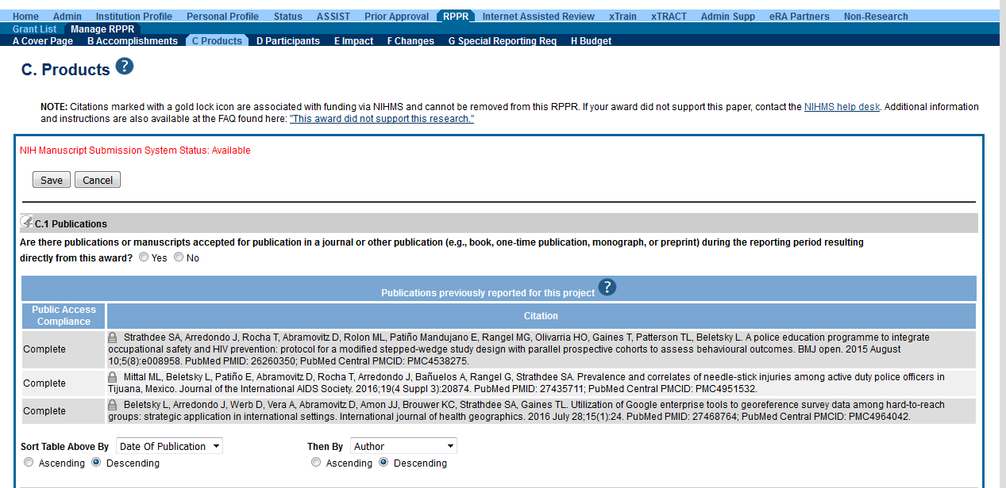
Default screen in RPPR module
The publication was accepted for publication or made public during the reporting period Report publications directly arises from the grant award
Notes:
clean up this slide, and remove middle portion not associated

Slide 41
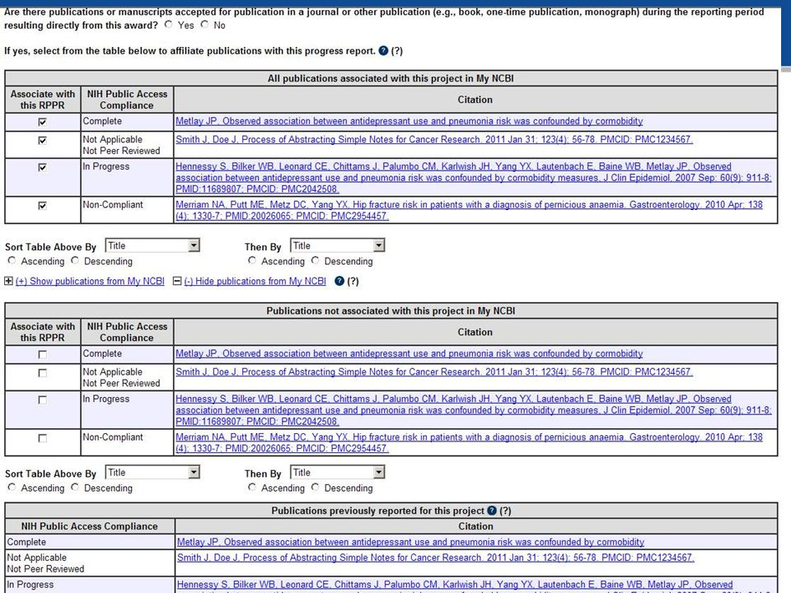
Table 1: Pubs that have not yet been reported
Table 2: Pubs NOT associated with this project in My NCBI
Table 3: Pubs that were previously reported, need to check compliance
Notes:
clean up this slide, and remove middle portion not associated

Slide 42
Associate with RPPR - defaulted to YES
Important things to remember:
If a publication is not in My NCBI, will not appear
If a pub is missing it must be added to My NCBI to appear in list
After adding the publication, it will become available to choose in the RPPR
Compliance is drawn from My NCBI:
Non-compliant pubs can not be corrected in the RPPR, only in MyNCBI
Notes:
clean up this slide, and remove middle portion not associated

Slide 43
Managing Compliance in MyNCBI
Non-compliant
In Process
Compliant
Unknown Status
RPPR can still be submitted with noncompliant pubs, however NIH will not issue the next year of funding until all publications are compliant
Grantee is responsible for compliance
Can take weeks to bring publications to compliance
Notes:
When the progress report is submitted to the agency, the publication data is frozen in the progress report

Slide 44
How to respond to a PRAM
What happens if you submit an RPPR with noncompliant publications?
Auto email - Progress Report Additional Materials (PRAM) sent to PI
PI initiates action in eRA Commons
Search grants, click on Public Access PRAM under Actions

Slide 45
How to respond to a PRAM
Either PI or assistant verifies compliance
Troubleshoot issue – Live Demo
Once all publications are compliant, generate a My NCBI PDF Report and upload via eRA Commons
Routed to SO (HSSPPO/OCGA) for submission to NIH
NIH preferred method

Slide 46
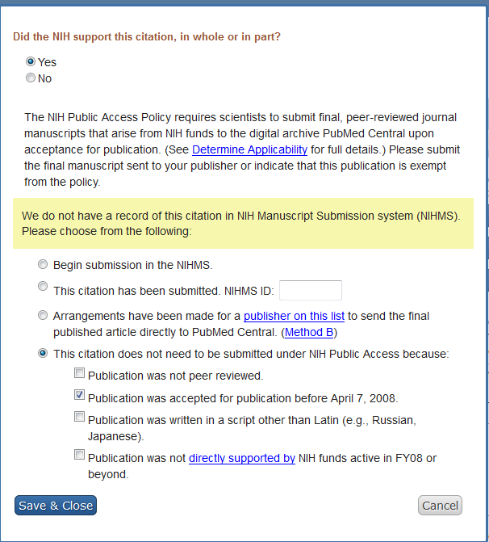
MyNCBI
screenshot

Slide 47
What AA’s Need to Know about Manuscripts
Article vs. Manuscript
Peer-review

Slide 48
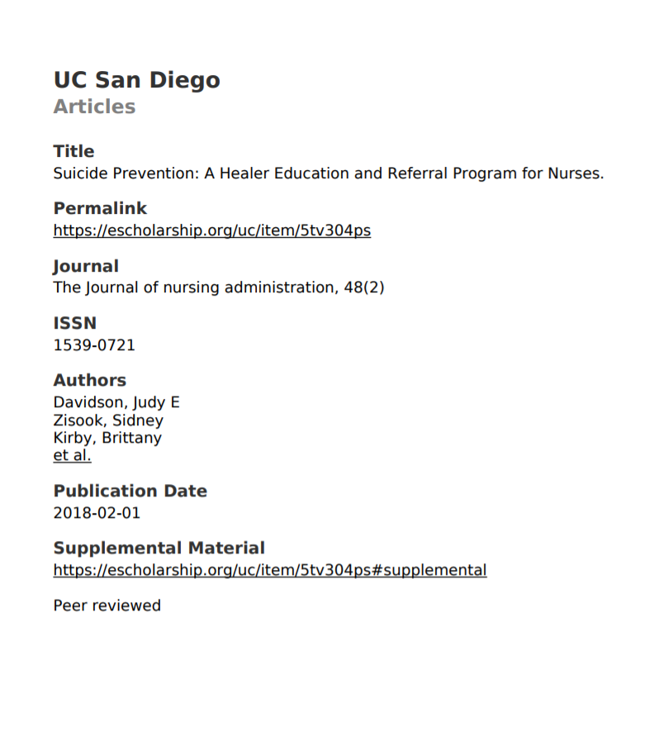
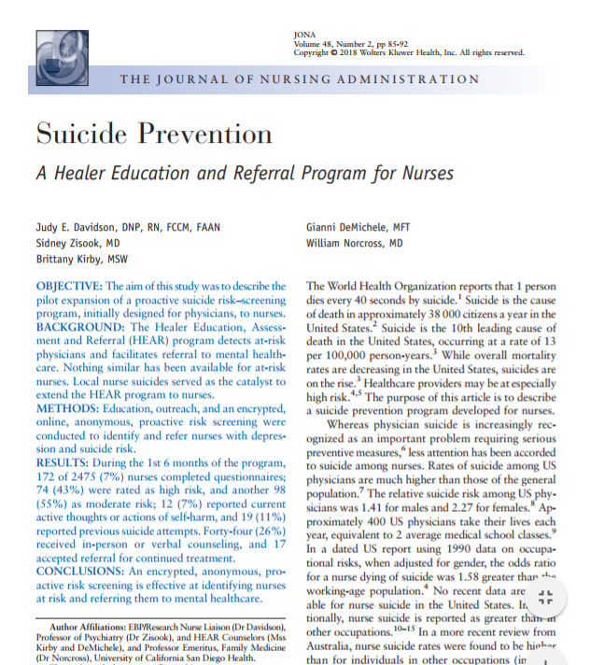
We are talking this and not the journal’s PDF.

Slide 49
Peer Review (aka refereed)
The peer reviewer (an expert on the article’s topic) helps the publisher decide whether the work should be accepted, considered acceptable with revisions, or rejected

Slide 50
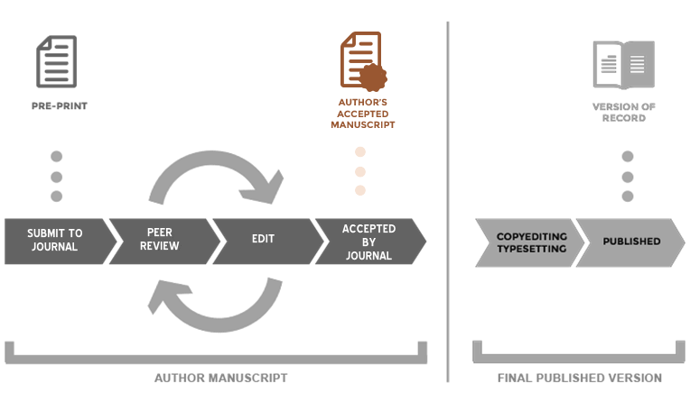
For PMC, What is the “Author Manuscript?”
Version of a paper that has been though peer review, has had author changes, and re-submitted & accepted for publication by the journal
from https://www.ncbi.nlm.nih.gov/pmc/about/authorms/

Slide 51
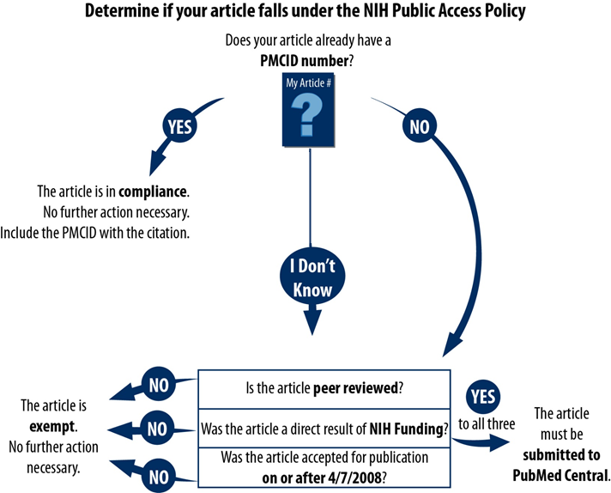
Public Access Policy
What does NOT apply to Public Access Policy?
Dissertations
Non peer reviewed materials
Non NIH research
adapted from http://guides.lib.umich.edu/nihpublicaccesspolicy

Slide 52
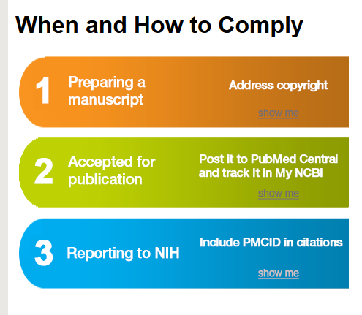
Public Access Policy - Compliance
Requires that papers related to research funded by the NIH must be available to the public free (in full text) through PubMed Central within 12 months of publication
But …
If the journal does not submit it, the author has that responsibility, and the manuscript needs to be deposited in the NIHMS system within 3 months after it is accepted (with an embargo)
No compliance = no future funding
Notes:
Clean up this slide

Slide 53
Method
 | Who Deposits? | What’s Next | Then What is Needed? | And Finally
A | Journal deposits the published version of all NIH funded articles in to PMC | Article is compliant
B | Author arranges to have Journal deposit the published version of specific NIH funded article in to PMC | Author is responsible to confirm the deposit in PMC
C | Author, or delegate, submits final peer reviewed manuscript to the NIH Manuscript Submission (NIHMS) system | NIHMS system sends an email asking author to approve submitted materials for processing | Author reviews & approves the PMC formatted PDF of the manuscript
D | Journal publisher submits final peer reviewed manuscript to the NIHMS system. | NIHMS system sends an email asking author to approve the submitted materials for processing | Author reviews & approves the PMC formatted PDF of the manuscript
PubMed Central Submission Methods

Slide 54
Method
 | Who Deposits? | What’s Next | Then What is Needed? | And Finally
C. | Author, or delegate, submits final peer reviewed manuscript to the NIH Manuscript Submission (NIHMS) system | NIHMS system sends an email asking author to approve submitted materials for processing | Author reviews & approves the PMC formatted PDF of the manuscript
PubMed Central Submission Methods

Slide 55
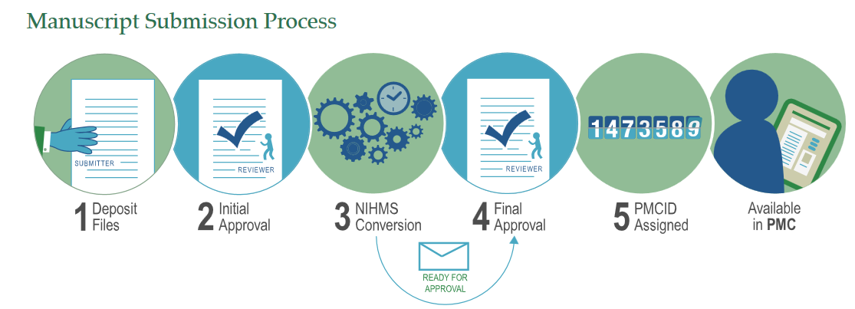
NIH Manuscript Submission System (NIHMS)
Method C. Author self-submits publication to NIHMS
https://www.nihms.nih.gov/db/sub.cgi
Notes:
Jill to clean up this slide
IHMS system supports the deposit of manuscripts into PubMed Central (PMC), as required by the public access policies of NIH and other participating funders

Slide 56
What is an ?
Embargo
There is a delay, as specified by the publisher, between when the article is published and when its full version can be made freely available in PMC
For NIH research, the embargo period can be no longer than 12 months

Slide 57
Managing Publications with MyNCBI
My NCBI
Space at the National Library of Medicine to help with the publication process and customize Pubmed
My can be linked to

Slide 58
My NCBI Tool - My Bibliography
My Bibliography
Provides a centralized place where
Individual’s citations are easily accessed, exported, or even shared
NIH’s way to manage grant-related publications
My Bibliography can be populated from:
PubMed
Manually entered
Bulk upload
Associate publications in with grants using
Notes:
Jill to rephrase last bullet point

Slide 59
My NCBI - My Bibliography
Why is My Bibliography important?
Citations must be added to My Bibliography to ensure that they appear in eRA Commons and thereby become associated with future annual progress reports (RPPR’s)
Notes:
Demo of Karen’s bibliography
How to add citations
Maintain citations
Deleting citations
Searching
highlights
narrowing results
Setting up alerts

Slide 60
Pubmed VS PMC
Search engine that includes the Medline database with citations from over 5,600 journals - current tally is over 28 million citations in PubMed
PMC - A free digital repository that archives publicly accessible full-text scholarly articles that have been published within the biomedical and life sciences journal literature and currently has 4.5 million articles
Notes:
CLean up slide alignments and fonts

Slide 61
Identification Numbers
PMID – Unique identifier number used in PubMed
PMCID -The number assigned once it is accepted into PubMed Central
What’s the difference between the two?
The PMCID links to full-text papers in PubMed Central
The PMID links to abstracts in PubMed
Notes:
First author or delegate is responsible for obtaining PMC
Who has seen an NIHMS #?
PubMed Central is an index of full-text papers, while PubMed is an index of abstracts.

Slide 62
Managing Compliance in MyNCBI
Non-compliant
In Process
Compliant
Unknown Status
RPPR can still be submitted with noncompliant pubs, however NIH will not issue the next year of funding until all publications are compliant
Grantee is responsible for compliance
Can take weeks to bring publications to compliance
Notes:
When the progress report is submitted to the agency, the publication data is frozen in the progress report

Slide 63
What do I do When MyNCBI Bibliography Shows …
Add the grant information
One of the compliance icons will appear

Slide 64
What do I do When MyNCBI Bibliography Shows …
Have a cup of tea and relax – it is compliant and requires nothing more

Slide 65
What do I do When MyNCBI Bibliography Shows …
A good sign – the compliance process has started
It may not need more action if a recent article
But, if more than 12 months old, something has stalled in the manuscript submission process – it needs checking out

Slide 66
What do I do When MyNCBI Bibliography Shows …
Yikes! It is not in compliance
The manuscript submission process has not been started
What comes next depends on a number of factors

Slide 67
First Things First
Check to see if the article acknowledges grant funding using either
The PubMed record
Get the full-text of the PDF
If no grant is listed, then there isn’t anything further to do, except letting the PI know
If a grant is listed, then you need to find one of the authors and help them start the NIHMS process

Slide 68
Let’s Play Stump the Librarian …
What are your questions?

Slide 69
Section D.
Participants

Slide 70
Section D. Participants
D.1 - What individuals have worked on the project?
Provide or update information for PD or PI ONLY
Do not report personnel (trainees) for whom a PHS 2271 appointment form has been submitted through xTRAIN

Slide 71
Section D.2 Participants
D.2 – Personnel Updates
D.2.a – Level of Effort (for PI or PD)
Will there be, in the next budget period, either:
a reduction of 25% or more in the level of effort from what was approved by the agency for the PD/PI(s) or other senior/key personnel designated in the NOA
OR
(2) a reduction in the level of effort below the minimum amount of effort required by the Notice of Award?
Usually no, because no paid effort for PI

Slide 72
Section D.2 Participants
D.2.b - New Senior/Key Personnel Yes or No
Are there new participating faculty (mentors)?
If yes, provide biosketches and other support
D.2.c - Changes in Other Support? Yes or No
Change in active support for key personnel since last reporting period

Slide 73
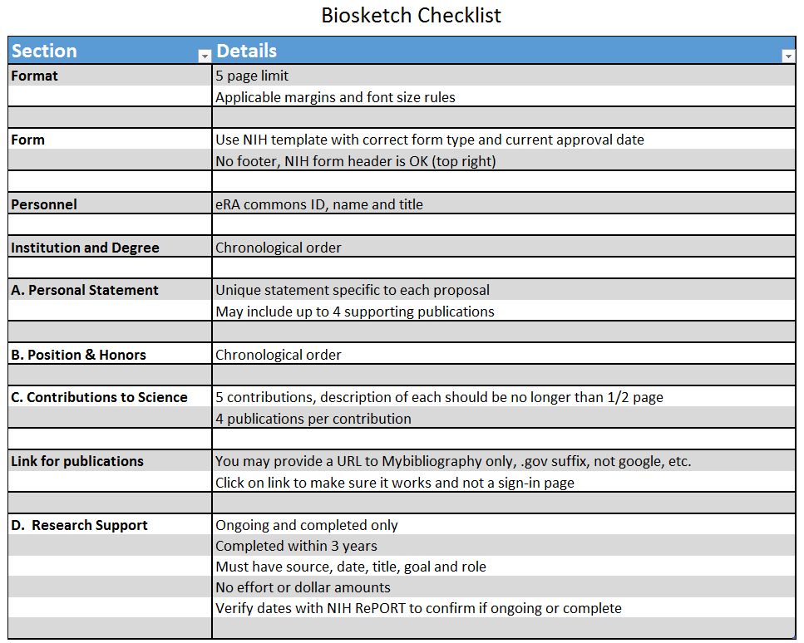

Slide 74
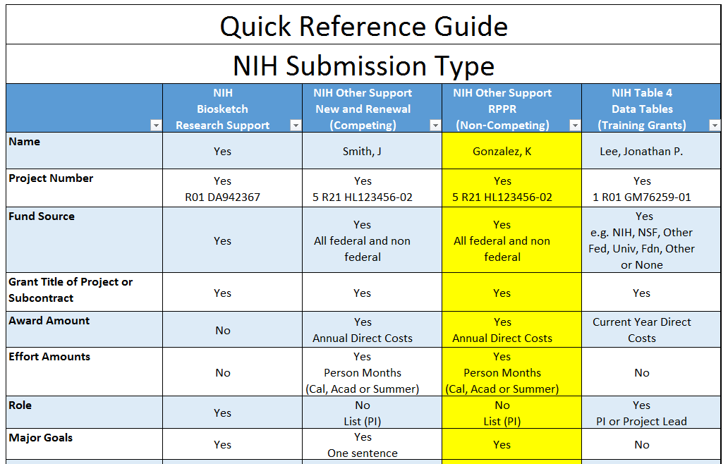

Slide 75
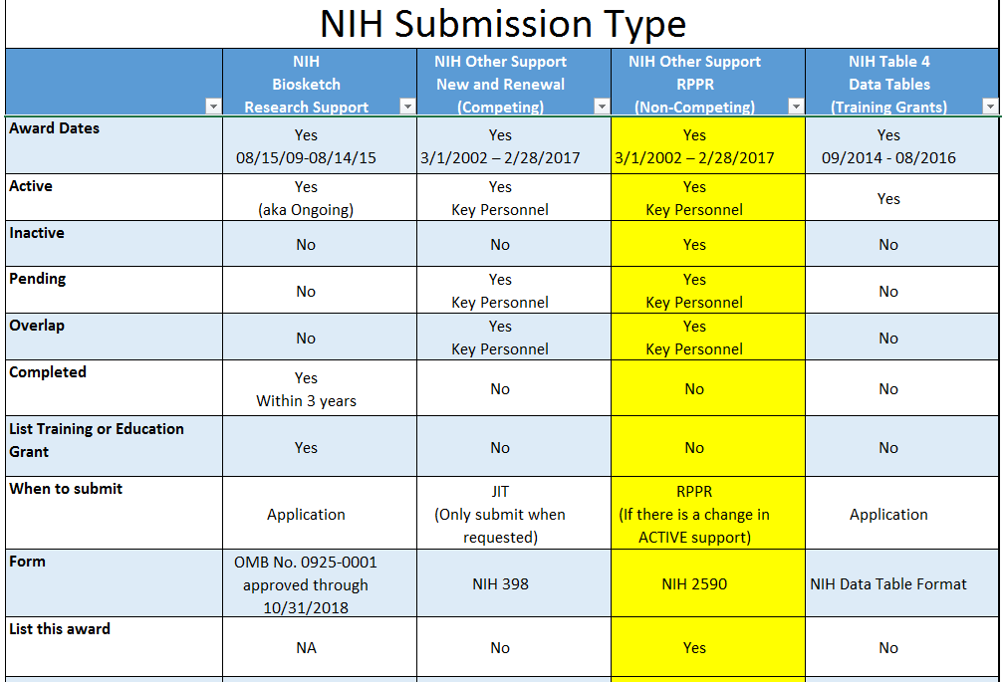

Slide 76
Section D. Participants (Cont.)
D.2.d - New other significant contributors? Yes or No
D.2.e - Will there a change in the MPI Leadership Plan for the next budget period? Yes or No

Slide 77
Section E.
Impact

Slide 78
Section E. Impact
E.1 – Not applicable for most awards
E.2 – What is the impact on physical, institutional, or information resources that form infrastructure?
Not applicable
E.3 – Not applicable for most awards
E.4 – What dollar amount of the award’s budget is being spent in foreign country(ies)?
Nothing to report, usually not applicable with TG’s

Slide 79
Section F.
Changes

Slide 80
Section F. Changes
F.1 - Changes in approach and reasons for change
Describe changes in the program for the next budget period, including changes in training faculty
Include, as appropriate, the role of external advisory committees, significant new training content, procedures or experiences, & indicate how these aid in strengthening the objectives & goals of the program
F.2 - Actual or anticipated challenges or delays and actions or plans to resolve them
Not Applicable

Slide 81
Section F. Changes
F.3 - Significant changes and not reported under another NIH award
F.3.a Human Subjects
F.3.b Vertebrate Animals
F.3.c Biohazards
F.3.d Select Agents
No changes or upload PDF

Slide 82
Section G.
Special Reporting Requirements

Slide 83
Section G. Special Reporting Requirements
G.1 - Special Notice of Award and Funding Opportunity Announcement Reporting Requirements
Nothing to report or upload file
G.2 - Responsible Conduct of Research
Required to report on annually appointed trainee activities to meet ethics requirements
Upload PDF attachment

Slide 84
Section G. Special Reporting Requirements
G.3 - Not applicable
G.4 – Human Subjects Yes or No
G.4.a - Does the project involve human subjects?
G.4.b - Inclusion enrollment data
G.4.c - ClinicalTrials.gov. Yes or No
G.5 - Human Subjects Education Requirement Yes or No
G.6 - Human Embryonic Stem Cell(s) Yes or No
G.7 - Vertebrate Animals Yes or No

Slide 85
Section G. Special Reporting Requirements
G.8 - Project/Performance Sites
Clean this up and just have UCSD listed once!
G.9 - Foreign component
Usually, not applicable

Slide 86
Section G. Special Reporting Requirements
G.10 - Estimated unobligated balance
G.10.a - Is it anticipated that an estimated unobligated balance will be greater than 25% of the current year's total approved budget? Yes or No
G.10.b – If so, provide an explanation in text box
G.10.c - If authorized to carryover the balance, provide a general description of how it is anticipated that the funds will be spent
Prior IC approval is required for any carry over funds for TG’s
Generally, not applicable to TG’s

Slide 87
Section G. Special Reporting Requirements
What’s the difference between unobligated balances and unliquidated obligations?
Unliquidated obligations are commitments of the recipient and are considered to be obligations and, therefore, should not be reported as unobligated balances

Slide 88
Section G. Special Reporting Requirements
G.11 - Program Income
Not applicable
G.12 - F&A Costs Yes or No
Not applicable
G.13 – Not applicable

Slide 89
Section H.
Budget

Slide 90
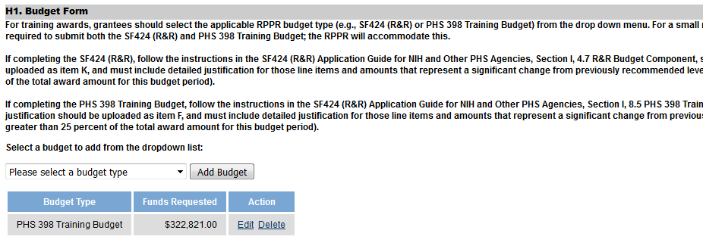
Section H. Budget
H.1 – Budget and Budget Justification
EPD is required since there is a budget component

Slide 91
Section H. Budget
Need to know:
Current NRSA stipend levels
https://grants.nih.gov/grants/guide/notice-files/NOT-OD-17-084.html
UCSD Graduate Fees
https://grad.ucsd.edu/financial/graduate-tuition-fees.html

Slide 92
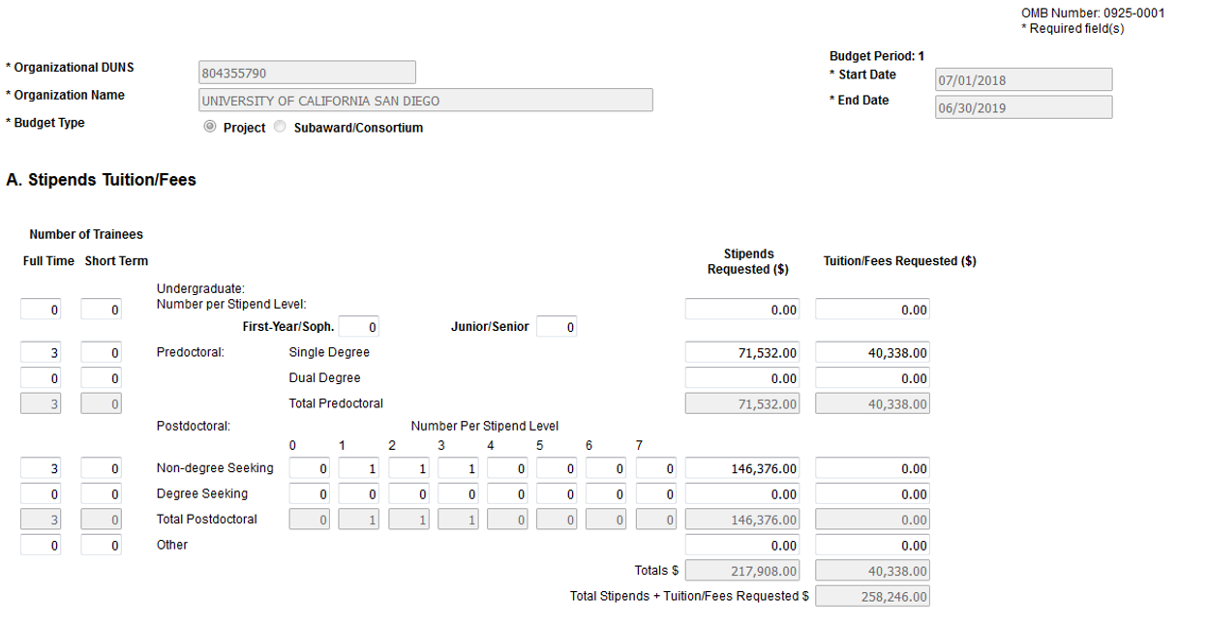
PHS 398 Training Budget - Exercise
Enter full amount of tuition/fees for predocs, exclude health insurance

Slide 93
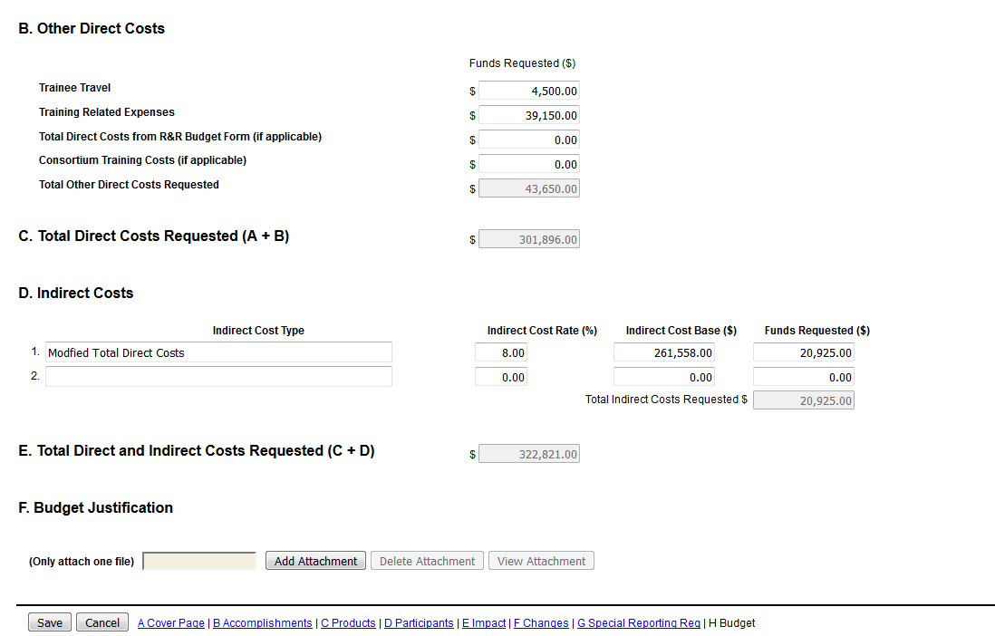
Enter postdoc benefits & admin support here
IDC base does not include tuition/fees

Slide 94
Section H. Budget
H.2 – Subaward Budget Form
Usually not applicable

Slide 95
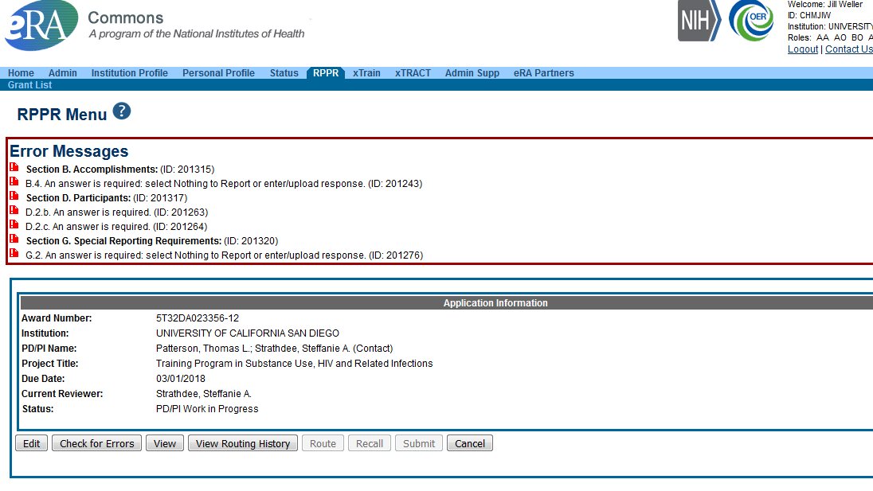
Finishing up
Check for errors

Slide 96
Finishing up
All errors must be corrected prior to submission!
However, it won’t prevent submission of an RPPR with warning messages
Once all validations pass, a message displays indicating:
No errors found on validation
Save complete PDF copy of RPPR for your records
PI/PD must route to HSSPPO or OCGA
Then submitted to agency

Slide 97
(Need AD to log in)
https://pulse.ucsd.edu/departments/research-service-core/training-grants/post-award/Pages/rppr.aspx

Slide 98
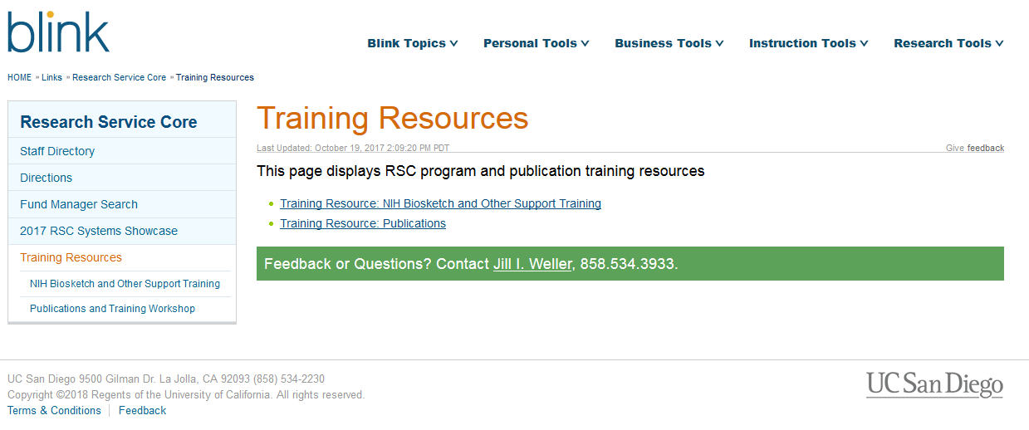
Website Resources
http://blink.ucsd.edu/sponsor/rsc/training-resources/index.html

Slide 99
Jill I. Weller
Training Grant Analyst
Research Service Core
X43933
jweller@ucsd.edu
Karen Heskett
Librarian
X41199
kheskett@ucsd.edu

