Slide 1
Training Grant RPPR’s (aka Progress Reports)
Jill I. Vampola Training Grant Analyst Research Service Core
January 18, 2024

Slide 2
Recap from last office hours
7
Publications of Those in Training
8
Program Outcomes

Slide 3
Purpose & Objectives
How to complete an NIH Training Grant Research Performance Progress Report (RPPR)
Understand the nuances between a Research RPPR and a Training RPPR

Slide 4
Presentation Outline
RPPR Sections
Section A. Cover Page
Section B. Accomplishments
Section C. Products
Section D. Participants
Section E. Impact
Section F. Changes
Section G. Special Reporting Requirements
e.g. Responsible Conduct of Research & Childcare Costs
Section H. Budget

Slide 5
Next week
Presentation on MyNCBI

Slide 6
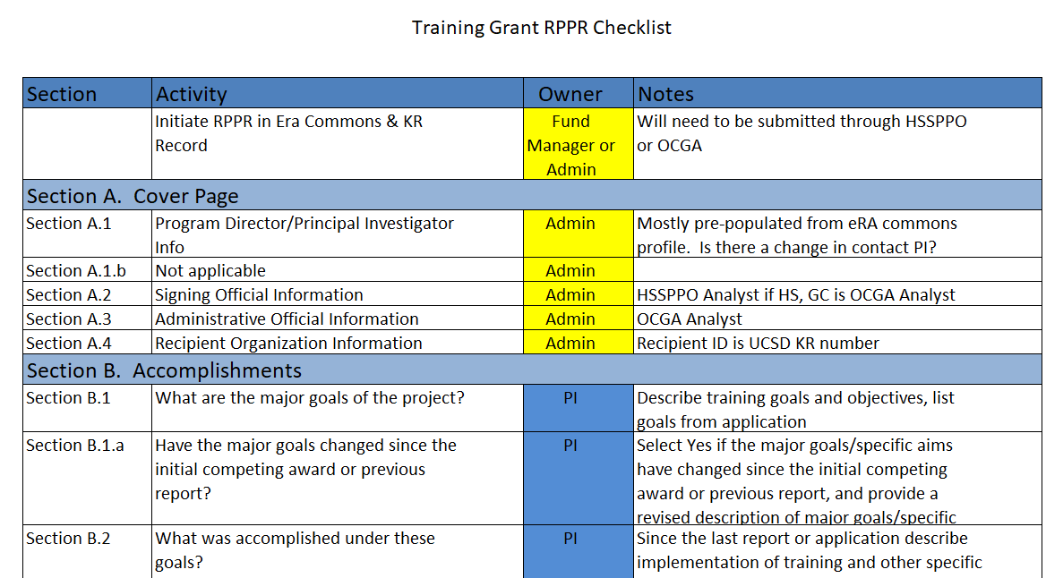
RPPR TG Checklist

Slide 7
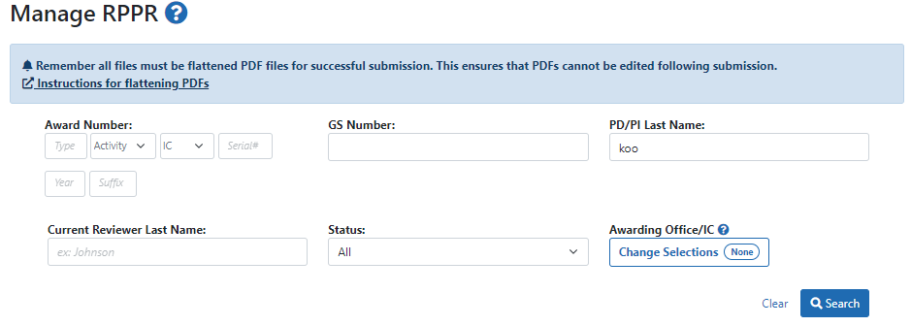
Accessing the RPPR in eRA Commons
Log into eRA commons as a delegate for your PI
Select RPPR on menu bar & search

Slide 8
Select Award Number to Initiate or Manage RPPR

Slide 9
Initiate the RPPR

Slide 10
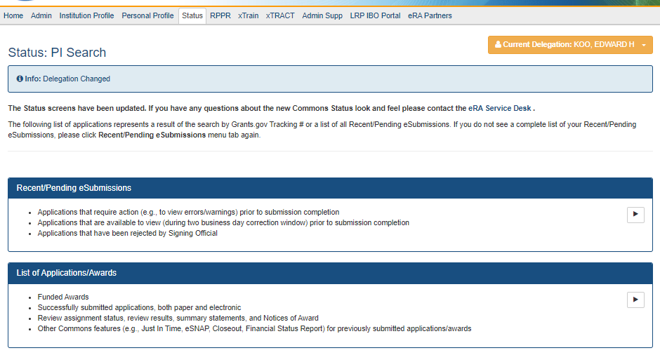
Or from Status tab with delegation

Slide 11
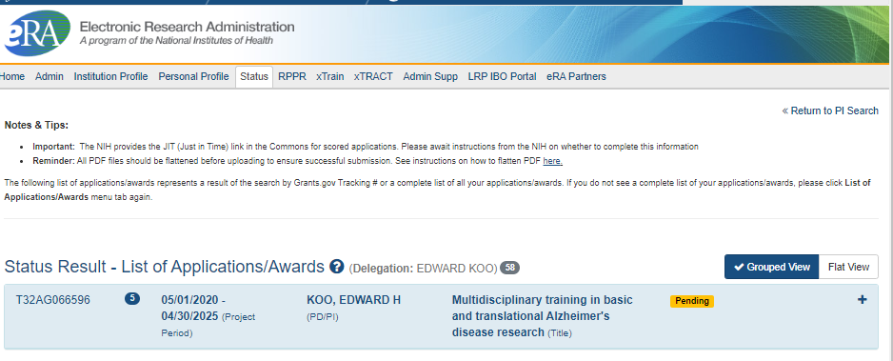
Getting Started - Status

Slide 12
Initiate the RPPR

Slide 13
Or if already initiated, click edit to manage the RPPR

Slide 14
Section A.
Cover Page

Slide 15
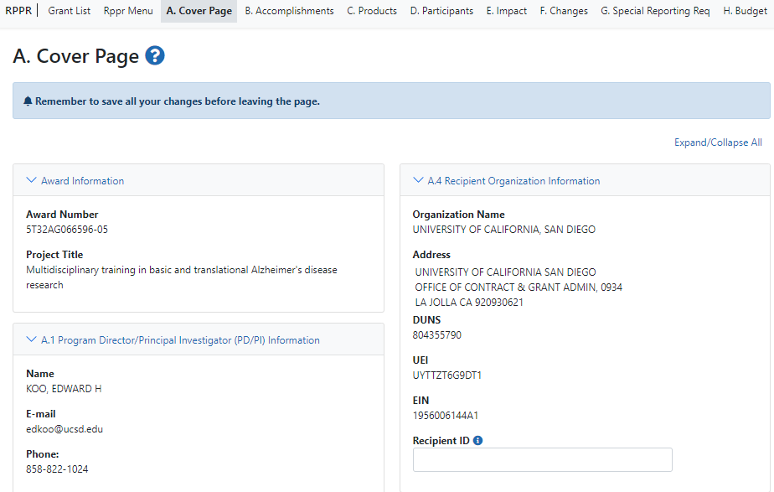
Section A. Cover Page
Mostly prefilled data from eRA Commons
KR Number

Slide 16
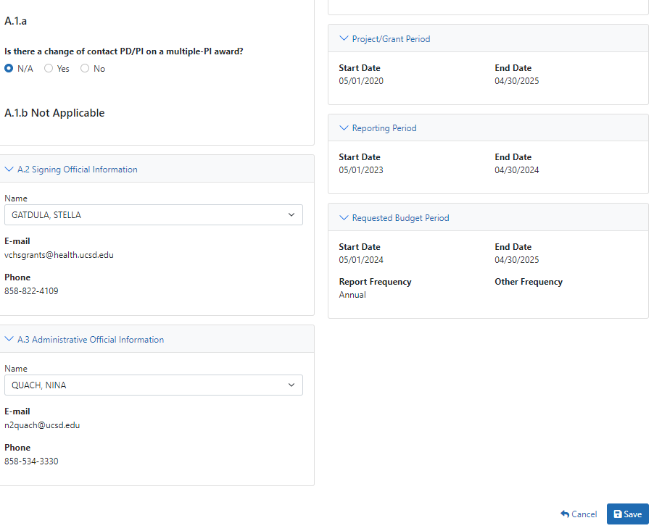
Section A. Cover Page
Signing Official is HSSPPO or OCGA
Confirm Project Dates & Reporting Period
Administrative Official is OCGA

Slide 17
Section B.
Accomplishments

Slide 18
Section B. - Accomplishments
B.1 - What are the major goals of the project?
Text should match project goals as stated in the approved application
B.1.a - Have the major goals changed since the initial competing award or previous report? Yes or No
B.2 - What was accomplished under these goals?
PDF upload
B.3- Competitive Revisions/Administrative Supplements

Slide 19
Section B. – Trainee Summaries
B.4 - What opportunities for training and professional development has the project provided?
Current trainee progress report summaries include:
Mentor
Coursework
Degrees
Description of research project and progress
Attended conferences
Presentations
Career development activities

Slide 20
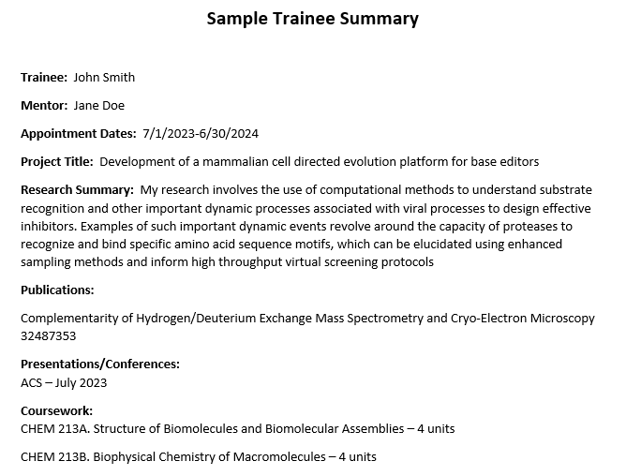
Section B.4 – Trainee Summary Example

Slide 21
Section B.4 – IDP & Data Table 8
B.4 – (Cont.)
Individual Development Plan (IDP)
PI needs to write summary but not include actual IDP’s
Table 8A,B, or C (Parts I, II & IV)
Part I. - Appointed to the training grant (accepted by agency)
Current and up to 15 years cumulative
Part II. - Clearly Associated
Part IV. - Program Statistics – Predocs only

Slide 22
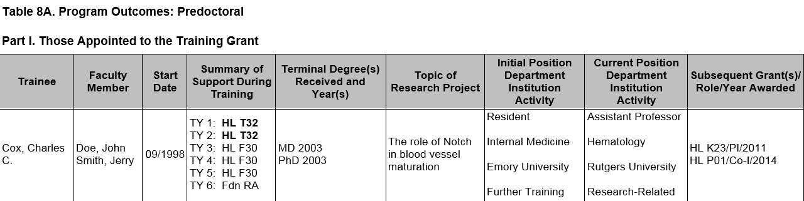
Data Table 8
Part IV. - Program Statistics – Predocs only

Slide 23
Table 8 Part I. Instructions
Part I. Those Appointed to the Training Grant
Provide updated trainee student information, reflecting new appointments/entrants and other changes over the last reporting period
Cumulative up to 15 years
xTRACT will import trainee names from xTRAIN
Part II. Those Clearly Associated to the Training Grant
Will have to be added separately since not already in xTRAIN

Slide 24
Table 8 – Definition of Clearly Associated
Current pre or postdocs who have a training experience identical to those appointed to this grant and they must have been or currently are funded by another HHS or NIH mechanism (fellowship, R01, etc.—even for a short time)
Can be either TGE or non-TGE (non-citizen). Eligibility is NOT a factor here
Users should initially report only current “clearly associated” students. Then in each subsequent year, they should continue to add new entrants & provide updated information about current & past clearly associated students until 15 years of data have been completed

Slide 25
Table 8 - Part IV. Program Statistics – Predocs only
The percentage of trainees entering 10 years ago that received support from this training grant who received PhDs or equivalent degrees
Average amount of years to Ph.D.
Calculated to one decimal place (e.g., 5.5 years)
PI needs to summarize this data in Section B.4

Slide 26
Entering Table 8 into xTRACT

Slide 27
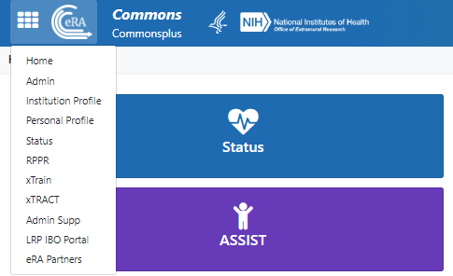
xTRACT
If you have SO, AO, BO, PI or ASST you will see xTRACT on the eRA Commons toolbar. However, the PI will still need to give you delegation of authority to work on their individual grant
RTD = Research Training Dataset or Data Table

Slide 28
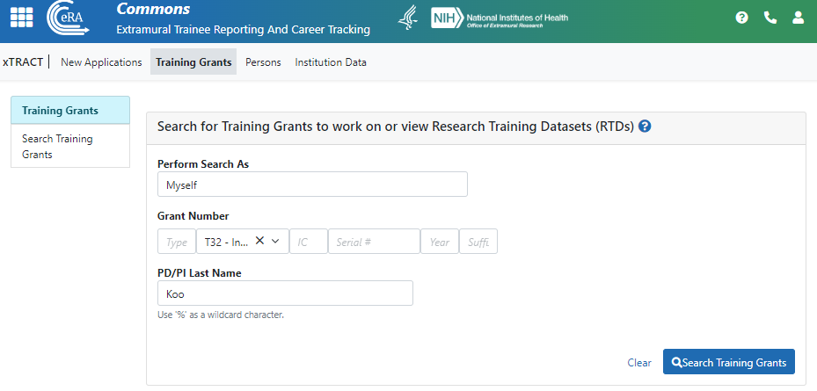
Main Landing Page

Slide 29
Select Prepare for RPPR

Slide 30
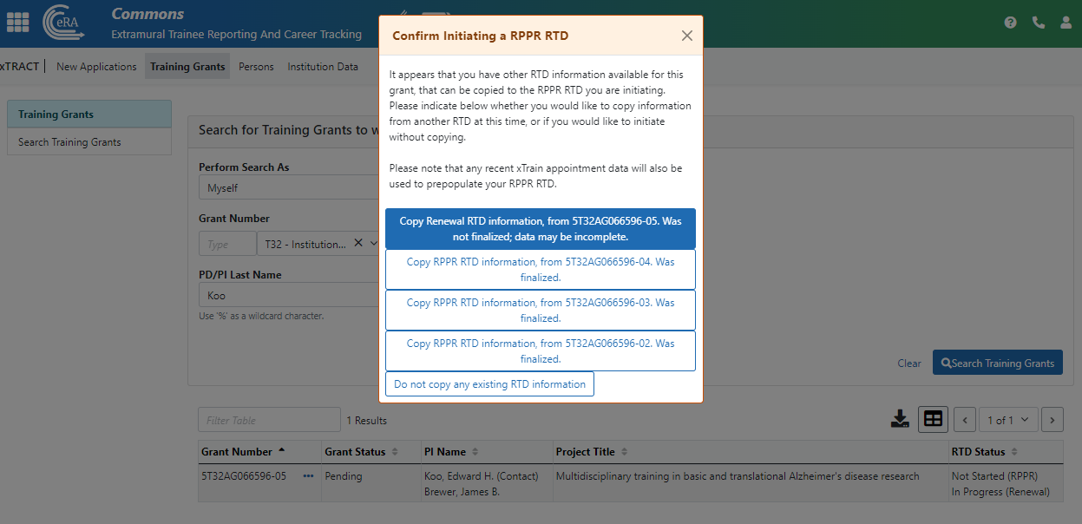
Copy prior RPPR Info

Slide 31
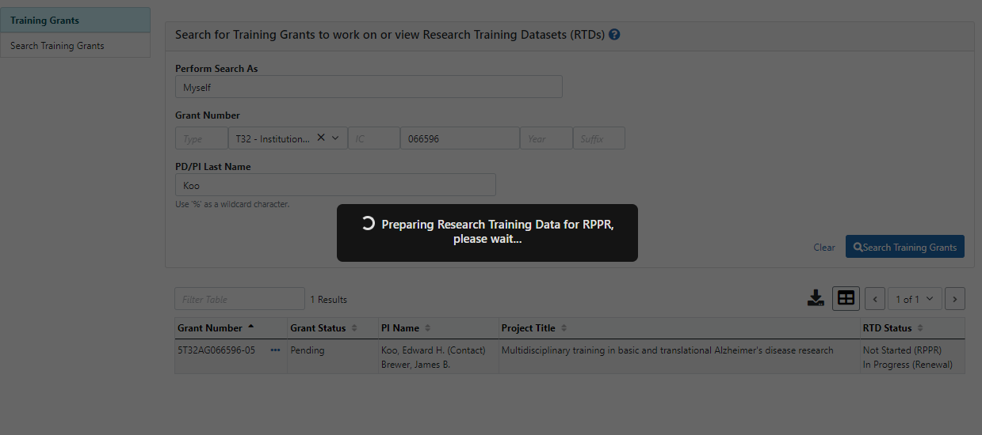

Slide 32
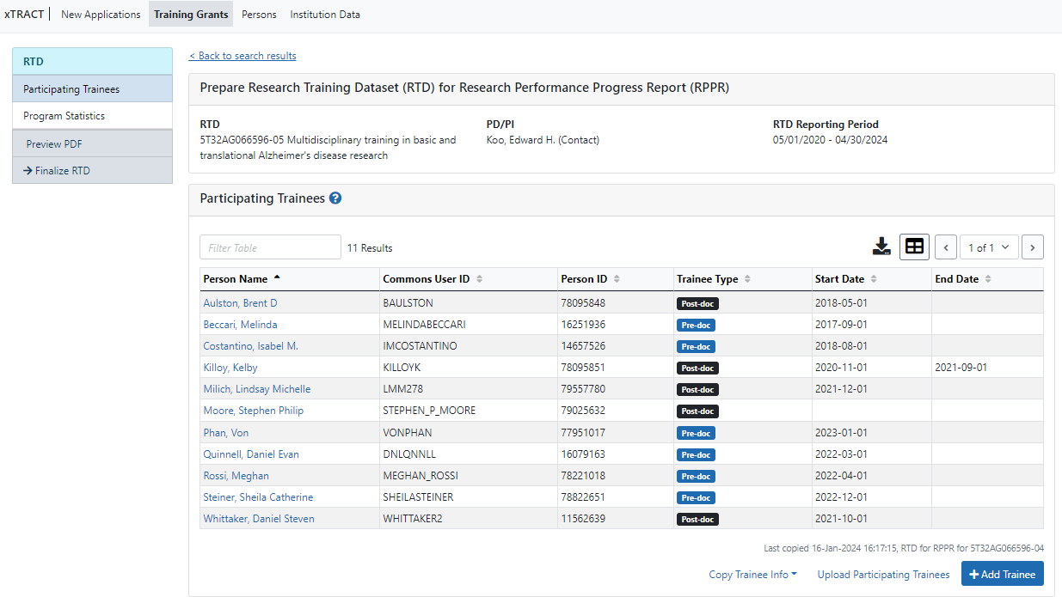
Edit Participating Trainees

Slide 33
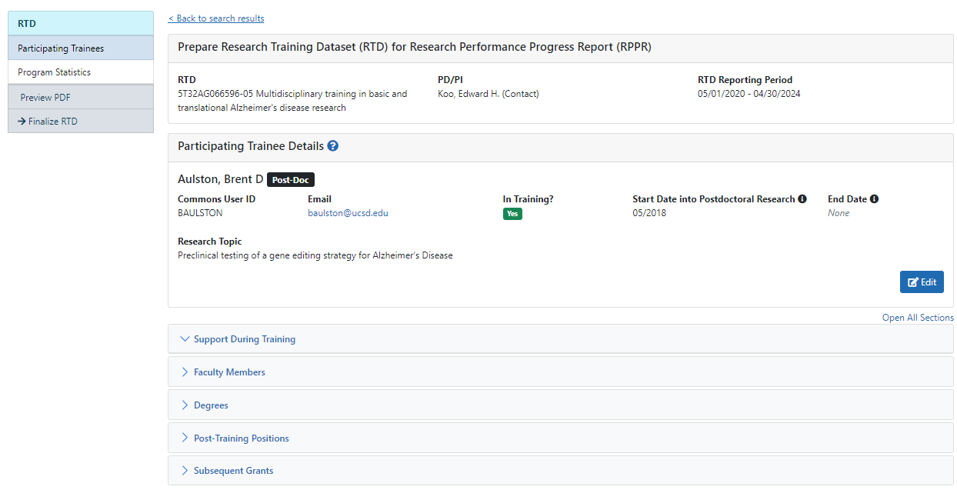
Participating Trainee Detail

Slide 34
Degree Info
If they are currently in training, list the terminal degree-to-date
If they are NOT a current trainee, the doctoral terminal degree needs to be indicated
Be sure to received in training if degree is from UCSD!

Slide 35
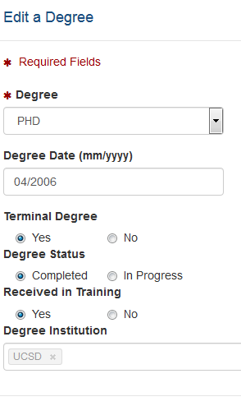
Editing Degrees
Be sure to click terminal degree if you want trainee that has ended training on this RTD!

Slide 36
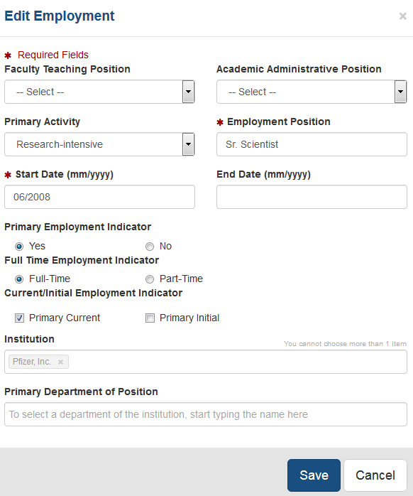
Adding or editing Employment

Slide 37
No Publications in xTRACT participating trainees use MyNCBI

Slide 38
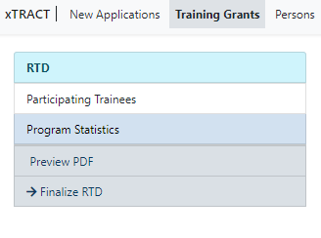
Table 8A Part IV. - Program Statistics – Predocs only
NOT Auto populated

Slide 39
Preview PDF
Check data tables

Slide 40
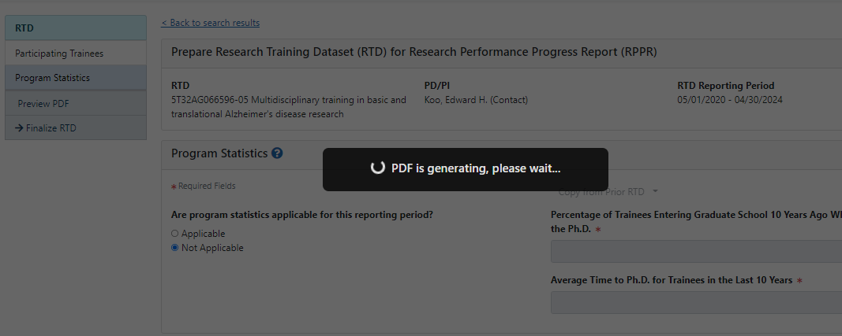
Preview PDF

Slide 41
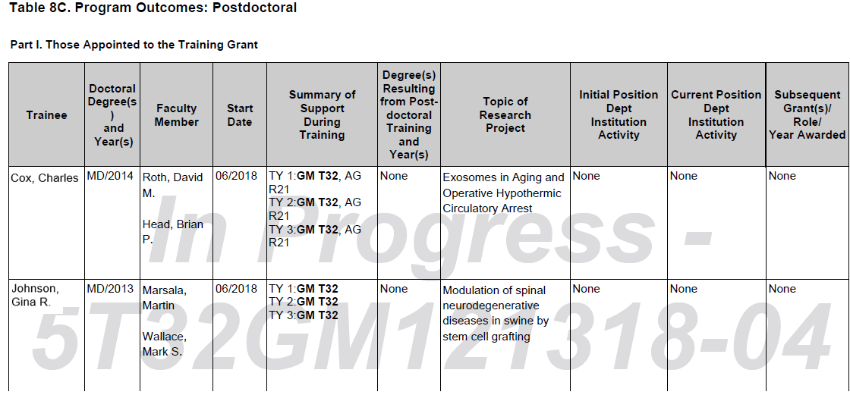
Preview PDF – note the watermark

Slide 42
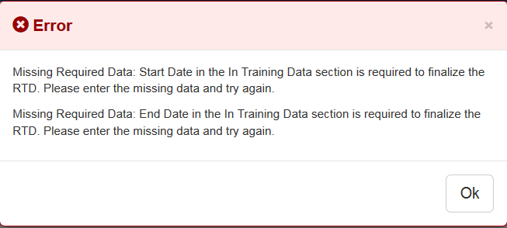
Finalizing the RTD – Errors?
All trainees must have a start date in the In Training Data section
Trainees with no selected for In Training status must have an end date
You will not be able to finalize the RTD if you have past trainees with no end date (under trainee data)

Slide 43
Table 8 Tips
For past trainees, if box is not checked, the trainee will not appear on RTD

Slide 44
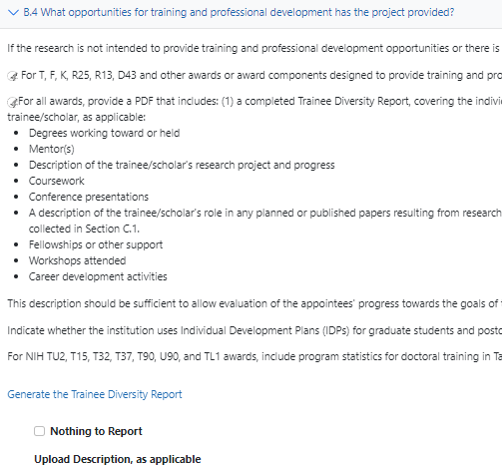
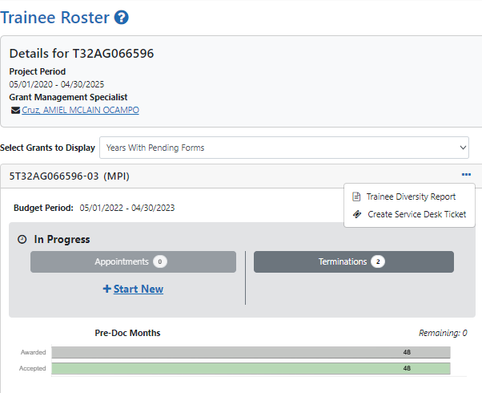
Section B.4 - Trainee Diversity Form
RPPR Module
OR
xTRAIN Module

Slide 45
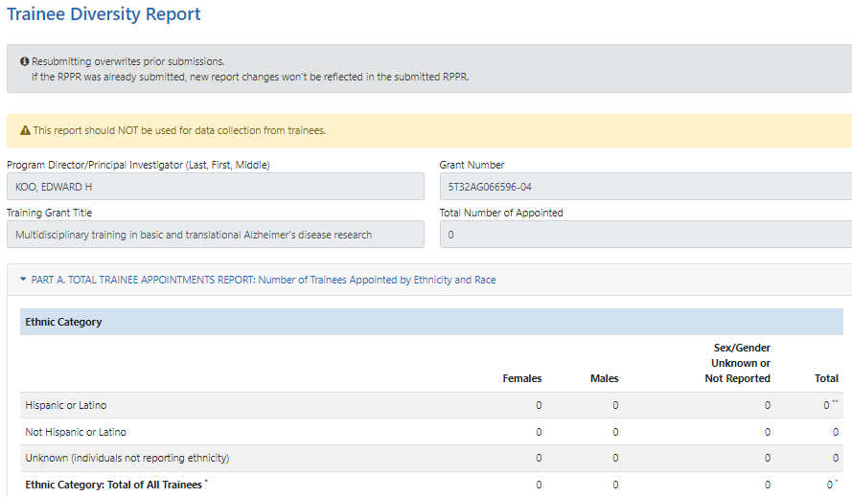

Slide 46
Section B.4 - PDF Upload
B.4 – When all components are complete – 1 PDF is uploaded
Collate this info:
Trainee Summaries
Individual Development Plan (IDP) summary from PI
PI needs to summarize table 8 and program statistics (predocs only)
Transmitted directly Trainee Diversity Report and Table 8

Slide 47
Section B. - Accomplishments
B.5 - How have results been disseminated to communities of interest?
Nothing to report or enter text. Usually, not applicable
B.6 - What do you plan to do for the next reporting period to accomplish the goals?
PI enters response in text box
Include plans for any modification based on the findings of your internal evaluations

Slide 48
Final Points to Remember for Section B
Per NIH – most common mistakes:
Missing trainee diversity form
IDP not described by PI
Missing or incorrect Data Table 8

Slide 49
Section C.
Products

Slide 50
Section C. Products
C.1 - Publications
C.2 – Website
Not applicable
C.3 – Technologies or Techniques
Not applicable
NEXT WEEK
Notes:
Jill’s section

Slide 51
Section C. Products
C.4 – Inventions, Patent Applications and/or Licenses
Not applicable
C.5 – Other Products and Resource Sharing
Nothing to report or provide description types. Usually not applicable
Notes:
Jill’s section

Slide 52
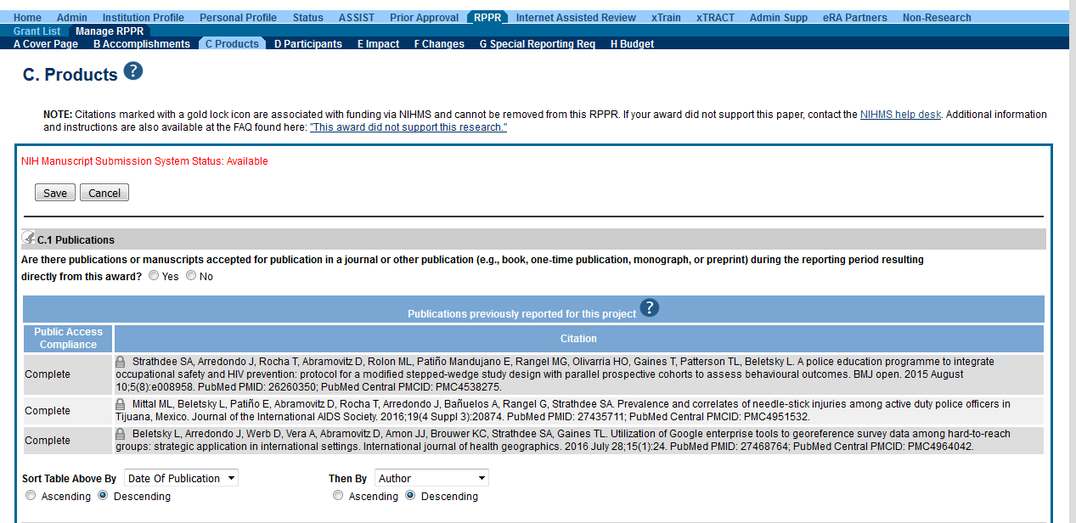
Default screen in RPPR module
The publication was accepted for publication or made public during the reporting period Report publications directly arises from the grant award

Slide 53
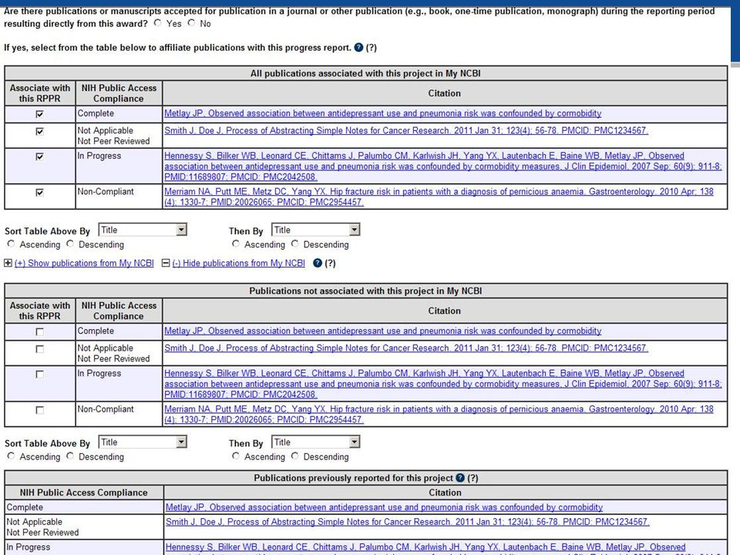
Table 1: Pubs that have not yet been reported
Table 2: Pubs NOT associated with this project in My NCBI
Table 3: Pubs that were previously reported, need to check compliance
Notes:
clean up this slide, and remove middle portion not associated

Slide 54
Associate with RPPR - defaulted to YES
Important things to remember:
If a publication is not in My NCBI, it will not appear
If a pub is missing it must be added to My NCBI to appear in list
After adding the publication, it will become available to choose in the RPPR
Compliance is drawn from My NCBI:
Non-compliant pubs can not be corrected in the RPPR, only in MyNCBI
Notes:
clean up this slide, and remove middle portion not associated

Slide 55
Section D.
Participants

Slide 56
Section D. - Participants
D.1 - What individuals have worked on the project?
Provide or update information for PD or PI ONLY
Do not report personnel (trainees) for whom a PHS 2271 appointment form has been submitted through xTRAIN

Slide 57
Section D. - Participants
D.2 – Personnel Updates
D.2.a – Level of Effort (for PI or PD)
Usually no, because no paid effort for PI – But you can’t enter 0

Slide 58
Section D. - Participants
D.2.b - New Senior/Key Personnel Yes or No
Are there new participating faculty (mentors)?
If yes, provide biosketches and other support
D.2.c - Changes in Other Support? Yes or No
Change in active support for key personnel since last reporting period

Slide 59
Section D. - Participants
D.2.d - New other significant contributors? Yes or No
D.2.e - Will there a change in the MPI Leadership Plan for the next budget period? Yes or No. If yes, provide a PDF

Slide 60
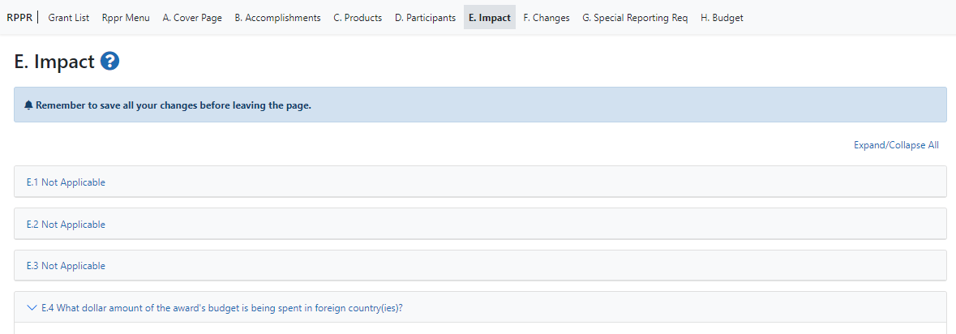
Section E.
Impact

Slide 61
Section E. - Impact
E.1 – Not applicable for most awards
E.2 – What is the impact on physical, institutional, or information resources that form infrastructure?
Not applicable
E.3 – Not applicable for most awards
E.4 – What dollar amount of the award’s budget is being spent in foreign country(ies)?
Nothing to report, usually not applicable with TG’s

Slide 62
Section F.
Changes

Slide 63
Section F. - Changes
F.1 - Changes in approach and reasons for change
Describe changes in the program for the next budget period, including changes in training faculty
Include, as appropriate, the role of external advisory committees, significant new training content, procedures or experiences, & indicate how these aid in strengthening the objectives & goals of the program
F.2 - Actual or anticipated challenges or delays and actions or plans to resolve them
Not Applicable

Slide 64
Section F. - Changes
F.3 - Significant changes and not reported under another NIH award
F.3.a Human Subjects
F.3.b Vertebrate Animals
F.3.c Biohazards
F.3.d Select Agents

Slide 65
Section G.
Special Reporting Requirements

Slide 66
Section G. - Special Reporting Requirements
G.1 - Special Notice of Award and FOA Reporting Requirements
If Childcare costs - Recipients must upload a PDF named Childcare_Costs.pdf. The PDF attachment must specify the number of trainees who used childcare costs in the reporting period.
You do not need to send supporting documentation, but it should be retained in the office of record.
G.2 - Responsible Conduct of Research
Required to report on annually appointed trainee activities to meet ethics requirements
Upload PDF attachment

Slide 67
Section G. - Special Reporting Requirements
G.3 - Not applicable
G.4 – Human Subjects
G.4.a - Does the project involve human subjects?
G.4.b - Inclusion enrollment data
G.4.c - ClinicalTrials.gov.
G.5 - Human Subjects Education Requirement Yes or No
G.6 - Human Embryonic Stem Cell(s) Yes or No
G.7 - Vertebrate Animals Yes or No

Slide 68
Section G. - Special Reporting Requirements
G.8 - Project/Performance Sites
Clean this up and just have UCSD listed once!
G.9 - Foreign component
Usually, not applicable

Slide 69
Section G. - Special Reporting Requirements
G.10 - Estimated unobligated balance
Carry over for most T32’s of an unobligated balance into the next budget period requires Grants Management Officer prior approval
G.10.c - If authorized to carryover the balance, provide a general description of how it is anticipated that the funds will be spent
G.10.a - Is it anticipated that an estimated unobligated balance will be greater than 25% of the current year's total approved budget?
Yes or No
G.10.b – If yes, provide an explanation in text box

Slide 70
Section G. - Special Reporting Requirements
What’s the difference between unobligated balances and unliquidated obligations?
Unliquidated obligations are commitments of the recipient and are considered to be obligations and, therefore, should not be reported as unobligated balances

Slide 71
Section G. Special Reporting Requirements
G.11 - Program Income Not applicable
G.12 - F&A Costs Yes or No – Usually not applicable
G.13 Not applicable

Slide 72
Section H.
Budget

Slide 73
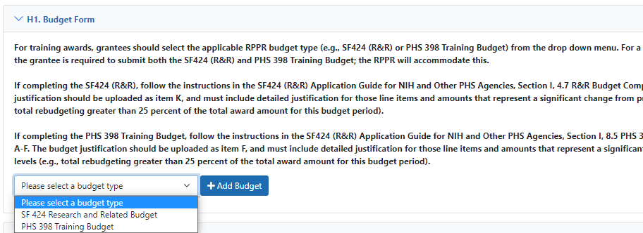
Section H. - Budget
H.1 – Budget and Budget Justification
KR Record is required since there is a budget component
PHS 398 Form

Slide 74
Section H. - Budget
To complete the budget you will need:
Current NRSA stipend levels
Prior NOA for reference
RPPR budget template on TG website
Use current UCSD Graduate Fees

Slide 75
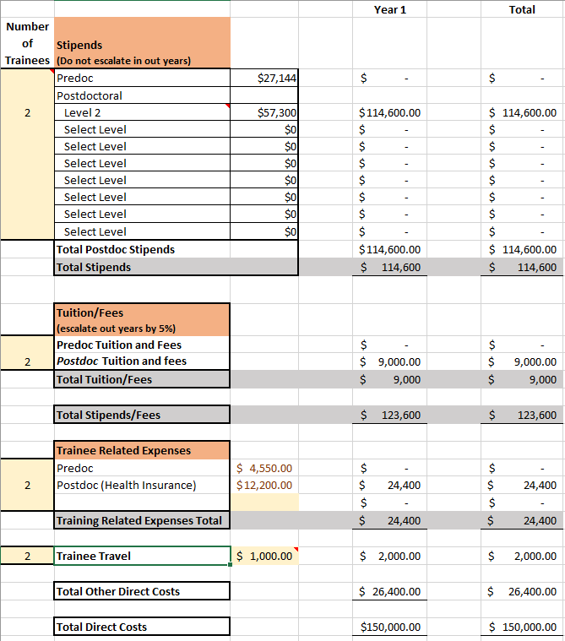
UCSD TG Budget Template

Slide 76
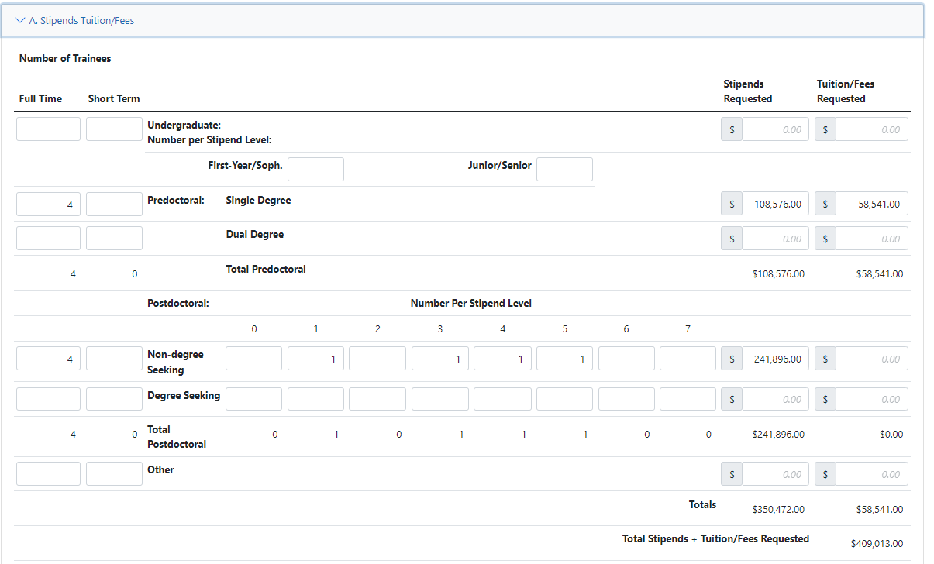
PHS 398 Training Budget – Stipends and Fees
For Predocs Enter full amount of tuition/fees for predocs, exclude health insurance

Slide 77
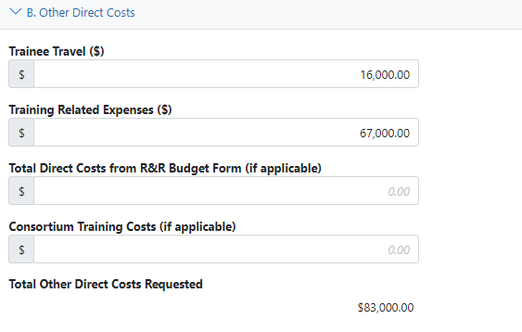
B. Other direct costs

Slide 78
C. Total Direct Costs, IDC, Budget Justification
IDC base does not include trainee tuition/fees

Slide 79
Section H. Budget
H.2 – Subaward Budget Form
Not applicable

Slide 80
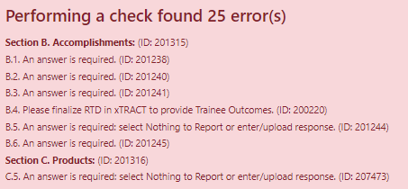
Finishing up
Check for errors

Slide 81
Finishing up
All errors must be corrected prior to submission!
It will do a validation check for xTRACT upload
However, it won’t prevent submission of an RPPR with warning messages
Once all validations pass, a message displays indicating:
No errors found on validation
Save complete PDF copy of RPPR for your records
PI/PD or delegate must route to HSSPPO or OCGA
Then submit to agency

Slide 82
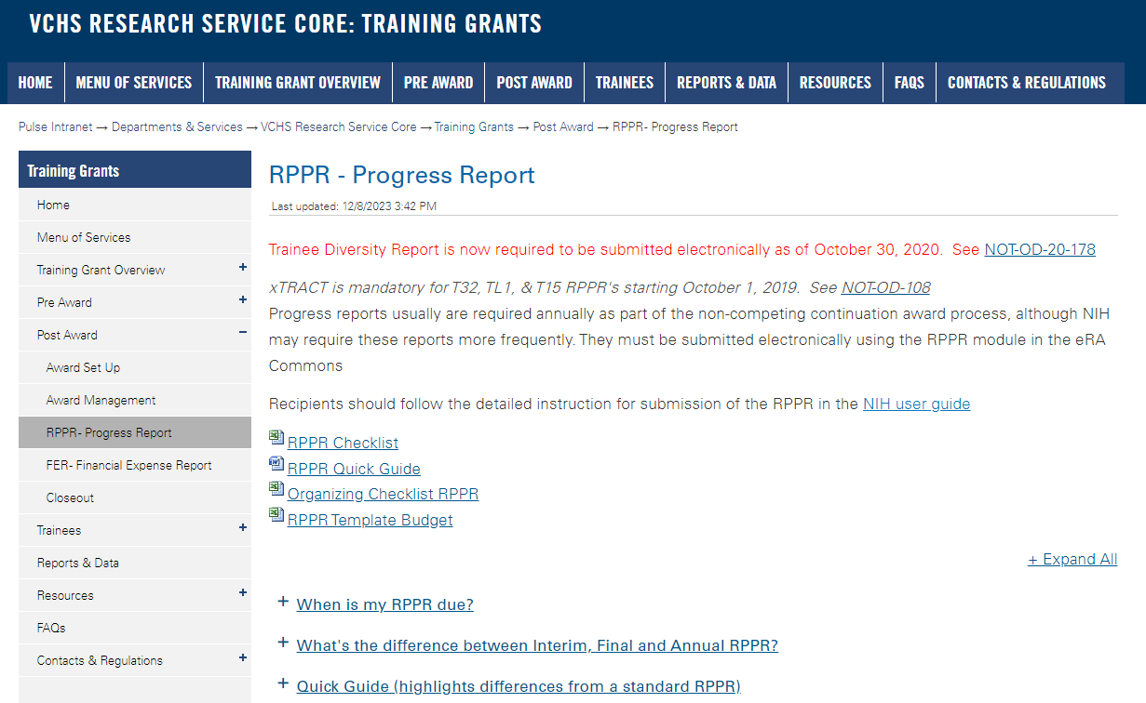
https://pulse.ucsd.edu/departments/research-service-core/training-grants/post-award/Pages/rppr.aspx

Slide 83
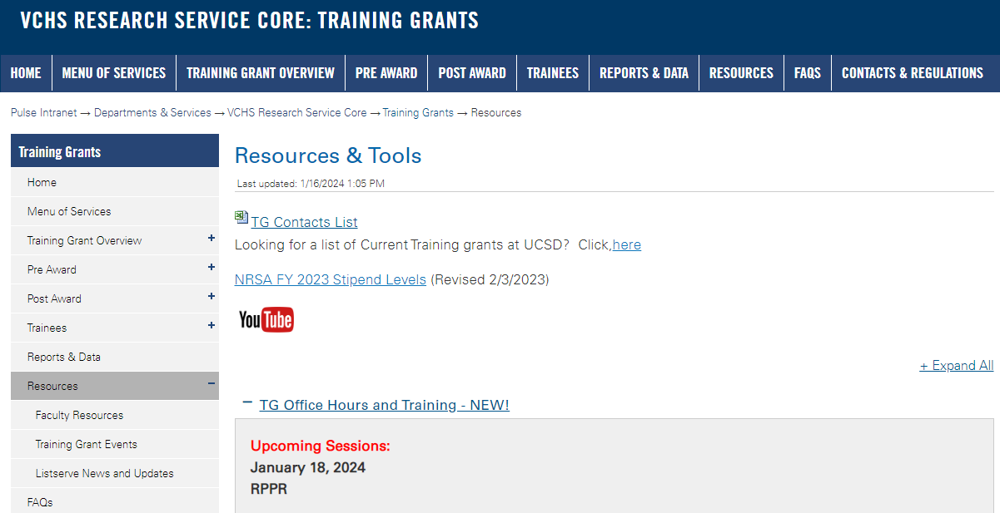
https://pulse.ucsd.edu/traininggrants - AD credentials required
Resources
Notes:
If you need to remember one thing.. Its the TG website.

Slide 84
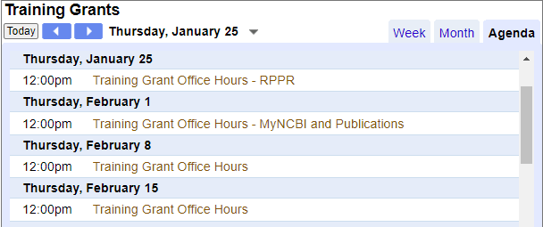
Coming up TG Office Hours
Notes:
Add this to your Google Calendar https://calendar.google.com/calendar/u/0?cid=amVjZHVqZTA0ZTM1aGQzcW1wbnB0djloNGdAZ3JvdXAuY2FsZW5kYXIuZ29vZ2xlLmNvbQ

Slide 85
Questions?

