Slide 1
Training Grant Financial Award Management with Wella Garcia
Jill I. Vampola Training Grant Analyst Research Service Core
August 24, 2023

Slide 2
Today’s Objective
Recap last week
Wella Garcia, Sponsored Projects Office

Slide 3
Award Set up
Award
Project
Task 1
Training Related Expenses (Travel)
Task 2
Stipends
Task 3
Tuition and Fees
Task 4
Childcare Costs

Slide 4
Postdoc Benefits
Benefits Account Codes
Allocability on Training Grants
Dental Insurance – PSBP
Health Insurance PSBP
Vision Insurance - PSBP
Disability Insurance – PSBP*
Life Insurance – PSBP*
Broker Fees – PSBP
State Worker’s Comp Ins*
Yes – but must be moved to TRE task
Yes – but must be moved to TRE task
Yes – but must be moved to TRE task
No – must be moved to an unrestricted fund
No – must be moved to an unrestricted fund
Yes – but must be moved to TRE task
No – must be moved to an unrestricted fund

Slide 5
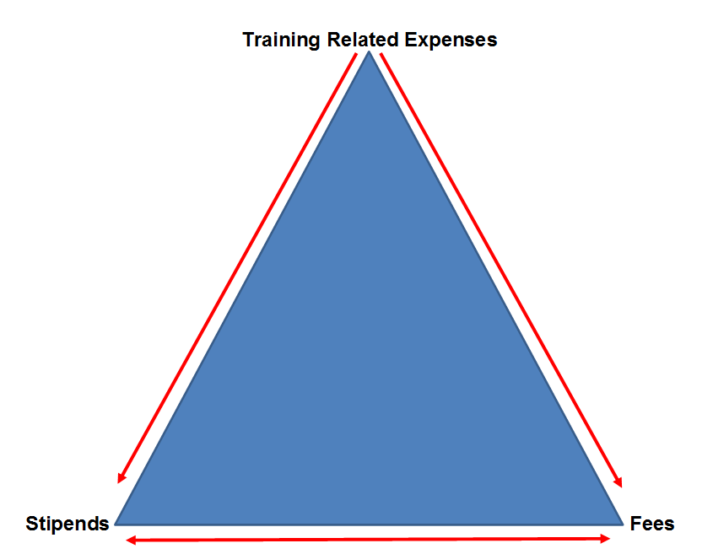
Re-budgeting Guidelines
Childcare Cost

Slide 6
Unliquidated Expenses/Obligations
Stipends
Tuition and Fees
Childcare Costs
Predoc and Postdoc Benefits in TRE Task

Slide 7
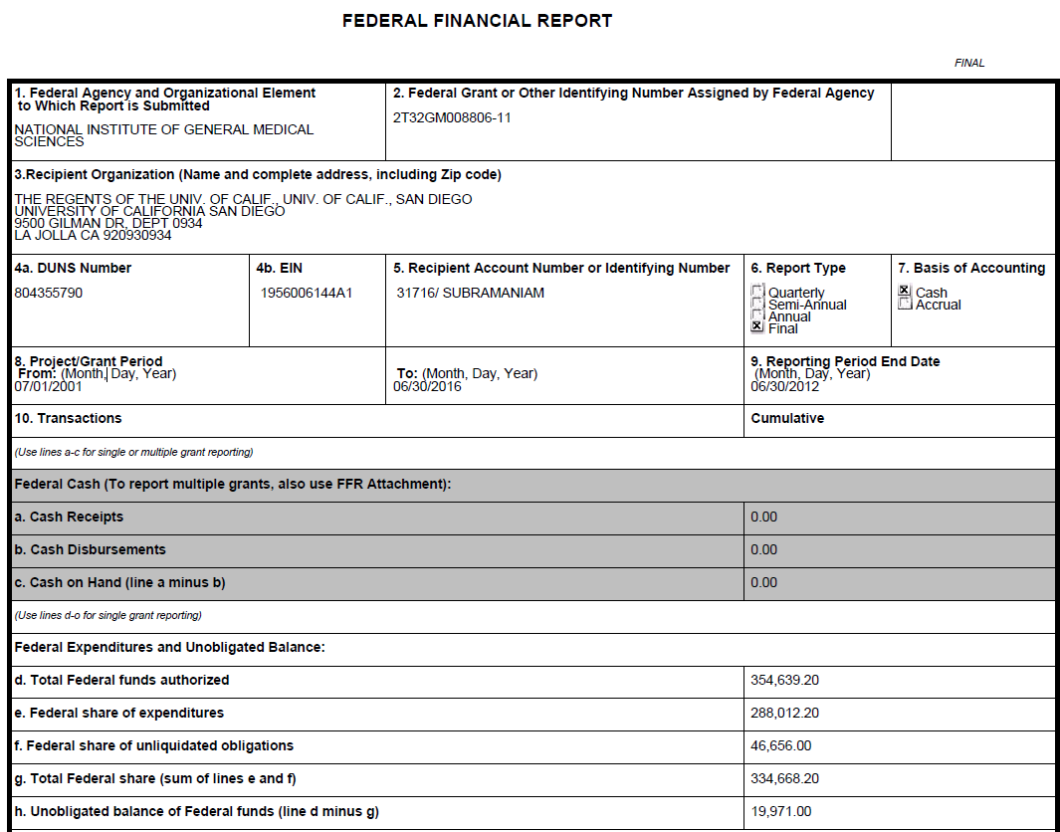
Unobligated Expenses

Slide 8
Questions
Is there a way to separate out unallowable expenses more effectively and an efficient way to set up splitting fringe off the stipend tasks from the beginning?
Can we set up separate project #s by budget year that are automatically created by SPF when the award is initially funded (so there is no waiting when we cross budget years and can immediately implement changes) similar to how SPF is now setting up project numbers for each subaward

Slide 9
Questions
R25 - There was a 10K stipend charged on that was not previously budgeted. How should I move forward with reconciling this?
Also, if the trainee's salary was included in participant costs of the budget, but we account for it on salaries on our ledgers, will I need prior approval to rebudget?

Slide 10
Questions
Can you use unobligated funds for a carryforward request from prior budget periods that have accumulated from year to year or are we only able to use unobligated funds from the previous budget period before the budget period we are requesting funds for?
Dr. xxxxx is looking to request carryforward funds where we have $339,983 in unobligated funds that have accumulated over the project period due to unfilled slots during a couple of budget periods.
However, all slots have been filled during the last budget period so there will most likely not be very much, if, any, carryforward funds from the last budget period.

Slide 11
Next TG Office Hours
8/31/2023
Jenn Bourque
Postdoc Affairs

Slide 12
Q & A

