Slide 1
Training Grants for Beginners
Jill I. Weller Training Grant Analyst Research Service Core
September 9, 2020

Slide 2
Purpose of today’s presentation
Overview of Pre-Award Process
Know Resources
Get Connected
Notes:
Often TG’s are mismanaged, people need better training and resources.

Slide 3
Presentation Outline
Overview
Training Grant Roles
Proposal Process
Data Tables & xTRACT
Budget preparation

Slide 4
Training Grant Overview

Slide 5
What is a NIH NRSA Training Grant?
National Research Service Award
Started in 1974
Supports broad, basic research that benefits the public
Ensures the training of independent researchers
Provides support to predocs, postdocs & short-term trainees
Ensures diversity of scientists to assume leadership roles

Slide 6
Who was Ruth L. Kirschstein?
NIH Pathologist
1955-1961
1974-1993
2002-2003
1955
Started at NIH
First Female director at NIGMS
Deputy Director of NIH
Key player in the development of polio vaccine

Slide 7
How is an NRSA TG different than a research grant?
Only 3 deadlines per year:
Jan. 25, May 25 and/or Sept. 25
AIDS related applications are Jan. 7, May 7 and/or Sept. 7

Slide 8
Application Dates Vary by Institute or Center
Not all NIH Institutes and Centers (ICs) accept applications for all types of grant programs
or they apply specialized eligibility criteria – Different FOA then Parent T32
e.g. NIA only accepts applications May 25
e.g. NHLBI only accepts renewal applications Sept 25

Slide 9
What’s another way that a NRSA TG is different research grant?
Budget is based on current NIH stipend levels and proposed amount of trainees
Data Tables are Required

Slide 10
NRSA - Two Categories
Individual Fellowships (Fs):
Award to support a specific individual (F30, F31, F32, F33)
Institutional Training Grants (Ts):
Award to an institution to support a training program (T32, T34, T35)
Focus of this Presentation is on NIH “T” awards
National Research Service Award (NRSAs)

Slide 11
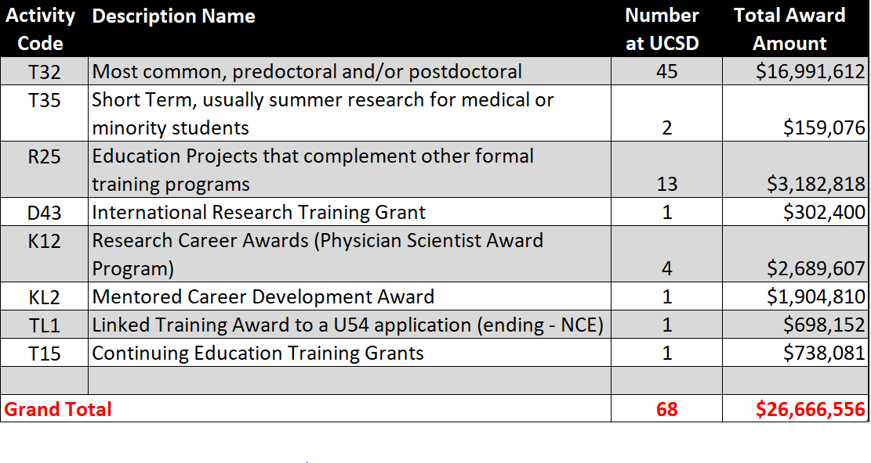
Types of Training Grants @ UCSD

Slide 12
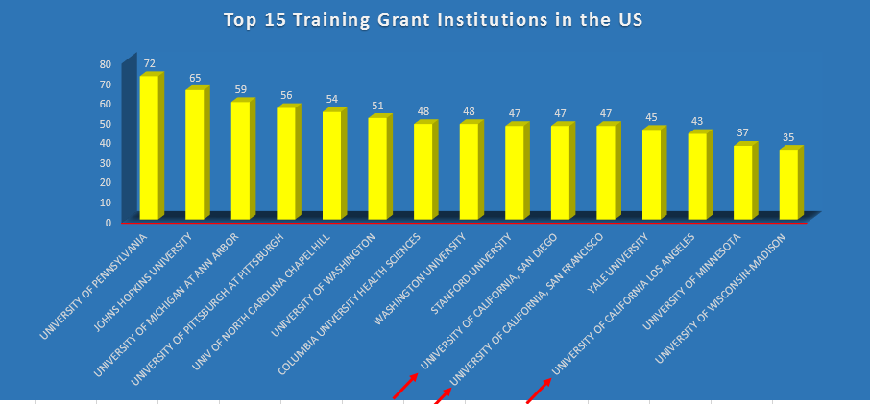
Institutional Comparison
UCSD is currently ranked 10th in the nation out of 253 institutions
Notes:
Update this slide

Slide 13
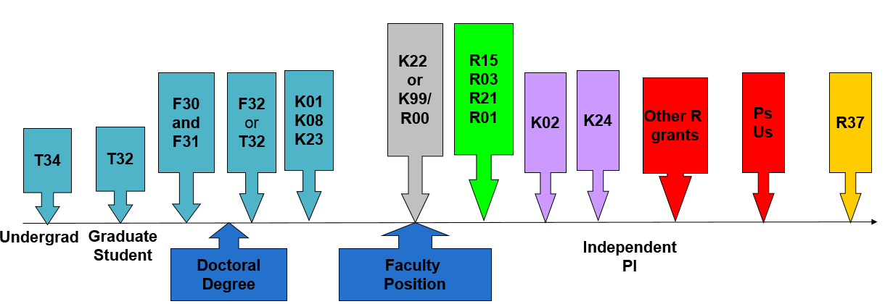
How do NRSA Awards fit into the Career Timeline of Other NIH Awards
Award Type
Career stage

Slide 14
Important Points to Remember
NRSA Awards
“F” are individual fellowships
“T” are training awards
Other types of NIH awards
“K” are career development
“R” is research
“P” is program projects

Slide 15
Training Grant
Roles
Notes:
Delete this slide?

Slide 16
Training Grant Roles

Slide 17
Program Director/PIs
The PD/PI is an established investigator
Directs the project or program supported
Even though it’s an institutional grant, the PI is responsible and accountable for the proper conduct of the project or activity

Slide 18
Program Director/PIs
Typically PI Effort is but no salary support

Slide 19
Preceptors/Mentors/Trainer/Participating Faculty
Individuals who contribute to the training program and are involved in the research area that is the focus of the training grant
Over 1000 Faculty Members @ UCSD serve as participating faculty, many on multiple training grants

Slide 20
Preceptors/Mentors/Trainer/Participating Faculty
Faculty Members must have strong record as researchers
They mentor the trainees appointed to the training grant
Provide Individual Development Plan (IDP) for trainees

Slide 21
Trainees
Predoc (Ph.D. candidates) and Postdoc fellows associated with a particular training program
Includes all previous trainees of the participating faculty members over the previous 15 years
Must be a citizen or permanent resident to be eligible

Slide 22
Current Trainee Slots @ UCSD
Undergraduates
30
Short-term
64
Predocs
261
Postdocs
150
Notes:
Update these numbers

Slide 23
Administrative Support Role
Compile & maintain data table info
Track applicants
Maintain xTRAIN
Coordinate seminars, travel, etc.
Other program activities

Slide 24
Admin are essential to making an effective program!
If applicable to your NIH IC, you can put administrative staff salaries on the training-related expenses portion of the budget

Slide 25
Important Stuff to Remember about TG Roles
No salary for PI’s
Trainees can be Predoc (not MS students) or Postdoc (included clinical residents)
Preceptors is a fancy name for Mentors

Slide 26
Proposal Process

Slide 27
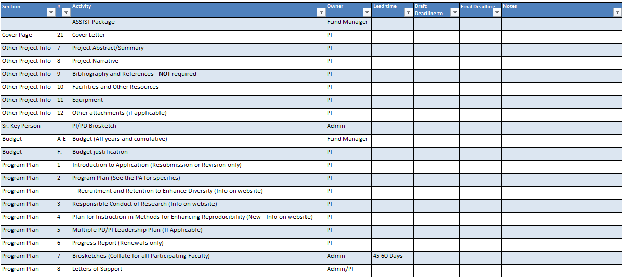
TG Proposal Checklist

Slide 28
Admin Strategy to Successful Proposals
If possible, plan a kickoff meeting with PI, leadership, fund manager, admin, etc.
Make sure everyone understands the expectations and deadlines
Establish frequency of future meetings to assess progress
Complete the data tables before PI has to finalize the narrative

Slide 29
PI’s Strategy to Successful Proposals
Design your program and make sure it is unique
How is this different than other programs on campus?
Identify your institute/center
Identify your participating faculty/mentors
Check overlapping faculty list to see if your faculty are on other UCSD training
Based on your participating faculty, what departments will be involved?
Review strengths and grants weaknesses on what reviewers look for
Notes:
Stay or go?

Slide 30
PI’s Strategy to Successful Proposals
Contact your Program official and get their advice and opinion on submission
Read and respond to review criteria if applicable (resubmission)
Secure institutional commitments
Familiarize yourself with the data tables
Your program plan needs to support the data in your data tables

Slide 31
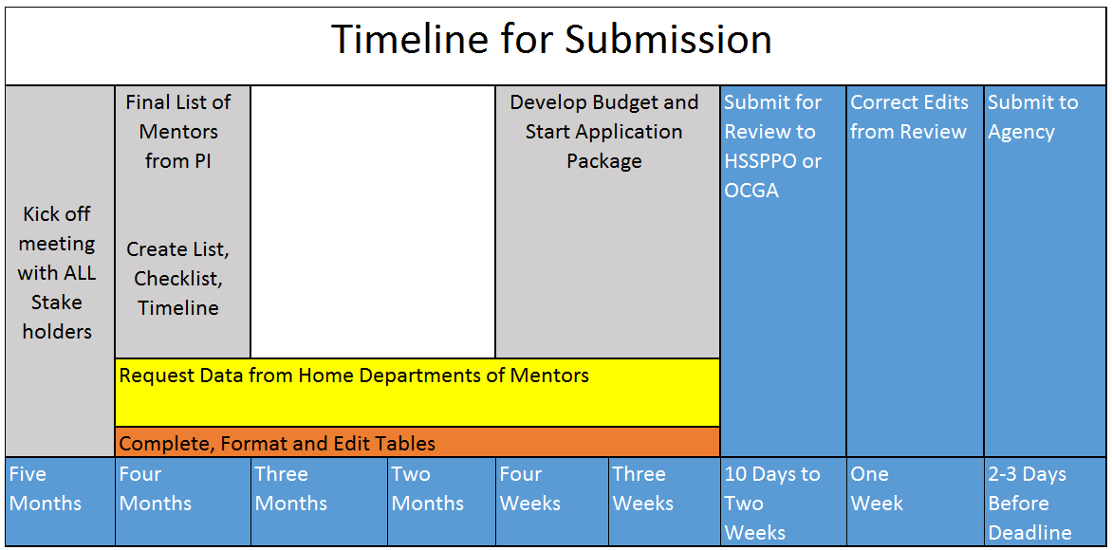
Create a Timeline

Slide 32
Data Tables
Census of Participating Departments and Interdepartmental Programs
1
Participating Faculty Members
2
Federal Institutional Research Training Grant and Related Support Available to Participating Faculty Members
3
Research Support of Participating Faculty Members
4

Slide 33
Data Tables
5 A & B
Publications of Those in Training
6 A & B
Applicants, Entrants, and their Characteristics for the Past Five Years
Appointments to the Training Grant for Each Year of the Current Project Period (Renewals only)
7
Program Outcomes
8

Slide 34
A vs. B Data Tables
A tables are for predoc trainees
Most B tables are for postdoc trainees
C/D Tables added for Undergraduate
Instructions may differ between new or renewal applications

Slide 35
6 high level steps in the “Data Table” process
Planning & Organization
Submit
Understand
Verify Data
Hunting & Gathering
Input into xTRACT

Slide 36
Detailed Data Tables Process
Understand purpose and instructions
Create timeline to submission, stakeholders meeting
Planning and organization
Identify tables that you need to complete
Decide to use xTRACT or MS Word
Input information
Verify Information
Use checklist to record responses
Draft & send PI emails
Obtain participating faculty list from your PI
Research hard to find info
Put it all together – formatting, etc.
Review, edits/revisions
Submit
Notes:
FINSH THIS SLIDE

Slide 37
Understanding the Background about Data Tables
Required for all NRSA applications
Present detailed and consolidated documentation of your Training Program

Slide 38
Understanding the Background about Data Tables
NIH evaluates the both past and present qualifications and accomplishments of:
Institution
Faculty
Trainees

Slide 39
Data tables are insight into the proposed program:
Environment of the proposed training (Tables 1 & 6)
Distribution of participating faculty by research interest (Tables 2, 3 & 4)
Existing support for training, and availability of funds to support trainees’ research (Table 4)

Slide 40
What are reviewers looking for?
Recruitment of new trainees and progress of existing trainees, as assessed by outcomes such as:
Degree completion (Table 8)
Publications (Table 5)
Career progress (Table 8)
Subsequent involvement in research-related activities (Table 8)

Slide 41
Where do I start?

Slide 42
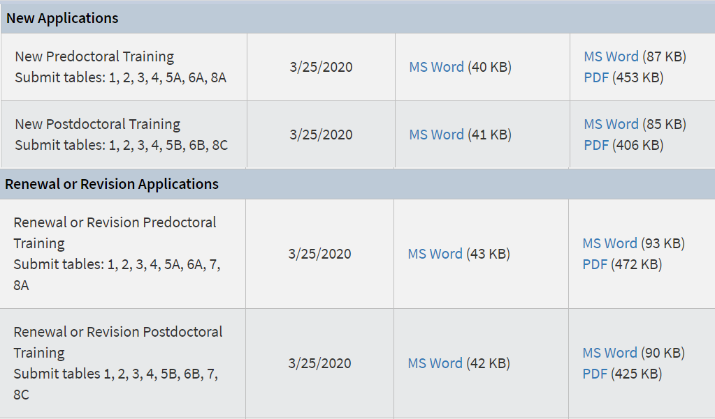
What tables do I fill out for my application?
RPPR’s = Table 8 Only

Slide 43
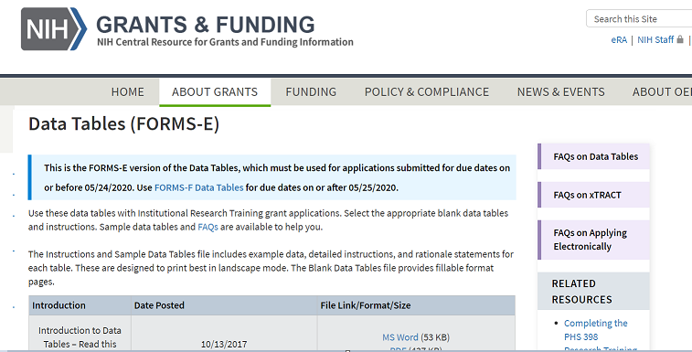
Data Tables in xTRACT or MS Word?
If you have a T34, T35 or R25 award you will need to use MS Word forms

Slide 44
What is xTRACT ?
Extramural
Trainee
Reporting
And
Career
Tracking
A tool within eRA Commons used to create data training tables for RPPR’s & training grant applications
T32, TL1, and T15 RPPR’s are required to use xTRACT
Still optional for new and renewal applications

Slide 45
Upside of xTRACT
xTrain
NIH RePORTER
Makes RPPR’s and Table 8 easier in the long run

Slide 46
Down
Requires a LOT of data entry in the beginning
Side
Bugs in the system that still need to be fixed by NIH
Notes:
And as you enter more and more data into xTRACT, that information will also become available for re-use when preparing later applications and RPPR’s.”
Will require more data entry at the beginning, but subsequent submissions will be easier!

Slide 47
xTRACT
RPPRs (Progress Reports) Mandatory
New or Renewal applications
Not mandatory, only recommended
If you have the appropriate delegation you will see xTRACT on the toolbar, if not, you do not have the proper access
https://grants.nih.gov/grants/guide/notice-files/NOT-OD-19-108.html

Slide 48
xTRACT Demo
https://public.era.nih.gov
Notes:
Need to complete

Slide 49
Planning
&
Organization

Slide 51
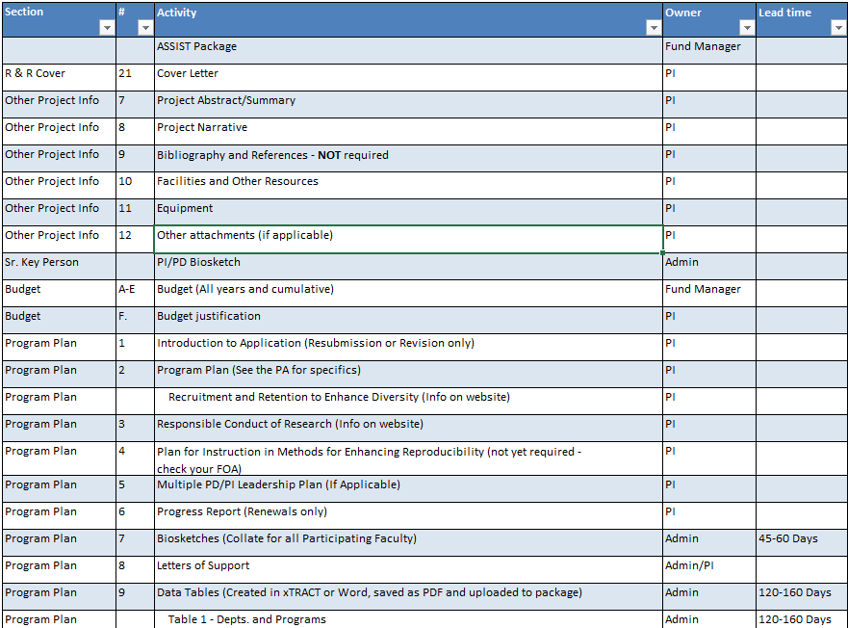
Training Grant Proposal Checklist

Slide 52
Sample email to PI admins
1
Research Interest/topic
2
Current Biosketch
Personal statement should include mentor record
3
Table 2 – Mentoring records for pre and postdocs
Program outcomes for Table 5 & 8 if applicable
4
Table 4 – Research Support
5 Optional
Facilities and Resources

Slide 53
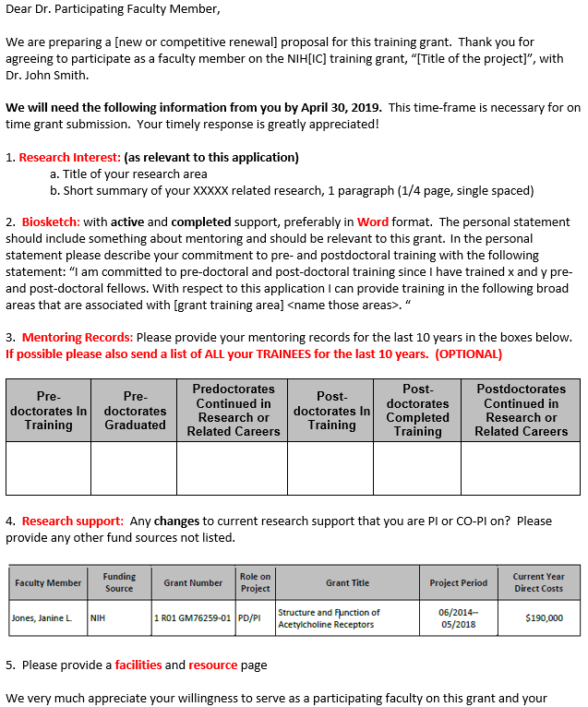
Sample email
1. Research Interest
2. Biosketch – with mentoring statement!
3. Mentoring Records for last 10 years *Past trainee outcomes are optional
4. Research Support
5. Facilities & Resources

Slide 54
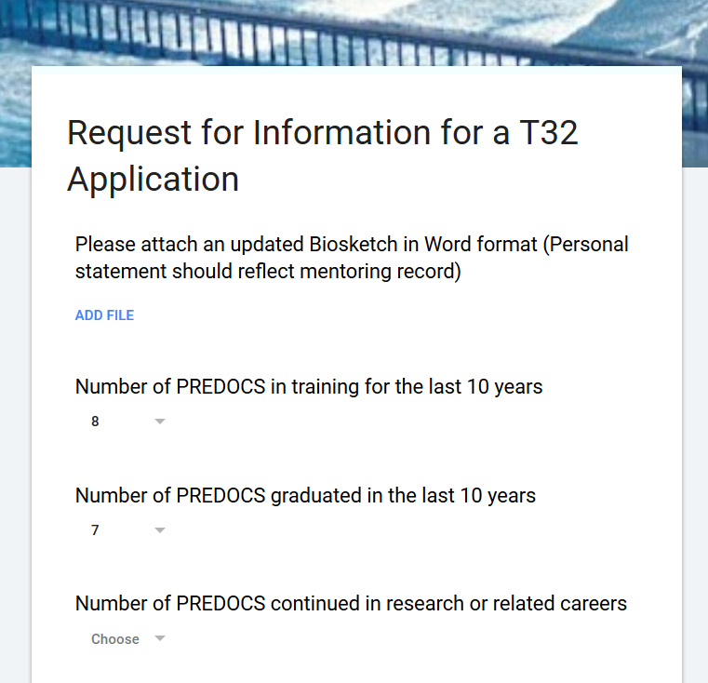
Available Alternative Google Form

Slide 55
Do NOT ask a PI for:
Table 1
Census numbers will have to come from an HR person in that applicable department
Table 3
TG Website
Table 6A
Grad info – Training Grant Analyst
Table 6B
Postdoc Office or HR in specific department
Table 7
Use xTRAIN and NOA to populate this data

Slide 56
Organizing Checklist(s)
Participating Faculty
Participating Trainees

Slide 57
Best Practices for Getting Started
Be organized!
Ask the right person the right question!
Keep a copy of the data table instructions handy – you may need to refer to them often!
Notes:
Chuck this slide?

Slide 58
Get organized!
Start early
Ask PI for final participating faculty (mentors) list
This will usually dictate which departments will be involved
Use the TG contacts list from website for help in identifying contact persons
Send one email per mentor
Leverage data (tables) from other depts.
Check last renewal (if applicable) for previous data tables
Caution – May be in 12 table format and it won’t look the same!

Slide 59
Data Table 2

Slide 60
Data Table Changes as of April 2020
https://era.nih.gov/news/era-reminder-xtract-and-xtrain-changes-accommodate-transition-forms-f-due-dates-or-after-may

Slide 61
Table 2: Participating Faculty Members
Assess the distribution of participating faculty by:
Rank (Junior vs. Senior)
Research interests
Department or interdepartmental program
Summarize and analyze this data in the Background section and the program faculty section of the program plan

Slide 62
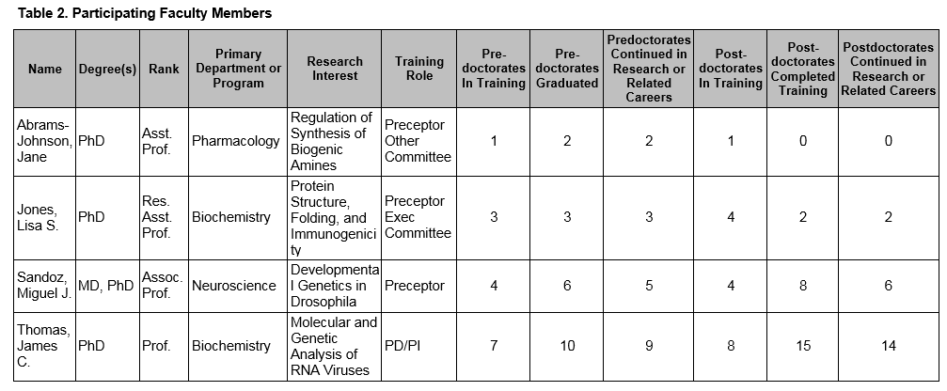
Table 2 Instructions
“Other” is now an option
One PRIMARY department only
Training Roles:
PI/PD
Preceptor (Mentor)
Executive or other committee member
Provide the terminal (highest) degree
First, last middle initial
Research interest that is relevant to the training program

Slide 63
Mentor Records
Predoc trainee is defined as a Ph.D candidate, master’s students and undergrads excluded
Mentoring Records = last 10 years
Predocs/Postdocs that have continued in research or related careers
Should include ALL current predocs and postdocs (even if they are NOT eligible) in mentor labs
Include ALL Predocs/Postdocs that have graduated or completed training in the last 10 years

Slide 64
New Data Table 2 Changes
Applicants may now report on faculty in non-academic settings
When reporting Faculty, the option of “Other” is provided for faculty Rank field

Slide 65
Define “Research or Related Careers?”
Any activity which involves:
Designs Experiments
Develops Protocols
Collects and Interprets Data
Review or administration of original research
Such activities may take place in agencies such:
NIH, FDA, NSF, or in a commercial setting including biotech or pharmaceuticals

Slide 66
Tips on Gathering info for Table 2
ALWAYS Confirm with the PI for any changes/additions to participating faculty
For renewals, start by checking what was submitted last time
Check past RPPR’s for additional faculty
Check faculty list on the TG website - under “Reports and Data”

Slide 67
Tips to Gathering & Verifying Data for Table 2
Mentor Records Need to come from each individual participating faculty member
Verify faculty members home department, program, division, or rank in

Slide 68
Best Practices for Table 2
The participating faculty list is your starting point to sending out emails
When in doubt ask your PI
Make sure your numbers are consistent within the table!
Notes:
Possibly bypass this demo for the sake of time

Slide 69
Data Table 1

Slide 70
Data Table 1 Objectives
Census of Participating Departments and Interdepartmental Programs
Provides insight into the environment in which the proposed training will take place
Does the program have the "critical mass" of trainees and faculty and to be effective
Summarize this data in the Background Section of the Research Training Program Plan

Slide 71
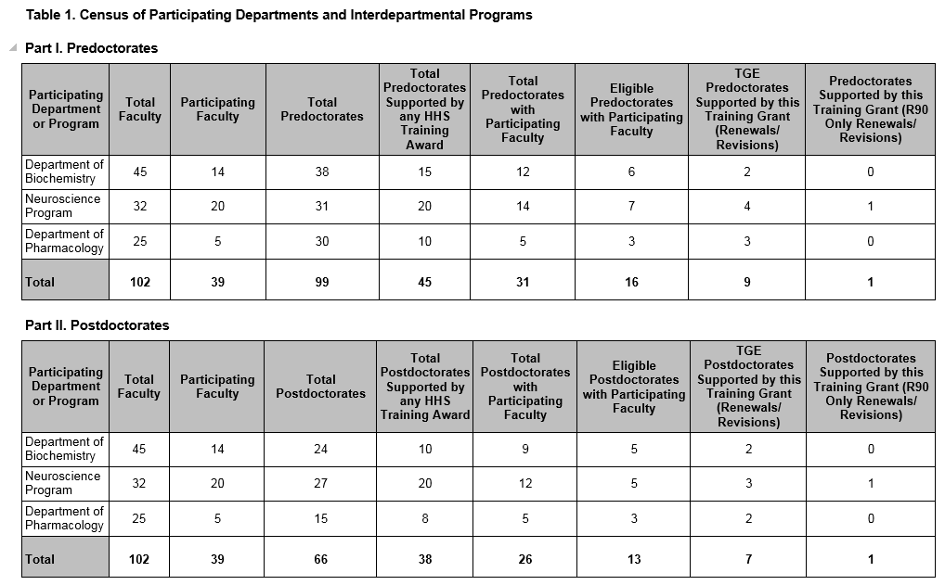
Table 1 - Instructions
Part I. Predocs
Part II. Postdocs
1. List program, dept. or division involved with the application
Biomedical Sciences (Grad program)
Biological Sciences (Division)
Physics (Dept.)

Slide 72
Table 1 – Dept. Counts
ENTIRE count of predocs or postdocs in that dept.
Total amount of predocs or postdocs in training with participating faculty
Total amount of current faculty in each dept., program or division
(12 predocs across 14 participating faculty)
TOTAL amount of predocs or postdocs supported on HHS TRAINING funds (T32’s, F32, etc.)
Total of participating in that dept. or program faculty on this grant

Slide 73
Table 1 – Dept. Counts
Only applicable to R90 grants, leave blank
Total amount of students eligible for support Exclude non-citizens
Training Grant Eligible (TGE) postdocs or predocs on this grant
Eligibility Policy for NRSA Grants - http://grants.nih.gov/grants/policy/nihgps_2012/nihgps_ch11.htm

Slide 74
New Data Table 1 Changes
Applicants proposing research training in settings where there are no students in predoctoral research training (such as some clinical departments or divisions) may now skip Part I.

Slide 75
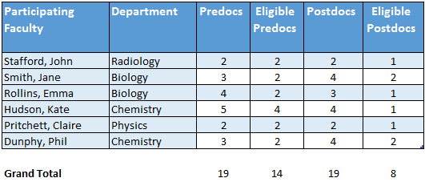
Best Practices and Reminders for Table 1
Use the “organizing spreadsheet” so you can easily calculate the amount of predocs & postdocs based on your participating faculty responses
Counts for total populations need to come from each individual department
“Table 1 mentor” tab
Notes:
Possibly bypass this demo for the sake of time

Slide 76
Data Table 3

Slide 77
Table 3 Objectives
Federal Institutional Research Training Grants and Related Support Available to Participating Faculty Members
Current level of support for related research training
Overlap in participating faculty
Used to assess the institutional environment and determine the number of training positions to be awarded

Slide 78
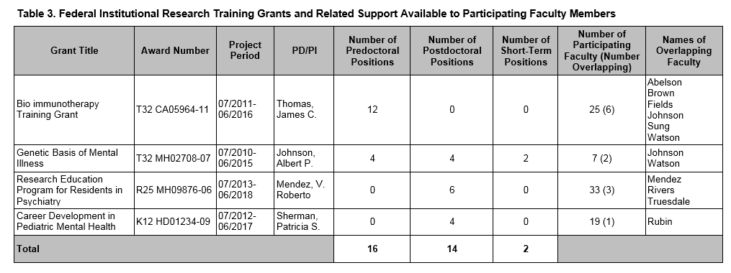
Table 3 Instructions
Inception to date - entire Project Period (MM/YYYY)
Full Grant Title
PD/PI of TG
Include mechanism (T32) and current year

Slide 79
Table 3 – Slot and overlapping faculty info
Total Participating
Faculty on TG
List Overlapping Faculty
Total Predoc, Postdoc, and Short-term Slots
Number of overlapping faculty between this grant and the one you are working on (in parenthesis)

Slide 80
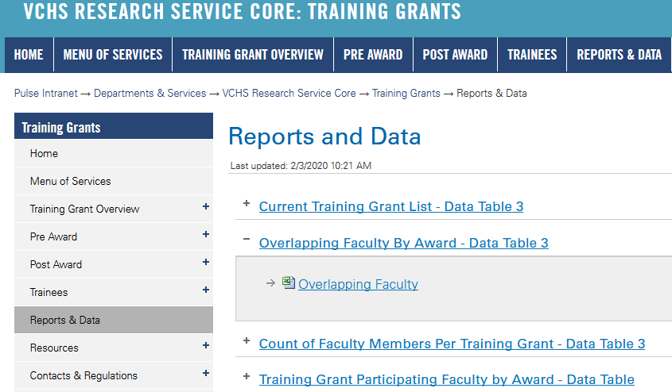
Tips to Gathering Data for Table 3
Go to “Reports and Data” on TG website – “Current Training Grant List - Data Table 3” and “Overlapping Faculty” list(s)
https://pulse.ucsd.edu/departments/research-service-core/training-grants/reports-data/Pages/default.aspx

Slide 81
Best Practices for Table 3
Only include grants that have overlap with the grant you are working on
Compare the grant you are working on with each one on the list
Use the TG website as a resource!
Notes:
Possibly bypass this demo for the sake of time

Slide 82
Data Table 4

Slide 83
Table 4 Objective
Research Support of Participating Faculty Members
Provides evidence of the strength of the research environment
The availability of funds to support research conducted by the trainees
Appropriateness of the participating faculty in terms of their active research support
Analyze and summarize this data in the Program Plan

Slide 84
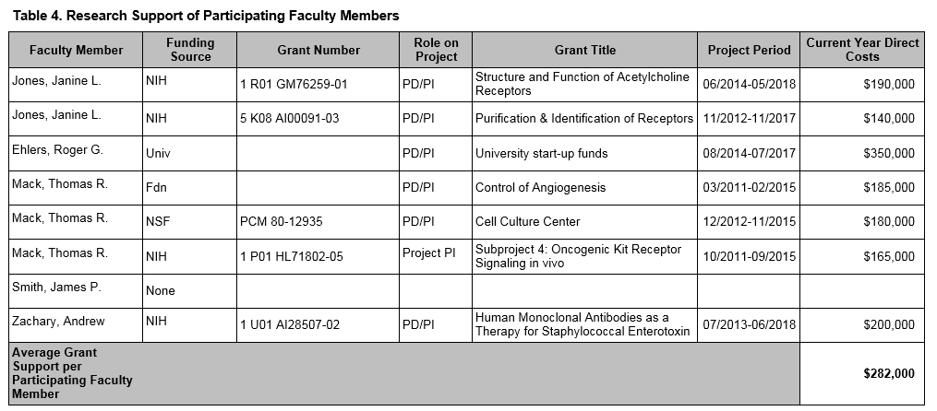
Data Table 4: Research Support Instructions
Participating Faculty
Agency/Fund Source of Funding
Full Grant Number
Role – should be PI only (NO CO-I unless a multi PI Project)

Slide 85
Data Table 4: Research Support Instructions
Full Grant Title
Current Year direct costs only - NOT total project costs
MM/YYYY format
Sum of current year direct costs divided by the total number of faculty

Slide 86
New Data Table 4 Changes
Ability to manually report Project Leads and provide subproject direct cost
Column 2 – “Funding Sources”
Exclude these applications:
Pending agency review
Administrative or competitive supplements
Awards in no-cost extension status

Slide 87
New Data Table 4 Changes
Column 7 - Current Year Direct Costs
For grants in the following categories, report direct costs according to the instructions, below:
Multi-PD/PI awards – Divide the direct costs by the number of PD/PIs, and report the result
Multi-year awards (e.g., DP3) – Divide the direct costs by the number of years of the award, and report the result
Multi-component awards (those with subprojects) – Report the costs associated with the subproject(s) for which the faculty member is responsible

Slide 88
Tips to Gathering & Verifying Data for Table 4
xTRACT pulls NIH grants in directly from NIH RePORTER when you add the participating faculty
However, the dollar amounts aren’t editable in xTRACT and may not be correct – especially for large project grants
Use NIH RePORTER to verify direct costs when you can
https://projectreporter.nih.gov/reporter.cfm

Slide 89
Best Practices for Table 4
Remember, Table 4 is not the same as a Biosketch and Other Support
However, you can glean most the information you need off these documents
No Co-I’s unless a program project or multi-PI award
xTRACT pulls NIH grants in directly when you add the participating faculty

Slide 90
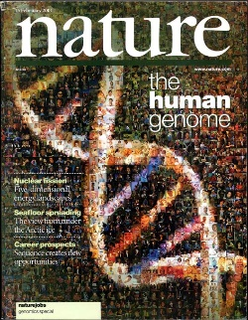
Table 5 - Publications of Those in Training
The faculty members ability to foster trainee productivity through publishable results
Allows assessment of the research quality and authorship priority of trainees
Summarize these data in the body of the application

Slide 91
Instructions differ between New and Renewal Applications
New
Renewal
List publications for participating faculty for current predoc/postdocs and those that would have been eligible for appointment to the TG for the last 10 years
List publications for renewal participating faculty, those trainees currently appointed to the TG or appointed in the last 10 years

Slide 92
Table 5 Instructions
Total training period in YYYY format only
Mentor to the trainee – can have up to 2
Full Citation
Trainee Name
Past or Current trainee

Slide 93
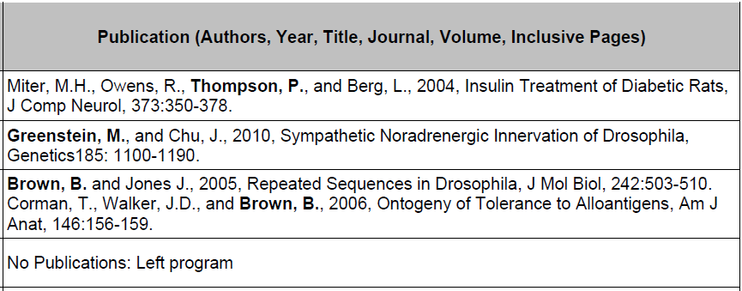
Publication Instructions
No longer need PMCID Number, collected at JIT
List all publications of students resulting from their period of training or in association with the current training program, through completion of their degree
Abstracts should no longer be reported

Slide 94
Publication Instructions
Boldface student’s name in author list
“No publications” require an explanation:
New entrant
Leave of absence
Change of research supervisor
Left program
Other
Do not list publications resulting from work done prior to entering the training program or arising from research initiated after the completion of the program

Slide 95
Table 5 Instructions
Publications are listed in alphabetical order by faculty
Grouped then by past, then current trainees
Then in chronological order

Slide 96
New Data Table 5 Changes
Remember, abstracts should no longer be reported

Slide 97
Tips to hunting & gathering for Table 5
Email PI or trainee directly for their publications list
Use and databases and search by grant or trainee
http://www.ncbi.nlm.nih.gov/

Slide 98
Best Practices for Table 5
Using xTRACT is much easier because it formats everything for you!
Be sure to follow the correct instructions for a new or renewal application

Slide 99
Tables 6 Objectives
Applicants, Entrants, and Their Characteristics – Permit the evaluation of the ability of participating departments/programs to recruit trainees
This data is useful in assessing:
Selectivity of the admissions process
Competitiveness of the training program
Appropriate number of training positions to be awarded
Analyze and summarize this data in the Program Plan

Slide 100
Two Parts to 6A and 6B
6A Predocs
Part I. – Counts – applicants and entrants
Part II. – Characteristics – GPA’s
6B Postdocs
Part I. – Counts – Applicant pool by degree type
Part II. – Characteristics – Publication averages
Both pre and postdocs include prior institutions, disability and URM
Summarize these data in the Program Plan (Trainee Candidate Section) of the Research Training Program Plan. Analyze the data in terms of the overall numbers of potential trainees, their credentials, characteristics and eligibility for support, and enrollment trends

Slide 101
Tables 6A, Part I. Counts - Predocs
Number of individuals who formally applied for training and were eligible for support from this grant. (i.e. Do not include non-citizens)
Basically listing all participating programs, depts. from table 1
Number of ALL individuals who formally applied for training to this program
Notes:
Do I want to use a better slide with more realistic numbers?

Slide 102
Tables 6A, Part I. Counts- Predocs
Number of new entrants to the department or program who were eligible for support from this grant. (i.e. Do not include non-citizens)
Number of new entrants to the department or program
Include non-citizens
(Renewals or Revisions only) Number of new entrants appointed to this grant
Notes:
Do I want to use a better slide with more realistic numbers?

Slide 103
Tables 6A, Part II. Characteristics - Predocs
For each category enter the mean number of months of prior, full-time research experience and also (range)
This is the institution the predoc entrant received their undergrad degree. List it only once, followed by the (range)
Leave the shaded cells blank as applicable

Slide 104
Tables 6A, Part II. Characteristics - Predocs
Percent of individuals with disabilities in each category
Percent of individuals from underrepresented groups in each category
Mean GPA and (range), using a 4.0 scale for each category include total applicant pool

Slide 105
Predocs Characteristics - mean across all years
Notes:
Do I want to use a better slide with more realistic numbers?

Slide 106
Table 6B, Part I. Counts - Postdocs
Postdocs are counted differently. List the following counts by each major degree type

Slide 107
Tables 6b, Part II. Characteristics - Postdocs
Mean number of publications
(range) for each category
Mean Number of First-Author Publications (range)
Similar to Predoc information but adds in publications info, no GPA or research experience required

Slide 108
Again, mean across all years for postdoc characteristics
Notes:
Do I want to use a better slide with more realistic numbers?

Slide 109
Tips to gathering data for Table 6A - Predocs
Contact Training Grant Analyst for 6A
Admissions and acceptance info by dept., ethnicity, degree and institution they received undergrad degree, GPA’s, some disability info, initial placement after they leave such type and institution
Or
Contact individual Graduate departments such as Biomedical Sciences, etc.
List of Graduate coordinators on Blink:
https://ga.ucsd.edu/a/grad_dept_prog_contacts

Slide 110
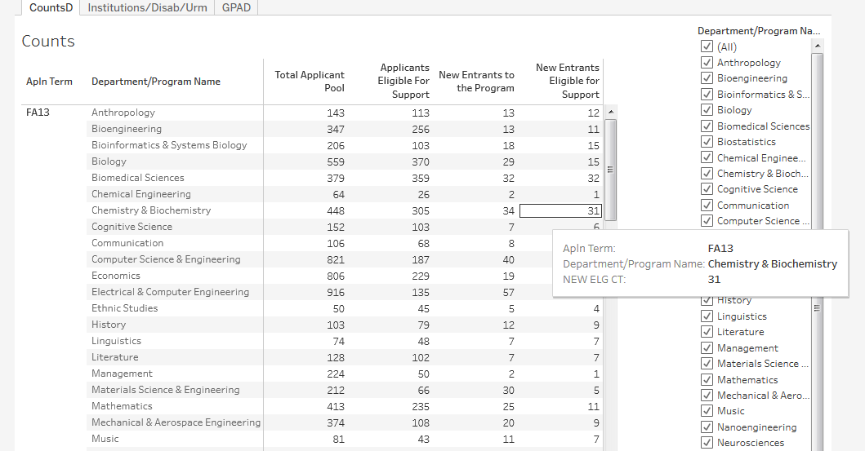
Table 6A Predoc – Tableau Reports

Slide 111
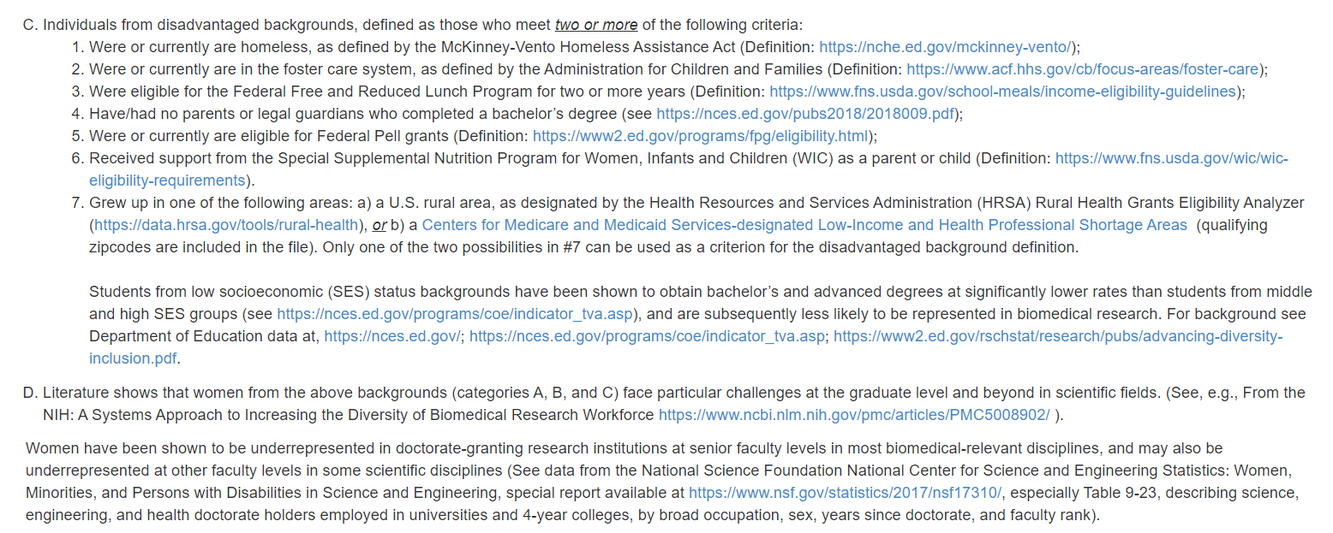
New Data Table 6A Changes
Definition of Diversity Changed
NIH’s Notice of Interest in Diversity
https://grants.nih.gov/grants/guide/notice-files/NOT-OD-20-031.html

Slide 112
New Data Table 6A Changes
If the participating departments, divisions, or programs do not collect information on all the groups identified in NIH’s Notice of Interest in Diversity, enter data on the groups for which information is available
https://grants.nih.gov/grants/guide/notice-files/NOT-OD-20-031.html

Slide 113
New Data Table A Changes
NIGMS only - Table A
Part Ia: Numbers and Characteristics of Applicants
Part IIa: Numbers and Characteristics of Admitted Individuals
Part IIIa: Numbers and Characteristics of Matriculants
Part IIb: Admitted Individuals Across Departments
The suggested Format Table A should be combined with the other required attachments (such as the Recruitment Plan to Enhance Diversity, Trainee Retention Plan, etc.) and uploaded to “Other Project Information” of the PHS 398 Research Training Program Plan Forms F and must not be included in the Data Table section
https://www.nigms.nih.gov/training/instpredoc/Pages/predoctoral-nih-data-tables-data-formats.aspx

Slide 114
New Data Table A Changes
https://www.nigms.nih.gov/training/instpredoc/Pages/predoctoral-nih-data-tables-data-formats.aspx

Slide 115
Tips to gathering data for - Table 6B - Postdocs
Office of Postdoc and Visiting Scholar Office (Research Affairs)
Research Scholar Appointment System RSAS System
No Applicant Data
Contact: Jennifer Oh-Bourque @ x46632 or jmoh@ucsd.edu
Funding mechanism
Ethnicity
Faculty mentor
Citizenship
Degree
Prior institution
No stats on disabilities or URM data
RSAS data just reflects data of postdocs entrants into UCSD since applicant data is not formally collected
https://pulse.ucsd.edu/departments/research-service-core/training-grants/Pages/default.aspx
Notes:
Small font, split slide?

Slide 116
Tips to hunting & gathering for Table 6B
Office of Postdoc and Research Scholar Affairs
Uses RSAS System – Research scholar Appt. System
Do not have stats on URM or disabilities
Jennifer Oh-Bourque x46632 or jmoh@ucsd.edu
No easy solution for gathering this data
https://pulse.ucsd.edu/departments/research-service-core/training-grants/Pages/default.aspx

Slide 117
Best Practices and Tips for Table 6A & B
Predocs - For the last 5 completed academic years
Starting with the most recent year i.e. 2018-2019, 2017-2018, etc.
Postdocs - Can be either grant or academic year for the last 5 completed years
Keep good records if possible, if not just try your best! This is a difficult table!

Slide 118
Data Table 7

Slide 119
Table 7 Objectives
Appointments to the Training Grant for Each Year of the Current Project Period
Awarded training positions for the last 5 years
(Renewal/Revision Applications Only)
Summarize this data in the Progress Report Section. Also useful to refer to this data within the “Recruitment and Retention Plan” to Enhance Diversity Section

Slide 120
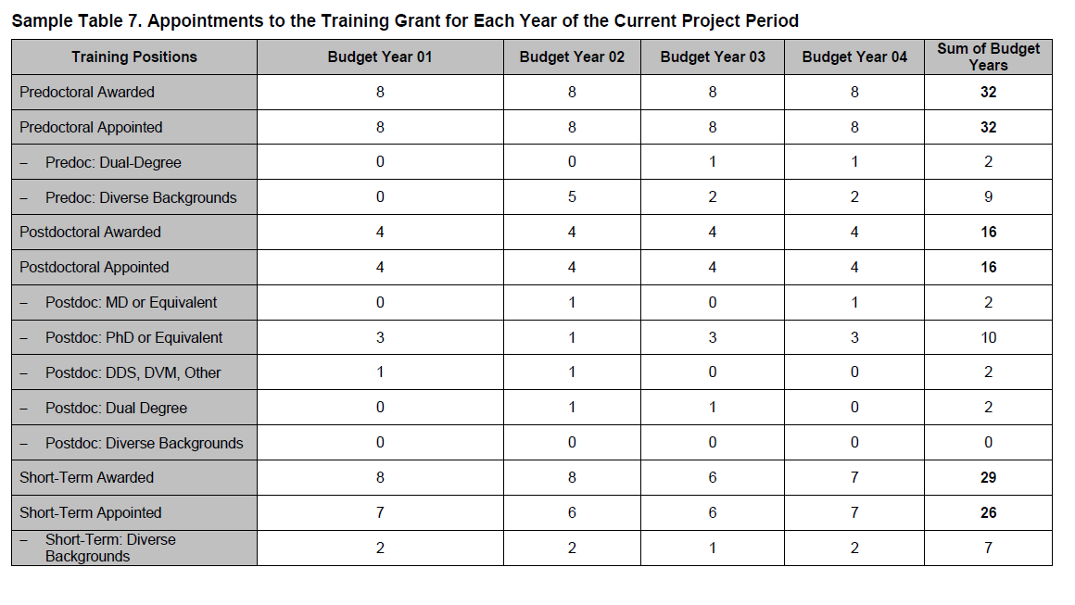
Table 7 Instructions
Since the last competing grant application provide the following counts awarded and appointed for each complete budget year
Sum of Budget Years

Slide 121
Tips on gathering Data Table 7 Info
Look at previous RPPR’s, notice of awards and/or tracking records for awarded slot information
Check your “trainee diversity report” from the past RPPR’s
If you have access to xTRAIN then you can view the grant detail for current and previous years

Slide 122
New Data Table 7 Change
Definition of Diversity Changed
NIH’s Notice of Interest in Diversity
https://grants.nih.gov/grants/guide/notice-files/NOT-OD-20-031.html

Slide 123
Best Practices for Table 7
Your numbers should match between awarded and appointed!
NIH will not look favorably if you didn’t fill all your slots!

Slide 124
Table 8 Objectives
Program Outcomes
Effectiveness of the proposed training program
Track trainee outcomes for 15 years
Summarize the data in the Program Plan Section or the Progress Report Section, as appropriate

Slide 125
Table 8 has Four Parts
Part I.
Part II.
Part III.
Part IV.
Those Appointed to the Training Grant
Those Clearly Associated with the Training Grant
Recent Graduates
Program Statistics – Predocs only
Notes:
FIX ANIMATIONS?

Slide 126
Instructions differ between application types
New
Renewal
RPPR
Part I. Those Appointed to the Training Grant
Part I. Those Appointed to the Training Grant
Part III. Only Recent Graduates for the last 5 years
Part II. Those Clearly Associated with the Training Grant
Part II. Those Clearly Associated with the Training Grant
Part III. Recent Graduates (only for expanding programs)
Part IV. Program Statistics – predocs only
Part IV. Program Statistics – predocs only

Slide 127
Data Table 8 Instructions
Up to two faculty members
The start date (MM/YYYY format - no day) is the first year that the trainee began graduate studies at the applicant institution, even if they did not become associated with the training program until later
Predoc trainee is defined as a Ph.D candidate, master’s students and undergrads excluded

Slide 128
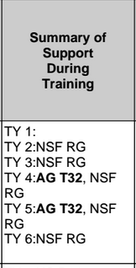
Sources of Support
Provide the primary source and type of support during each 12-month period of training, using TY1 for Training Year 1, etc.
If the trainee was listed on a prior RPPR for any NIH grant, it should appear in xTRACT automatically. Other non-NIH fund sources will need to be manually entered.
Sources of Support
• NSF
• Other Federal (Other Fed)
• University (Univ)
• Foundation (Fdn)
• Non-US (Non-US)
• Other (Other)
Types of Support
• Research assistantship (RA)
• Teaching assistantship (TA)
• Fellowship (F)
• Training Grant (TG)
• Scholarship (S)
• Other
**New option to report leave of absence for trainees, when applicable

Slide 129
Degrees for Predocs
For past predocs, list the terminal degree received and year awarded
Trainees currently in the program should be designated “in training”
Those who have left the graduate program without a degree, report “none.”

Slide 130
Topic of Research – Predocs & Postdocs
Research Topic is limited to 200 characters

Slide 131
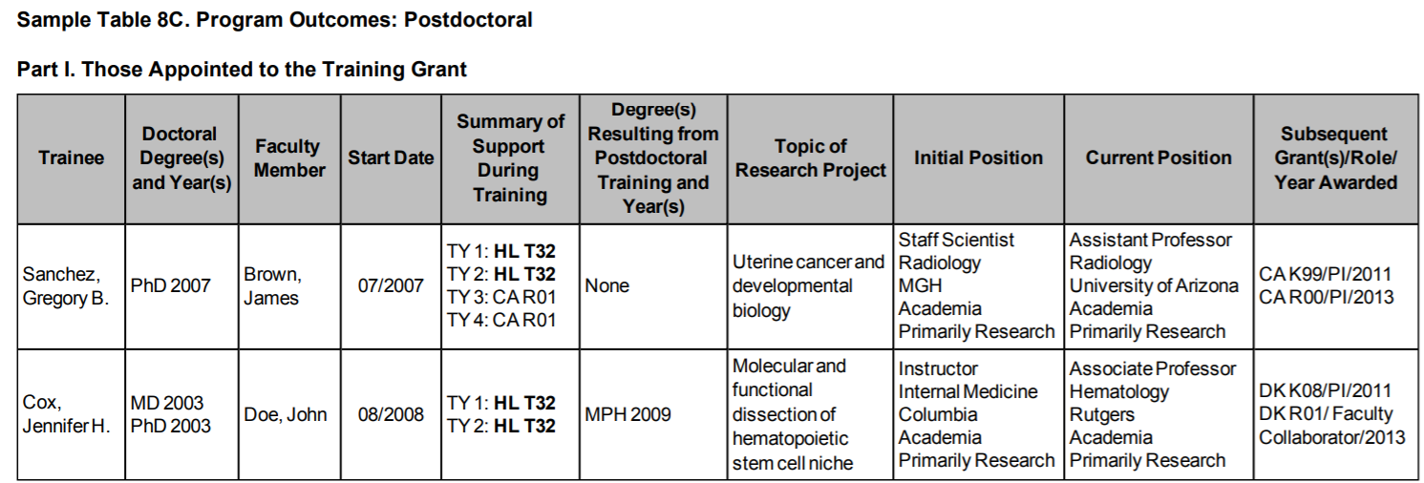
Degrees Dates for Postdocs
List degree resulting from postdoc training, usually “none.”

Slide 132
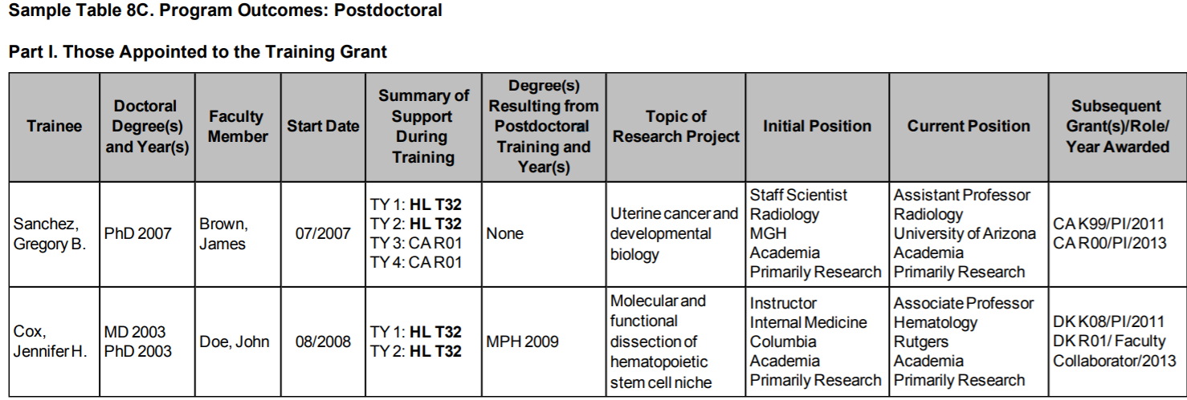
Post-Training Positions
For trainees who completed or left the program, provide their initial and current positions, departments, and institutions
Classify each position as predominantly:
Research-intensive
Research-related:
Teaching
Administering research
Science policy
Technology transfer
3. Further Training
4. Other
If information is not available, report “unknown.”
**New - Indicate “work force” and “principal activity.”

Slide 133
Subsequent Grants
The support can be from any source whether as PD/PI or in another senior role:
Co-I
Faculty collaborator
Staff scientist
Other
If applicable, list the type of
support after completed training:
Subsequent fellowship (F)
Career development (K)
Research grant (R)
Up to five grants may be listed

Slide 134
New Data Table 8 Changes
Other Sources of Support
New option to report leave of absence for trainees, when applicable
For each initial or current position indicate the:
Workforce sector
i.e., academia, government, for-profit, nonprofit, other
Principal activity
i.e., primarily research, primarily teaching, primarily clinical, research-related, further training, unrelated to research

Slide 135
Part II. Clearly Associated Students

Slide 136
Clearly associated is defined as:
A current trainee who is having a training experience identical to those appointed to this grant and they must have been or currently are funded by another HHS or NIH mechanism (fellowship, R01, even for a short time)
Eligibility to be on a TG is NOT a factor here
e.g. non-citizen’s can be listed if they are on HHS or NIH fund sources

Slide 137
Table 8 Part II. Clearly Associated
Same instructions as Part I.
For RPPR’s -
In each subsequent year, they should continue to add new entrants and provide updated information about current and past clearly associated students until 15 years of data have been completed
Notes:
Split slide, small font?

Slide 138
Table 8 Part III. Recent Graduates

Slide 139
Table 8 Part III. Recent Graduates
Similar instructions to Part I & II
For NEW applications & predoc renewal/revision applications requesting an expansion to postdoc support OR vice versa
List sequentially all pre or postdocs whom have completed the proposed program in the last five years who would have been eligible for appointment, if an NIH training or related award were available
Summarize the data from Parts I-III (as applicable) in the Research Training Program Plan, either in the Program Plan Section or the Progress Report Section, as appropriate
Notes:
Split slide, small font?

Slide 140
Table 8 Part III. Recent Graduates
For each predoc or postdoc, no summary of Support During Training
Notes:
Split slide, small font?

Slide 141
Table 8 Part IV. Program Statistics

Slide 142
Table 8 Part IV. Program Statistics – Predocs
The percentage of trainees entering 10 years ago that received support from this training grant who received PhDs or equivalent degrees
Average amount of years to Ph.D.
Calculated to one decimal place (e.g., 5.5 years)

Slide 143
Table 8 Part IV. Program Statistics - Predocs
New programs that have not yet had any trainees complete the PhD should not include this table at all
For RPPRs - summarize this data in the Accomplishments Section
What opportunities for training and professional development has the project provided?”

Slide 144
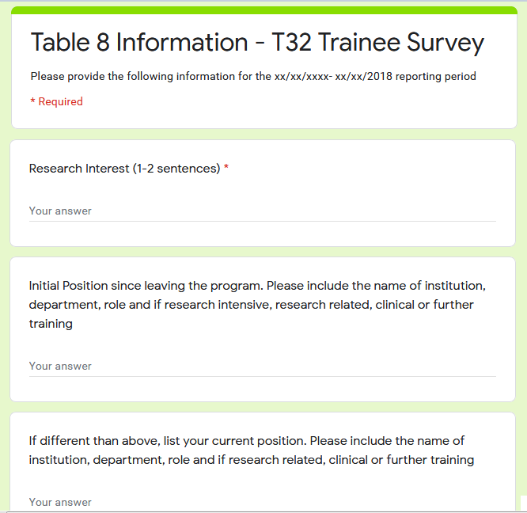
Tips on Gathering Info for Table 8
Create a group page for your program. At the time of appointment be sure to have the trainee add themselves to the account and that they understand the expectation of staying in contact for the next 15 years
Send out a Table 8 Annual survey
Email trainees to update their “Personal Profile” in

Slide 145
Trainee Tracking
Applicants
Participating Faculty
Trainees
https://pulse.ucsd.edu/departments/research-service-core/training-grants/trainees/Pages/trainee-tracking.aspx
Notes:
Why is this slide here?

Slide 146
Best Practices for Table 8
Provide as much data as reasonably possible. Exercise due diligence in collecting and verifying data
Start early with your tables there is a LOT of data entry, especially in xTRACT
Consider yourself a professional stalker!

Slide 147
Final Thoughts on Table 8
Be proactive and begin collecting the relevant information at the beginning of the grant, so that it will be available in the future
Tracking former participants after program completion can be challenging. Establish expectations at the time of appointment
These records are essential for creation of annual progress reports (RPPR’s) and a future renewal application

Slide 148
Finalizing the Data Tables
Provide as much data as reasonably possible. Exercise due diligence in collecting and verifying data
Start early with your tables there is a LOT of data entry, especially in xTRACT
Begin collecting the relevant information at the beginning of the grant, so that it will be available in the future

Slide 149
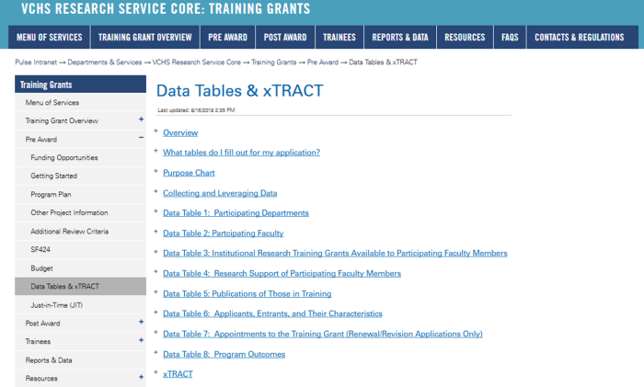
Data Tables - Website
Use your active directory (AD) credentials to log in
http://grants.nih.gov/grants/funding/datatables/datatables_intro.pdf

Slide 150
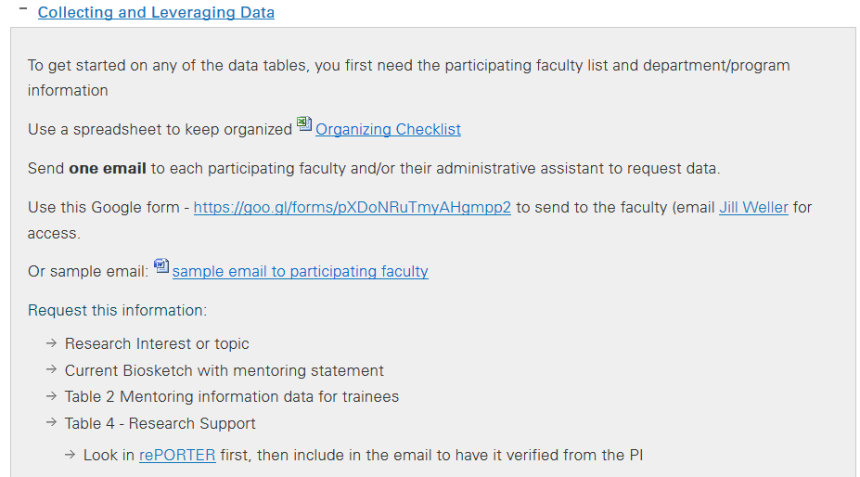
Data Tables –Tips

Slide 151
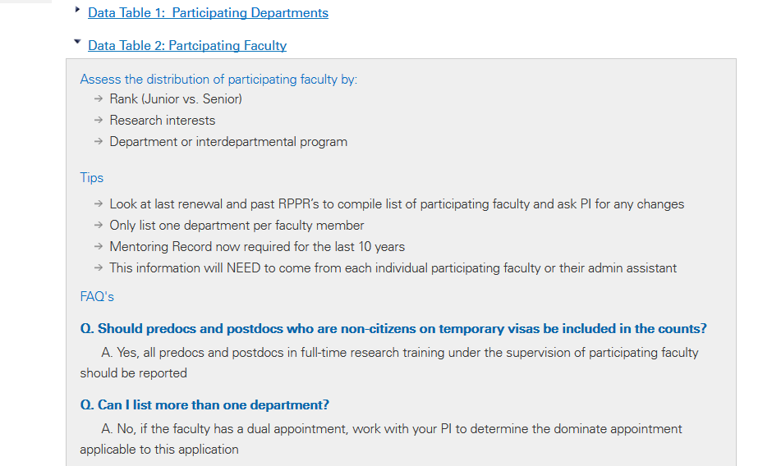
Data Tables –Tips

Slide 152
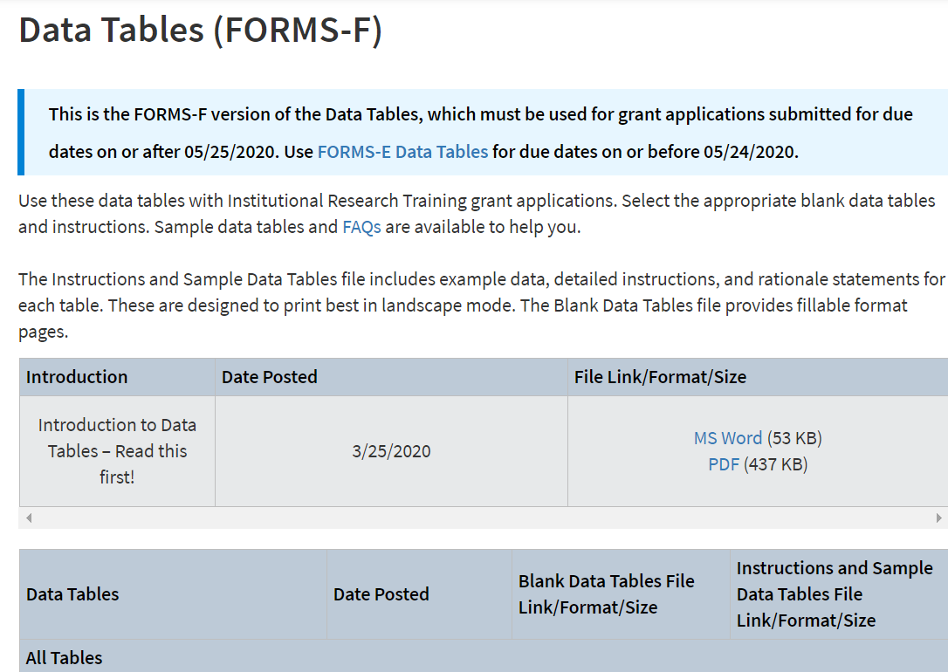
Data Tables: New FORMS-F
NIH Introduction to Data Tables
http://grants.nih.gov/grants/funding/datatables/datatables_intro.pdf

Slide 153
Important Points to Remember for all Data Tables
Be organized – use spreadsheets, and checklists
Keep a copy of the instructions handy and refer to them often
Different instructions for new VS renewal application
Use the TG website as a resource: pulse.ucsd.edu/traininggrants

Slide 154
Preparing a Budget

Slide 155
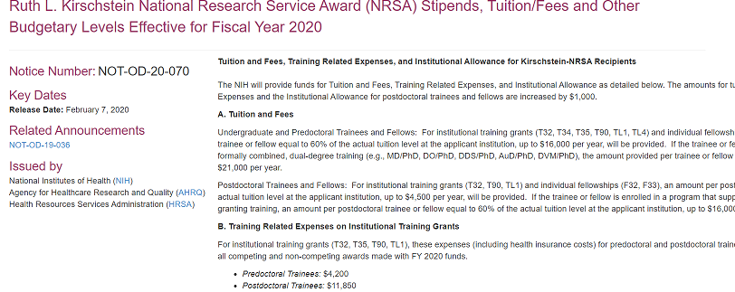
NOT-OD-20-070 FY2020 NRSA Stipend Levels

Slide 156
Building a Budget
Determine the number of slots requesting each year
Undergrad R25, T34
Predocs T32
Postdocs
T32
Short-Term Trainees T35, KL2, R25

Slide 157
Undergrad Stipends - MARC Program (T34) FY2020
Annual Stipend - $13,368
Monthly - $1,114
https://grants.nih.gov/grants/guide/notice-files/NOT-OD-20-070.html

Slide 158
Predoc Stipends
For T32, T35, T90, TL1 and individual fellowships F30, F31:
One stipend level is used for all predocs, regardless of the level of experience
Most programs such BMS pay “additional compensation” to their predoc trainees
Career Level | Years of Experience | Stipend for FY 2020 | Monthly Stipend
Predoctoral | All | $25,320 | $2,110

Slide 159
Postdoc Stipends
Stipend level for the first year of support is determined by the number of full years of relevant postdoc experience when the award is issued
Relevant experience may include:
Research experience (including industry)
Teaching
Internship
Residency
Clinical duties, etc.

Slide 160
Postdoc Stipends
Once the appropriate stipend level has been determined, the fellow must be paid at that level for the entire grant year
The stipend for each additional year of NRSA support is the next level in the stipend structure and does not change mid-year
Year 3
Level 2
Year 2
Level 1
e.g. In subsequent years based on initial level + 1 year
Year 1
Level 0

Slide 161
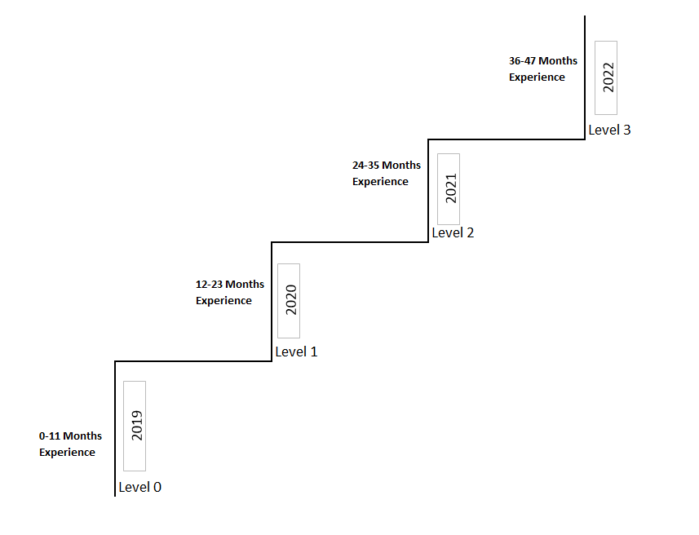
initial level + 1 year

Slide 162
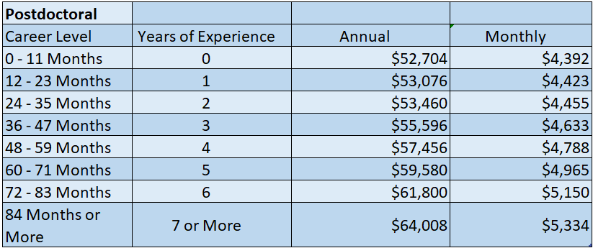
Postdoc Stipends Amounts
https://grants.nih.gov/grants/guide/notice-files/NOT-OD-20-070.html

Slide 163
Predocs Tuition/Fees
For T32, T34, T35, T90, TL1, F30, F31
An amount per predoc trainee equal to 60% of the level requested by the applicant institution, up to $16,000 per year, will be provided
Link to Graduate Division tuition/fees for 2020/2021
https://grad.ucsd.edu/financial/tuition-fees.html#Proposed-2020/2021-Tuition-&-Fe https://grants.nih.gov/grants/guide/notice-files/NOT-OD-20-070.html

Slide 164
Tuition/Fee Overdraft
Any remaining predoc tuition/fees balance must be covered by the mentor or department from a non-federal fund source

Slide 165
Postdoc Tuition/Fees
T32, T90, TL1, F32, F33
An amount per postdoc trainee or fellow equal to 60% of the level requested by the applicant institution, up to $4,500 per year, will be provided
https://grants.nih.gov/grants/guide/notice-files/NOT-OD-20-070.html

Slide 166
Training Related Expenses
For T32, T35, T90, TL1, F30, F31, F32, F33
Predoc Trainees: $4,200
Postdoc Trainees: $11,850
These expenses (including health insurance costs for postdocs) will be paid for all competing and non-competing awards made with FY 2020 funds

Slide 167
Postdoc Benefits Overdraft
Any remaining Postdoc benefits balance must be covered by the mentor or department from a non-federal fund source

Slide 168
Travel
Usually per/trainee formula bases, varies among institutes
Can be different ranges for pre and postdocs
Keep the request per student within reason and identical unless instructed otherwise by the NIH or IC

Slide 169
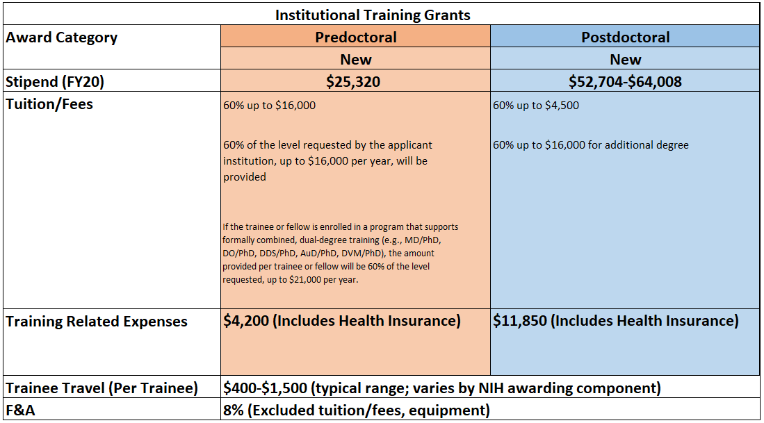
Budget: Synopsis
Notes:
Make this into a handout

Slide 170
Budget
Justification

Slide 171
Stipends - Number of training slots
Predoc
Postdoc
e.g. 6 Predocs @ $25,320 = $151,920
Justify the specific stipend levels requested
e.g. 1 Level 0 Postdoc = $52,704
e.g. 1 Level 1 Postdoc = $53,076
Stipulate the duration of the proposed program
e.g., 2 years for each trainee

Slide 172
Training Related Expenses
Predoc
Postdoc
e.g. $4200 x 6 = $25,200
e.g. $11,850 x 2 = $23,700
Amount per trainee

Slide 173
Tuition/Fees & IDC
Predoc
Postdoc
Always ask for the full amount, don’t do the cut yourself!
e.g. Resident tuition/fees for 6 predocs - $13,528 x 6 = $81,174
5% escalation in out years
Describe the specific course(s) each trainee will take and the amount
e.g. All level postdoc will attend CREST Courses, $4500 x 2 = $9,000
Notes:
Do you need to break out health insurance out of tuition/fees for predocs? That will contradict the budget

Slide 174
Travel
Predoc or Postdoc
Trainee travel funds – list conferences if known
$1,000 per trainee, $1000 x 8 = $8,000
Notes:
Do you need to break out health insurance out of tuition/fees for predocs? That will contradict the budget

Slide 175
IDC (Burden)
8% IDC Rate
Tuition and fees are excluded from indirect cost base
Notes:
Do you need to break out health insurance out of tuition/fees for predocs? That will contradict the budget

Slide 176
Important Points to remember about the Budget
Always use NRSA stipend levels per the latest NIH NOT-OD-20-070
Don’t escalate the stipend levels on a 5 year budget
Do escalate the fees at 5%
https://grants.nih.gov/grants/guide/notice-files/NOT-OD-20-070.html

Slide 177
Build a Budget Exercise

Slide 178
Other Application Components

Slide 179
Samples of Other Components
Program Plan
Enhance Diversity
Responsible Conduct of Research
Facilities and Resources
Narrative
Progress Report (if applicable)
Abstract
Biosketches
Animals
Human Subjects

Slide 180
Samples of Other Components
Facilities & Resources
Abstract
Program Plan
Narrative
- Responsible Conduct of Research
- Recruitment Plan to Enhance Diversity
Animals
Progress Report (Renewals)
Human Subjects
Faculty Bio- sketches
Institutional Commitment Letter

Slide 181
Biosketches

Slide 182
Mentoring Biosketch is different from Research Biosketch
Personal statement should describe commitment to mentoring
Address diversity/inclusion efforts
Address Responsible conduct of Research (RCR)
Format and layout matter
Is the Biosketch consistent with other parts of the application?

Slide 183
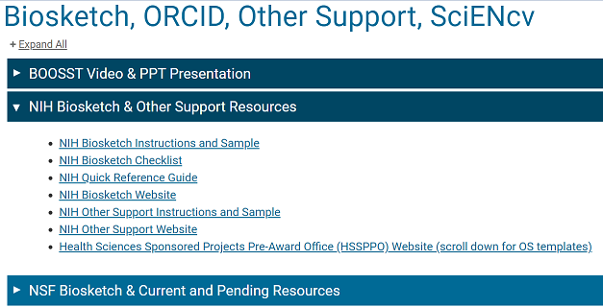
Biosketches
Required for all Key Personnel and Participating Faculty
Should be collated into one PDF and uploaded into ASSIST package
Resources and Samples on Blink:

Slide 184
Institutional Commitment Letter

Slide 185
Institutional Commitment Letter
Per new NIH requirements: NOT-GM-19-017 PAR-19-102
One 10 page letter maximum
Signed by institutional leader (EVC)
Must include information such as:
Harassment and discrimination
How UCSD supports training programs
Diversity and inclusion
https://grants.nih.gov/grants/guide/notice-files/NOT-GM-19-017.html
https://grants.nih.gov/grants/guide/pa-files/PAR-19-102.html

Slide 186
Institutional Commitment Letter
Safety of Trainees
Adequate facilities & resources
Sufficient funds for PI’s that lose funding
Disabilities
Grad Division Commitments
See FOA/NOT for more details
Contact Training Grant Analyst to start the Institutional Letter Process at least 6 weeks before deadline
https://grants.nih.gov/grants/guide/notice-files/NOT-GM-19-017.html
https://grants.nih.gov/grants/guide/pa-files/PAR-19-102.html

Slide 187
KR Demo Day 2
Notes:
Do you need to break out health insurance out of tuition/fees for predocs? That will contradict the budget

Slide 188
Website Demo
Know your Resources
Forms
Reports and data
Templates
Handouts
pulse.ucsd.edu/traininggrants

Slide 189
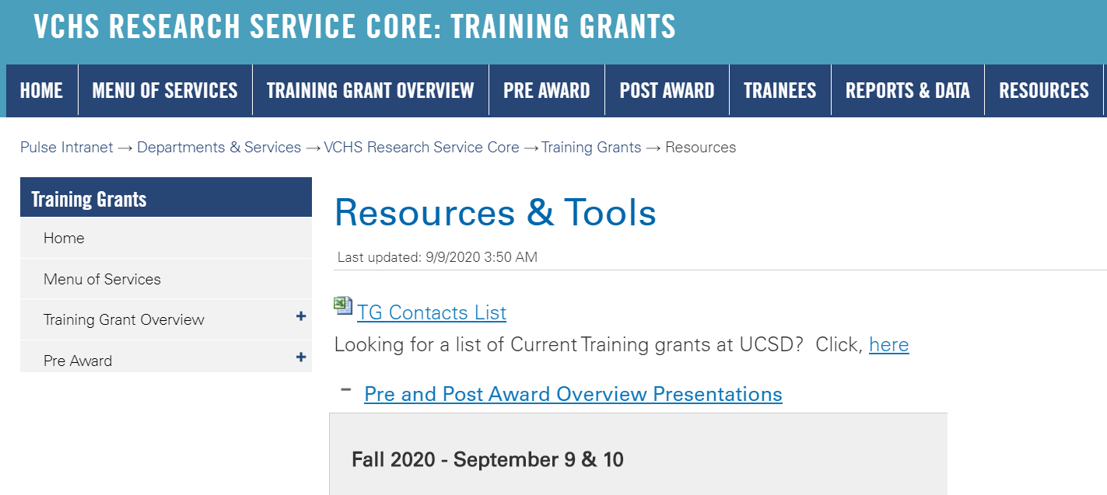
https://pulse.ucsd.edu/traininggrants

Slide 190
Jill I. Weller
Training Grant Analyst
X43933
jweller@ucsd.edu
Questions?

