Slide 1
Tax Information
Jill I. Vampola Training Grant Analyst Research Service Core
March 7, 2024

Slide 2
Stipend and Taxes
No federal and state taxes are withheld from monthly stipend check
Trainee receives gross pay with no taxes taken (social security, federal, state, Medicare, SDI, etc.)
Trainees are not subject to employer/employee FICA withholding

Slide 3
Stipend and Taxes
Trainee will not receive a W2 for stipend payments
Trainees are not employees of the university
Trainee is required to report stipend payments as “additional income” to the IRS
UCSD does not issue 1099’s at the end of the year

Slide 4
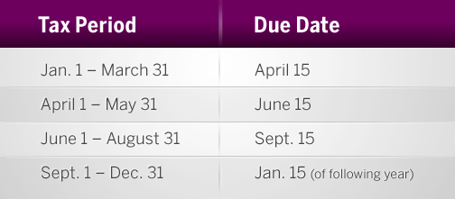
Tax Liability Options
Option to submit federal and state quarterly estimated tax payments by using the Federal Form 1040-ES and California State Form 540-ES
https://pulse.ucsd.edu/departments/research-service-core/training-grants/trainees/Pages/trainee-pay-taxes.aspx

Slide 5
Another Option
Trainees receive a stipend and additional compensation (salary) payments each month and have the option to increase the amount withheld from the salary paycheck to cover any tax liability for the total combined income

Slide 6
Stipend and Additional Compensation | Predocs | Postdoc Researcher | Clinical Resident
NIH Stipend Payment | ProSAM - Student Aid Management System | UC PATH | UC PATH
Additional Compensation | UC PATH | UC PATH | UC PATH
Additional Tax Withholdings from payroll check to cover stipend

Slide 7
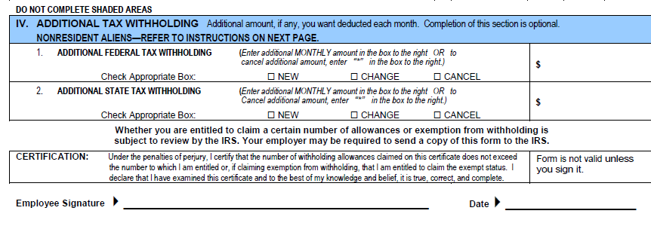
Additional Withholdings
In Section IV of the UC W-4, you may authorize additional federal and state tax withholding

Slide 8
Additional Withholdings
Remember to cancel the additional withholdings when they are no longer receiving stipend payments and receive only GSR or Resident Physician salary

Slide 9
Common Questions about Taxes
Why didn't I receive my W-2?
Stipend payments have not yet been reported to the IRS, it is self-reported on your W-4 as "additional income.“
How do I know the amount of stipends I received for the last tax year?
Refer to the initial trainee appointment letter for the stipend amount
I received my W-2, but it doesn't list my entire income for last year
Only additional compensation will be on the W-2, the stipend portion is self-reported and not reflected

Slide 10
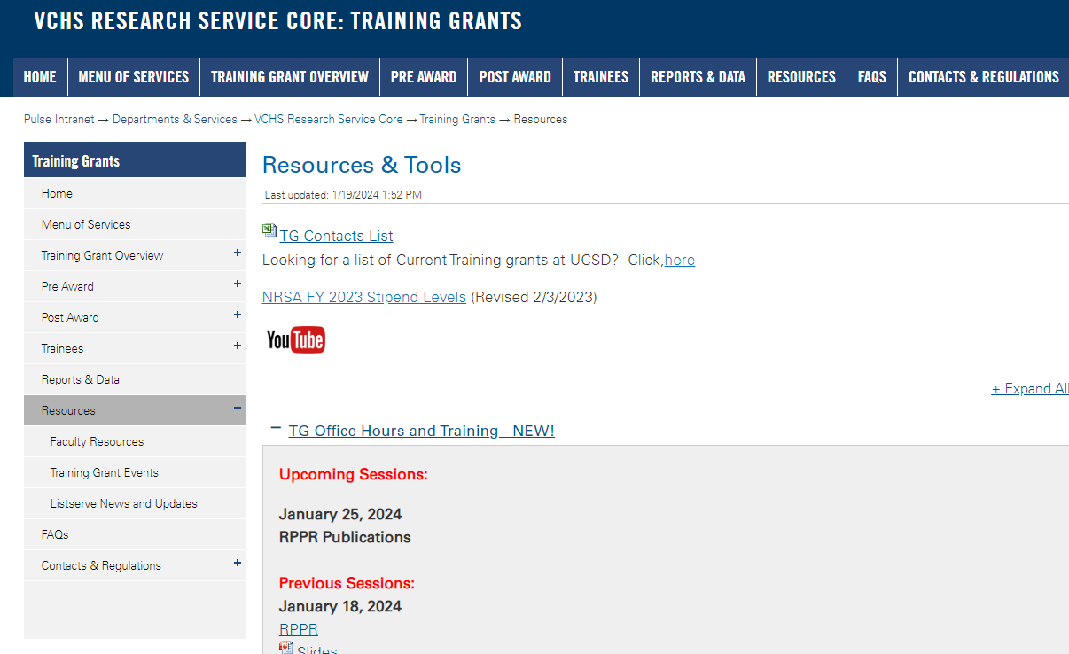
https://pulse.ucsd.edu/traininggrants - AD credentials required
Resources
Notes:
If you need to remember one thing.. Its the TG website.

Slide 11
Coming up TG Office Hours
Notes:
Add this to your Google Calendar https://calendar.google.com/calendar/u/0?cid=amVjZHVqZTA0ZTM1aGQzcW1wbnB0djloNGdAZ3JvdXAuY2FsZW5kYXIuZ29vZ2xlLmNvbQ

Slide 12
Questions

