Slide 1
Trainee Grant Tracking
Jill I. Vampola Training Grant Analyst Research Service Core
September 28, 2023

Slide 2
Recap from last office hours
Jenn Bourque, Director of Postdoctoral Scholar Affairs

Slide 3
Today’s Presentation
4 Areas of Trainee Tracking

Slide 4
Four Key areas of Trainee tracking
Applicants (for Data Table 6b)
Participating Faculty (Data Table 2)
Current and Past Trainees (for Data Table 5 & 8)
Program Activities (RPPR’s & Renewals)

Slide 5
Tracking Importance
Training program information must be recorded, maintained and updated regularly
Avoid the last minute struggle to gather info when requested!
These programmatic records are essential for creation of annual progress reports (RPPR’s) and a future renewals

Slide 6
Applicants (Postdocs)

Slide 7
Tracking Applicants -Data Table 6
Anyone that applies to the TG (even if not accepted into the program)
Application Date
Start date if acceptance into the program
Citizenship (determines eligibility)
Terminal and any received degrees
Prior Institution

Slide 8
Tracking Postdoc Applicants -Data Table 6
Any Publications
Note 1st authored papers
Prior Teaching or Clinical Experience (predocs only)
Race/Ethnicity
Prior NRSA Support

Slide 9
Underrepresented Groups
Individuals from groups that are underrepresented in the sciences as defined by the NSF:
Racial and ethnic groups
Disability
Disadvantaged backgrounds
https://grants.nih.gov/grants/guide/notice-files/NOT-OD-20-031.html
https://www.nsf.gov/statistics/showpub.cfm?TopID=2&SubID=27

Slide 10
Group A: Underrepresented racial and ethnic groups
Black or African American
Hispanic or Latino
American Indian/Alaska Native
Native Hawaiian or Other Pacific Islander

Slide 12
Group B: Individuals with Disabilities
Disability Definition
Physical or mental impairment that substantially limits a major life activity
Major Life Activities Include but are not limited to:
Caring for oneself
Performing manual tasks
Breathing, walking, talking, hearing, eating, seeing, sleeping
Working
https://www.ada.gov/law-and-regs/ada/

Slide 13
Group C: Individuals from disadvantaged backgrounds, defined as those who meet two or more of the following criteria
Were or currently are homeless
Were or currently are in the foster care system
Were eligible for the Federal Free and Reduced Lunch Program for two or more years

Slide 14
Group C: Individuals from disadvantaged backgrounds
Have/had no parents or legal guardians who completed a bachelor’s degree
Were or currently eligible for Federal Pell grants
Received support from the Special Supplemental Nutrition Program for Women, Infants and Children (WIC)

Slide 15
Group C: Individuals from disadvantaged backgrounds
Grew up in one of the following areas:
A U.S. rural area, as designated by HRSA Rural Health Grants Eligibility Analyzer https://data.hrsa.gov/tools/rural-health or
A qualifying zip-code https://www.qhpcertification.cms.gov/s/LowIncomeandHPSAZipCodeListingPY2020.xlsx?v=1
Only one of the two possibilities can be used as a criterion for the disadvantaged background definition
https://grants.nih.gov/grants/guide/notice-files/NOT-OD-20-031.html

Slide 16
Participating
Faculty

Slide 17
Tracking Participating Faculty - (Data Table 2)
Participating Faculty
Rank
Department
Admin contact
This information directly affects other TG’s on campus: e.g., Table 3 Overlapping faculty. Be sure to update changes in the progress reports (RPPR’s)

Slide 18
Trainees
(Current and Past)

Slide 19
Current and Past Trainees (for Data Table 8)
Permanent Email
Mentor Faculty (Co-mentor if applicable)
Trainee Type: Predoc or Postdoc
Terminal Degree(s) Received and Year(s)
Degree(s) Resulting from Training and Year(s)
Beginning and End dates in the program
Topic of Research Project

Slide 20
Current and Past Trainees (for Data Table 8)
Initial Position after leaving UCSD Program
Current Position
Workforce Sector
Academia
Government
For profit
Non profit
Other

Slide 21
Current and Past Trainees (for Data Table 8)
Current Principal Activity
Primary Research
Primarily Teaching
Primary Clinical
Research Related
Further Training
Unrelated to Research
Subsequent grants awarded

Slide 22
Current and Past Trainees (for Data Table 8)
Coursework – such as Ethics (RCR) Training
Individual Development Plan (IDP) Completed
Social Media links such as:

Slide 23
Program Activities

Slide 24
Program Activities
Courses Offered and Enrollment
e.g. CREST Program for clinical postdocs
Symposia & Seminars Held
Keep flyers & any information on guest speakers
Attendance and (Poster) Presentations at Professional Meetings
e.g. Presented Poster at ACS conference in July 2023

Slide 25
Program Activities
Other milestones of the training program
Professional Career Development Activities (Grant Writing Courses, Postdoc Bootcamp, etc.)
Specialized Training or New Lab Techniques

Slide 26
Tracking Spreadsheet & Forms

Slide 27
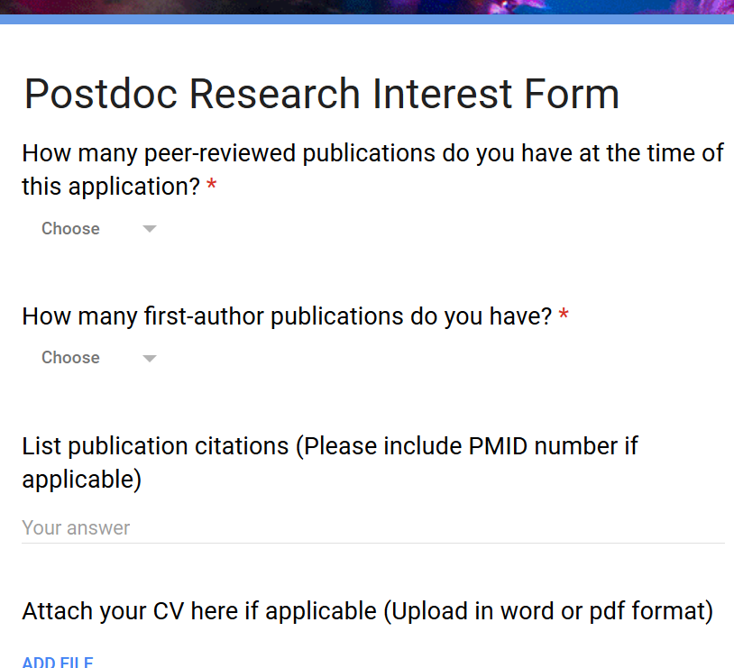
Collecting 6B Data
Intended for a postdoc that makes an inquiry to join your PI’s lab

Slide 28
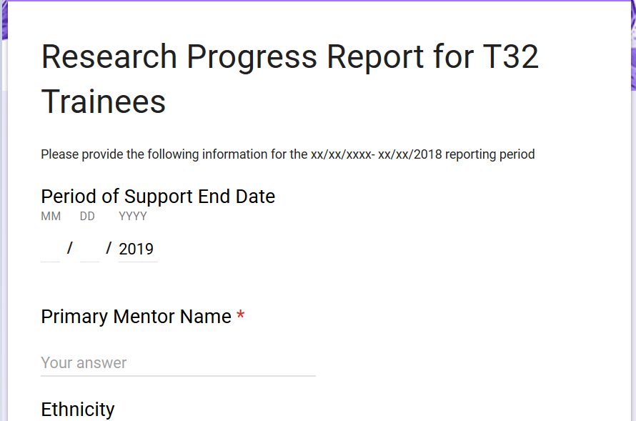
Annual RPPR survey for current trainees

Slide 29
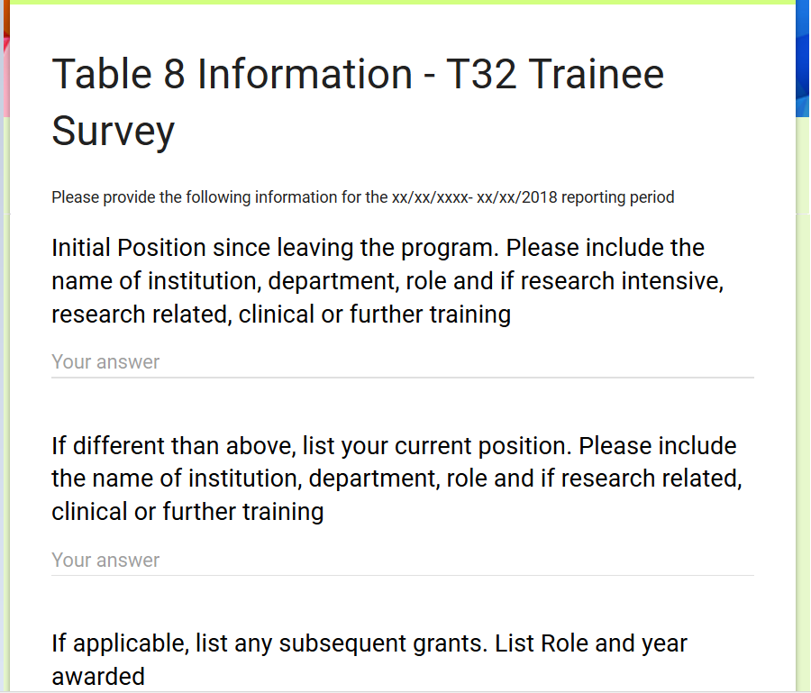
Annual survey for Past Trainees
Table 8 is 15 years of data

Slide 30
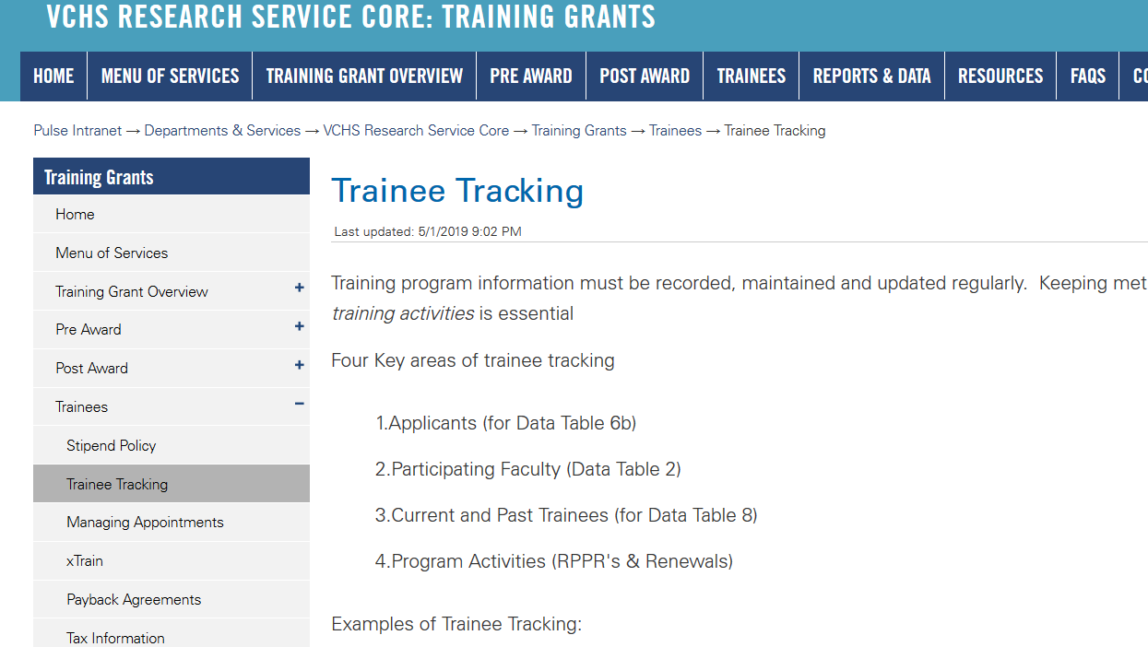
Training Tracking on Website

Slide 31
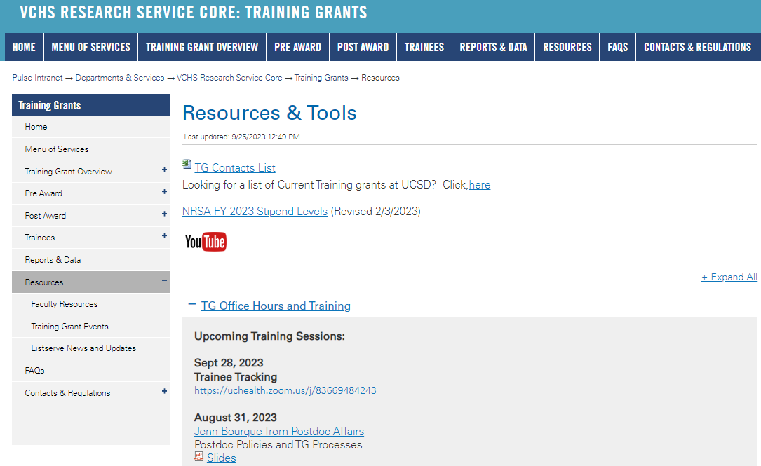
https://pulse.ucsd.edu/traininggrants - AD credentials required
Resources
Notes:
If you need to remember one thing.. Its the TG website.

Slide 32
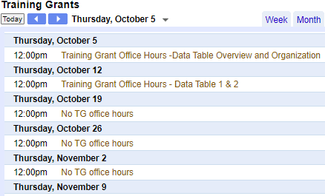
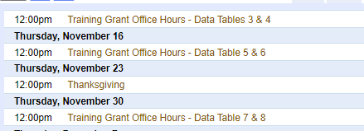
Coming up TG Office Hours
Notes:
Add this to your Google Calendar https://calendar.google.com/calendar/u/0?cid=amVjZHVqZTA0ZTM1aGQzcW1wbnB0djloNGdAZ3JvdXAuY2FsZW5kYXIuZ29vZ2xlLmNvbQ

Slide 33
Questions

