Slide 1
Learn @ Lunch NIH xTRACT February 14, 2019
I Training Grants
Jill I. Weller
Training Grant Analyst
Presented by the Research Service Core & Moore’s Cancer Center &

Slide 2
Today’s objective
Understand how to use NIH xTRACT to create Data Table 8 for a training grant progress report - RPPR
Notes:
Often TG’s are mismanaged, people need better training and resources.

Slide 3
Presentation Outline
Review Data table 8 Instructions
xTRACT for RPPR’s
xTRACT Demo
Questions?

Slide 4
xTRACT is a learning experience!
Reminder, xTRACT is Mandatory for RPPRs for T32, T15 and TL1’s
Changes are constantly happening within xTRACT without NIH releasing an update notice
NIH admits they are not updating their user guide as changes occur
We need to share our experiences, to lessen the growing pains – were all in this together!!
Notes:
Fix slide

Slide 5
Review of Data Table 8
Part I. Those Appointed to the Training Grant
Part II. Those Clearly Associated with the Training Grant
Part III. Recent Graduates (only for new applications)
Part IV. Program Statistics – Predocs only
Notes:
FIX ANIMATIONS?

Slide 6
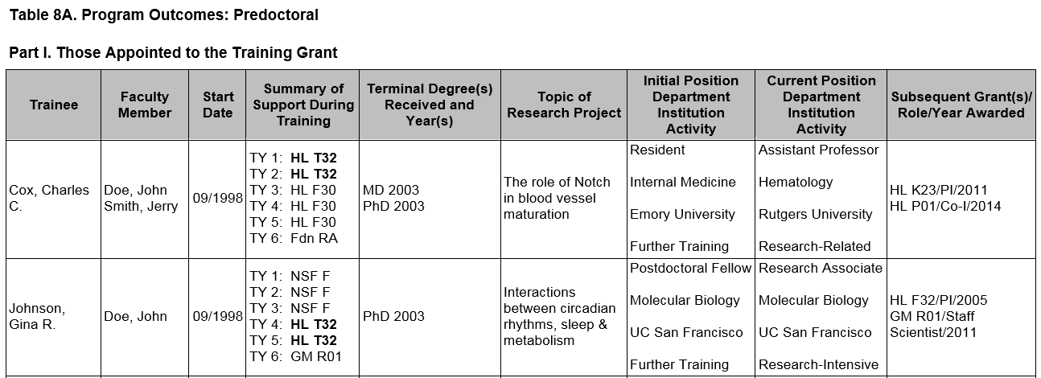
Review Data Table 8
Up to two faculty members
The start date (MM/YYYY format - no day) is the first year that the trainee began graduate studies at the applicant institution, even if they did not become associated with the training program until later
Trainee Name

Slide 7
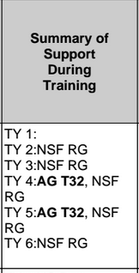
Sources of Support
Provide the primary source and type of support during each 12-month period of training, using TY1 for Training Year 1, etc.
If the trainee was listed on a prior RPPR for any NIH award, it should appear in xTRACT automatically. Other non-NIH fund sources will need to be manually entered.
Sources of Support
• NSF
• Other Federal (Other Fed)
• University (Univ)
• Foundation (Fdn)
• Non-US (Non-US)
• Other (Other)
Types of Support
• Research assistantship (RA)
• Teaching assistantship (TA)
• Fellowship (F)
• Training Grant (TG)
• Scholarship (S)
• Other

Slide 8
Degrees for Predocs
For past predocs, list the terminal degree received and year awarded
Trainees currently in the program should be designated “in training”
Those who have left the graduate program without a degree, report “none.”

Slide 9
Degrees Dates for Postdocs
Since day is omitted, may cause error with overlapping dates
List degree resulting from postdoc training, usually “none.”

Slide 10
Topic of Research – Predocs & Postdocs
Research Topic is limited to 200 characters

Slide 11
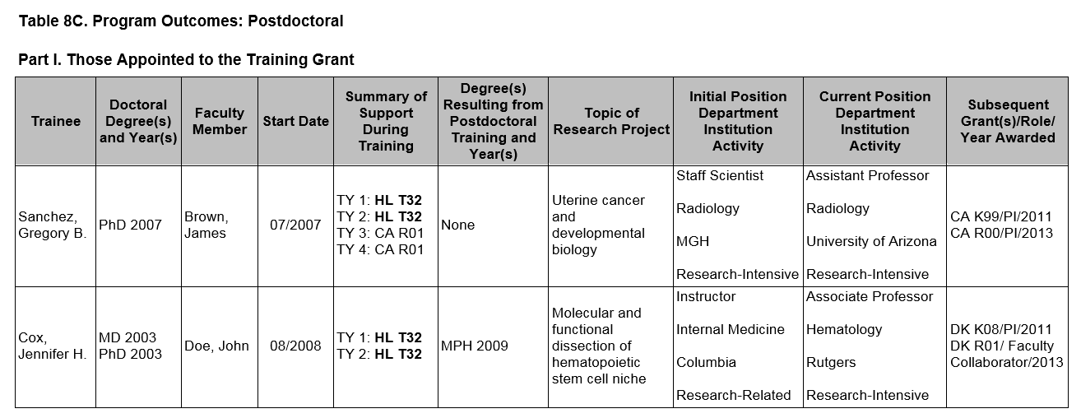
Post-Training Positions
8. For trainees who completed or left the program, provide their initial and current positions, departments, and institutions.
Classify each position as predominantly:
Research-intensive
Research-related:
Teaching
Administering research
Science policy
Technology transfer
Further Training
Other

Slide 12
Subsequent Grants
The support can be from any source whether as PD/PI or in another senior role:
Co-I
Faculty collaborator
Staff scientist
Other
If applicable, list the type of
support after completed training:
Subsequent fellowship (F)
Career development (K)
Research grant (R)
Up to five grants may be
listed

Slide 13
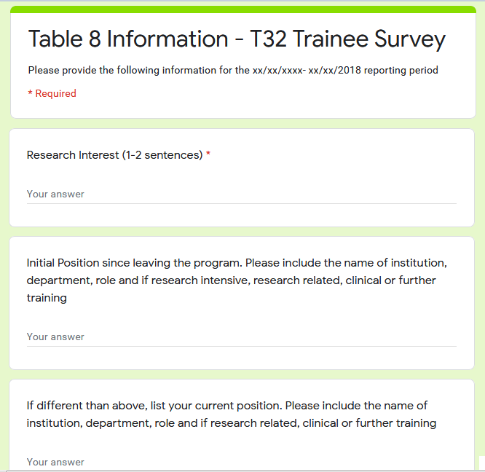
How do I gather this information?
Create a group page for your program. At the time of appointment be sure to have the trainee add themselves to the account and that they understand the expectation of staying in contact for the next 15 years
Send out a Table 8 Annual survey
Email trainees to update their “Personal Profile” in
Or research yourself - AKA stalking!

Slide 14
xTRACT

Slide 15
What is xTRACT ?
Extramural
Trainee
Reporting
And
Career
Tracking
A tool within eRA Commons used to create data training tables for RPPR’s & training grant applications
T32, TL1, and T15 RPPRs are required to use xTRACT

Slide 16
Upside of xTRACT
Able to pre-populate some training data
xTrain
NIH RePORTER / Prior RPPR’S
Manual entry data is stored in xTRACT and can be re-used when preparing subsequent training table submissions
Makes RPPR’s and Table 8 easier in the long run

Slide 17
Down
Requires a LOT of data entry in the beginning
Side
Bugs in the system that still need to be fixed by NIH
Notes:
And as you enter more and more data into xTRACT, that information will also become available for re-use when preparing later applications and RPPR’s.”
Will require more data entry at the beginning, but subsequent submissions will be easier!

Slide 18
Access to xTRACT
If you have the appropriate delegation you will see xTRACT on the eRA Commons toolbar, if not, you do not have the proper access
https://grants.nih.gov/grants/guide/notice-files/NOT-OD-18-133.html

Slide 19
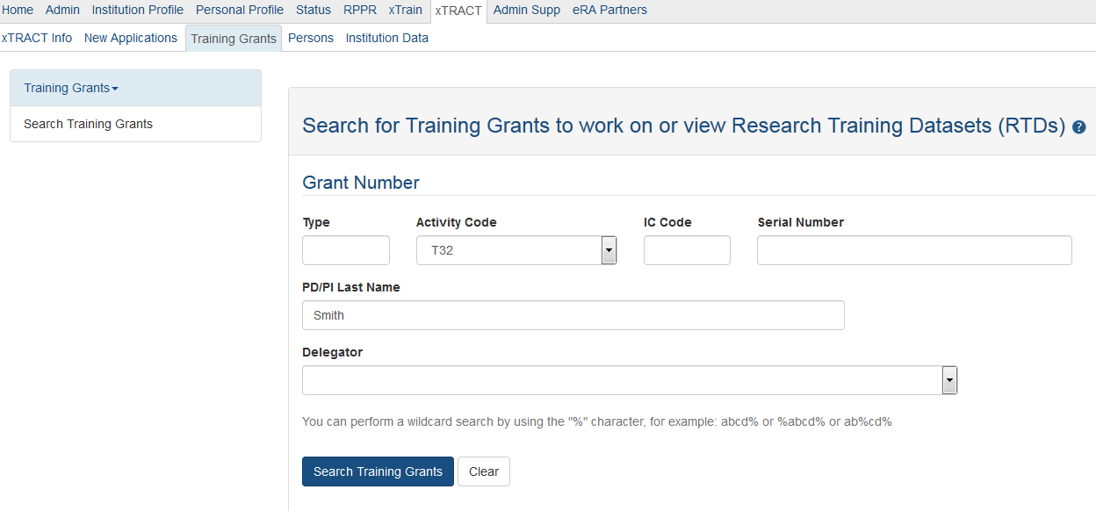
Search Training Grants for RPPR

Slide 20
Prepare for RPPR
Choose the correct reporting year

Slide 21
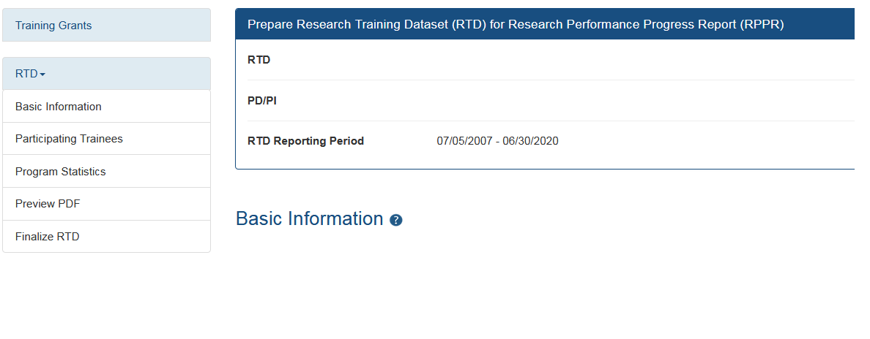
Basic Navigation
Input Data Table 8 info here for your RPPR

Slide 22
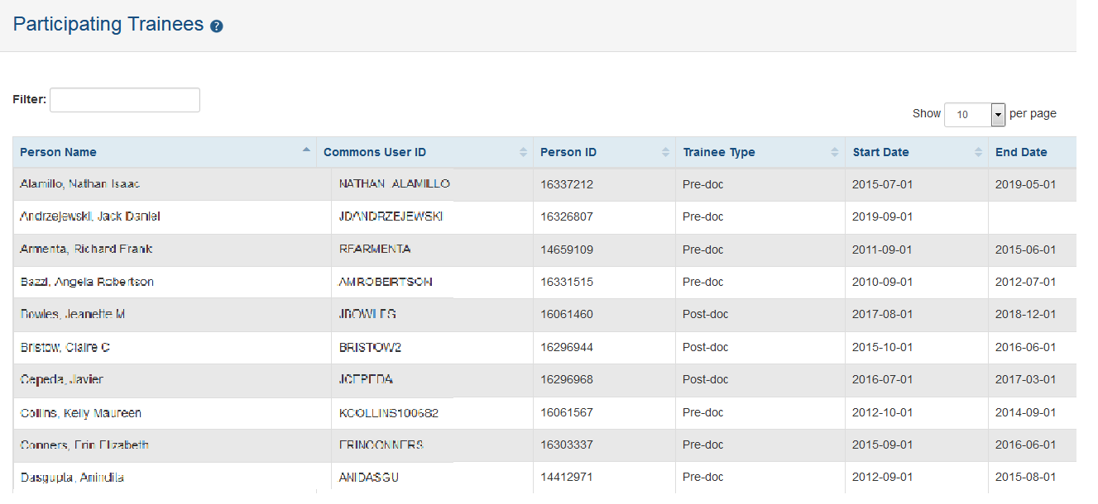
Participating Trainees
All trainee names previously appointed to the TG are imported directly from xTRAIN

Slide 23
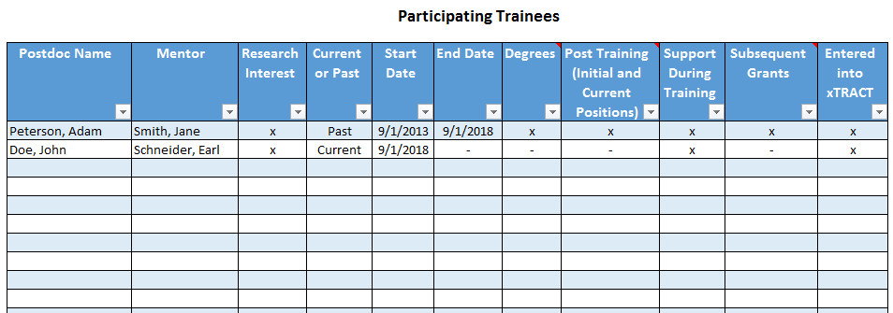
Organizing Checklist for RPPR’s
Go to xTRAIN to find the last 15 years of trainees and add them to your spreadsheet.
Input data from those trainees into xTRACT from last year’s RPPR Data Table 8.
Update for current year.

Slide 24
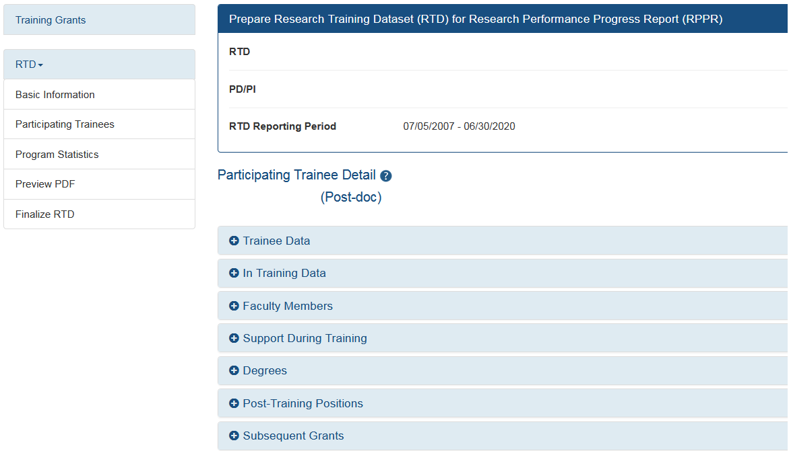
Participating Trainees

Slide 25
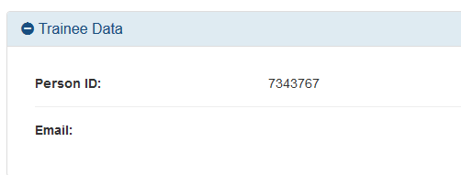
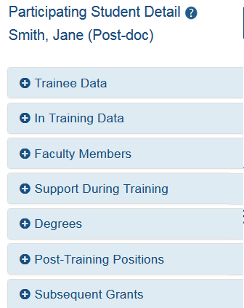
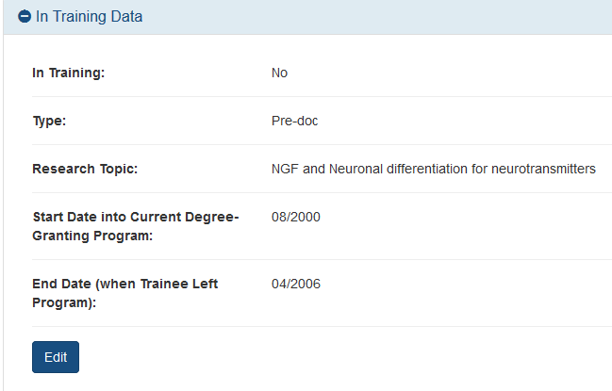
Trainee Details
Auto populated
For prior trainees, be sure to put to enter an end date or you will not be able to finalize the RTD

Slide 26
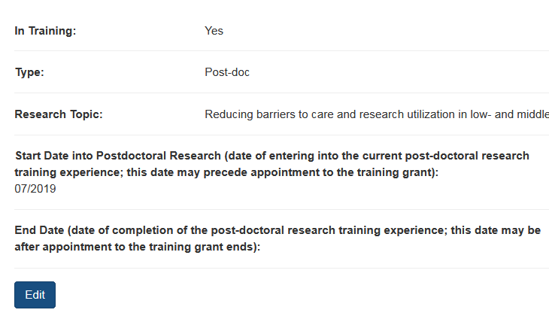
Trainee Details

Slide 27
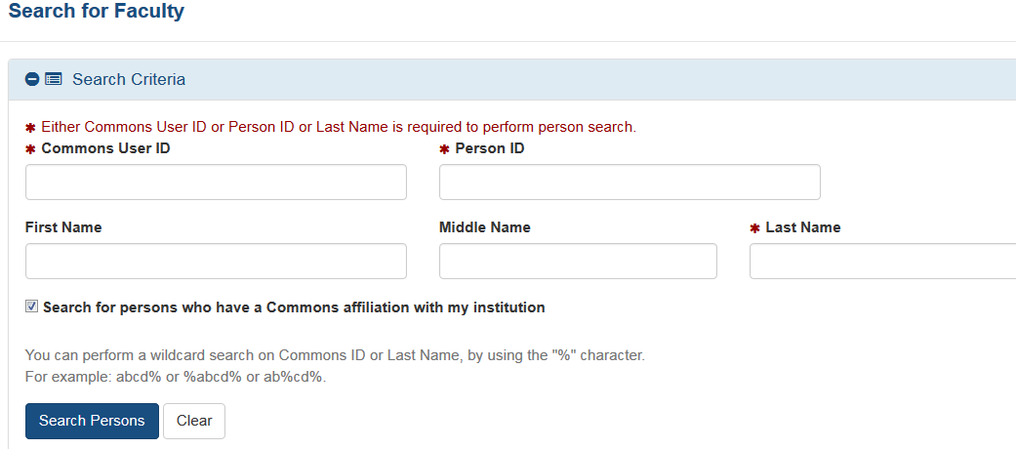
Add Faculty Mentor
Up to two faculty members

Slide 28
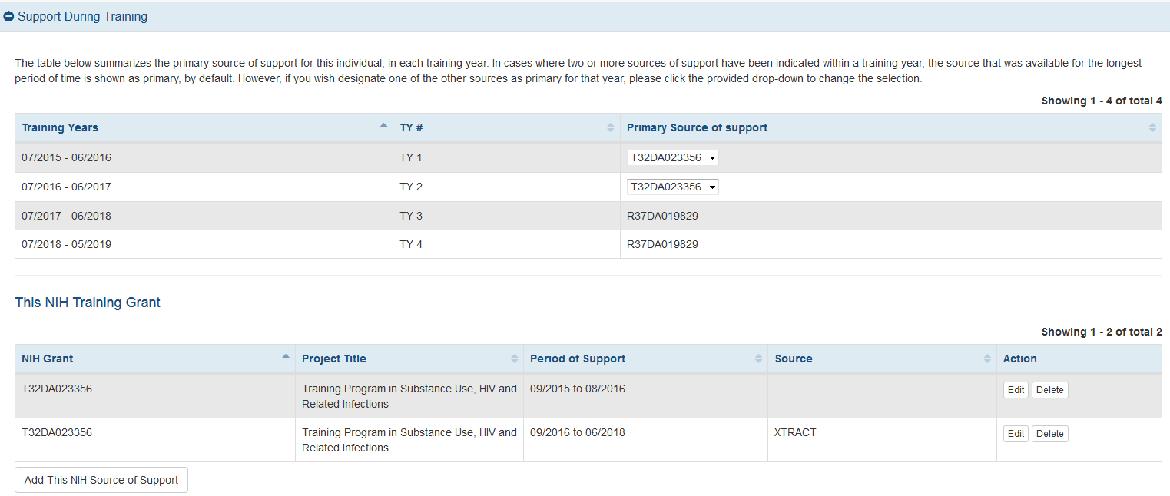
Sources of Support
Training Years on the TG
Dropdown menu added for some fund sources
Same info
Imported from another RPPR

Slide 29
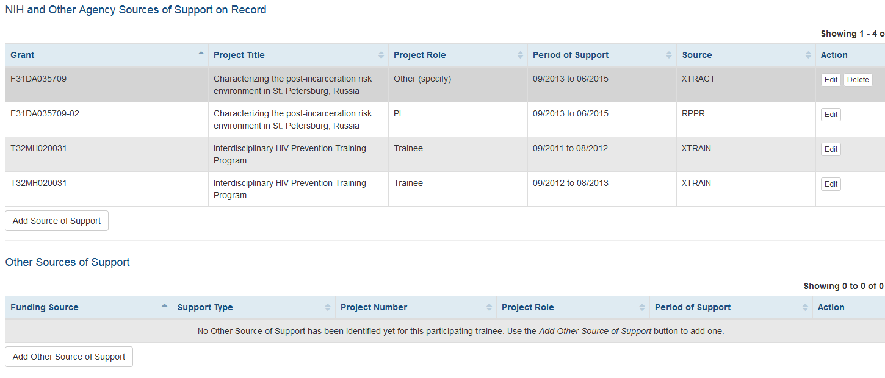
Detailed View - NIH TG Support or Other Sources
If they had prior effort on another grant, xTRACT should pull in that data from those prior RPPR’s
Optional to combine duplicates. Ability to delete and edit some entries
Add non NIH or other support here

Slide 30
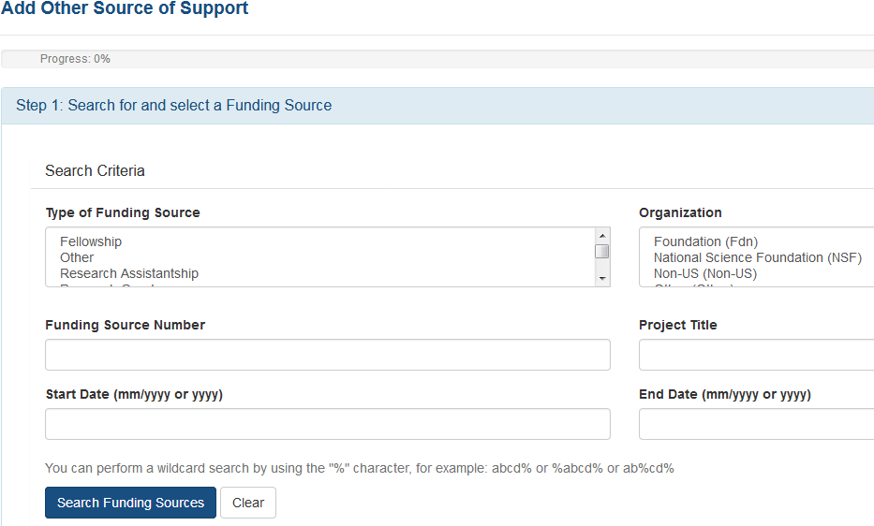
Searching Other Sources of Support if NON-NIH

Slide 31
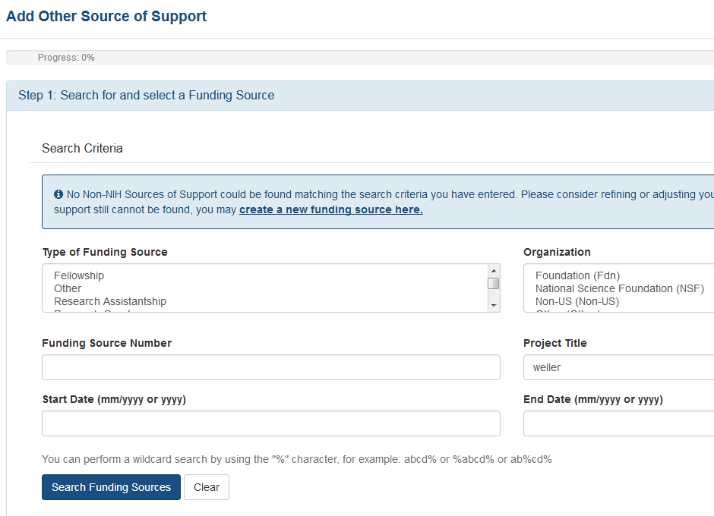
Adding NON-NIH Sources of Support

Slide 32
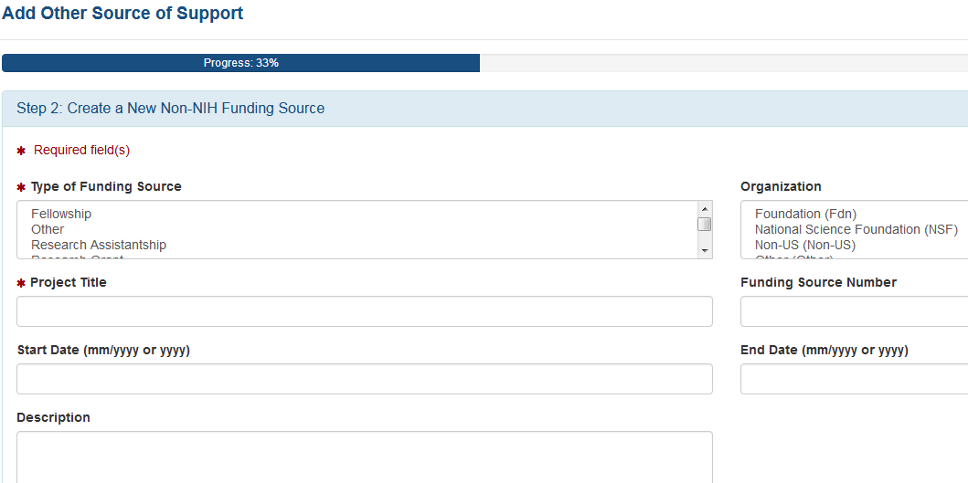
Create a new funding source

Slide 33
Degree Info
If they are NOT a current trainee, the terminal degree needs to be indicated
If a predoc has graduated, click “received in training”
If they are currently in training, list the terminal degree-to-date

Slide 34
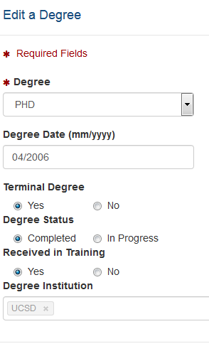
Editing Degrees
If a predoc received their Ph.D while in the training (not necessarily on the TG) program, then click “received in training” or they will not appear on the RTD

Slide 35
Post-Training Positions
Be sure to differentiate between initial and current positions, or it could be both
Notes:
Need a screenshot of adding in employers

Slide 36
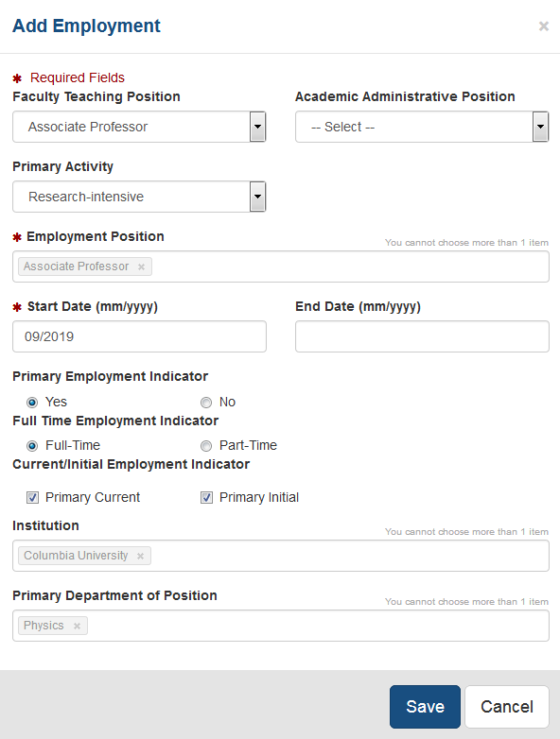
Adding Post-Training Positions

Slide 37
Subsequent Grants
Recommend combining if possible. Ability to edit and remove some entries

Slide 38
Part II. Clearly Associated Students

Slide 39
Clearly associated is defined as:
A current trainee who is having a training experience identical to those appointed to this grant and they must have been or currently are funded by another HHS or NIH mechanism (fellowship, R01, even for a short time)
Eligibility to be on a TG is NOT a factor here
e.g. non-citizen’s can be listed if they are on HHS or NIH fund sources

Slide 40
In each subsequent year…
Continue to add new entrants and provide updated information about current and past clearly associated students until 15 years of data have been completed

Slide 41
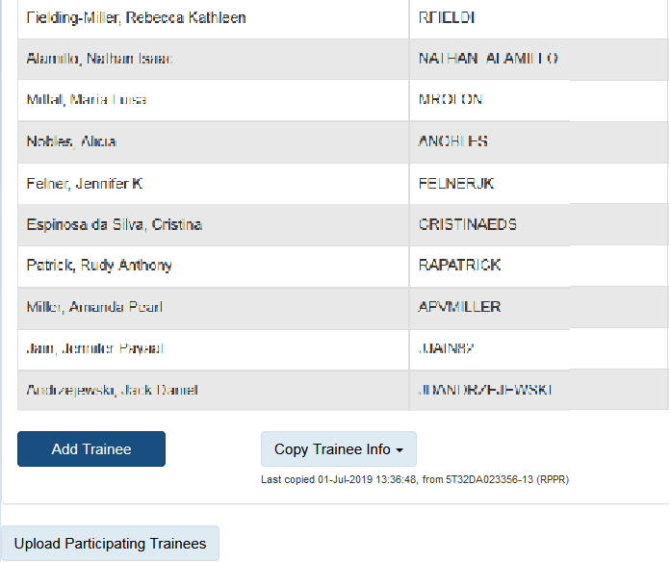
Adding Clearly Associated Trainees
At the bottom page of “participating trainees” you can add (clearly associated) trainees

Slide 42
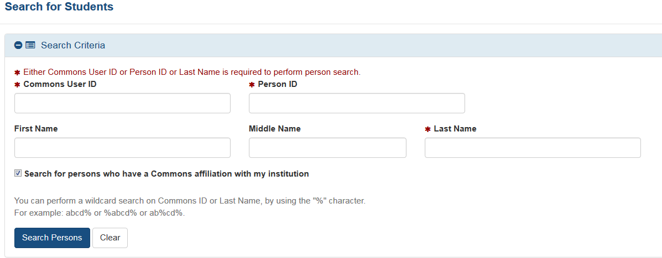
Search for a Trainee

Slide 43
Add Trainee as a Pre or Postdoc
Add as predoc or postdoc
If they don’t have a eRA Commons account, you can add them manually

Slide 44
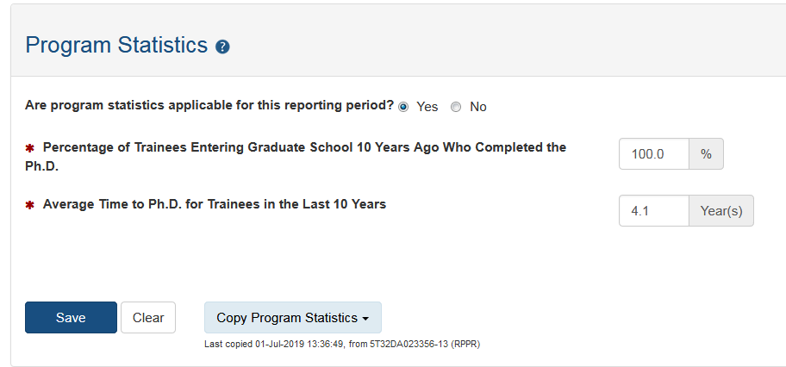
Program Statistics – Predocs only
Data Table 8A, Part IV
NOT Auto populated

Slide 45
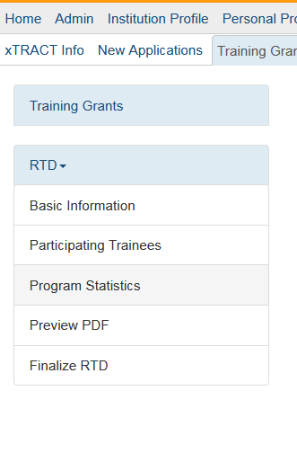
Preview PDF
Cross check with your spreadsheet to make sure all your trainees are APPEARING correctly on the PDF!!

Slide 46
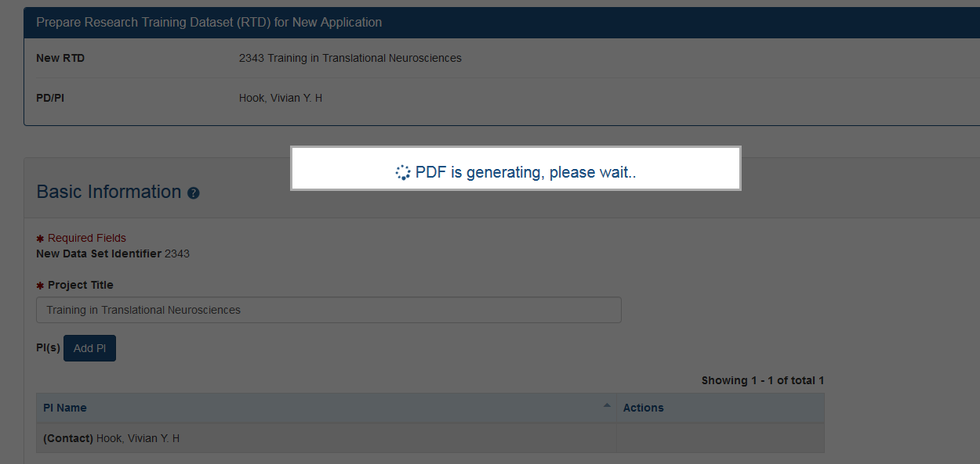
Preview PDF

Slide 47
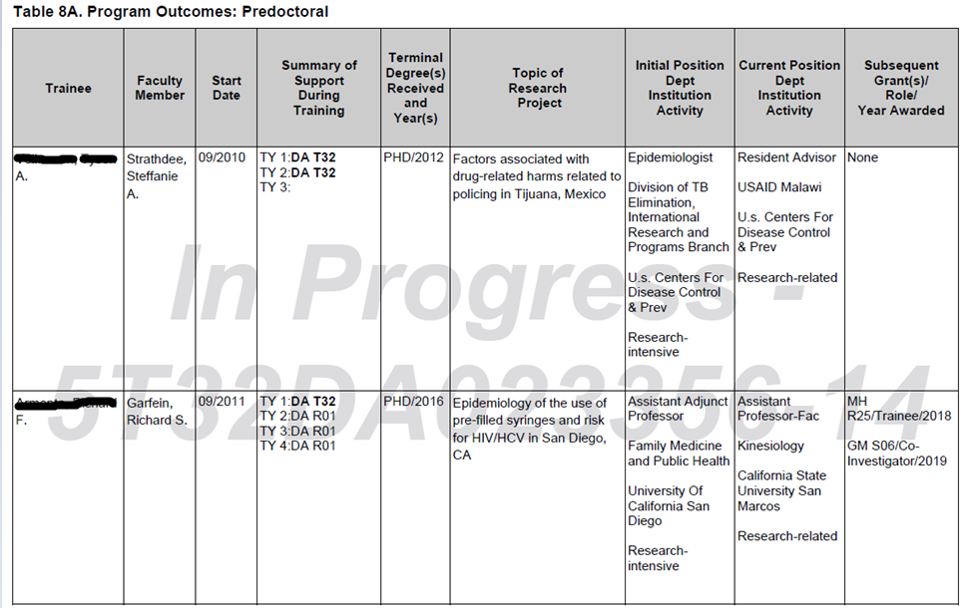
Preview PDF

Slide 48
Finalizing the RTD – Almost done!
You will not be able to finalize the RTD if you have past trainees with no end date (under “in trainee data”)

Slide 49
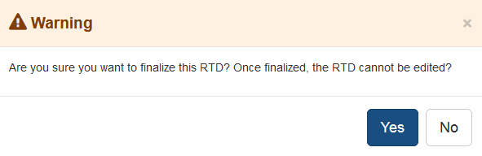
Finalize and Unfinalize
Ignore the warning, you can unfinalize it. However, once the RPPR is submitted to the NIH, you probably will no longer have that option
Anyone can finalize the RTD now - doesn’t have to necessarily by the PI

Slide 50
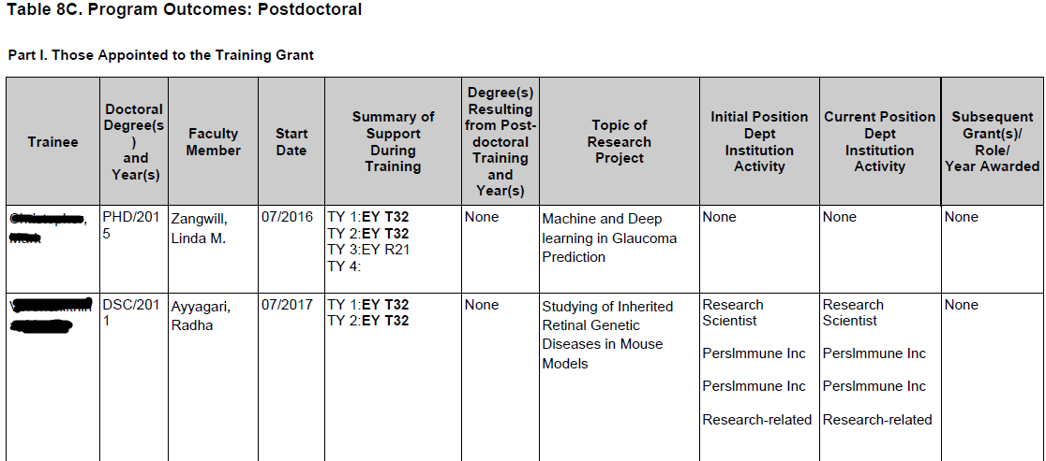
Finalized and View PDF watermark removed

Slide 51
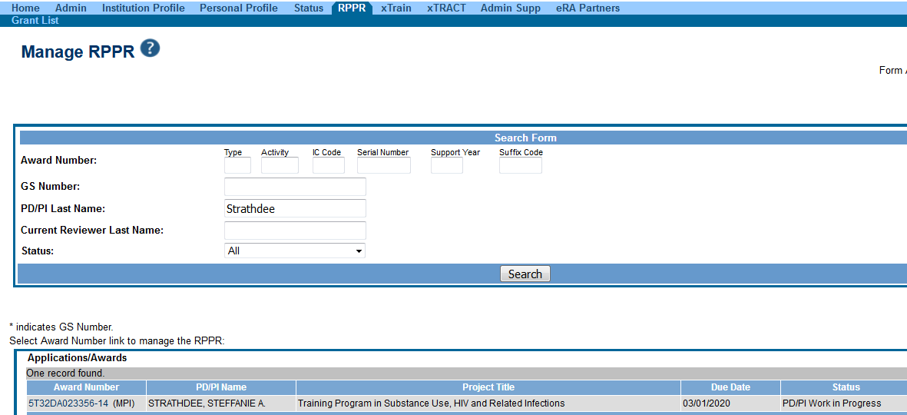
Now onto to the RPPR module

Slide 52
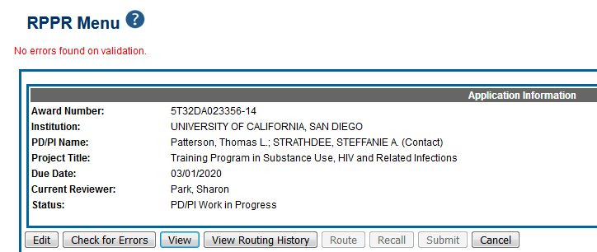
RPPR Menu

Slide 53
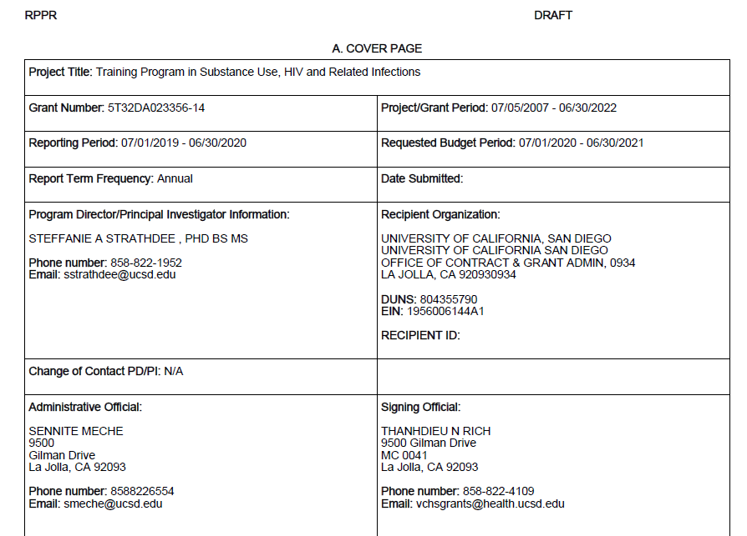
View PDF with RTD (Table 8) embedded in RPPR

Slide 54
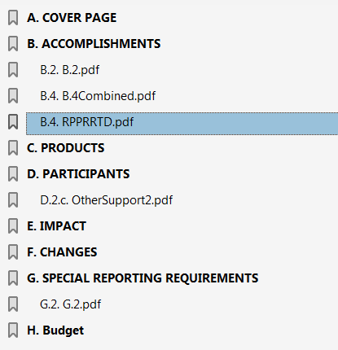
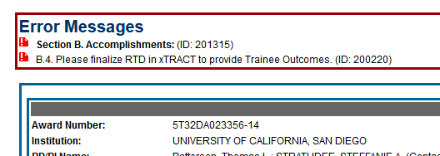
View PDF with RTD (Table 8) embedded in RPPR

Slide 55
Demo & Troubleshooting in xTRACT
Refer to handouts on troubleshooting guide and sample Table 8
Notes:
Finish this slide

Slide 56
Best Practices
Start early
Be organized
Crosscheck xTRACT PDF to Checklist

Slide 57
Training Grant Website & Resources
Use your active directory (AD) credentials to log in
https://pulse.ucsd.edu/traininggrants
Notes:
DEMO THE WEBSITE

Slide 58
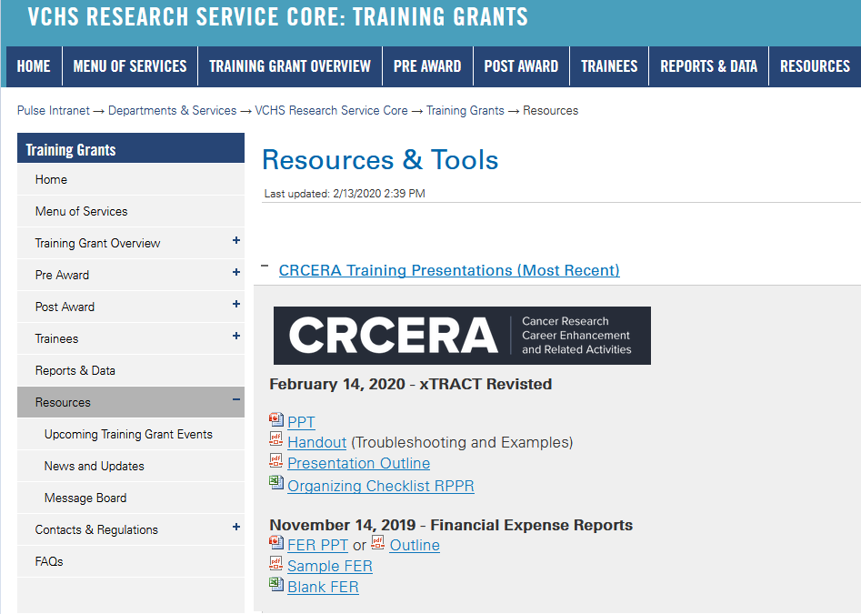
PPT and Handouts

Slide 59
NIH Website
For more information: https://era.nih.gov/erahelp/xtract/#xtract/intro.htm%3FTocPath%3D_____2
https://era.nih.gov/services_for_applicants/other/xTract.cfm

Slide 60
Upcoming Training – Save the Date!
What: Data Table Training – (2 Days)
Dates: March 17th & 18th, 2020
Time: 9:00-11:30am
Place: Medical Education and Telemedicine Building, Room 313 Classroom
Sign up on the website! Or watch your email!

Slide 61
Thank you for attending today. Any feedback is greatly appreciated!
Jill I. Weller
Training Grant Analyst
jweller@ucsd.edu

