Slide 1
NIH xTRAIN Terminations
Jill I. Vampola Training Grant Analyst Research Service Core
August 3, 2023

Slide 2
Today’s Objective
Recap NIH xTRAIN appointments from last week
NIH xTRAIN Terminations

Slide 3
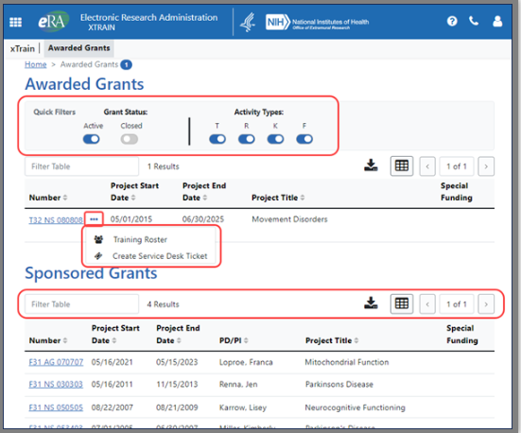
What is xTrain?
xTrain is used to electronically prepare and submit appointments and terminations associated with NIH training grants or fellowships

Slide 4
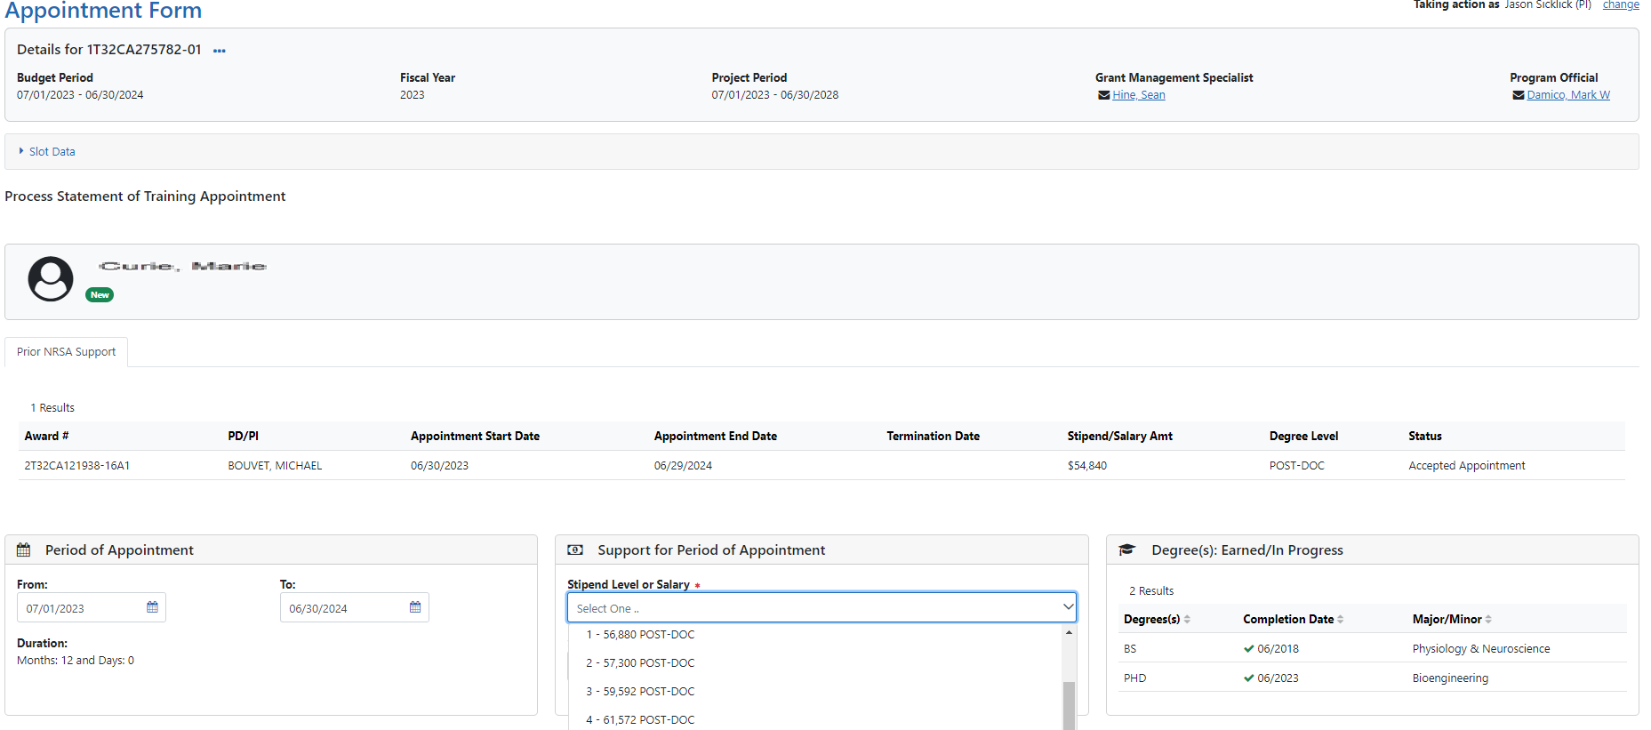

Slide 5
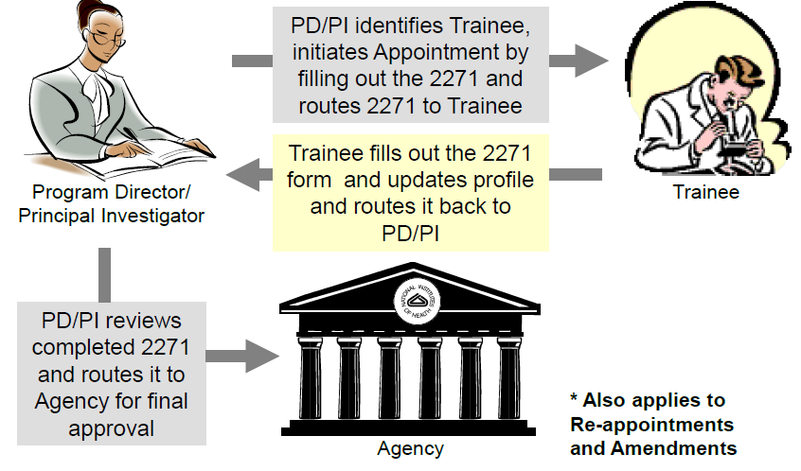
Appointment Process

Slide 6
Termination notices
NRSA - T32, T34, T35, F30, F31, F32 & F33
Only the BO can submit a Termination Notice (TN) to the Agency
Business Official (BO) will need to verify stipend amounts and check against UCSD financial/payroll
Career or research education series - K12, KL2, R25, R90
Only the PD/PI can submit a Termination Notice
The BO is not involved

Slide 7
Initiating a Termination notice
General Rule ~
Should be initiated within 30 days of the end of the appointment

Slide 8
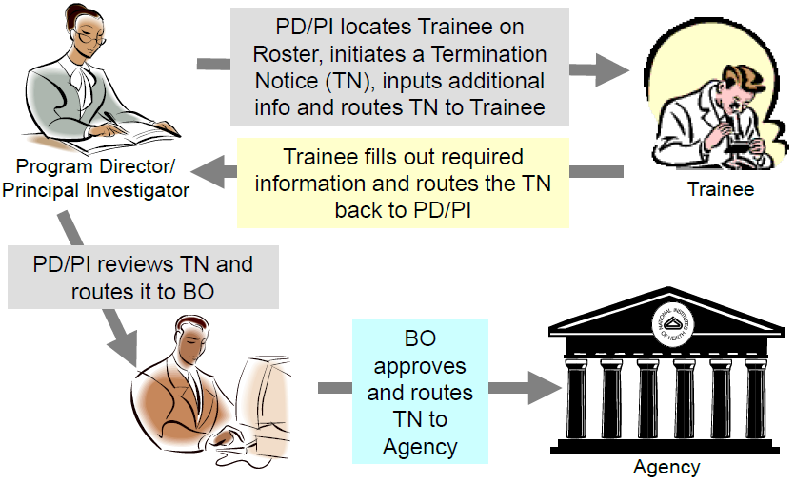
NRSA Termination Process
In Progress PI
In Progress Trainee
In Progress by BO
Pending Agency Review
Accepted

Slide 9
Initiating a Termination notice
Pull up grant by PI last name or grant number

Slide 10
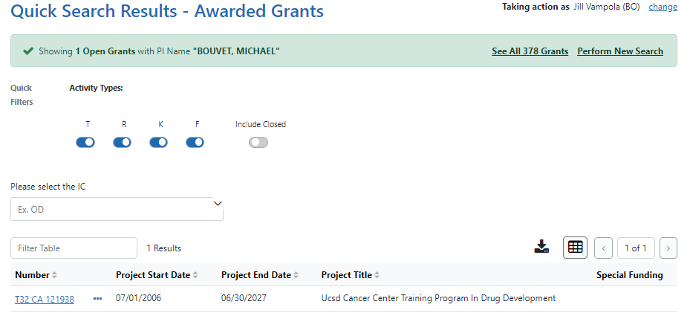
Initiating a Termination notice
Click hyperlink to view Trainee Roster

Slide 11
Initiating a Termination notice
In Trainee Roster under the ellipsis, click “initiate termination notice”

Slide 12
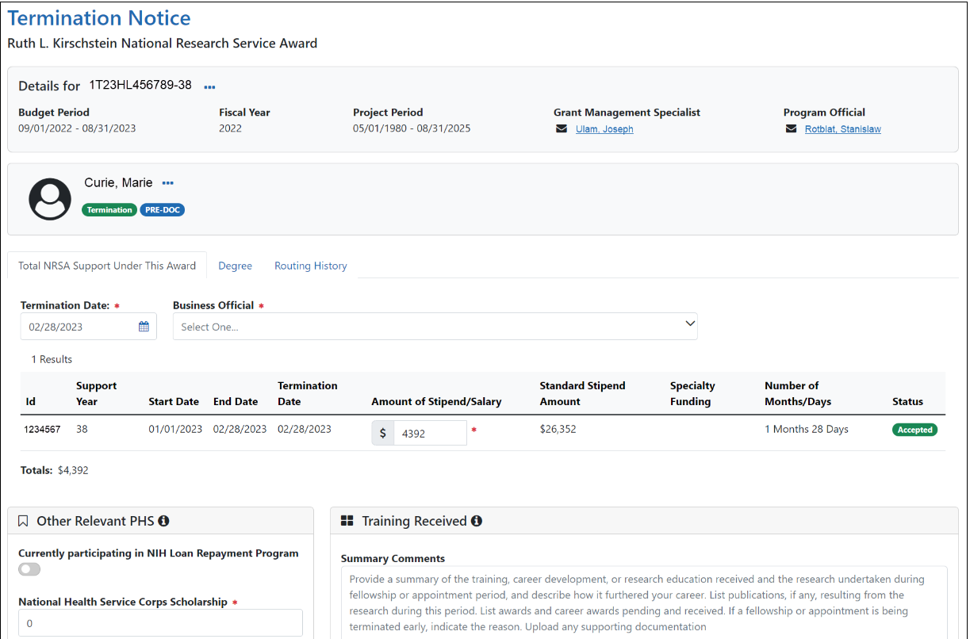
Confirm termination date
Add business official (BO)
Confirm stipend amount

Slide 13
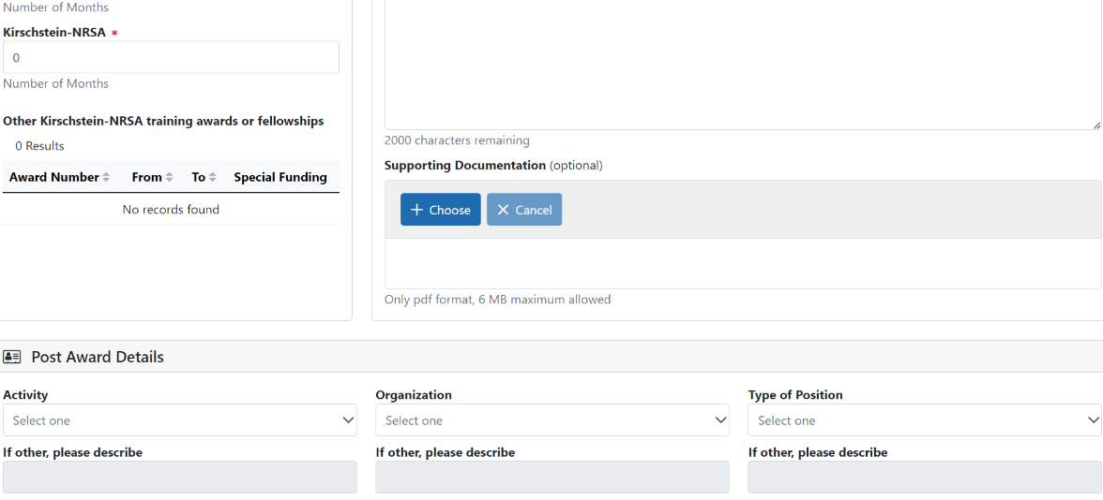
Initiating a Termination notice
Trainee will fill add scientific report

Slide 14
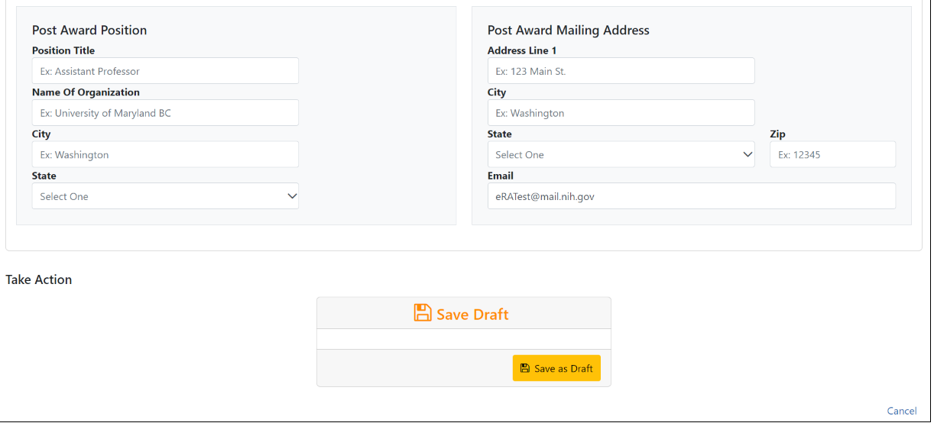
Trainee should add employment info
Either save as a draft or route the termination to the trainee

Slide 15
Add comments and route to trainee

Slide 16
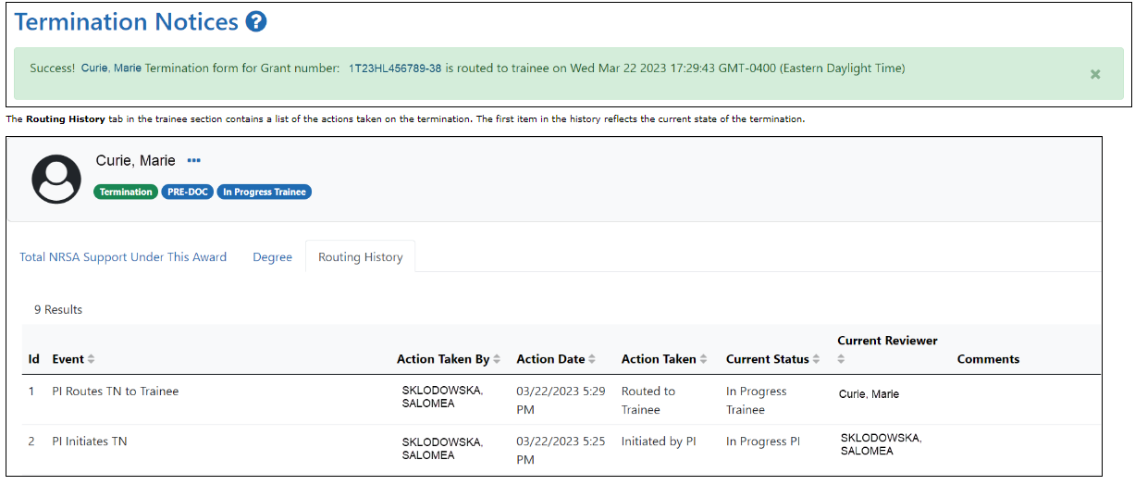
View routing history
The status of the termination is changed to In-Progress Trainee

Slide 17
Trainee

Slide 18
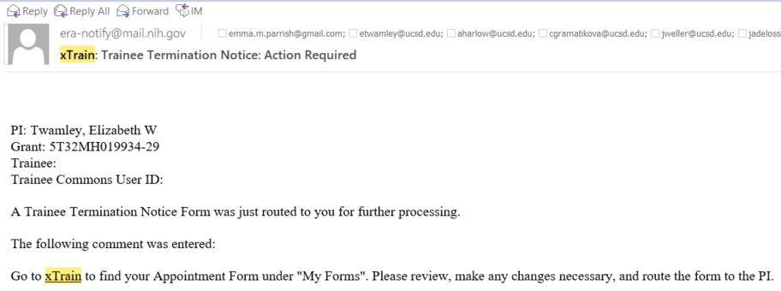
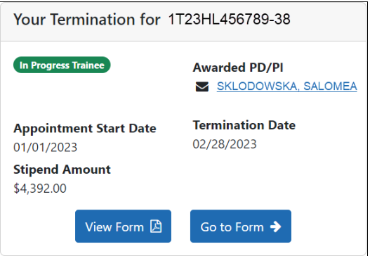
Trainee View
Trainee receives email and logs into eRA Commons

Slide 19
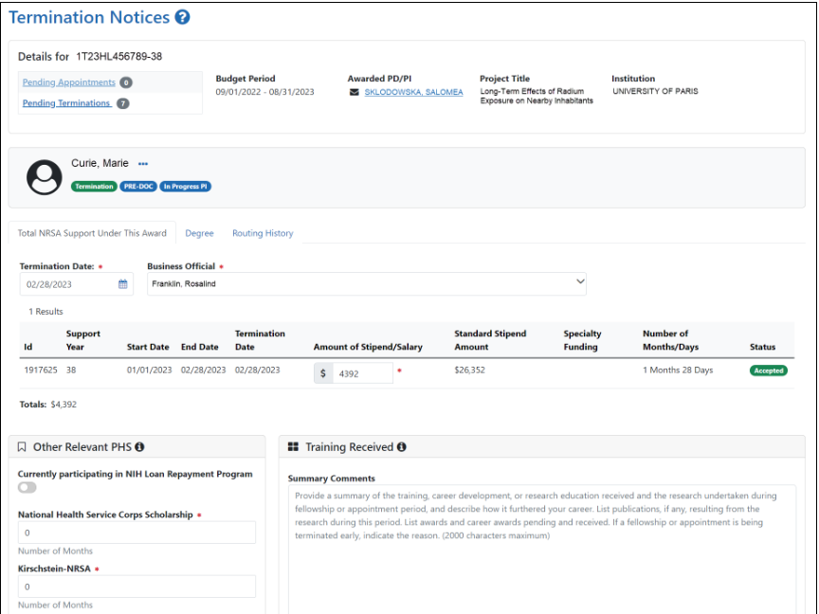
Trainee View
The trainee reviews and completes the scientific progress report

Slide 20
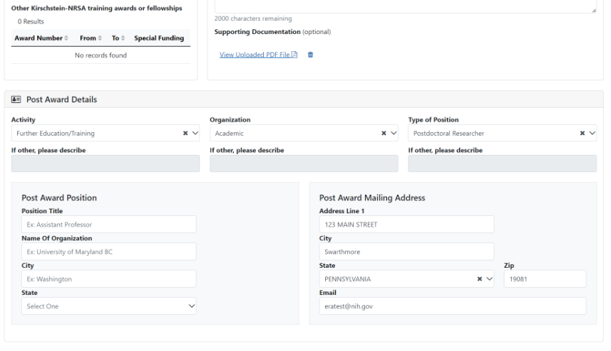
Trainee View
If known, the Trainee should also provide Post Award employment info

Slide 21
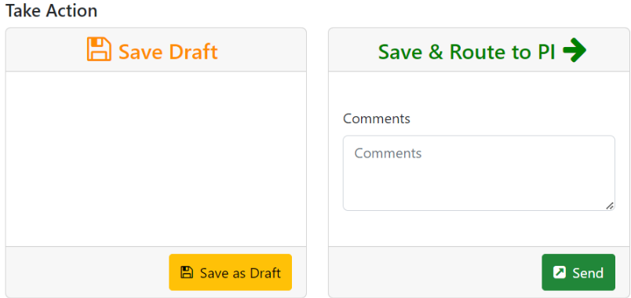
Trainee View
The trainee can save as a draft or route the termination back to the PD/PI

Slide 22
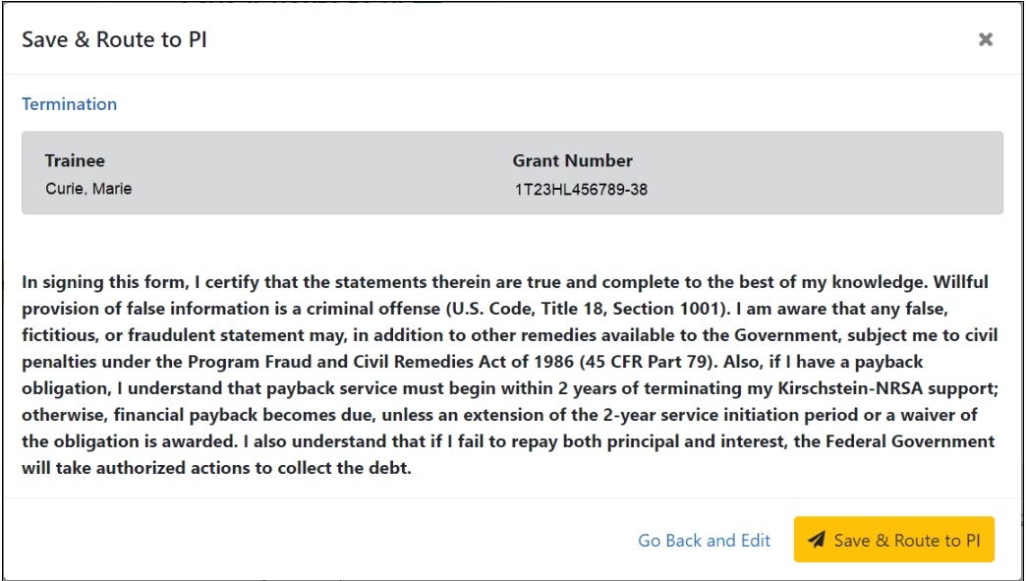
Trainee View
The Trainee’s electronic signature is recorded and the status is changed to In-Progress PI

Slide 23
What if a Trainee doesn’t respond?
If the Trainee does not route the Termination Notice to the PD/PI within 14 days, the system will automatically route the Termination Notice to back to the PD/PI

Slide 24
PI

Slide 25
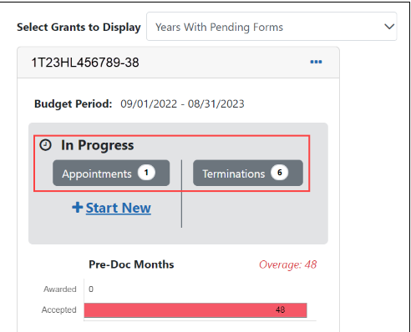
PD/PI View

Slide 26
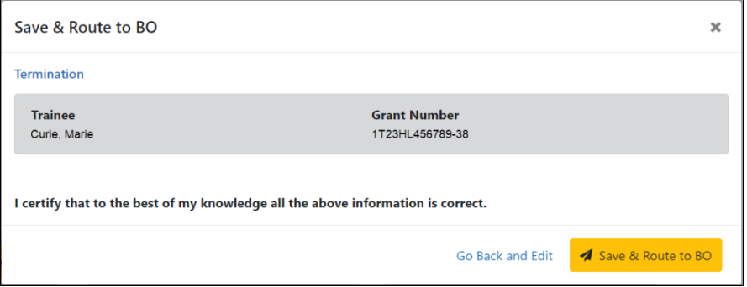
PD/PI View
The PD/PI reviews the form and if everything is OK, clicks the Save & Route to BO button to send the form to the Business Official

Slide 27
PD/PI View
Status is changed to In Progress BO

Slide 28
Business Official

Slide 29
Business Official View
Click the hyperlinked trainee name to display the Termination Notices screen

Slide 30
Business Official View

Slide 31
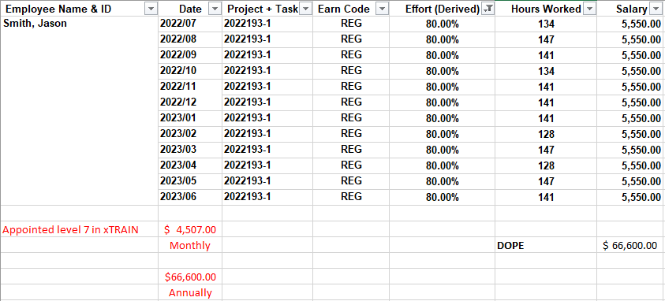
Business Official View
Compare the DOPE to the amount in xTRAIN

Slide 32
Business Official View

Slide 33
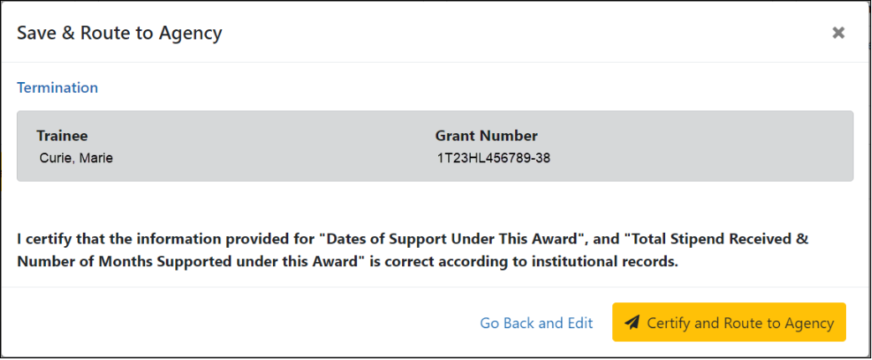
Business Official View
Status is changed to Pending agency review

Slide 34
Status Types for Terminations
In Progress PI
In Progress Trainee
In Progress BO
Pending Agency Review
On hold by agency
Accepted

Slide 35
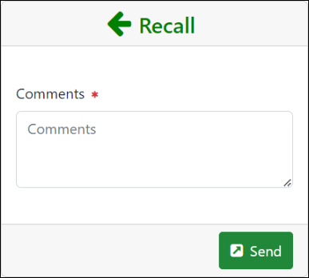
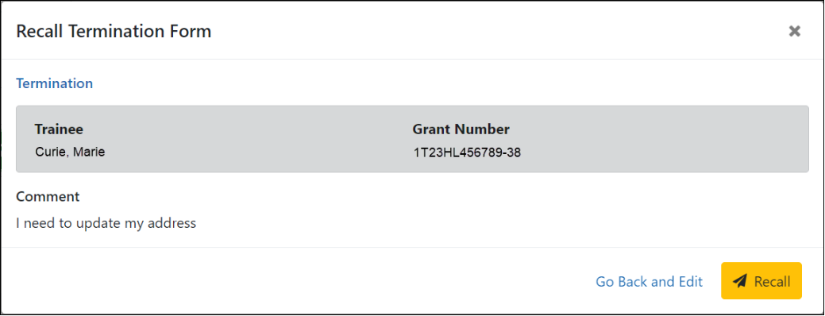
Other xTRAIN Features
If necessary, you can recall a termination form that has been routed onward to make edits

Slide 36
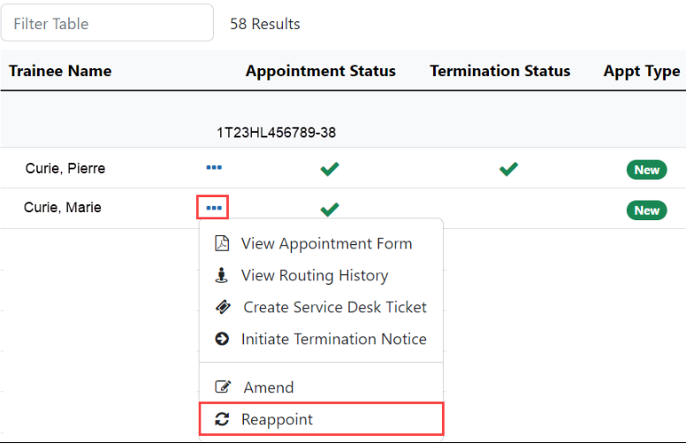
Reappointments
Trainees whose appointments are coming to an end can be reappointed to grants that have future award years
Similar process to appointments but much of the info is already in xTRAIN

Slide 37
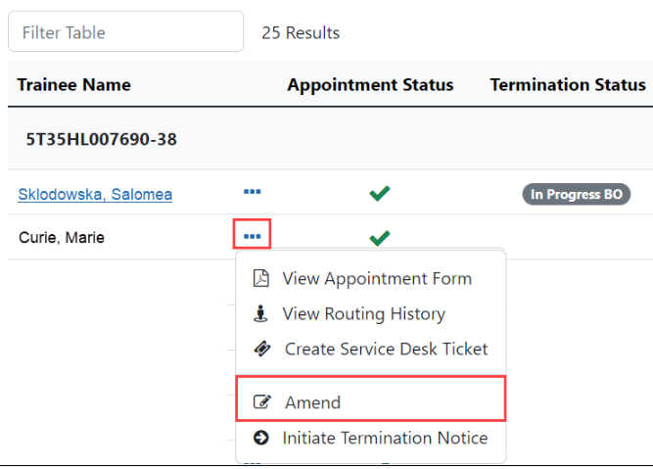
Amendments
Once an appointment is accepted by the Agency, an amendment is required in order to change any of the following items:
Name
Permanent Mailing Address
Appointment Period (early termination)
Support from the Grant (stipend amounts)
Must be a PD/PI or Delegate (ASST) to amend an appointment

Slide 38
NRSA Termination Process
In Progress PI
In Progress Trainee
In Progress by BO
Pending Agency Review
Accepted

Slide 39
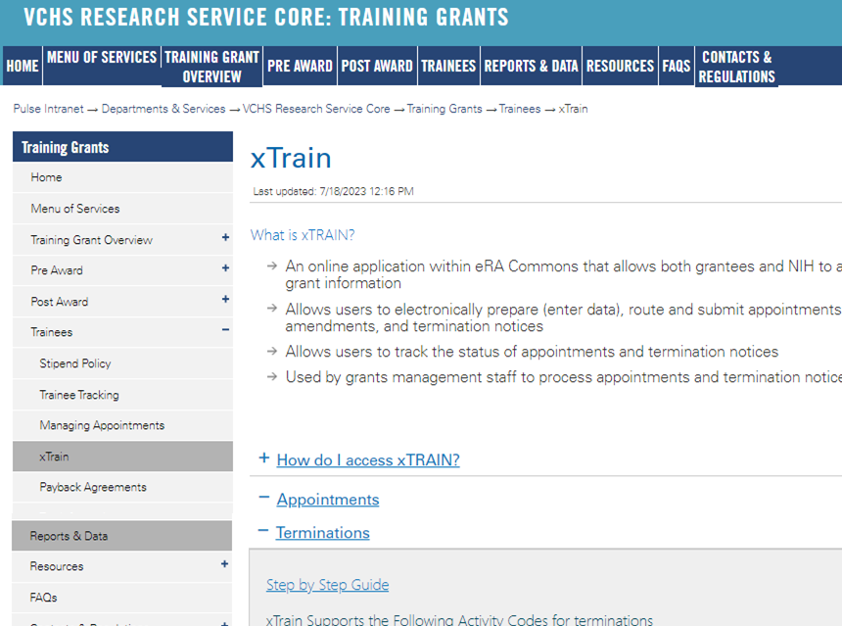
https://pulse.ucsd.edu/traininggrants AD credentials required
Resources
Notes:
If you need to remember one thing.. Its the TG website.

Slide 40
Coming up Next Week
8/10/23
*TG Financial Award Policy*

Slide 41
Q & A

