Slide 1



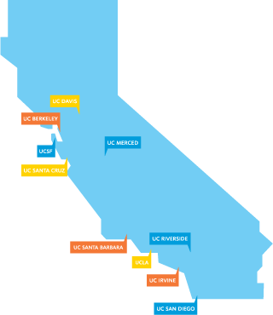







UC Training Grant Consortium
Executive Committee:
Robin Faria - UCLA
Kelly Lozo - UCLA
Jill Vampola - UCSD
Holly Wright - UCSD
Rachel Reeves, UCD
Yergalem Meharenna, UCI
January 12, 2026

Slide 2
Agenda
SciENcv Overview
Common forms Overview
Biographical Sketch & NIH Biographical Sketch Supplement
Will not be covering OS now current and pending other support (CPOS)
Delegation

Slide 3

What is SciENCV?
The Science Experts Network Curriculum Vitae
NCBI’s platform for creating, managing and submit biosketches and Current & Pending (Other) Support documents for federal (NIH, NSF, etc.) grant applications.

Slide 4
What SciENcv Offers
Import biosketch data and citations by linking ORCID, eRA Commons, and NSF accounts.
Have these set up before you start in SciENCV!
Manage multiple tailored CVs or biosketches for different grant applications.
Automatically formats documents to meet agency requirements.
Pulls pubs from My Bibliography and PubMed
Notes:
Karen’s section
Eliminates the need to repeatedly enter biosketch information • Reduces the administrative burden associated with federal grant submission and reporting requirements • Provides access to a researcher-claimed data repository with information on expertise, employment, education, and professional accomplishments • Allows researchers to describe their scientific contributions in their own language

Slide 5
Effective for due dates on/after January 25, 2026
Applies to:
New and renewal Applications
RPPRs
Just-in-Time (JIT)
Prior Approval Requests

Slide 6
Common Forms Required for:
Biographical Sketch
Biographical Sketch Supplement
Other Support (Current & Pending)
All must be generated and certified in SciENcv

Slide 7
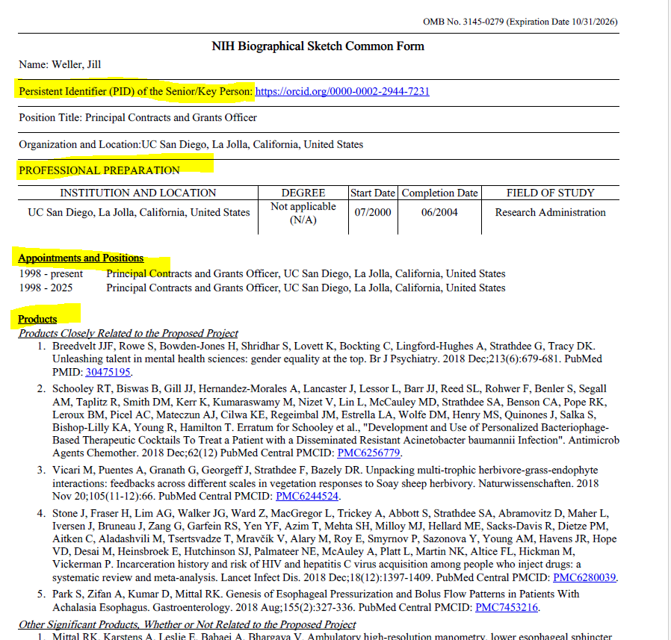
Elements to the Common form
Identifying information
Professional Preparation
(AKA Education and Training)
Appointments and Positions
(AKA Scientific appointments)
Products

Slide 8
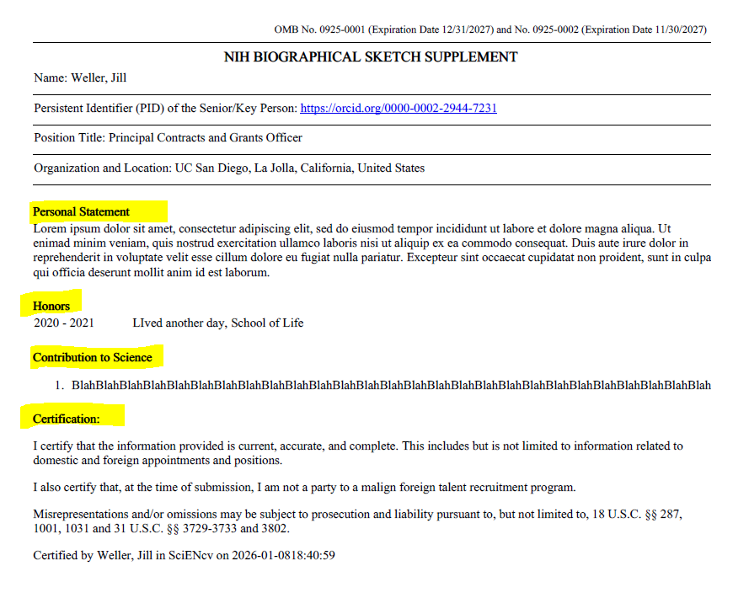
Supplemental Form Elements
Personal Statement
Honors
Products
(AKA contributions to science)

Slide 9



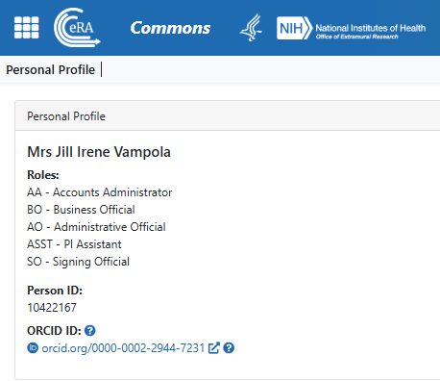

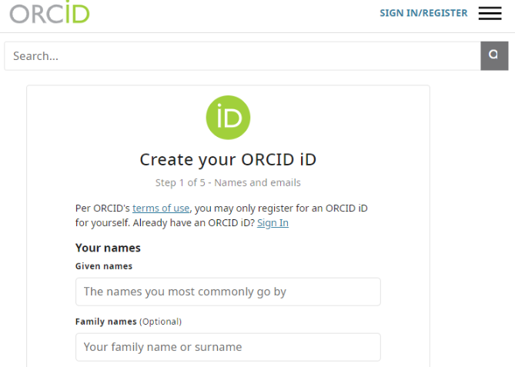
All Senior/Key Personnel must have an ORCID ID linked
Notes:
Karen’s section
Eliminates the need to repeatedly enter biosketch information • Reduces the administrative burden associated with federal grant submission and reporting requirements • Provides access to a researcher-claimed data repository with information on expertise, employment, education, and professional accomplishments • Allows researchers to describe their scientific contributions in their own language
One SciENcv can have multiple forms

Slide 10
Getting started in SciENcv

Slide 11
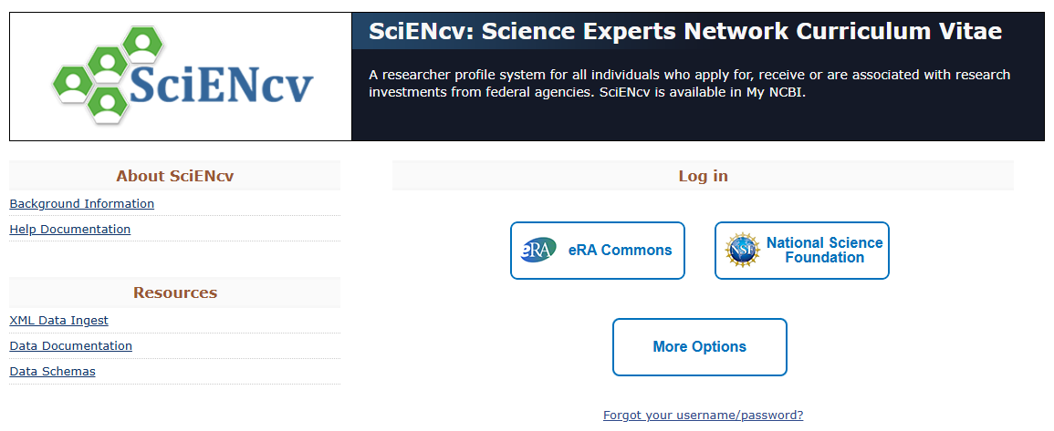
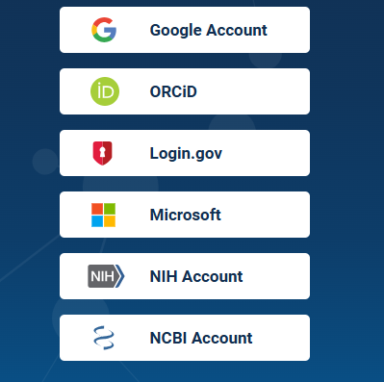
Log into your NCBI Account
Log in with eRA Commons or NSF ID login
https://www.ncbi.nlm.nih.gov/sciencv/

Slide 12
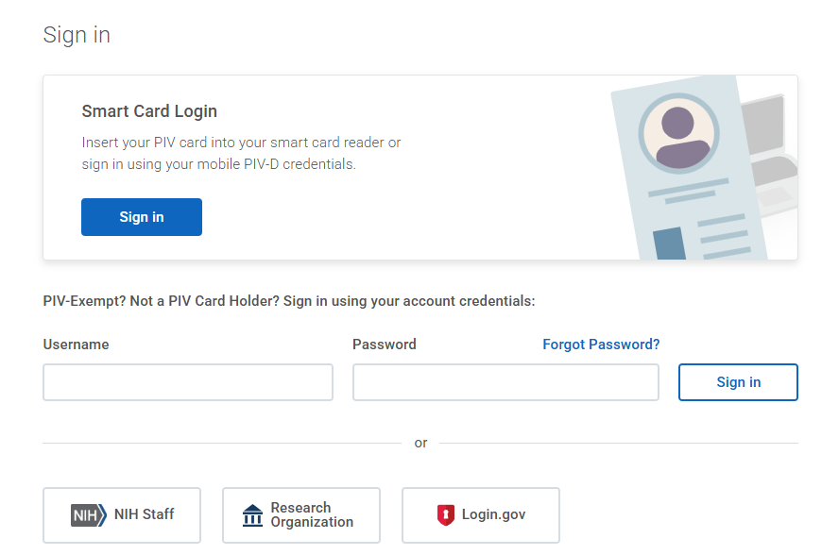

Slide 13
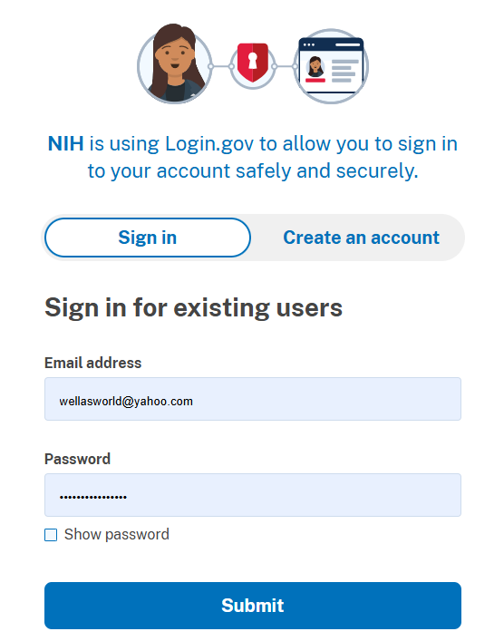

Slide 14
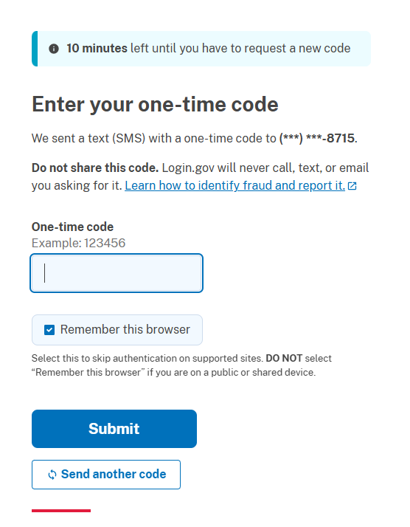
2FA Two-Factor Authentication

Slide 15
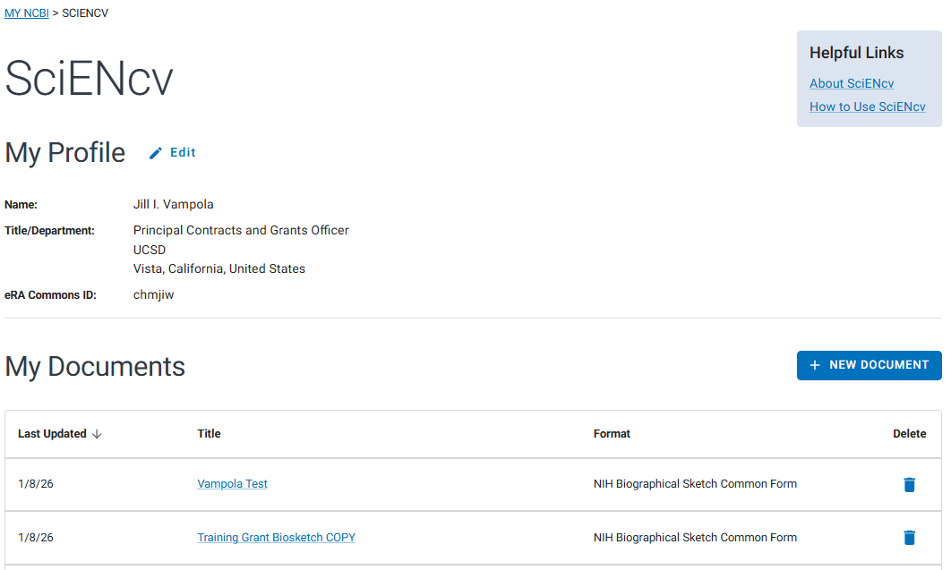
Landing page

Slide 16
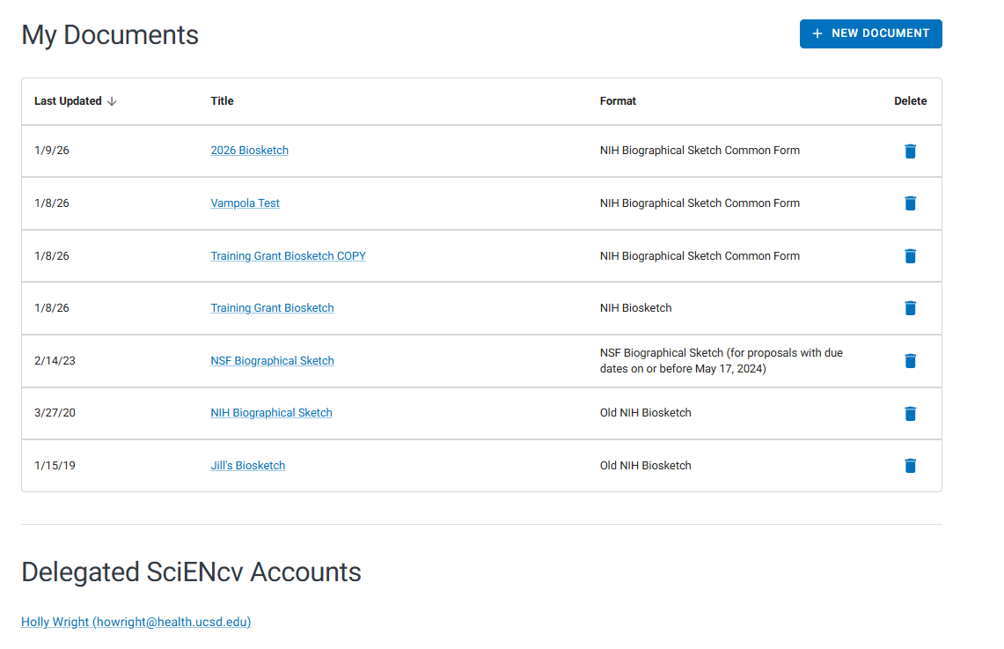
Still Landing page…

Slide 17
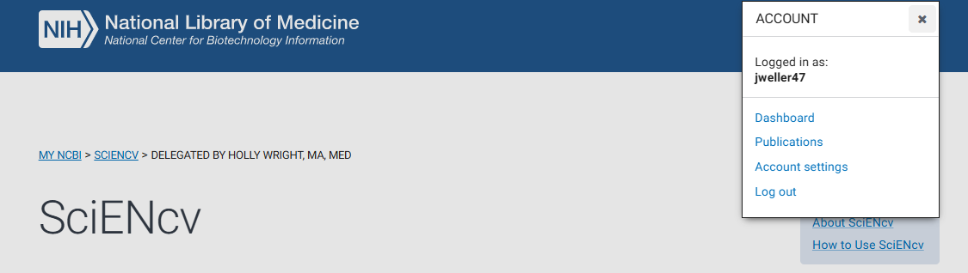
Account Settings

Slide 18
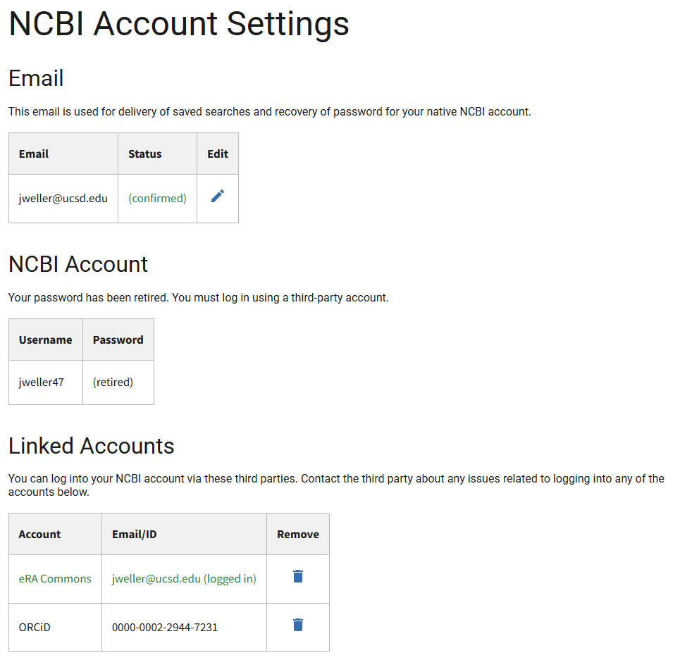

Slide 19
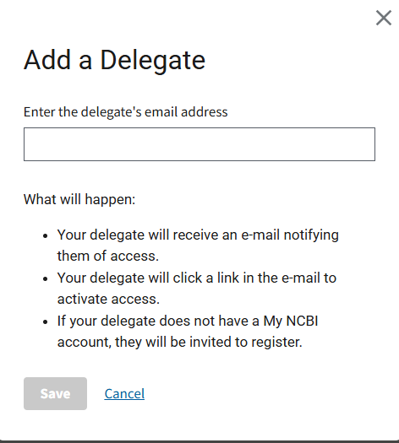

Adding a Delegate

Slide 20
Remember
Delegating access allows others to assist you in creating and managing your SciENcv documents.
But they will not be able to certify!
https://www.ncbi.nlm.nih.gov/books/NBK53593/#preferences.Account_Settings

Slide 21
Landing page

Slide 22
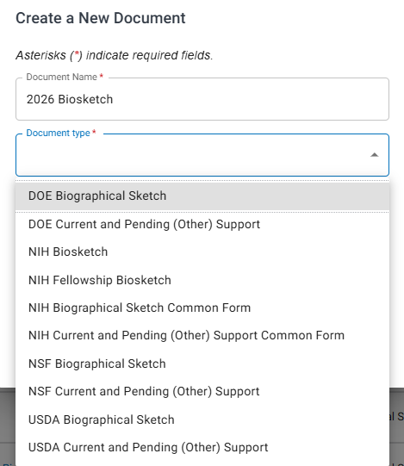
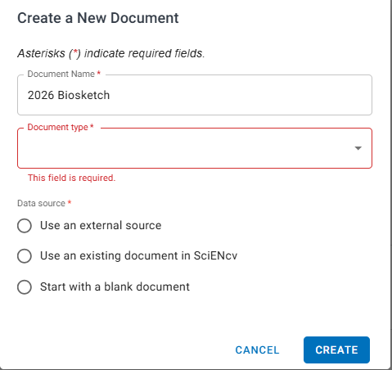
Create a New Document

Slide 23
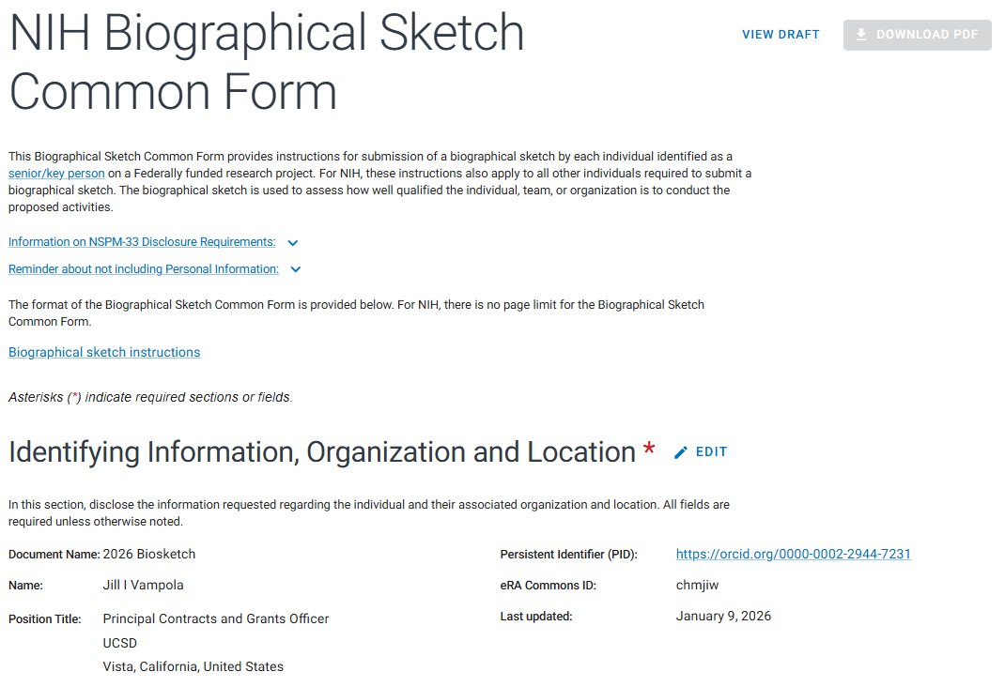

Slide 24
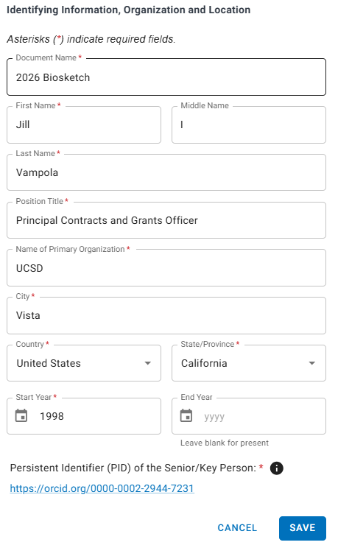
Identifying Information, Organization and Location, linking ORCID ID (PID)

Slide 25
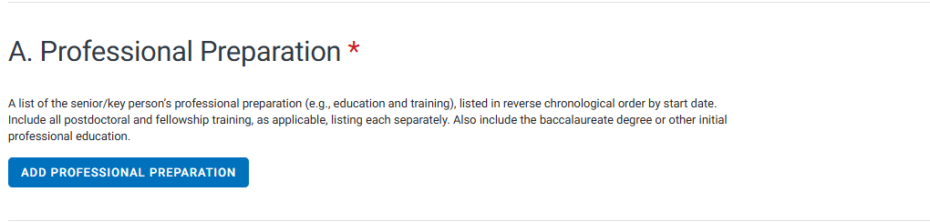
Add Professional Preparation (education & training)

Slide 26
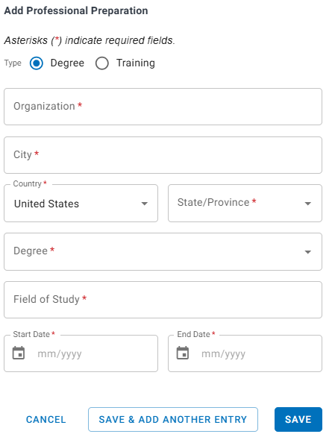
Add Professional Preparation (education & training)
New

Slide 27
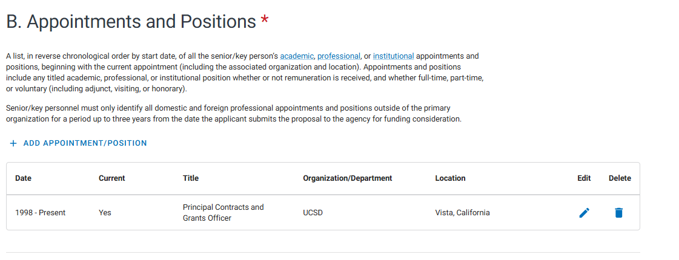
Appointments and Positions
Reverse chronological order
Academic
Professional
Institutional
Full, part-time and voluntary
Foreign and Domestic appointments and positions (up to 3 years)

Slide 28
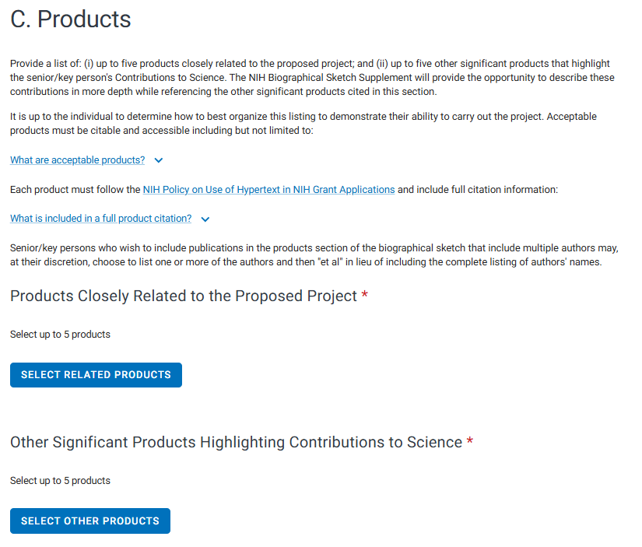
Products
10 Total

Slide 29
What is a Research Product?
Publications
Conference papers
Presentations
Website(s) or other Internet site(s);
Technologies or techniques;
Inventions, patents, patent applications, and/or licenses; and
Data, databases, or datasets
Physical collections
Audio or video products Software
Educational aids or curricula
Instruments or equipment
Research material
Interventions (e.g., clinical or educational)
New business creations

Slide 30
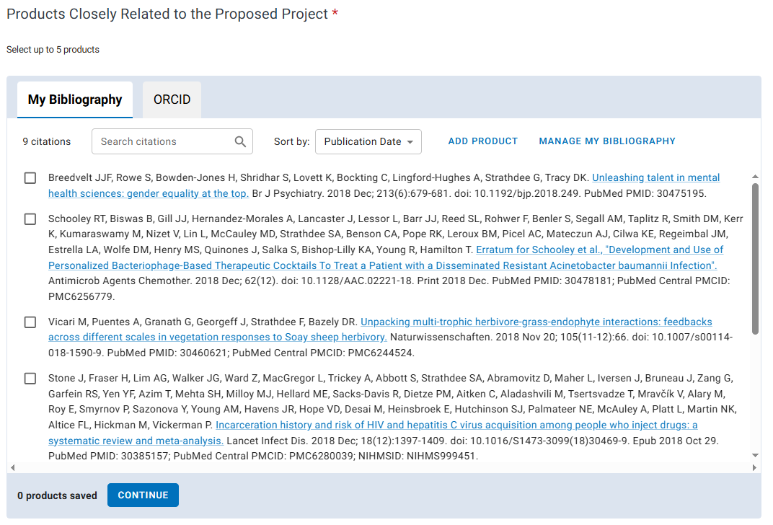

Slide 31
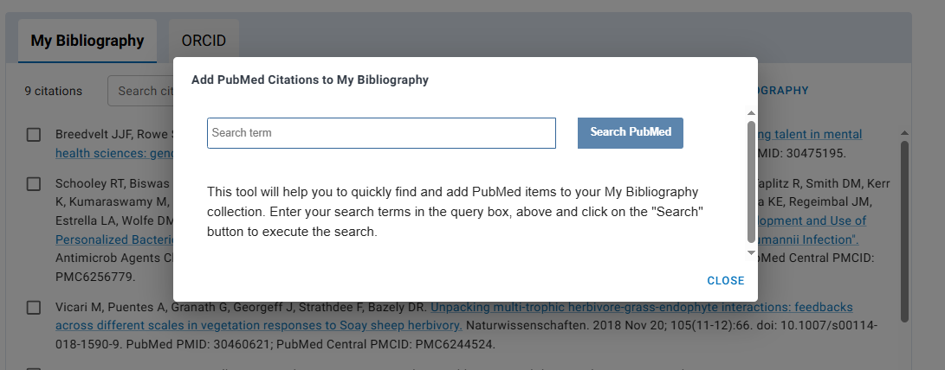
Search PubMed directly from SciENcv
Search PubMed
Add manually into My Bibliography
Find via ORCiD

Slide 33
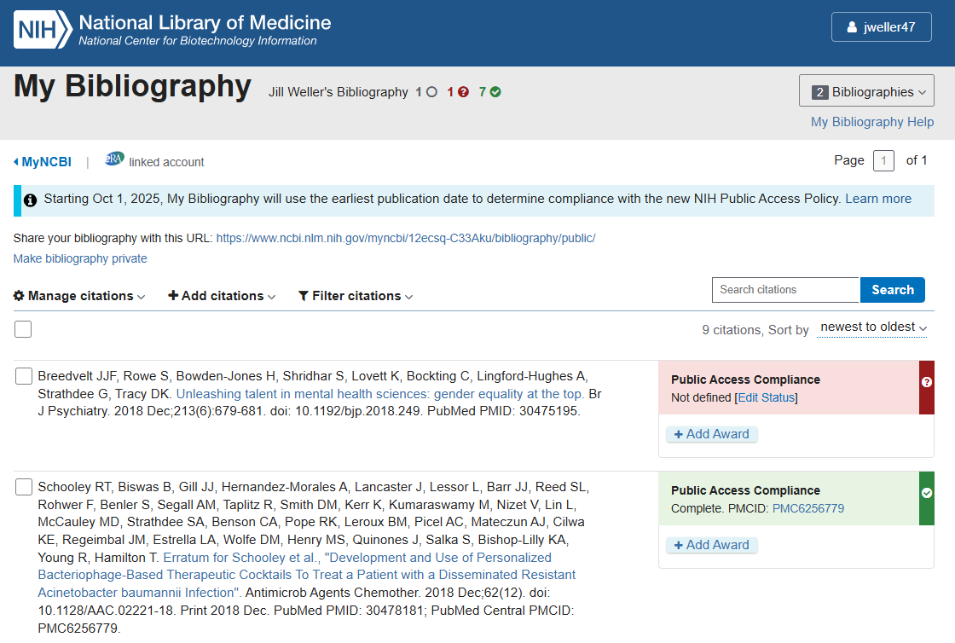

Slide 34
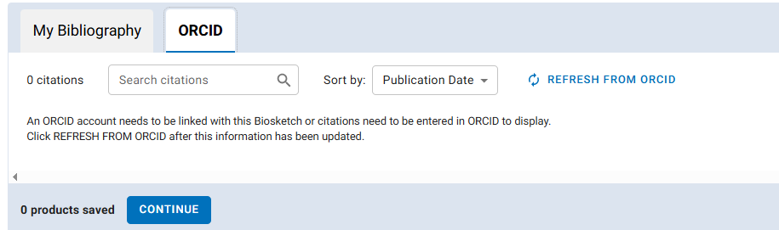

Slide 35
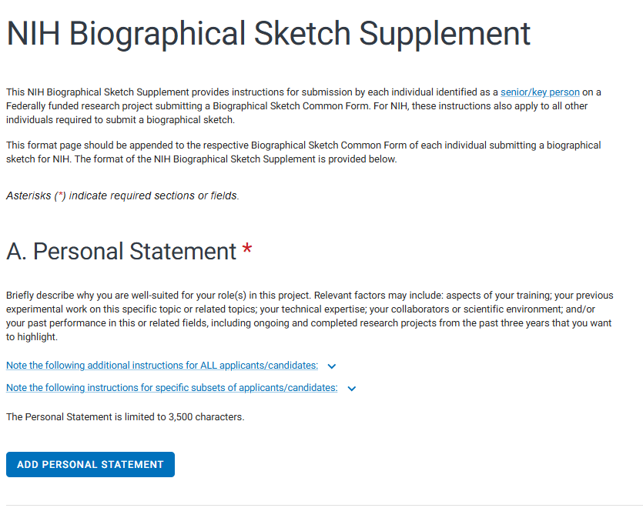
Personal statement
Honors
Contributions to science

Slide 36
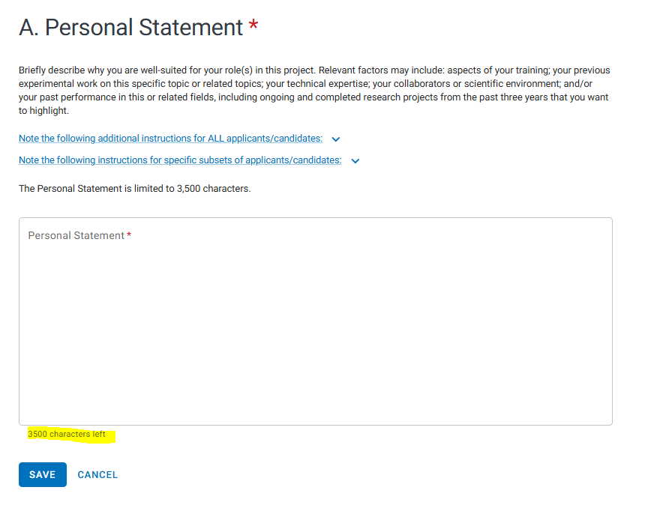
May no longer include up to 4 publications/products
May include Research support up to 3 years

Slide 37
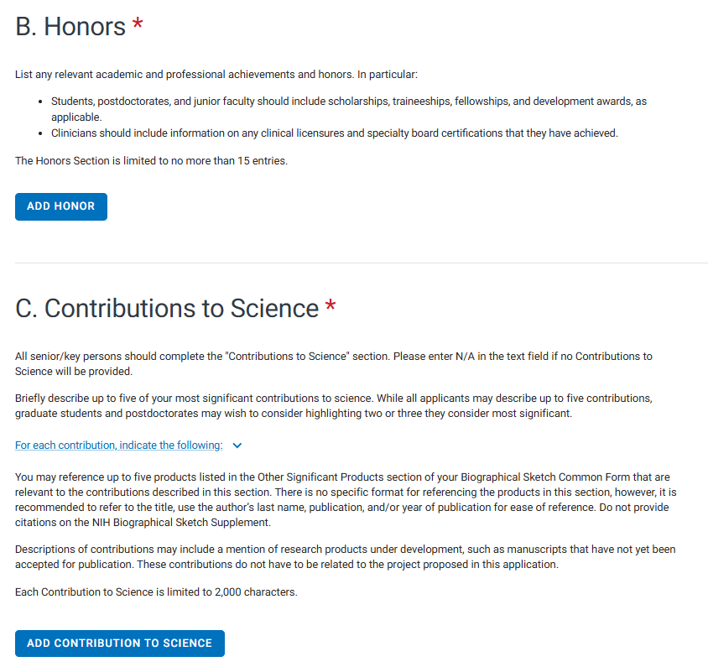
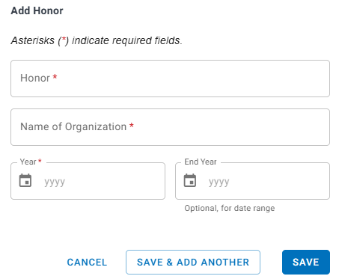
Up to 15 entries
Include Licensures/Board certifications
Postdocs/Junior Faculty:
Scholarship
Traineeship
Fellowship
Development awards

Slide 38
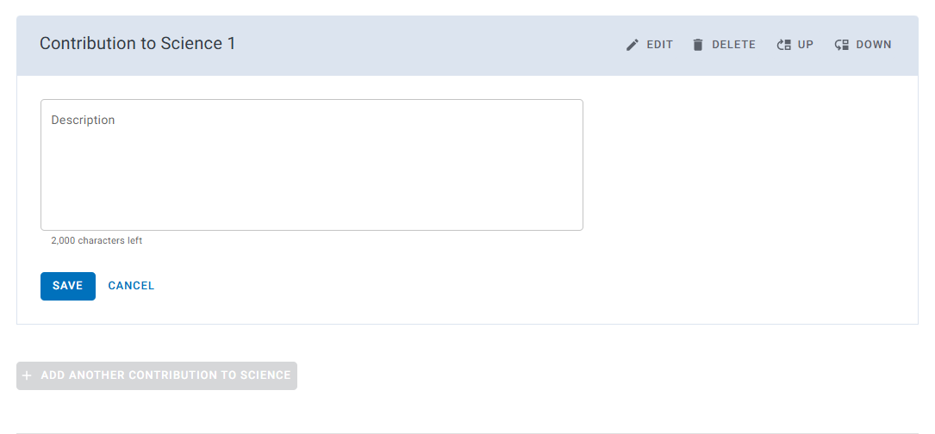
Contributions to Science
Limited to 2,000 Characters
Up to 5 Contributions
No citations
No URL to MyBibliography

Slide 39
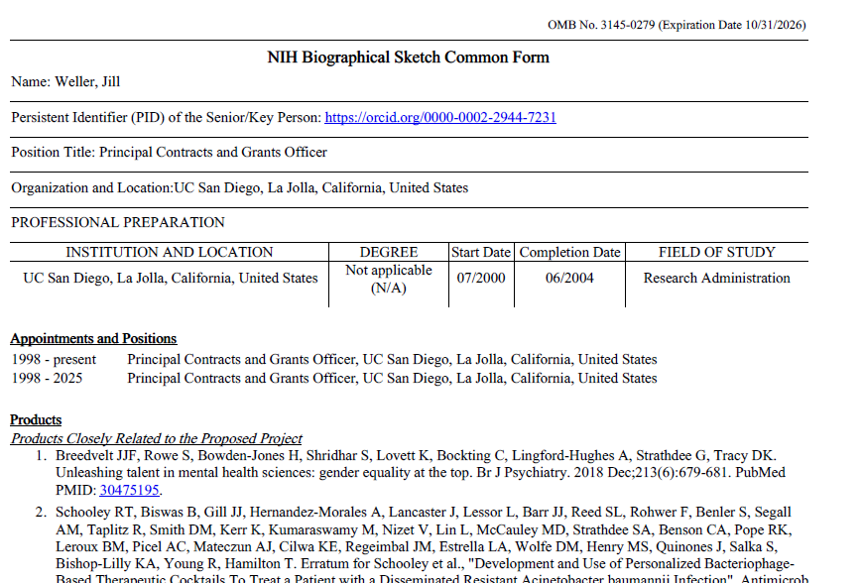
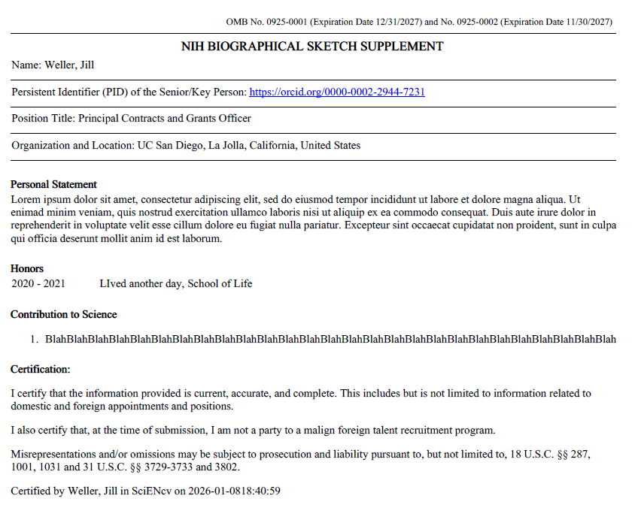
Download into one PDF
Common form
Supplement form

Slide 40
SciENcv
Live Demo

Slide 41
Info to remember
Set up ORCID ID before you start in SciENCV or you won’t be able to certify and have to start over must do it at the profile level
No more 5 page limit
You cannot flatten the certified PDF.
For combining multiple participating faculty common forms, you will need to flatten each PDF, then combine.
Era help desk ticket just quoted the GPS

Slide 42
Info to remember
Authorized admin to update and manage your records, (but they can NOT certify the common forms)
Old NIH form pages will not be accepted after January 25, 2026
Grace period up to 2/6/26 per FAQ’s on TG and Center grants
Before you start:
Have your ORCID ID (link in Era Profile)
Pubs in MyBibliography
ERA Commons ID

Slide 43
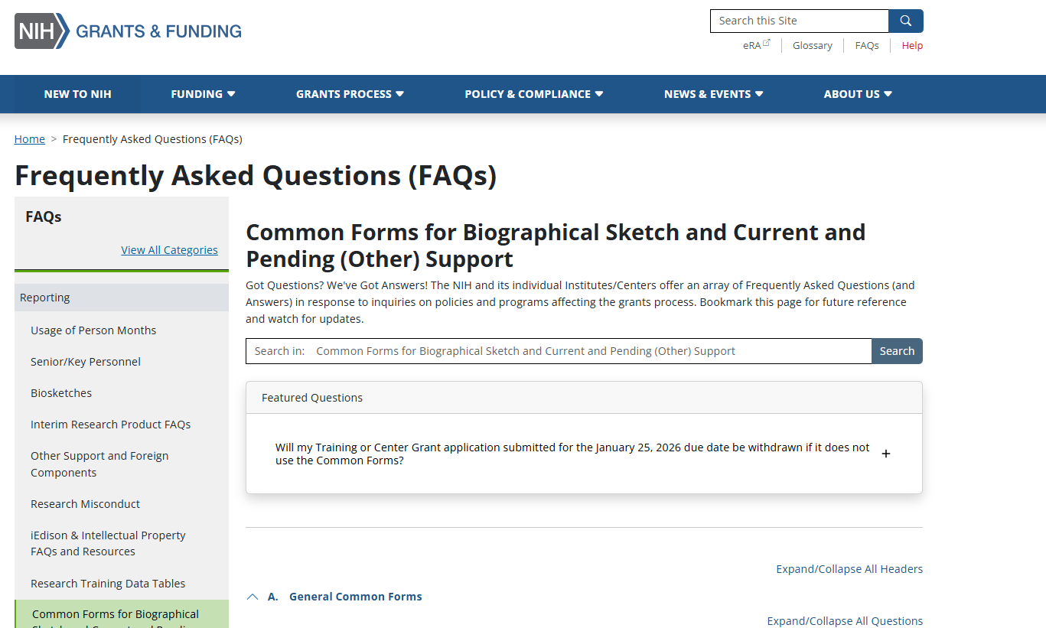
FAQ’s

Slide 44
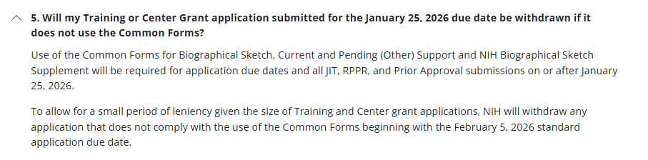
FAQ’s

Slide 45
Helpful Comparison Table on Differences
Current NIH Biographical Sketch | Common Form: Biographical Sketch | Common Form: Supplement Form
Name, eRA Commons ID, Position/Title | Name, ORCID iD, Position/Title, Organization and Location (pre-populates) | Name, ORCID iD, Position/Title, Organization and Location (pre-populates)
Education & Training | Professional Preparation | N/A
Personal Statement Allowed to list up to 4 products (publications) | N/A | Personal Statement Max of 3,500 characters allowed No products (publications) are allowed
B. Positions, Scientific Appointments, and Honors Current positions and scientific appointments only | Appointments and Positions Outside of primary organization, only list for a period up to 3 years from the submission date other appointments and positions | Honors Max of 15 entries allowed
C. Contributions to Science Max of 5 contributions allowed Max 4 products (publications) per contribution allowed Link to Complete List of Published Work in MyBibliography allowed | Products (Publications, Patents, etc.) Up to 5 products closely related to the proposed project allowed Up to 5 other significant products that highlight contributions to science allowed | Contributions to Science Max of 5 contributions allowed Each contribution is limited to 2,000 characters allowed No products (publications) are allowed
Limited to 5 pages | No page limit | No page limit
N/A | Senior/Key Person required to certify to download secure PDF | Senior/Key Person required to certify to download secure PDF

Slide 46
More Resources
Common Form Biographical Sketch
Relevant web page: https://grants.nih.gov/grants-process/write-application/forms-directory/biographical-sketch-common-form
Instructions: https://grants.nih.gov/sites/default/files/Common%20Form%20NIH%20Biographical%20Sketch_FINAL.pdf
NIH Biographical Sketch Supplement
https://grants.nih.gov/grants-process/write-application/forms-directory/nih-biographical-sketch-supplement
https://grants.nih.gov/sites/default/files/NIH%20Biographical%20Sketch%20Supplement_FINAL.pdf
NOT-OD-26-018 (December 2, 2025)
https://grants.nih.gov/grants/guide/notice-files/NOT-OD-26-018.html

